Slide 1




Slide 2

Getting started as an active play
Young Leader
Module 4 - Review

Slide 3

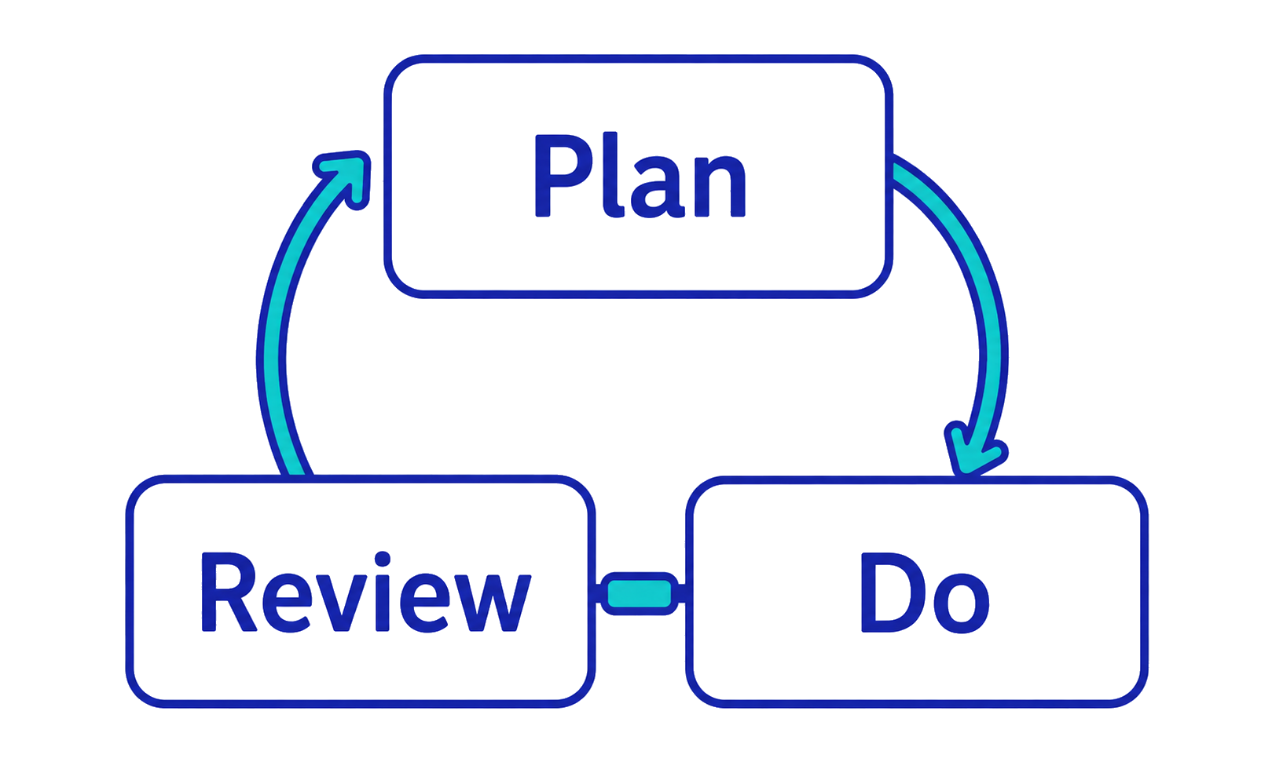
As young leaders, we will…
What do we need to know in advance?
How do we check they are working?
How will we run the activities?

Slide 4
You might see or hear children…
Laughing
Helping
Perservering
Smiling
Encouraging
Celebrating
Joining in
Focusing
Challenging self
Mixing
Experimenting
Sharing
Notes:
TEACHER NOTES
Use the slide to summarise and/or add to the young leaders’ examples.
Remind the young leaders that different children might behave in different ways so looking and listening will only give them a general idea if their activities are working.
They will also need to ask the children.

Slide 5
Players’ voices
Before – consult to identify young people’s…
  Barriers
  Motivations
During and after – gather feedback to find out…
  What they felt and thought
  What worked well and what would make it even better

Slide 6
Snowball
How could you gather feedback from other young people?
Individually, write your ideas clearly on a piece of paper.
Scrunch the paper to make a paper ball (snowball).
Play in two teams – each team in one half of the court.
On ‘go’, throw your snowballs into the other team’s zone. Try to keep your zone clear by throwing them back.
Play for 60 seconds. Which team has fewest snowballs in their zone.
Notes:
TEACHER NOTES
This is one of the Activate Our Voice activities.
To see the details or for alternative activities, download the cards from: https://www.youthsporttrust.org/media/np2h14be/youth-voice-activity-cards.pdf

Slide 7
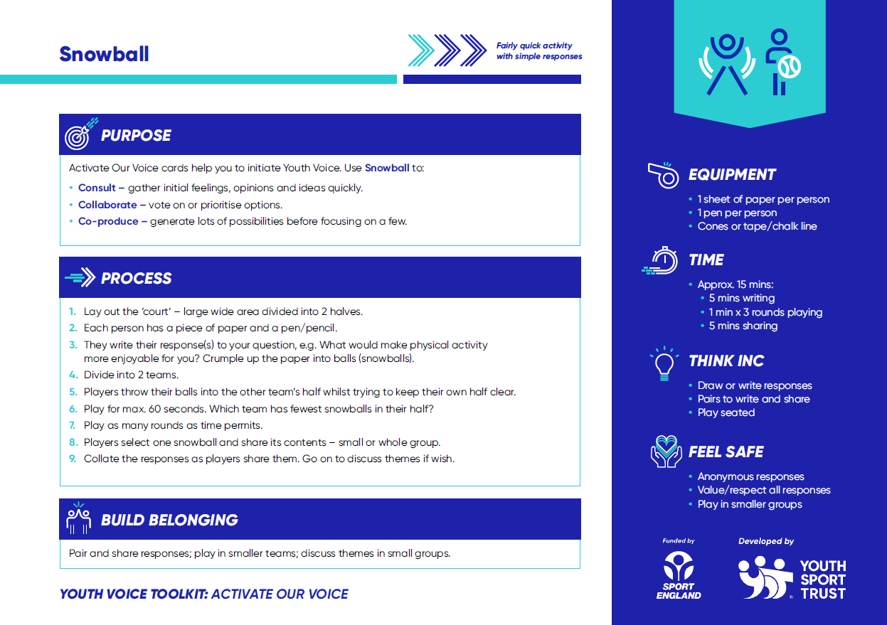
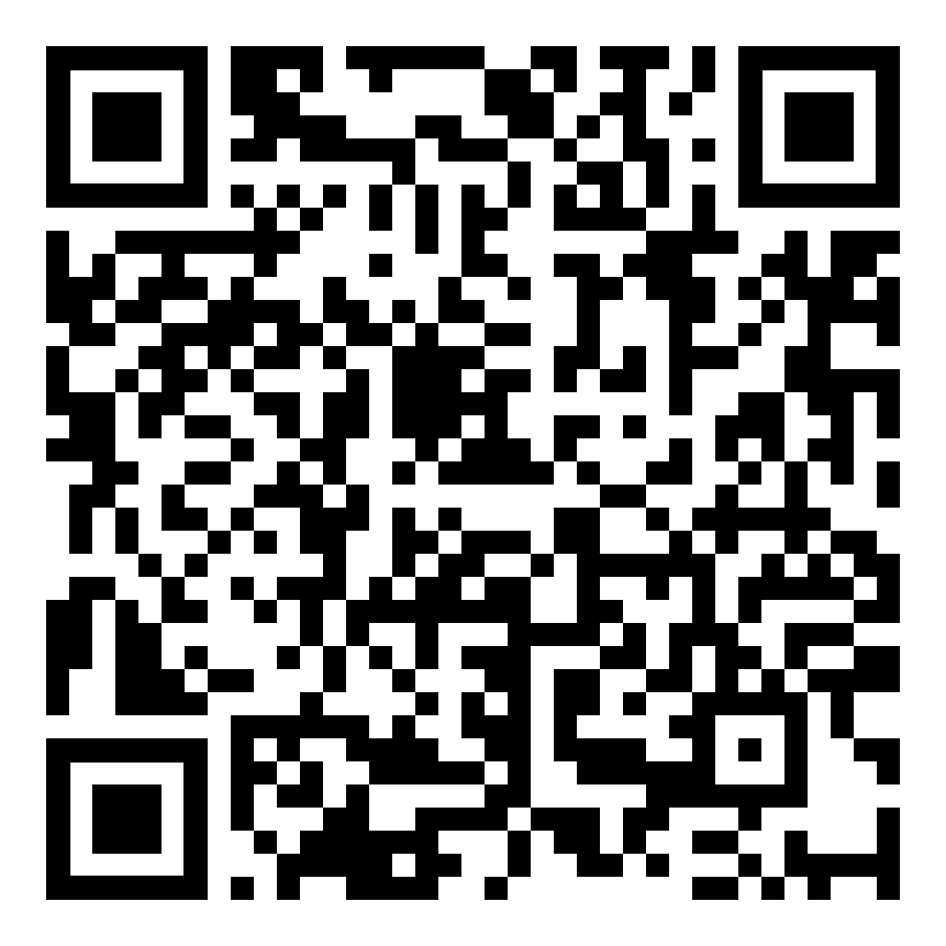
Activate Our Voice
Find fun consultation and feedback activities at:
Notes:
TEACHER NOTES
Share the Activate Our Voice cards with the young leaders as examples of how they can use fun activities to consult with other young people.
Download them from: https://www.youthsporttrust.org/media/np2h14be/youth-voice-activity-cards.pdf

Slide 8



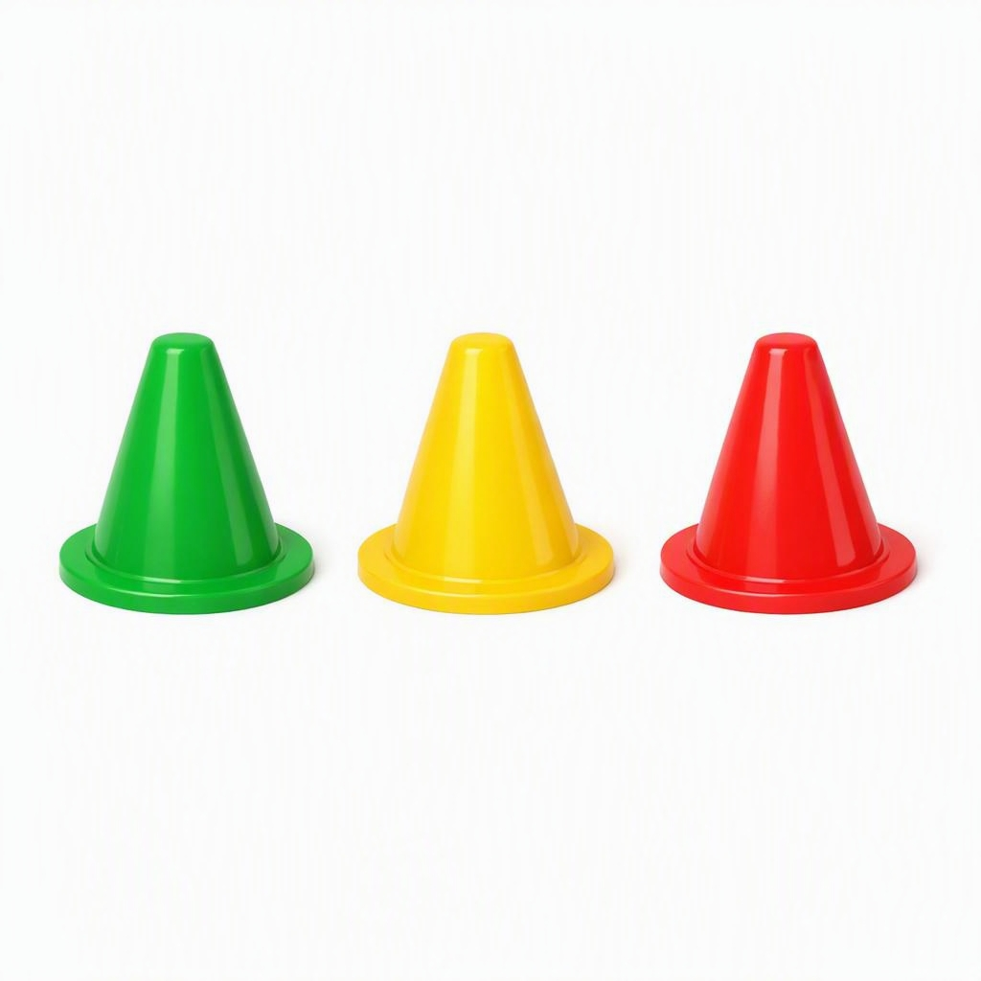

Find out from the children
Use simple tools to get feedback
Emojis
Thumbs
Bean bag votes
Traffic light cones
Two stars and a wish
Notes:
TEACHER NOTES
Explain that the young leaders can get feedback from the children.
Use the slide to share some simple tools for getting feedback during and after activities.
Share an example of how you use these to gather pupils’ feedback in school and/or ask young leaders for one or two examples.

Slide 9
How could you use feedback tools?
In your group, use one of the snowball ideas or one of the tools shown here.
How could you use this to get feedback from the players during or after an activity session?
Demonstrate one quick idea.

Slide 10
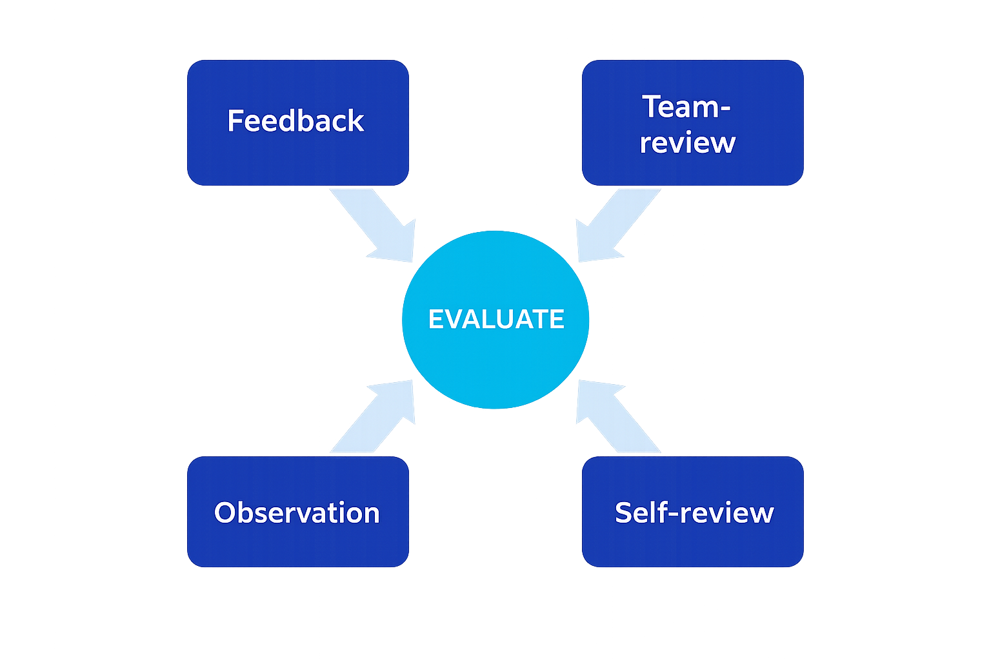
How do we evaluate our leadership?

Slide 11
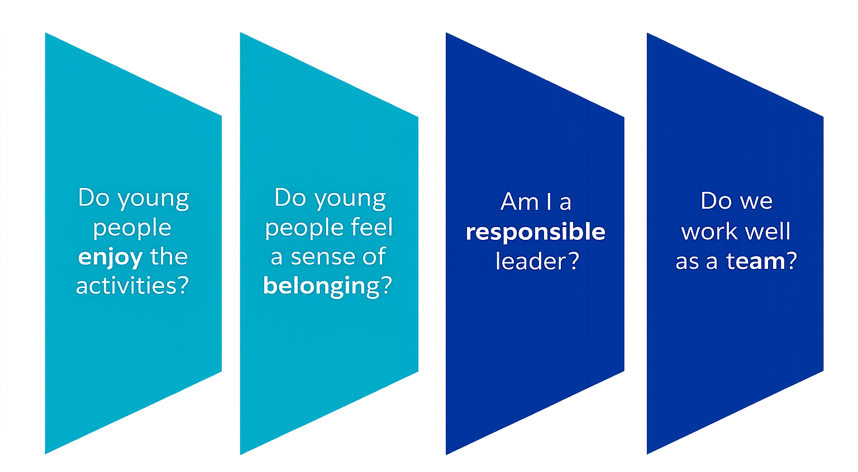
How do we evaluate?

Slide 12
Practise to make progress
Group 1
What will we be doing if we are responsible?
Write 5 top tips.
Example: Be punctual.
Group 2
What will we be doing if we work effectively as a team?
Write 5 top tips.
Example: Communicate.

Slide 13
Top tips examples
Responsible
Use notes or reminders
Check for and manage risks
Manage time effectively
Provide correct equipment
Check and follow instructions
Complete tasks fully
Tidy up afterwards
Show initiative – step up or adapt
Be resilient
Teamwork
Communicate effectively
Respect each other
Include everyone
Agree plans and decisions
Agree roles and responsibilities
Support each other
Share ideas and resources
Share the workload
Be resilient

Slide 14
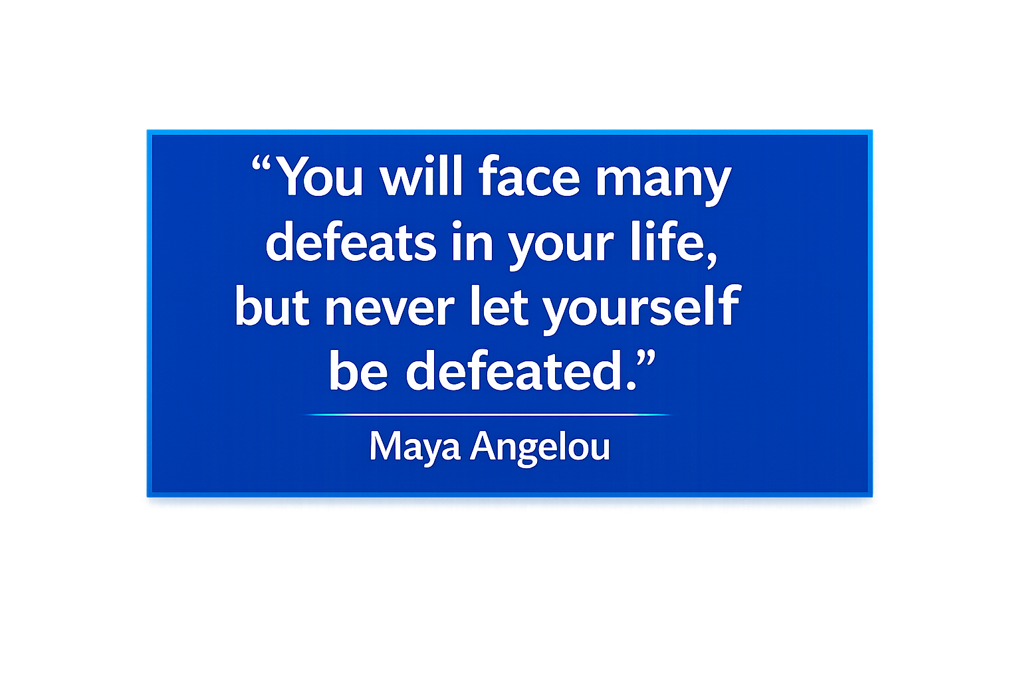
Resilience: bouncing back after setbacks
Practise resilience by…
Staying calm
Persevering
Trialling different methods
Recognising what is and isn’t effective
Seeking help if you have tried everything else
Learning from mistakes
Being willing to try again in future

Slide 15
Scenario 1
You consulted young people about activities they would like to play.
You spent time planning, promoting and preparing a series of lunchtime sessions.
Very few young people turn up to the first session.
How do you stay resilient?

Slide 16
Scenario 2
You organise an after-school ‘stay and play’ session that offers lots of different activities.
To make it inclusive and fair, you sort groups for each of the activities.
Some young people argue and disrupt the groups as they want to play with other people.
How do you stay resilient?

Slide 17

What are you grateful for – as a young leader or in life?
Stick your notes to the gratitude tree.
Individually, write what you are thankful for on sticky notes – one per note.
Remember and add to them to keep you resilient and motivated!
Notes:
Love this!!

Slide 18
Congratulations
You have completed four modules to support you as a young leader.
It’s time to put your learning into action!
Notes:
Reorder slides 11 and 12 if you use the optional task.

