Slide 1
Holiday Activities & Food Package

Slide 2
Context
All Local Authorities need to work with vulnerable children and young people across the 2021holidays sometimes without being able to deliver a face-to-face. They need a reputable and virtual means of delivering engaging and meaningful content that supports their physical and emotional health that can be procured and delivered at scale.

Slide 3
Need
Many children and young people living in our poorest communities are not getting access to the fundamental benefits of play and basic food. They don’t have toys, resources or access to the internet in the home, and have a lack of belonging to something positive and healthy during the holiday period.

Slide 4
Need
Growing inequalities in education, health and physical activity
Lack of toys, play, parent support and stimulus in home
Digital deprivation in home
Sense of belonging
Maintain positive behaviours on food/hydration/activity in the home
Development deficit physically, socially and emotionally
Increase in loneliness, anxiety and unhappiness
Support needs e.g. 14-16, SEND, social mobility

Slide 5
Package solution
Holiday
Activities and
Food Home
Packs
Overcome the
‘Digital Divide’
Guidance for parents and carers
Support food and wider wellbeing messages
Small equipment package to support activities
Sense of belonging and legacy for projects already in place
End to end procurement and delivery inc. contactless

Slide 6
Package Options - example
PACKAGE | BRONZE | SILVER | GOLD
EXAMPLE CONTENT* | Activity Cards Food/hydration Cards Unbranded Bottle Unbranded bag | Activity Cards Food/hydration Cards Branded Water Bottle Psycho-social poster Digital channel Branded bag | Activity Cards Food /hydration Cards Branded Water Bottle Psycho-social poster Chateez Keyrings Inflatable frisbee/ball Equipment package Digital channel Branded bag
COST X 1,000 | £7.50/Pack | £10/Pack | £27.50/Pack
COSTS X 5,000 | £6/Pack | £8/Pack | £20/Pack
COSTS X 10,000+** | £5.50/Pack | £7.50/Pack | £18/Pack
*Contents can be tailored with additional local resources **Greater savings for bespoke packages over 25,000

Slide 7
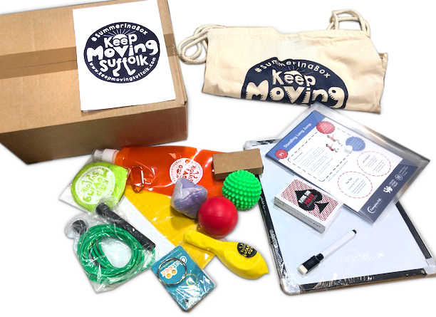
Package solution - example

Slide 8
Age appropriate activity content (YST)
Activity content
Create online playlist for age and stage relevant activities
Hard copy resources to overcome digital deprivation
Linked to PE at home and the national curriculum
Simple ‘how to’ guide for all children and young people
Ensure content is accessible against SEN, environment, ability, COVID etc.
Choose activities that are ‘equipment light’ but give opportunity for creativity
Mixture of activities that are individual and family pairs/groups
Develop timetable for activities throughout the day/week/holiday period.

Slide 9
Guidance for parents and deliverers (YST)
Guidance
Light touch ‘instructions for use’ for parents/deliverers
Assistance with ‘timetabling’, inclusion and strategies for when to be active
Consider elements of Autism, PE at Home for PMLD
Orientation around the social and emotional content
Delivered digitally through e-comms or hard copy.

Slide 10
Healthy Lifestyle and emotional wellbeing content
(YST)
Lifestyle & emotional support
Hard-copy resources for healthy eating and cooking
Utilise healthy eating and oral health resources from local authorities
Introduce resources from our social and emotional support programmes
Utilise a series of videos orientating around the poster(s) through YouTube
Ensure accessibility of the poster/video content

Slide 11
Small equipment package to support activities (YSTe)
Equipment packs
Drawstring bag with branding
Home packs for Reception/KS1
Differentiated equipment packs for KS2/KS3/KS4
A variety of creative, innovative and inclusive equipment
Small, scaleable and accessible equipment
Able to be used and sustained within the home/flat
Consider a lack of outdoor space
Consider a difference in parent/carer support

Slide 12
Procurement of equipment, additional resources and packaging (YSTe)
Procurement
Procurement of equipment items
Printing of posters and activity hard-copy resources
Printing of guides and postcards
Co-ordination of other supporting resources through local authority
Procurement of drawstring bags and packaging
Adhere to COVID restrictions and operating guidelines
Drive carbon offset principles
Work with new suppliers around product availability

Slide 13
Delivery of packs through logistics company (YSTe)
Delivery
Pick and pack all equipment and resources
Co-ordinate packages for Healthy Movers Home packs
Co-ordinate packages for KS2/KS3/KS4
Co-ordinate delivery addresses
Delivery of all packages into homes or community centres
Contactless delivery straight into children’s homes or hubs

Slide 14
Virtual Holiday Activities Programme
Budget
Budget based on:
Staff time for creating playlists and online libraries
Staff time for project management for delivery
Staff time for YSTe and procurement
Equipment and printing/branding
Packaging
Warehousing, picking and packing, delivery costs
Intellectual property
Could include monitoring and evaluation and impact report

Slide 15
Further information
CHRIS WRIGHT, HEAD OF WELLBEING
chris.wright@youthsporttrust.org
CHRIS ELLIS, SENIOR DEVELOPMENT MANAGER
chris.ellis@youthsporttrust.org

