Slide 1




Slide 2

Getting started as a Youth Sport Trust
Young Leader
Step 3 – Do

Slide 3

Overview for teacher
Aim: Enable primary-age pupils to run fun and informal physical activities for other children in school.
Audience: Pupils aged 8-11 years who are new to leading physical activities.
Organisation:
This introductory resource includes four bitesize modules, which use pupil-facing slides and interactive tasks to help young leaders to get started. The four steps are:
Purpose
Plan
Do
Review
Time:
Each module includes approx. 30 mins of core tasks plus 15-30 mins of optional tasks.
Preparation:
Read the individual slide notes to support your delivery of the module to your pupils.
Play the slides in slideshow mode to see how the animations work.
Refer to slide 4 for a summary of the module, including required equipment and resources.
Download the associated handouts to support pupils’ learning (optional).
Inclusion: The slide notes suggest alternatives to help you to include pupils with different needs and abilities.
Notes:
Teacher slide – will be hidden during presentation.

Slide 4
Module 3 summary: do
Aim: Help young leaders to recognise how to run fun physical activities that are enjoyable for all children.
Plan-do-review | Use the slide to remind the young leaders about plan-do-review; this session will focus on do. Share the key elements that young leaders will manage. Optional: run a task to model a fun, inclusive activity that also highlights the need to work as a team. | Cones or tape (optional) Labels (optional)
How will activities be run? | Use a simple target game to explore how to run activities to achieve SMILES. | SMILES handout (downloads) Paper for balls/targets
How will activities be adapted? | Use a keepy-uppy game to explore STEP as a way to adapt activities. | STEP handout (downloads) Balloons, paper balls, beach ball, bat
Grow activity ideas | Share how the young leaders can continue to grow their bank of activity ideas | Activity cards Activity ideas Group sort ideas (downloads)
Notes:
Teacher slide – will be hidden during presentation.

Slide 5
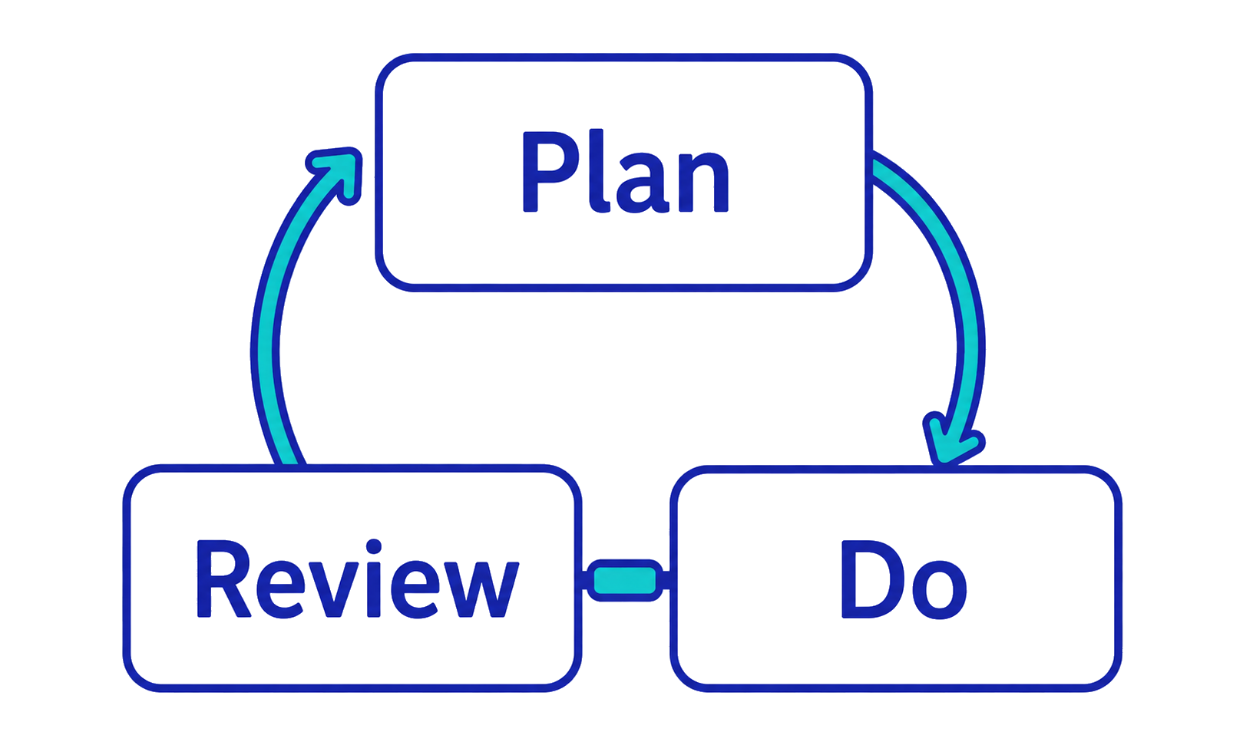
As a young leader, you need to…
Notes:
TEACHER NOTES
Remind the young leaders that there are three stages to running fun physical activities: plan-do-review.
This session will focus on do – this means when they are running the physical activities with the other children.

Slide 6
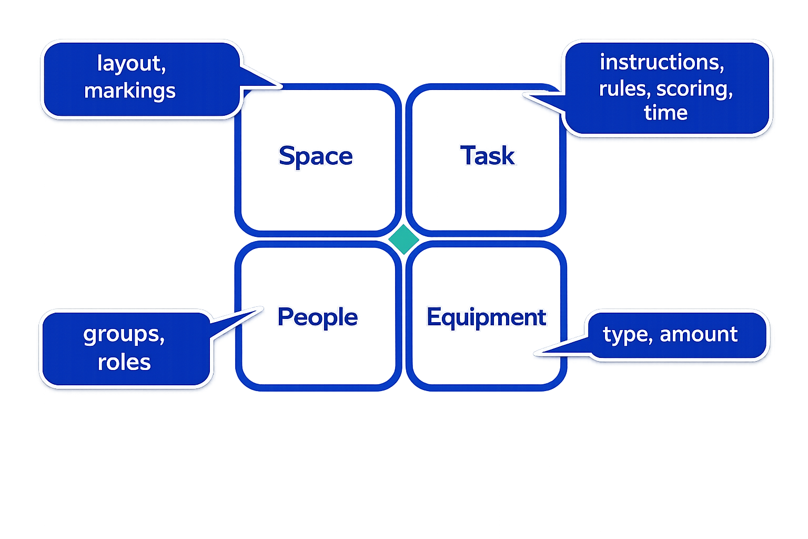
When you run an activity, you will sort…
Notes:
TEACHER NOTES
Share the key elements that the young leaders will need to organise when they are running activities.
These are the things they will need to sort at the start of and during activities.
Changing these things changes how children participate in and feel about an activity.
Ask the young leaders to bear them in mind during the next two sections.

Slide 7
Can you cross the river?
Notes:
OPTIONAL TASK
TEACHER NOTES
Use this to model (demonstrate) how to run a fun and inclusive activity and to highlight the need for the young leaders to work as a team.
PREP
Using cones or masking tape, mark out a ‘river’ between 2 parallel ‘riverbanks’ in the space (wide enough that the young leaders cannot jump across).
Use cards/sticky notes to create 4 labels (one set for each team). The labels are Chicken, Fox, Corn and Boat.

Slide 8

Team challenge
In your team, get the chicken, corn and fox over the river in the boat, without anything being eaten.
Rules:
Only one item at a time may be taken across the river in the boat.
All of the items and the boat must start on the near bank and end up on the far riverbank.
If the fox is left alone with the chicken, it will eat it.
If the chicken is left alone with the corn, it will eat it.
Can you make it in the time?
Notes:
OPTIONAL TASK
TEACHER NOTES
Sort the young leaders into teams of 4 (or 3).
Give each team a set of the labels. Team members decide which of them wears each label. (If there are only 3 people in a team, do not use the Boat label.)
Decide on a time limit, e.g., 10 mins. maximum.
Use the slide to set the task to the teams.
Encourage them to focus on their own team, rather than copying or competing against the other teams.
This is a problem-solving team task so, as long as they don’t break the rules, teams may create their own solutions. Avoid coaching them!

Slide 9
How well did you work as a team?
In your team, consider:
What did you do that helped you to achieve the task?
What did you do that stopped you from achieving the task?
Notes:
OPTIONAL TASK
TEACHER NOTES
After the task, ask the teams to reflect on how they worked together.
Encourage them to focus on the process – how they worked – irrespective of the outcome.
Ask each team to share one ‘help’ example and one ‘hinder’ example, preferably without repeating what other teams said. (There will be overlap with the communication skills explored in module 2.)
Keep going until all of the teams’ different points have been shared.
Remind the young leaders that they will need to work as a full team when they are planning and running activities for children.

Slide 10
Teamwork skills
As a good team worker, I…
Do as I am asked
Share ideas, resources and the workload
Help others and accept help when I need it
Try to find agreement (instead of focusing on disagreements)
Work towards the team’s goal, not just my own
Notes:
OPTIONAL TASK
TEACHER NOTES
Reinforce that teamwork is one of the leadership skills.
Use this slide to summarise how each young leader can contribute to the overall team, i.e., what they can do as an individual to create good teamwork.

Slide 11
How will activities be run?
Notes:
TEACHER NOTES
This section focuses on how the young leaders will run activities so that they are enjoyable for children.
OPTIONAL TASK
If you used the optional ‘crossing the river’ task, ask the young leaders if they enjoyed that activity and, if so, what made it enjoyable. If they didn’t enjoy it, ask them what would have made it more enjoyable for them.
Use their answers to lead into the SMILES summary on slide 12.

Slide 12
Everyone should have SMILES during activities
S | Safe | Children are safe and feel safe.
M | Maximum participation | Children are involved as much as they want to be.
I | Included | All children can take part.
L | Learning | Children learn different skills (not just physical).
E | Enjoyment | Activities match children’s interests.
S | Success | Children feel pleased with themselves.
Notes:
TEACHER NOTES
Share the SMILES acronym – this summarises how we want children to be and feel during activities.
The young leaders can create SMILES for everyone by how they run the activities.
Each letter of SMILES helps the young leaders to think about how the activities are organised and run.
It can be used as a simple checklist before and during activities.
Use the next slide to give practical examples.

Slide 13
Examples of SMILES in a tag game
S | Safe | Only tag players between shoulder and knee.
M | Maximum participation | No one is ‘out’ – they become an extra tagger.
I | Included | Make a no-tag rest zone for some players.
L | Learning | Play in tag teams so players learn teamwork.
E | Enjoyment | Ask children for their tag game ideas.
S | Success | Celebrate joining in – not number of tags.
Notes:
TEACHER NOTES
Use the slide to show how SMILES can be achieved within a simple tag (chasing) game.
Optional: ask the young leaders for additional tag-related suggestions as you work through SMILES.

Slide 14
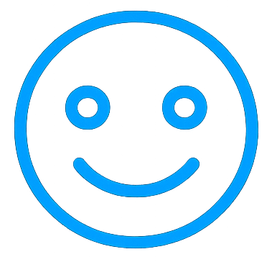
How will you make SMILES?
In your group, play a simple target game.
How will you run it so that it makes SMILES?
Focus on ideas for the letters your group was given.
Safe
Maximum participation
Included
Learning
Enjoyment
Success
Notes:
TEACHER NOTES
Use the slide to guide the young leaders through the task.
Show the young leaders a simple target game. This can be classroom-based, e.g., throw scrunched up paper balls on to different tables to score points.
Work in small groups.
Give each group two or three letters to focus on (e.g., 2 groups = 3 letters each; 3 groups = 2 letters each).
Ask them to play the game so that it includes SMILES.
Use the SMILES handout (see downloads) for support during the task or to reinforce learning afterwards.
ALTERNATIVES
Ask each group to design its own target game from the outset (incorporating their SMILES letters).
If a practical version is not possible, ask the young leaders to think about a target game (e.g., bowls, skittles, boccia, ten-pin bowling, throw golf, quoits, petanque, etc.) then share written or verbal ideas.
Vary how many and which letters of SMILES the groups focus on.
Each group demonstrates its target game and the other young leaders review it using SMILES to guide their feedback.
Work through one game as a whole group.
Provide an audio prompt for SMILES instead of the handout.

Slide 15
How will activities be adapted?
Notes:
TEACHER NOTES
This session focuses on using STEP to adapt activities to achieve SMILES for every child.

Slide 16

Making SMILES for everyone
If children do not have SMILES during an activity…
…you need to adapt the activity to suit the children.
You will need to STEP in.
Notes:
TEACHER NOTES
Explain that some children may not have SMILES during an activity.
We want every child to enjoy physical activities so the young leaders should adapt the activity to suit the child/children.
They can use STEP to help them.
It means using their creativity and problem-solving skills to try different ways to run the activity. Reinforce that problem-solving is one of the leadership skills (see module 1 and personal goals download).

Slide 17
STEP in to change an activity
You can change…
Space | Where it is happening.
Task | How it is happening.
Equipment | What is being used.
People | Who is doing what.
Notes:
TEACHER NOTES
Share the STEP acronym.
Thinking about each letter of STEP will help the young leaders to adapt their activities to suit the child/children.
Share the STEP download (page 1) to give examples. (Save page 2 for after they have completed the task on slide 23.)

Slide 18
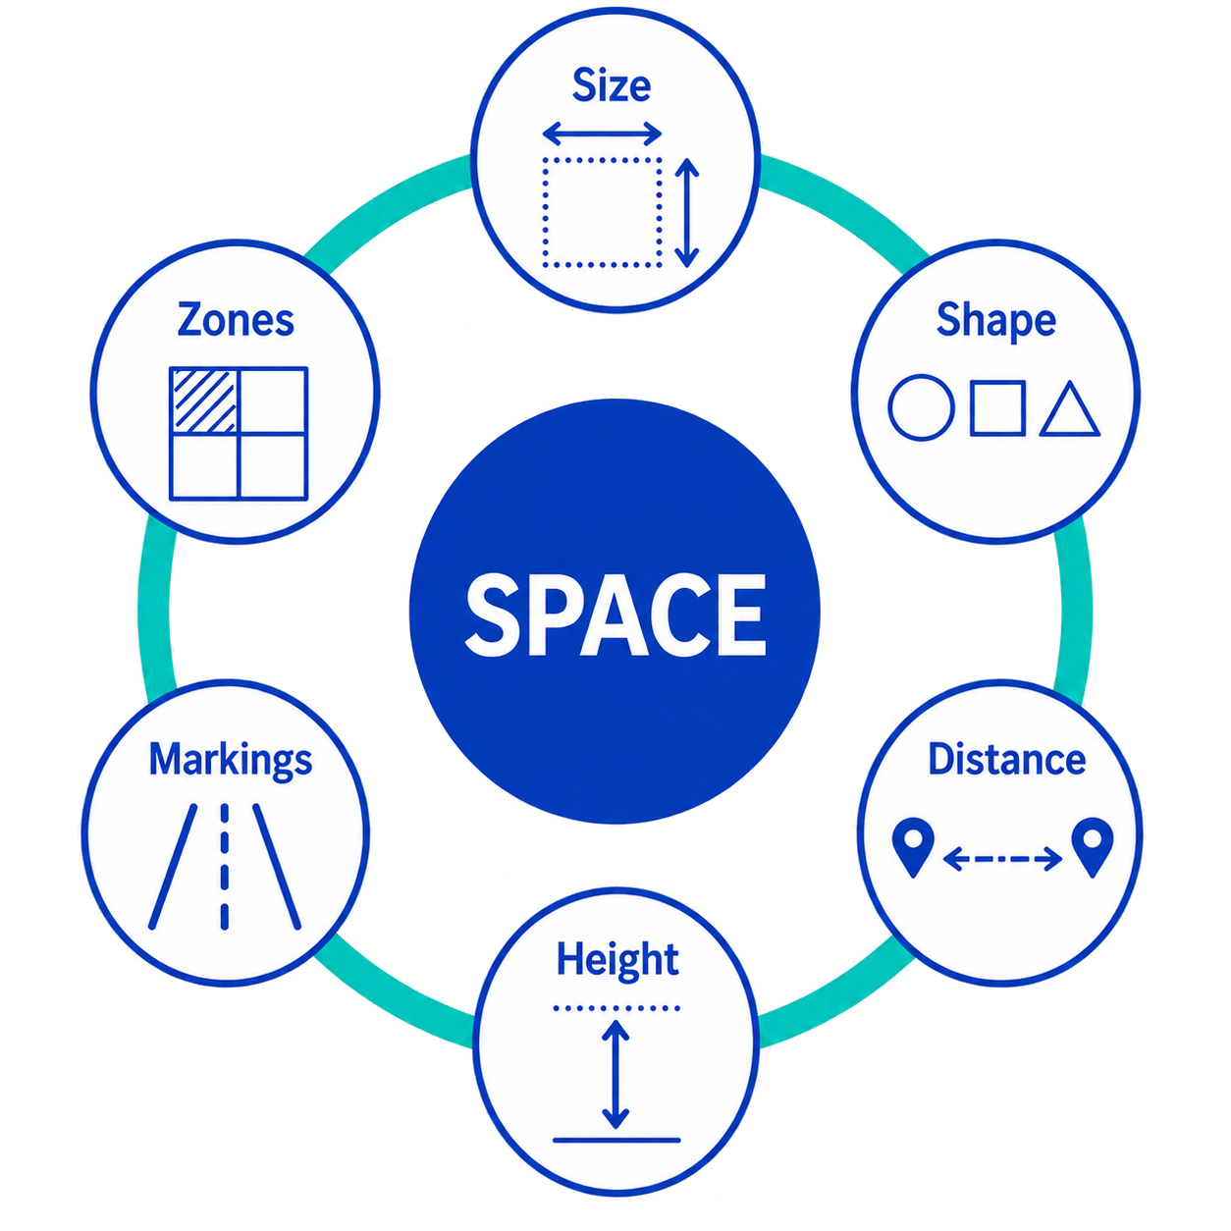

Space
You can change…
Notes:
Teacher slide – will be hidden during presentation.
EITHER use this to support your own knowledge of STEP
OR unhide slide (see Slide Show task bar) and share examples with the young leaders.
There are two downloads to support STEP – one for staff and a simpler one for the young leaders.

Slide 19
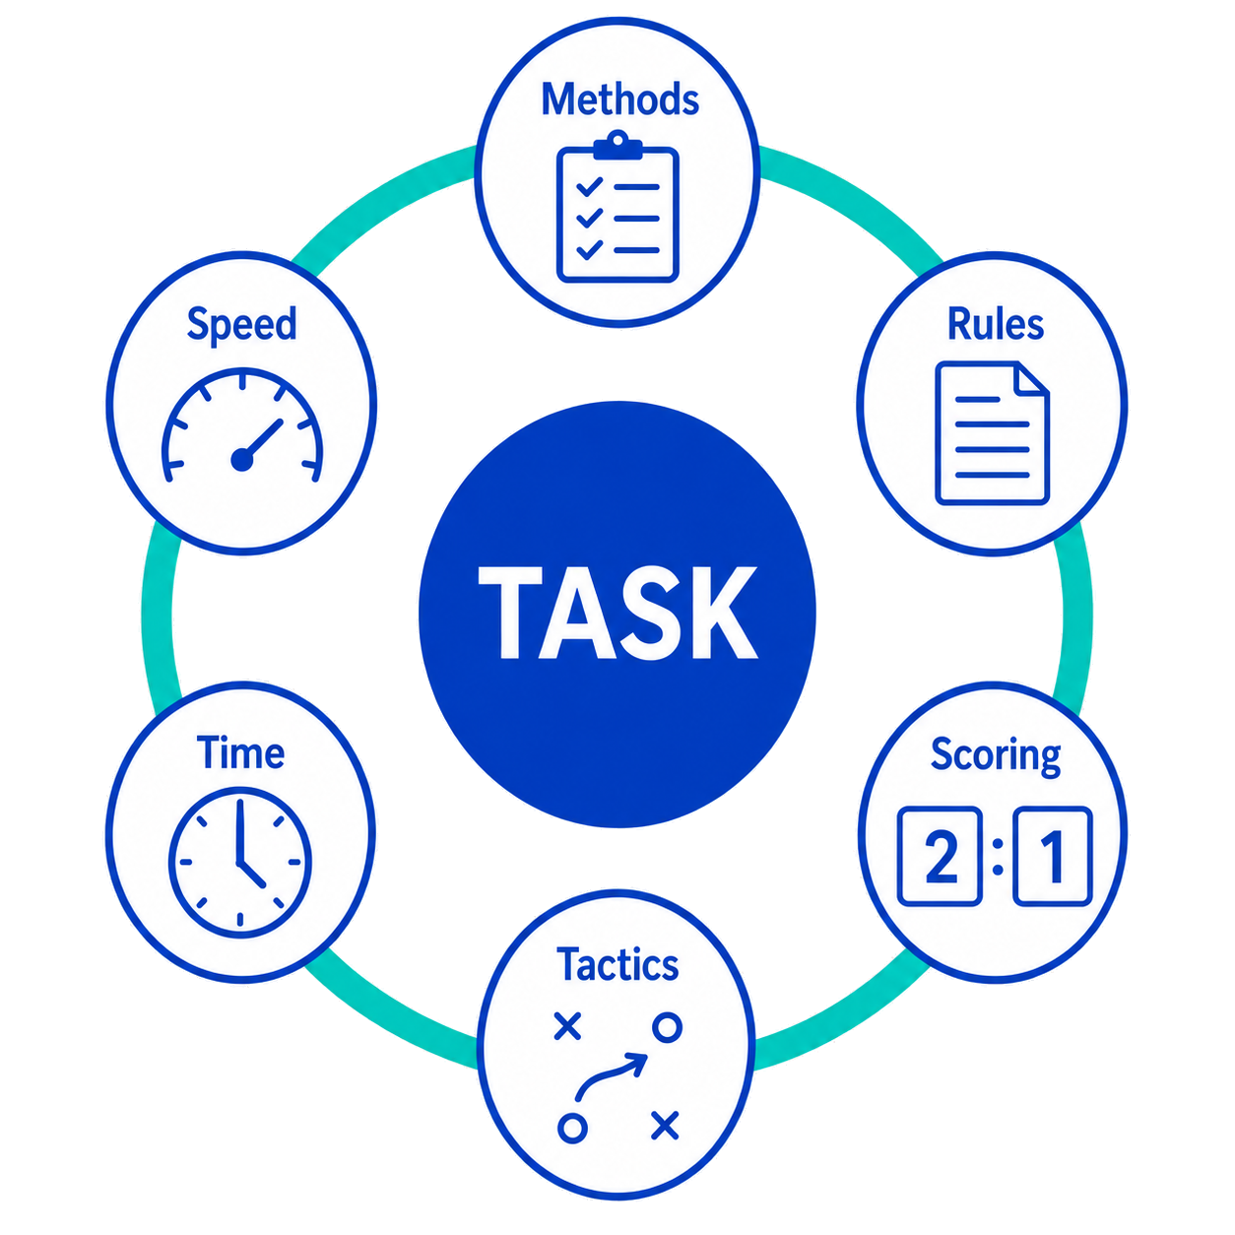

Task
You can change…
Notes:
Teacher slide – will be hidden during presentation.
EITHER use this to support your own knowledge of STEP
OR unhide slide (see Slide Show task bar) and share examples with the young leaders.
There are two downloads to support STEP – one for staff and a simpler one for the young leaders.

Slide 20
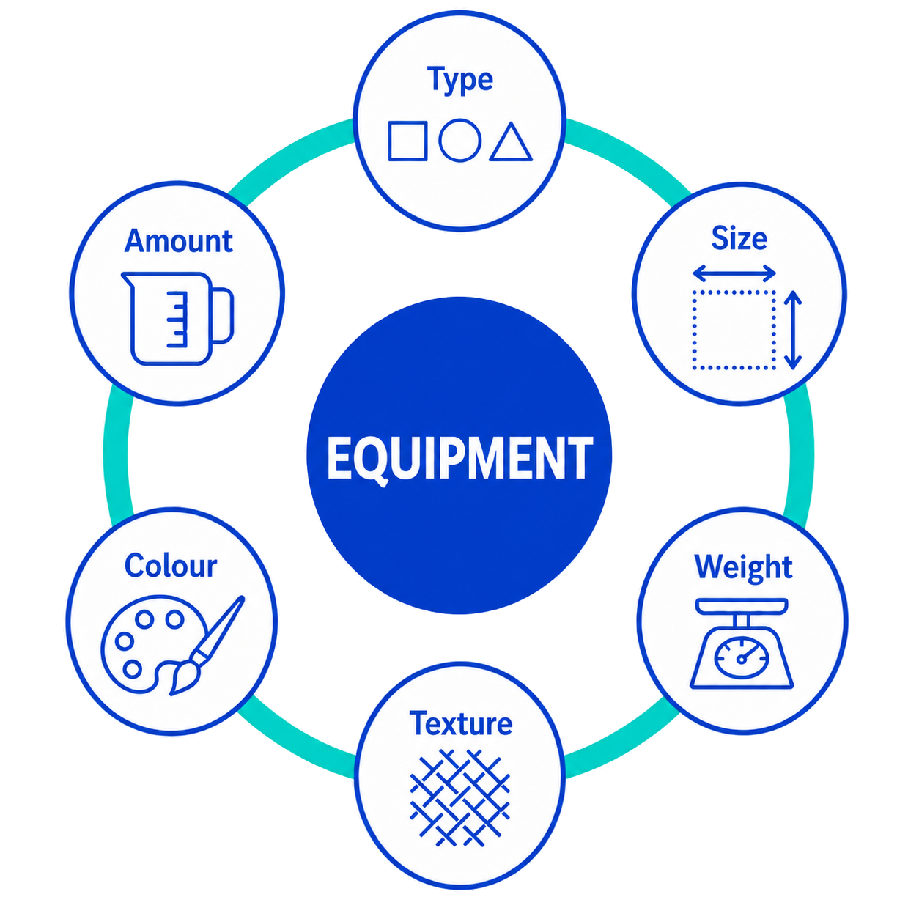

Equipment
You can change…
Notes:
Teacher slide – will be hidden during presentation.
EITHER use this to support your own knowledge of STEP
OR unhide slide (see Slide Show task bar) and share examples with the young leaders.
There are two downloads to support STEP – one for staff and a simpler one for the young leaders.

Slide 21


People
You can change…
Notes:
Teacher slide – will be hidden during presentation.
EITHER use this to support your own knowledge of STEP
OR unhide slide (see Slide Show task bar) and share examples with the young leaders.
There are two downloads to support STEP – one for staff and a simpler one for the young leaders.

Slide 22
Examples of STEP in a target game
Space | Move targets closer or farther away.
Task | Score 2 points for hitting a target, not just 1.
Equipment | Use bean bags instead of balls.
People | Play in pairs (joint score) instead of singles.
Notes:
TEACHER NOTES
Share the example of STEP within a target game.
Optional: ask the young leaders for additional suggestions.
Explain that changes can be for one child, multiple children or the whole group.

Slide 23
Space
Task
Equipment
People
How will you STEP in?
In your group, play a game of keepy-uppy.
What changes can you make?
Try at least one idea for each letter of STEP.
You can make changes for everyone or for individuals.
Notes:
TEACHER NOTES
Use the slide to guide the young leaders through the task.
Keepy-uppy is possible, even within a classroom.
Try to provide a variety of equipment even if in a classroom (see alternatives below).
Work in small groups.
Encourage groups to trial ideas for all of the STEP letters as they play.
Use the STEP handout (see downloads) for support during the task or to reinforce learning afterwards.
ALTERNATIVES
Use STEP as your own prompt to adapt the activity as needed. For example:
Space – sit on chairs across a table, stand or sit in a circle (on chairs or the floor), pass up and down a line in a corridor.
Task – use different body parts (hand, elbow, knee, foot, head), have more than one tap before passing, make it a timed challenge.
Equipment – balloon/balloon ball, small paper balls, beach ball, volleyball, scarf, bat instead of hand.
People – pairs instead of groups, solo, large group.

Slide 24
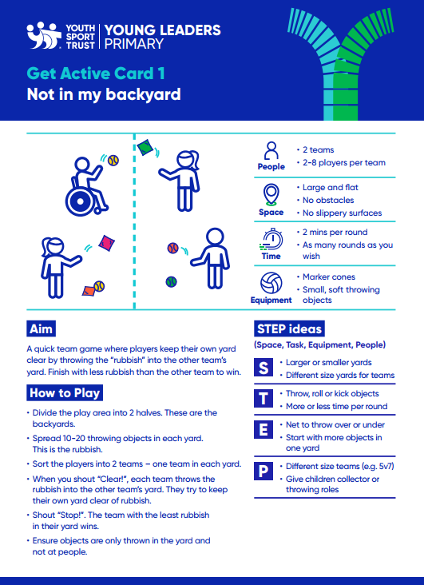
Grow your activity ideas!
Use the activity cards.
See the activity ideas handout.
Ask the children for their ideas.
Find out what adults used to do.
Notes:
TEACHER NOTES
Reinforce that, as the young leaders gain experience, they will become even more confident and effective at using STEP to make SMILES for every child.
Signpost them to other ways to gain ideas for running and adapting activities:
Activity cards (see downloads).
Activity ideas (see downloads) – there is also a handout for group sorting ideas.
Listening to and sharing ideas with other children (not just other leaders).
Finding out what activities adults used to do when they were children (e.g., school staff, family members, neighbours, community groups).

Slide 25
Well done! You have completed step 3.
Get ready for step 4…
Notes:
TEACHER NOTES
Let the young leaders know when step 4 is to be delivered.

