Slide 1



Welcome
This session will be recorded
Please turn your camera on and mute on (until breakout rooms)
Type questions into the chat function

Slide 2
Agenda- 24 April 24
SAM Subgroup Updates
School Games Organiser Network review
Spotlight sessions
Date of next webinar
Optional discussion time

Slide 3


Advocacy
Local advocacy, promotion of the YST manifesto.
General Election
Advocacy spotlight session
  9th February, 10:00-10:30
Roundtable on future YST membership/support
ADVOCACY
Active support from the key stakeholders. Selling the narrative
Schools, Politicians, Local Authority, Public Health, sports stars and personalities and most importantly young people.

Slide 4

Health & Well Being
Adrian Bethune and Ben Levison led an excellent spotlight session for us in March. They spoke passionately about the power of focussing on young people's health and wellbeing, sharing some practical examples that colleagues could use. Well worth checking it out on the SAM hub.
We are welcoming Pete Thorp into the subgroup. We would love to welcome 1 more person to the group. If interested, please email Dean: dw.nossp@bgn.oxon.sch.uk
H+W support doc. This is a “one stop shop” document signposting the network to useful documents, videos, podcasts etc….. The idea is that everyone in SAM community can access and update information to share.
The document can be found here: https://docs.google.com/spreadsheets/d/1wQWT0Z6LeLU4fr_QaMjF_Y8qu3j6pmXLz0yn9pDLYjM/edit?usp=sharing
HEALTH & WELL-BEING
* National Agenda
* Social/Mental/Physical
* Data Gathering / Sharing
* Projects/Organisations /Initiatives (ie Wellschools)

Slide 5

Structures & Sustainability
Business Management Discussion Workshop
The workshop will give colleagues that are running a business/charity set up an opportunity to discuss how they are managing:
    Insurance
    Payroll
    HR
    Accounting & Auditing
What systems do you have in place? Are you getting best value?
Monday 13th May 4-5pm
Zoom Registration link – https://youthsporttrust.zoom.us/meeting/register/tZYqfuitrjIrH9aQUJYkDXq8LepsPQ4juJ2F
Sub Group Members - Claire Tennyson, Rebecca D’Arcy, Amanda Jack, Sarah Price, Stewart Seymour, Beky Williams, Ali Mapp
STRUCTURES & SUSTAINABILITY
Represent variety of structures represented (SGO/PDM/SSP/CIC/Consultant etc)
Support network for developing new structures
Horizon scanning for sustainability
Ensure representation of all involved with a voice

Slide 6
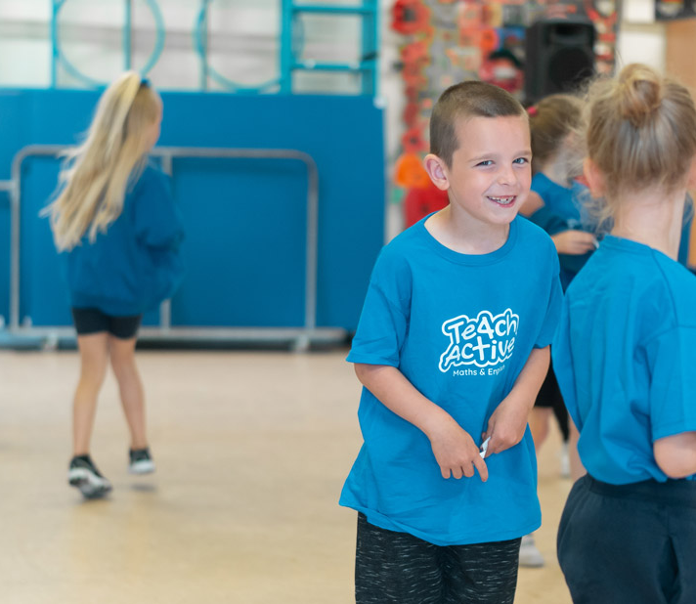
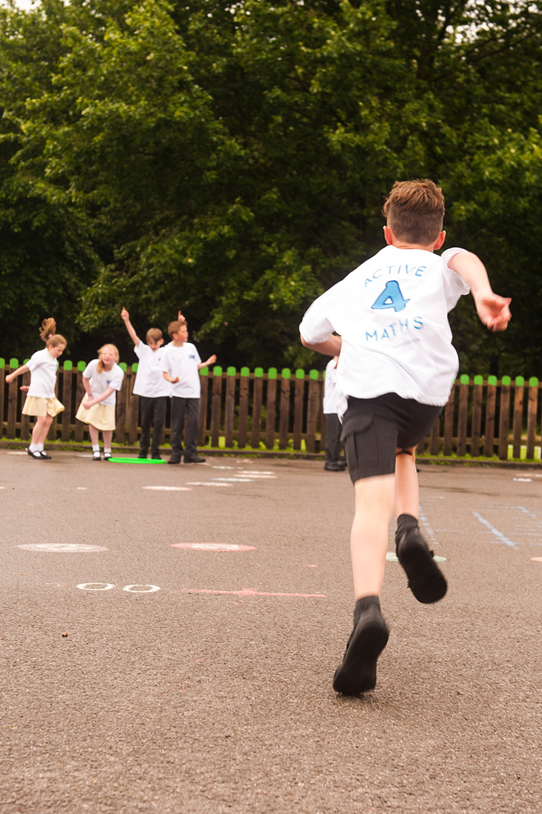


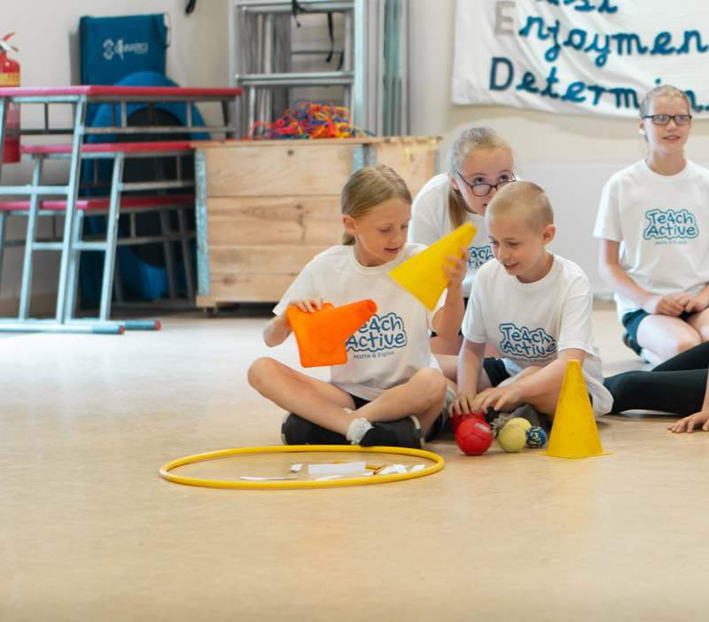
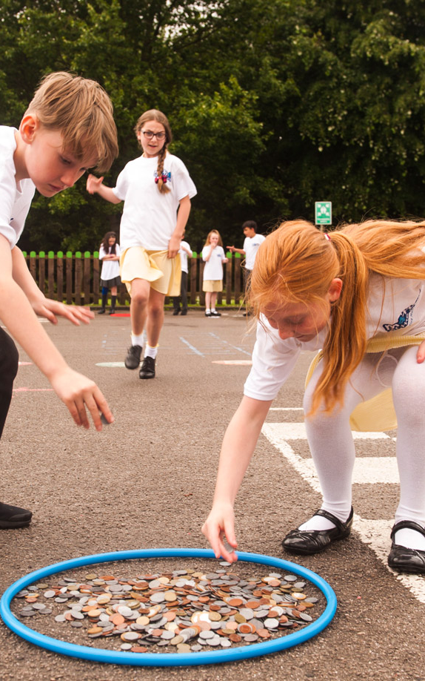
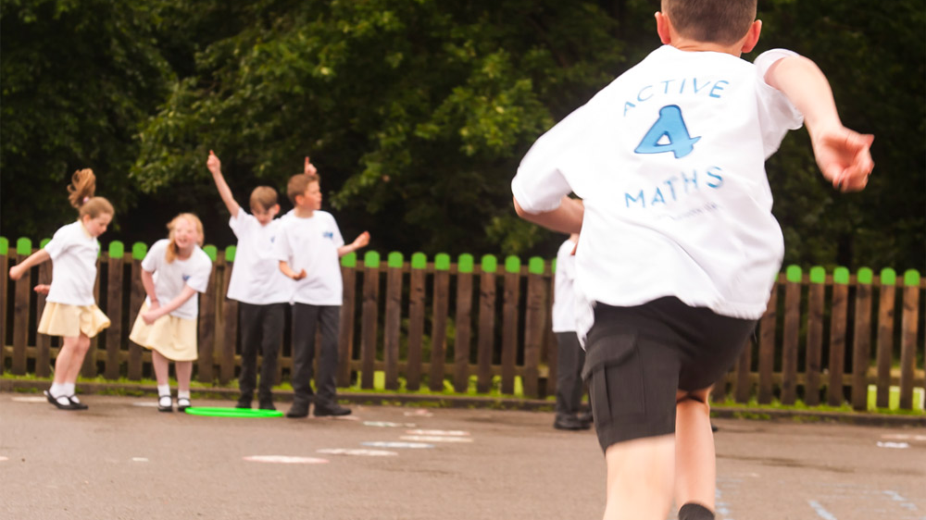
Using physical activity as a catalyst to raising attitudes and attainment in Maths and English

Slide 7
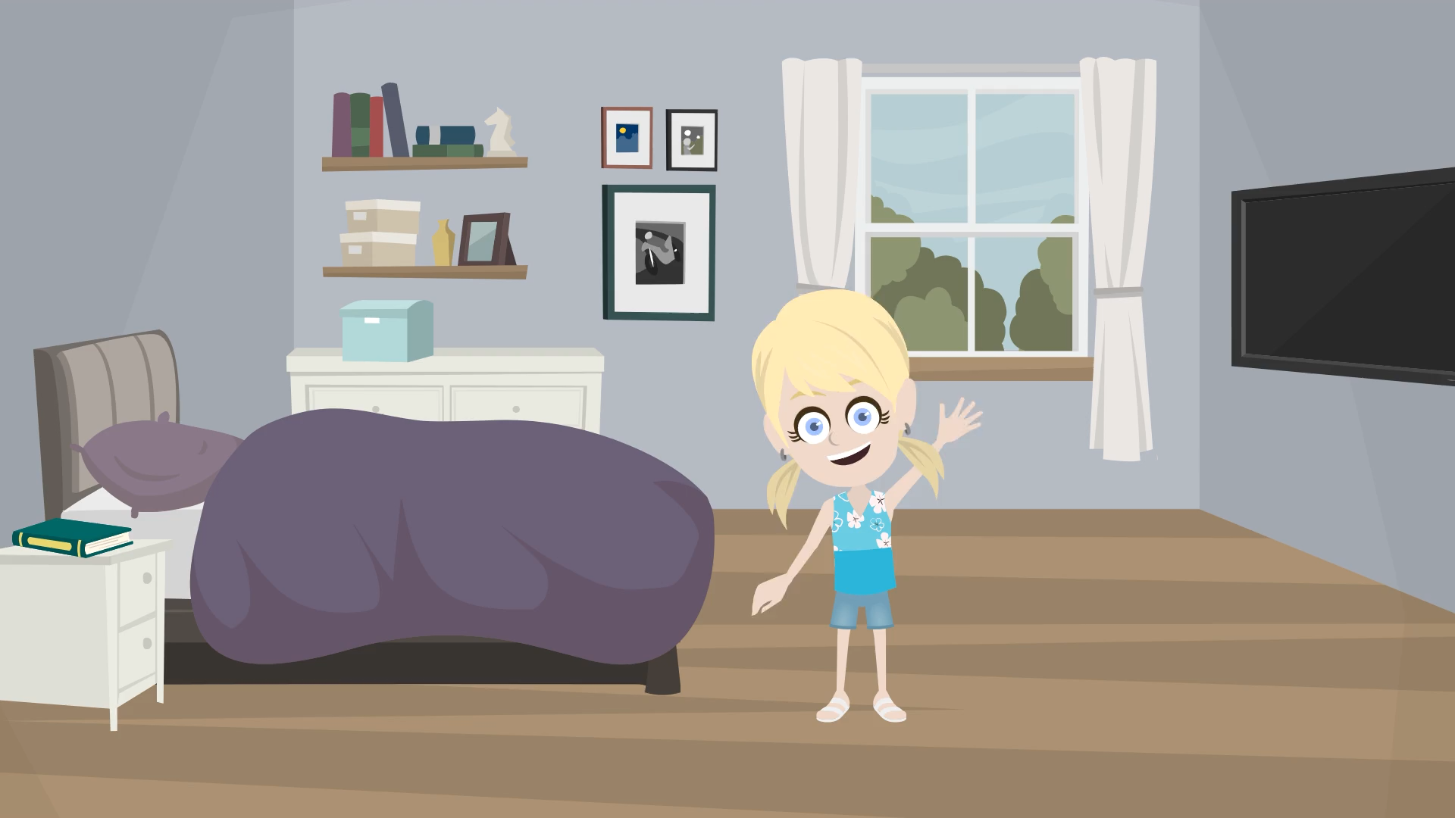

Slide 8
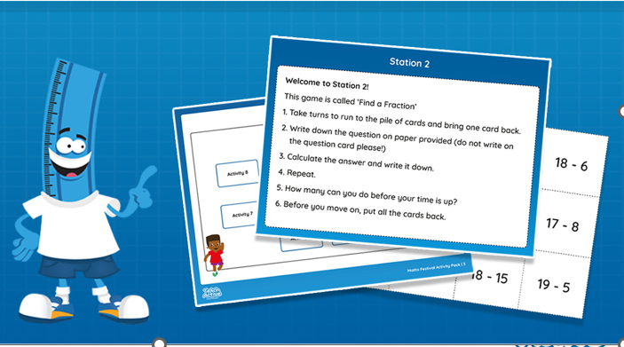
Active Maths Festival Packs
Complete pack to deliver an Active Maths Festival
All activities provided
All resources provided
Notes for organiser
Powerpoint to train young leaders
Notes and instructions for young leaders
“These festivals have been very well received by our schools. Children were engaged throughout, and we had lots of positive feedback from teachers. The leader training was a great addition and leaders felt confident and prepared for the festival”
Zoe Root, Essex

Slide 9


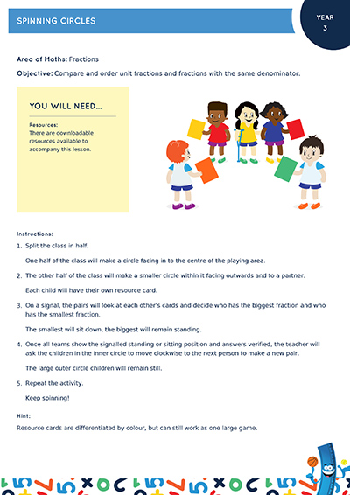
Making Teach Active part of your buy-in
Include Teach Active as part of your SSP package
Discounted prices
CPD included
Access for SSP staff
All year round support for your schools
“Teach Active is a highly effective way to deliver some of the physical activity aspects of our LA buyback. There is high impact across all schools involved. Teachers value the support in making lessons more engaging through practical activities“ - Paula Felgate, Enfield PE

Slide 10
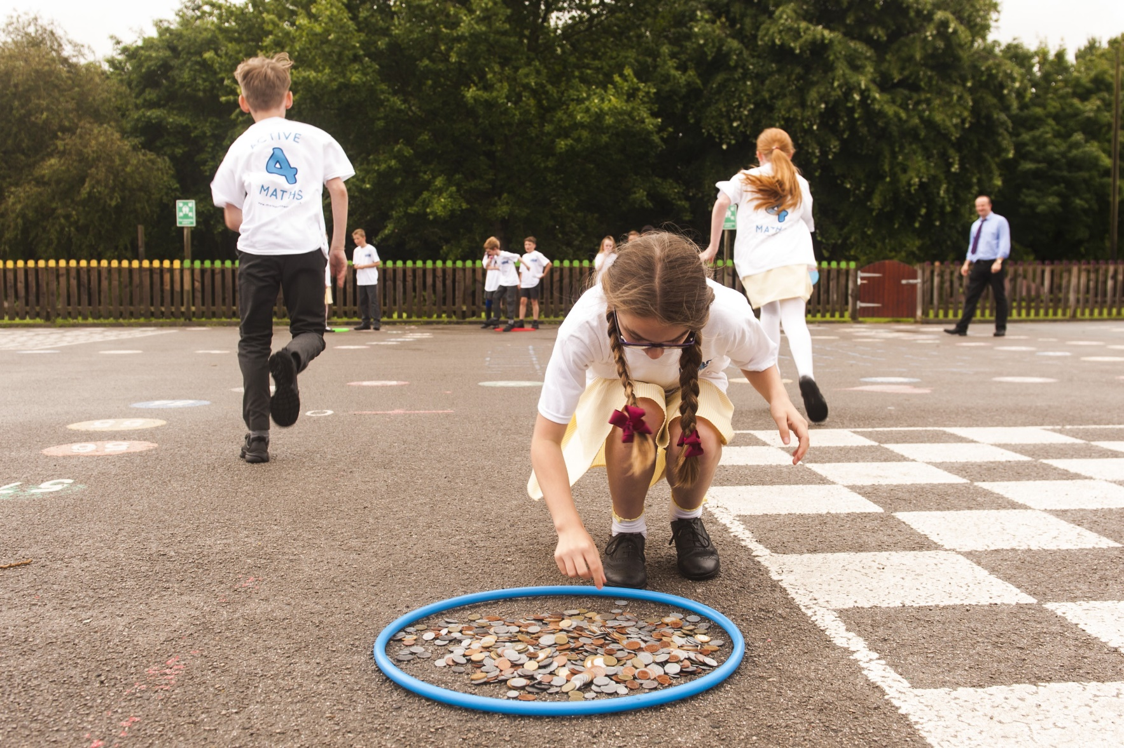
Working with SSP’s and other partners
ie. Active Partnerships/Councils/Public Health
Projects targeting different schools based on
NCMP data
Deprivation
Inactivity
Neurodiversity
Maths/English attainment
‘Teach Active is the perfect whole school programme to help keep all children active throughout the school day. As a Public Health professional, I see the positive impacts physical activity can have on our health and Teach Active provides fantastic opportunities to encourage activity from an early age. We’d recommend other areas taking up this excellent programme!’ - Ellie Forrester, Senior Public Health Officer, South Tyneside

Slide 11
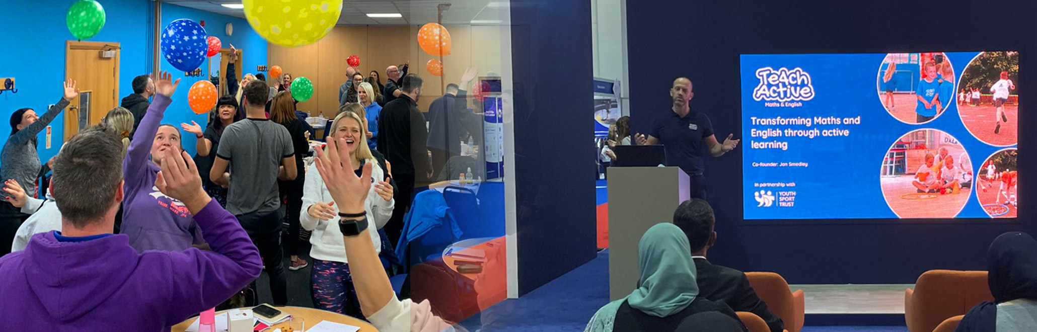
Delivering Keynotes/CPD at your conferences
This past year we have delivered keynotes and workshops at many conferences, looking at the importance of active learning.
“Teach Active is a great resource to support schools in introducing active lessons - making the school day more active, whilst raising standards. We have worked with Teach Active consistently over the past 5 years and are happy and confident to promote their resources to our schools” - Vincent Brittain Inspire+ CEO

Slide 12
Let’s have an informal chat about partnership working
Book a call with Jon Smedley (Teach Active Director)
Book a meeting in Jon’s calendar HERE
or e-mail…
Jon@teachactive.org

Slide 13


Slide 14
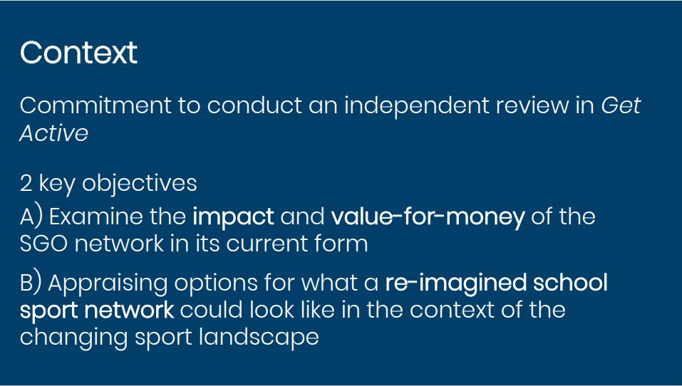

Slide 15
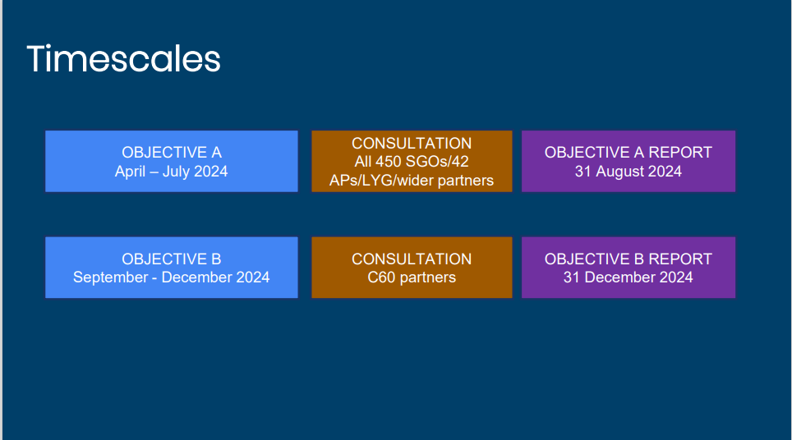

Slide 16

Responding to the SGO Review
What impact do SAM members see that they (SGOs) currently have?
What factors help make a success of the SGO role currently?
What do SAM members consider adds to arguments about VfM?
What factors prevent the SGO role from being as successful as it could be?
If greater capacity for SGOs was available, how could this be used locally to create greater impact?
What would SGOs do differently?
What support/change would be required to bring this about?
Notes:
We want to understand how the SGO network see the future of the role.
We also want to help SAM members who are SGOs to prepare to give a considered response to the review.
Finally, we want to start to consider what a re-imagined network might look like for SGOs.
SGOs – be as honest as you can in this forum – by bringing forward both successes AND challenges we can collectively work through these and help improve the quality of survey response
Non-SGOs – again honesty is important but please be sensitive to those whose livelihoods count on the SGO role

Slide 17
Spotlights
Webinar title
Advocacy | Holiday Activity Food Funding
What is a Community Interest Company (CIC) | Working with Public Health
Business Management Discussion Workshop* | Apprenticeships
Health and Wellbeing myth busting session | * Business Management Discussion webinar, 13th May, 4pm. Please contact rebecca.darcy@youthsporttrust.org to book on

Slide 18
New Members
Link for new members to sign up on SAM landing page:
https://www.youthsporttrust.org/join-us/networks/schools-active-movement

Slide 19
Future Webinar Dates
When: 24th June, 2024 at 10:00.
Register in advance for this meeting:
https://youthsporttrust.zoom.us/meeting/register/tZMtc-2hrD4iG9O4XIRrbZtN-rasiyRtuhc8
After registering, you will receive a confirmation email containing information about joining
the meeting.

Slide 20
Optional Discussion

