Slide 1
Week 4: To understand budgets and the importance of sticking to them
Use simple financial information to plan and manage a budget and keep track of spending
Know how to manage money and the influences on saving and spending
Describe how people make choices about spending money
Be able to research where to buy things and make comparisons between prices when deciding which is best value for money

Slide 2
Notes:
Video link is embedded but in case of any problems playing, link is
https://vimeo.com/540721493/2c92152894

Slide 3
Team Talk
What is meant by a budget?
Why is it important to stick to a budget?
What options do we have if we are struggling to keep to a budget?

Slide 4
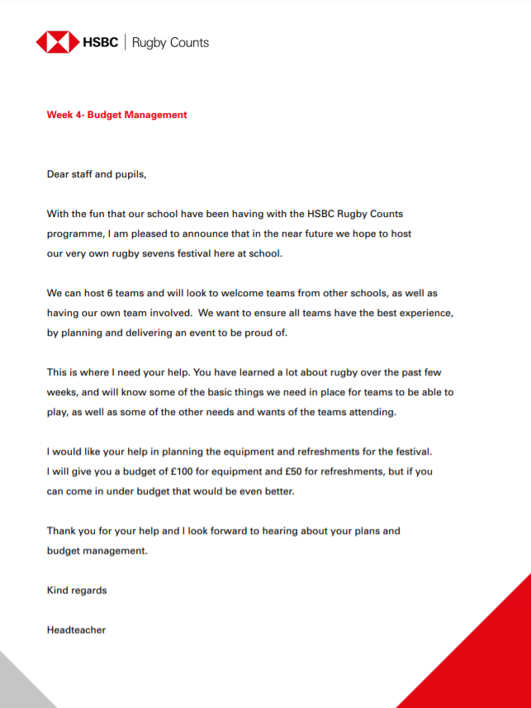
Planning a rugby festival
What do we need to know?
What is the key information?

Slide 5
Team Talk
Remembering needs and wants from lesson 2 think about:
What do you want?
What do you need?
What is most important and why?

Slide 6
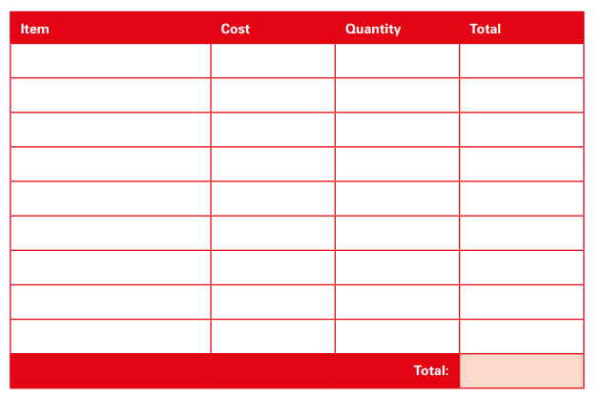
Budget Plan

Slide 7
Budget Management
Did you manage to stay within budget?
If you are over budget how could you make savings?
How does it feel when you can’t afford something?
What might you do about that?

