Slide 1



MLB First Pitch
Impact & Stories (2024/2025)
Produced by the Youth Sport Trust Research and Insight Team
Notes:
Vicci

Slide 2

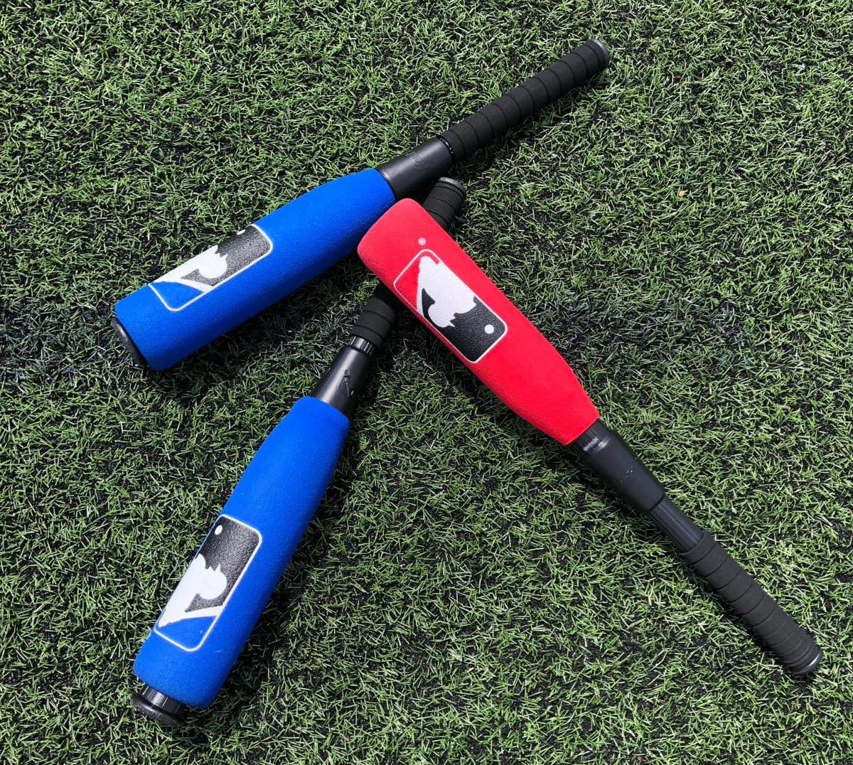













MLB First Pitch 2025 – Executive Summary
Major League Baseball (MLB) First Pitch is a programme that offers fun and inclusive resources to spark an interest in physical activity and sport through play and basic skill development.
2025 Delivery:
1,757 MLB First Pitch sessions
109 MLB First Pitch Festivals
59 MLB First Pitch Championships
Impact on young people:
89%
84%
86%
79%
77%
313
practitioners were trained or supported programme delivery
Improved their enjoyment of taking part in sport and physical activity
Improved their confidence to take part in sport and physical activity
Improved their happiness
Improved their resilience
Improved their connectedness to others
The majority who attended the training improved their:
Competence
Confidence
Motivation
Great session delivered really well with great content that’s provided me with confidence and motivation to teach baseball at my school.
All children have benefited from the MLB First Pitch programme at our school but especially those with additional SEND and neurodiversity… It has been a vehicle to boost confidence and engagement in physical activity. We have seen a positive impact across social, emotional and physical health. Class teachers have noticed the difference this sport has made to their class’s general self-esteem and well-being.
48% female
52% male
49% from Ethnically Diverse Communities
33% from low-income families
17% have Special Educational Needs or Disabilities
13,187 young people and 272 schools engaged
Provided lots of ideas and support on how to get it running in our schools. I am leaving the sessions feeling enthusiastic about delivering baseball in school.
12%
of schools created community club links

Slide 3



Engagement - Overall
Total number of schools engaged in MLB First Pitch 2025 and the reported reach / demographics of practitioners trained and young people participating.
# This number includes any adult that we have delivered training to, or those that are supporting the delivery of the programme (but may not necessarily have received training during the current year)
13,187 young people participating
Average 79 per school
6,236 new; average 70 per school
6,951 retained; average 90 per school
313 practitioners trained / supporting delivery
272 schools engaged
130 retained schools
115 retained schools linked to hub schools
15 retained schools not linked to a hub school
142 new schools
107 new schools linked to hub schools
35 new schools not linked to a hub school
48% female; 52% male
49% EDC (38.0% national average†)
33% From low-income families* (26.7% national average*)
17% SEND (14.2% national average) (not including those with EHCP)^
97% Primary-age
53% female; 47% male
32% EDC (36% national average‡)
3% disability (34% national average‡)
Sample: n=148-161 lead practitioners (Programme Reporting)
*this is measured by young people’s eligibility for pupil premium funding
† https://explore-education-statistics.service.gov.uk/find-statistics/school-pupils-and-their-characteristics ^ https://explore-education-statistics.service.gov.uk/find-statistics/special-educational-needs-in-england
* Pupil premium: allocations and conditions of grant 2025 to 2026 - GOV.UK
‡ https://www.ons.gov.uk/census
Sample: n=147-166 lead practitioners (Programme Reporting)

Slide 4
Training Feedback
Overall feedback and recommendations from practitioners attending MLB First Pitch training in 2025.
The resources provided are excellent and lots of ideas and suggestions were shared to help make it as inclusive and engaging as possible.
Because not many people know the rules to baseball so the course gives them a good introduction to the sport. Plus the resources you get are fantastic.
Great morning with a very inspiring and motivated tutor. Activities were all very engaging and tailored to our working environments. It’s a great programme to embed in our school and add some fun, fresh and new to our school PE curriculum.
It was a great experience with lots of fun.
Insert relevant quotes/examples of training feedback
Very good course delivered by a passionate tutor with great knowledge.
Informative, motivational and constructive. Engaging throughout and can't wait to get started.
Great resources and clear structure to lessons easy for other staff to pick up.
Very clear objectives and practical content. Equipment is great and means it will work in school.
Very informative and helpful in terms of how to deliver and get children involved.
Exceptional resources. Fantastic and practical session.
Sample: n=66 lead practitioners (Post-Training Survey)

Slide 5
Positive feedback from teachers
Teachers reported that the children enjoyed taking part in MLB First Pitch activities, and that the resources and equipment were inclusive and allowed everyone to take part and enjoy a new sport.
As a huge MLB fan, I absolutely loved delivering these sessions. It brought together children with a very wide range of disabilities, and they were all able to play together. They loved watching (or listening as two participants were blind) condensed baseball games before each session, which really increased their understanding of what they were doing and got them excited. They also really enjoyed dressing up in my hats and jerseys!
All of the children learned new skills. For example, a couple of wheelchair users refined their self-propelling skills by moving around the bases, other children developed their ability to grip and push objects or raise their heads….We really appreciated all of the resources that came with it. It was wonderful that there were different types of bats and balls to support children working at different levels. We used some of our own equipment to adapt for individuals with the more severe disabilities, which is usual when delivering any sport…
We really appreciated being a part of this. In my experience, children with complex needs are often excluded from mainstream sports in favour of 'tokenistic' adaptations that do not reflect the world they live in. Being able to take part in baseball shows the world that this cohort can play the same sports as anyone else. Thank you for respecting their right to do so by including our school.
The children have absolutely loved this activity. Being able to access the MLB First Pitch programme has enabled us to add baseball to the PE curriculum. It is so many of the children’s favourite sport of the year. We are connecting with local schools to play games and I will contact our local club to create a link for our children to access playing even more regularly.
It is an excellent programme and very simple to understand and implement with the activity cards. It is also adaptable for younger children because of the t ball stand.
I love the fact that anyone can play. It’s differentiated so well all level of ability can access it.
The children have enjoyed the unit of work. Furthermore, some of my more reluctant children have also been more active and involved.
Sample: n=57 lead practitioners (Programme Reporting and Retained Surveys)

Slide 6




Stories – 2024/2025

Slide 7


Hurstmere School – Hub School (1)
Sidcup, Bexley
School Story
Context of your school
Hurstmere School is an all-boys secondary school in the London Borough of Bexley. The school hosts 2 School Games areas and we work very closely with our SGO. We have been an MLB Hub site for 2 years and the programme is driven by our SGO.
Motivation to be part of the MLB First Pitch Programme? Our SGO was looking for different sports to engage harder to reach groups of children in local primary schools to inspire them to be active. Baseball seemed like a good fit as no primary school was currently delivering the sport in the curriculum or after school. It was also a good opportunity to provide PE Leads with some CPD and resources to use back in school. We saw this as an opportunity to engage new audiences but also to support transition to secondary school.
Who have you involved? What have you delivered?
In year 1 the programme, we engaged 11 primary schools who attended face to face CPD and then delivered sessions within the curriculum as well as some extra curricula clubs. Schools either targeted year 5 pupil premium children or year 6 and used this as a transition activity as it is a sport they might play at secondary school. We also made links with Greenwich Giants who were our nearest community club, and their Coach visited several schools delivering assemblies and taster sessions. A Bexley and Bromley Festival was also held in September at Greenwich Giants and an England player visited to inspire the children. In year 2 of the programme, we maintained 10 schools and recruited 2 new schools onto the programme. This year, we have trained 18 sports leaders to deliver a baseball festival as part of our Just4Fun programme and worked with one of our schools who delivered a baseball day attended by 6 schools. We continue to work with Greenwich Giants providing schools with further opportunities and a pathway into community sport.

Slide 8
Hurstmere School – Hub School (2)
Sidcup, Bexley
School Story
Have there been any challenges?
In year 1 of the programme, we would have struggled to deliver the festival without any kit, fortunately Greenwich Giants stepped in and ran this with us. Year 2 of the programme, the festival packs were greatly received and have been put to good use. When festivals are delivered during the school day, it can be a challenge to get sports leaders out of school to support delivery. Schools also found it difficult to attend the cross curricular training sessions as they weren’t allowed off timetable to attend the online training or were delivering clubs after school.
Have there been any successes? Have you seen the pupils develop through/following the programme?
The greatest success was forging a link with our community club, Greenwich Giants. The coach shares the same passion as us and has given up his own time to deliver taster days in schools, run festivals and work with us to build baseball across the area. We have also been able to tap into his wealth of knowledge and expertise. Schools are reporting that baseball is boosting self-esteem and inspiring children to try something new. One school told us that one of their pupils got teased at school because he wasn’t any good at football but when everyone saw him bat in baseball, he gained respect from everyone.
What are your next steps and plans to continue? Have you connected with a community club?
We have strong links with Greenwich Giants and also link up with Bromley and Greenwich MLB Hub areas. In year 3 of the programme, we aim to train sports leaders from 3 schools to support delivery of the 3 festivals we have planned and hope to repeat the baseball day.

Slide 9

Upton Primary School (1)
Bexleyheath, Kent
School Story
Context of your school
We are a two-form entry school based in Bexleyheath, Kent. At Upton Primary School, we pride ourselves on offering children as many opportunities as possible to engage in a broad range of sports. Our PE curriculum is designed to encourage participation and enthusiasm through in-class learning, intra-school competitions, inter-school competitions and borough festivals. We aim to develop every child’s physical literacy by exposing them to a variety of sporting experiences throughout their primary years.
Motivation to be part of the MLB First Pitch Programme? Our motivation for joining the MLB First Pitch programme was to introduce baseball as a new and exciting sport within our school community. After being promoted by our School Games Organiser for Bexley Borough, Sue Allsop, we took the opportunity and signed up. In year 1 of the First Pitch Programme, I attended a brilliant CPD event in which we were given a start pack and resource pack. We saw this as a valuable opportunity to broaden our sport offer, promote new skills, and inspire a love for a new sport. The programme allowed us to give our pupils access to unique experiences that they wouldn’t typically encounter in primary school setting. In year 2 of the programme, we embedded baseball into the curriculum and also added in intra-school baseball competition.
Who have you involved? What have you delivered?
All pupils from Year 1 to Year 6 were introduced to baseball both within PE lessons and through extracurricular lunchtime activities. Baseball quickly became a popular addition to our sports offering. Pupils took part in local borough festivals and, as part of the MLB First Pitch initiative, attended the main festival event in Stratford. This was followed by an incredible experience at the MLB Hitting Day held at the London Stadium, further deepening their connection to the sport and providing unforgettable memories.

Slide 10
Upton Primary School (2)
Bexleyheath, Kent
School Story
Have there been any challenges? Our main challenge has been delivering a progressive and structured baseball curriculum that effectively caters to all age groups from Year 1 through to Year 6. As baseball was a completely new sport for most of our pupils, the learning curve was steep, and building a framework that supports continued development is an area we aim to improve going forward. Will Lintern from Greenwich Giants has supported us throughout the year with anything as a school we were unclear on.
Have there been any successes? Have you seen the pupils develop through/following the programme?
The introduction of baseball has significantly enhanced our pupils’ striking and fielding abilities. Furthermore, we successfully integrated cross-curricular links such as using maths for scoring games and exploring the global reach of baseball through geography lessons. A particular highlight was hosting an intra-school baseball competition where team colours competed for the inter-house baseball trophy. Another highlight was hosting a borough-wide School Games Baseball League Day at our school, supported by Will from the local club, Greenwich Giants. Will brought expert knowledge and enthusiasm to the day and has remained a valuable connection throughout the year. We are also incredibly grateful to Sue Allsop, our School Games Organiser, who has worked tirelessly to bring schools together and establish a strong baseball presence in the borough since the programme began.
What are your next steps and plans to continue? Have you connected with a community club?
Looking ahead, we aim to continue strengthening our relationships with the Greenwich Giants and our SGO to ensure baseball remains a growing part of our school and wider borough sporting landscape. We are committed to further embedding the sport in our curriculum and to offering our pupils continued access to high-quality coaching, competitions, and enrichment opportunities. We will continue any First Pitch programmes and anything they have to offer.

Slide 11

King Edward VI Aston School – Hub School (1)
Aston, Birmingham
School Story
Context of your school
King Edward VI Aston School Sport Partnership is located in an area of high deprivation where most of our partner schools are located in areas of an IDACI score of 1 or 2. Young people often encounter barriers and challenges when taking part in sport and physical activity, particularly when the sport isn’t traditionally played in the area. With this in mind, baseball is a relatively new sport for most of our schools.
Motivation to be part of the MLB First Pitch Programme? The partnership wanted to allow young people in primary schools in the most deprived areas to access the sport of baseball and as a vehicle to support the development of fundamental movement skills. In addition, we wanted to give a local young people in one of our secondary schools the opportunity to complete the baseball leaders training and deliver a festival to our primary schools.
Who have you involved? What have you delivered?
Primary schools that completed the MLB First Pitch training in 2023 were invited to a baseball festival along with schools in the partnership that had an IDACI score of 1 or 2 as statistically, these young people have fewer opportunities than their more affluent counterparts. These original schools were still delivering baseball in their schools. In total, 8 more schools are now part of the MLB First Pitch programme with us as well as the 14 original schools. Year 10 girls from King Edward VI Handsworth were trained to deliver some of the festival stations, which schools now have access to via their MLB resource pack. 14 girls delivered our festival in July 2025.

Slide 12
King Edward VI Aston School – Hub School (2)
Aston, Birmingham
School Story
Have there been any challenges? Some schools have difficulty getting to a festival that is off their school site as they do not have mini buses or transport. We have flagged the online training to these schools, so they can still access the resources and support to deliver in their schools.
Have there been any successes?
The partnership has retained all the schools from year 1 of the programme who are now delivering baseball within their schools. In addition, we have trained 14 young leaders to deliver the content from the resource cards to other young people in their area. The leaders reported that their confidence grew throughout the event, and they were very likely to volunteer if another opportunity arose to deliver another baseball festival.
What are your next steps and plans to continue? Have you connected with a community club?
As a result of the MLB First Pitch festival in July 2025, we have now connected with our local club, Birmingham Baseball Club and they have forwarded information on their baseball sessions for 7–14-year-olds. All schools have received this information as an exit route for their young people. We have another festival planned for June 2026 with the hope that we can recruit 4 more schools. The focus next year will be to split the festival into a skills-based morning and a games-based afternoon session so young people can put their skills into action.

Slide 13

St Faiths CofE Primary School (1)
Norwich, Norfolk
School Story
Context of your school
The staff lead for the planning and delivery of the MLB First Pitch programme is a physical education specialist teacher, employed by the Nebula Federation, to work in three of our six schools. A number of staff including teachers and TA’s have also completed the training and deliver sessions with enthusiasm. St Faiths’ Primary is situated just outside Norwich. Although the published demographics are in line with national averages, the catchment area of the school has a higher than average recent build profile and a high percentage of social housing. According to Office of National Statistics Figures national rural social housing is around 8% - St Faiths’ is 17%.
The number of pupils identified with SEND within school is 50%. This means that a huge amount of resource is channelled into provision for these pupils in order that their needs are met and their outcomes are as strong as possible. Any additional provision that we can acquire for our pupils enables us to continually broaden our curriculum, engage our pupils and promote enjoyment – improving attendance. As a Federation we have always had a strong emphasis on physical education and activity, believing that physical literacy is essential to mental wellbeing, behaviour and success in the classroom – this transcends barriers to learning created by economic hardship. At St. Faiths’ Primary, 25% of pupils are eligible for free school meals. Academically, pupils at St. Faiths’ Primary School make excellent progress. In 2025, at the end of KS2, 77% of pupils reached the expected standard in reading; 57% in writing; 78% in maths and 64% in Grammar, Spelling and Punctuation.
Motivation to be part of the MLB First Pitch Programme? Our PE teacher developed a passion for Softball during her PGCE teacher training year based at Fakenham High School, Norfolk (a hub for Softball with official pitches and a cage where an adult league was formed and she then played regularly). She went on to introduce and deliver softball within her teaching roles thereafter in various high schools. Since working across three of our Nebula primary schools, she had been searching for ways to be able to introduce softball or baseball into our primary school curriculum and after a few years of trying to figure a way of making it happen, found the MLB First Pitch programme which she has jumped into and has delivered with a passion.
Who have you involved? What have you delivered?
Since the MLB training two years ago, we have embedded baseball into our striking and fielding element of the PE curriculum. All primary school ages from Reception age to Year 6 experience baseball during the summer term in PE lessons. We have organised matches and events between the three schools the PE teacher works across.

Slide 14
St Faiths CofE Primary School (2)
Norwich, Norfolk
School Story
Have there been any challenges? The PE teacher has sourced two second hand baseball jerseys, a few batting gloves, a helmet, a catching glove etc for the children to be able to dress up too when they are playing which has added to the excitement of the lessons. We would love to be able to have a few more jerseys for the children to wear and share so we will keep looking for anything we can find.
Have there been any successes?
We have seen a growing interest in the sport, from teachers now watching MLB based in America, to children playing it at home at their leisure. Children look forward to their PE lessons, they enjoy the skills and games sessions provided within the First Pitch training set. The introductory equipment set we received during the training is excellent and provides variety, suiting all abilities across all year groups for our primary school age range.
What are the benefits you have seen in the young people taking part?
All children have benefited from the MLB First Pitch programme at our school but especially those with additional SEND and neurodiversity. The equipment set and activities provided are so incredibly inclusive enabling all children to progress, build resilience and succeed. It has been a vehicle to boost confidence and engagement in physical activity. We have seen a positive impact across social, emotional and physical health. Class teachers have noticed the difference this sport has made to their class’s general self esteem and well being.
What are your next steps and plans to continue? Have you connected with a community club?
Without the MLB First Pitch programme, it simply would not have been possible to bring this sport to our school, and we are so grateful for the opportunity. We are in touch with the local Norwich Baseball Club awaiting further information regarding youth sessions they may be hosting this summer holiday for the primary school age range. It is without doubt that we will be continuing to deliver baseball within our curriculum, and we will stay in touch with the local club for any further opportunities that may arise for the children to play even more regularly outside of school.

Slide 15

Additional case studies
The below in-depth case studies were collected by the Research & Insight Team after attending MLB First Pitch Festivals in Oxford and Walsall.
Oxford case studies
Walsall case studies
John Henry Newman Academy
Pegasus Primary School
Goldsmith Primary Academy
Greenfield Primary School
Pelsall Village School
Watling Street Primary School
To access the case studies, please click on the name of the school.

Slide 16


