Slide 1

Physical Literacy Toolkit

Slide 2
Introduction
This toolkit has been produced by the School Sport and Activity Sector Partnership physical literacy action group*; a committed, collaboration group of sector partners aiming to unite efforts for consistent messaging, education and action in relation to physical literacy and creating positive movement experiences for all.
*Action group members include…
Youth Sport Trust — International Physical Literacy Association
Cabot Learning Federation — Chance to Shine — Active Sussex
British Fencing — British Judo — Swim England — Bath University

Slide 3










Slide 4



Toolkit Aims
Building knowledge
and understanding
Advocates
Collaboration around systemic and/or
thematic challenges
Tracking and
celebrating progress
Notes:
The toolkit aims align with the Sport England convened positive experience collective objectives.
We want to:
continue to build consistent knowledge and understanding of the concept of physical literacy
increase advocates for the concept and physical literacy informed practice that ripples the messaging and approaches across the sector and wider system
Foster collaboration in creating positive experiences
Increase examples of good practice

Slide 5
Toolkit Approach
Ignite —
Why it matters?
Connect our networks with their own relationship with movement and physical activity to better understand what we mean by the term, considering what it means personally and professionally.
Unite —
What can we do differently, together?
Develop consistency of understanding which impacts consistency of policy and practice to ensure positive movement experiences for all
Excite —
How to build momentum, create ripples
Empower and elevate examples of impact, creating more advocates
Notes:
The toolkit is structured around the following framework:
Ignite: building knowledge and understanding by getting personal with our own relationship with movement
Unite: evolve understanding to action considering approaches, frameworks and principles that empower the workforce and unite our efforts for consistency of policy and practice
Excite: showcase examples of good practice to continue to empower others to be part of the movement and the advocacy
Knowing your audience for any delivery and messaging opportunities is key- there will be those who are new to physical literacy, those who think they understand the concept but may have some misconceptions and those who get it- hence the framework provides you with a range of tasks and content to meet the audience where they are- we would always advise starting with ‘ignite’ to build greater depth of understanding from there.

Slide 6

Ignite
Why it matters
Connect our networks with their own relationship with movement and physical activity to better understand what we mean by the term, considering what it means personally and professionally.
Notes:
Ignite section guidance
The tasks can be used as part of staff meetings, training and workforce development.
They are intentionally short, snappy and interactive to introduce easily as stand-alone tasks or to build into existing content and messaging.
We have not prescribed set timings to the tasks- some can build and progress, some will be led by discussions. They are intentionally flexible
In power point format, they can be lifted directly into your own power point materials
The content can be edited and adapted accordingly but we would recommend only small changes e.g. change of images specific to your audience or organisational branding, rather than a lot of changes that could take away from the intent of the tasks.
We ask that where possible the school sport and activity sector partnership branding is retained, or at least reference (through links to the website) to the partnership and this toolkit be included as part of your use of the tasks
The tasks can be used with a range of audiences, from senior leaders to practitioners, with set teams, whole organisational/school staff and possibly even adapted for young people.
The tasks are intentionally personal to connect the audience with their own relationship with movement, physical activity and sport, before considering what it means within their professional role. Please embrace this while also being mindful of creating a safe space for people who may not have had such a positive relationship.
Following the task(s) you may wish to include and reference the Sport England Physical Literacy consensus statement materials https://www.sportengland.org/news-and-inspiration/physical-literacy-consensus-statement-england-published

Slide 7
Task 1: Our movement history
Notes:
This first task asks participants to reflect on their relationship with movement from their earliest memory to the present day-considering how their relationship has changed over time. The task builds and progresses, building knowledge of physical literacy in stages- you can do all components, focus more on one or pick and choose.
The task(s) will stimulate reflection and conversation and really showcases all aspects of what physical literacy is.
It supports people to understand that physical literacy is complex, it ebbs and flows and is always in flux (as is the natures of a relationship).
It highlights how the journey is unique to each of us,
It spotlights factors that affect our relationship
It delves into experiences and what stands out to individuals in terms of how the activity makes them move, think, feel and connect
It explores the importance of skill, competencies and capabilities in relation to a positive relationship
It encourages understanding of what people enjoy, find meaning and value in

Slide 8
Our Movement History
What you’ll need:
Pen and paper
Your memory!

Slide 9
Reflection Activity
Engagement with physical activity
Your life course (age)
Notes:
Task input: We’re going to take some time to personally reflect on our own relationship/engagement with Physical Activity across our life so far
On a piece of paper draw the following axis and map out what your relationship/engagement with Physical Activity has looked like across your life.
This can be done individually, or in groups on one large piece of paper with all using a different colour to draw their line of engagement.
Add comments, reflections on what was happening at some of the highs and lows

Slide 10
Reflect and discuss
When have you had a positive relationship, sustained engagement with physical activity? Why was this?
When have you been disengaged with physical activity? Why was this?
How has your relationship with physical activity changed over time?
Notes:
Reflect and discuss activity
In small groups participants discuss their graph in relation to the questions.
Take feedback from individuals/groups
Consolidation of contributions from participants
- the factors that effect engagement e.g. environment, opportunity, where people live, family influence, friends influence
The key life moments that play a part e.g. transition points, starting work, relocation, starting a family, injury/illness
Summarise discussions, pulling on specific examples from each of the angles above

Slide 11
Learning and development
Write down the skills, competencies and capabilities that have helped you to develop and maintain a positive relationship with movement and physical activity throughout your life.
OR
Write down the lacking skills, competencies and capabilities that you believe have hindered your relationship with movement and physical activity.
Notes:
Task input: Discuss and write down all of the skills, competences and capabilities that you believe have helped you to develop and maintain a positive relationship with movement and physical activity.
This could also be flipped to consider what may be lacking that has contributed to a more negative relationship.

Slide 12
What makes our experiences positive?
Think of a specific positive movement, physical activity or sport memory.
How did the experience make you move, think, feel and connect with others, your surroundings and yourself?
How enjoyable, meaningful and valued was this experience? What shaped this?
Notes:
Task input: Encourage participants to delve deeper into a specific moment/memory of Physical Activity and sport that features on their timeline.
Discuss thoughts in relation to questions.

Slide 13
This is physical literacy
It is both an outcome and a concept/framework to work by
It reflects how we value, enjoy and engage with physical activity
It shapes and is shaped by how we move, connect, think and feel in and through movement
It is affected by people, communities, culture, circumstances, places, and spaces around us
It contributes to our health, wellbeing and quality of life
It evolves, changes, ebbs and flows throughout life
It’s personal because no one person’s relationship is the same
It’s why we like and loathe physical activity
Notes:
Task input: Use the learnings from the task(s) to highlight and summarise how all of this is physical literacy

Slide 14
Task 2: Activity portfolio
Notes:
This task is similar to task 1 but focuses more specifically on the activities and the physical aspect of your journey/relationship with movement and physical activity.
Participants will consider how the activities they do have changed throughout their life phases and why this may be.
This will highlight:
The personal nature of physical literacy
The domains that are more dominant for different people and at different points in our lives.

Slide 15
Your activity portfolio
Think about your own relationship with physical activity throughout your life to date.
Can you list chronologically the activities you participated in (this could be broken down into decades).
Why did you start and stop certain activities?
Why do you remember some activities more fondly than others?
What benefits did each of the activities give to you?
Physical literacy
is our relationship with movement and physical activity throughout life
Notes:
Task input: Record your activity portfolio throughout history. Discuss any changes to the types of activities, why this may have been.
Take feedback and summarise.

Slide 16
Task 3: Moments of impact
Notes:
This task asks participants to think of the standout moments that they feel have impacted most on their relationship with physical activity.
This should spotlight key factors that are personal and unique to the individual such as people, environment, communities, circumstances and how experiences rooted in movement, but also thinking, feeling and connection can create moments of impact that drive enjoyment, meaning and value of physical activity.
It highlights how our past can have far reaching ripples (positive and negative), and the importance of creating positive moments of impact in the activities we offer and facilitate.

Slide 17

Moments of Impact
A moment of impact has potential for change, has ripple effects far beyond what we can predict. The thing is each one of us is the sum total of every moment that we’ve ever experienced with all the people we’ve ever known. And it’s these moments that become our history. Like our own personal greatest hits or memories that we play and replay in our minds over and over again.
The Vow, 2012
Notes:
Task Input: Share quote on screen taken from the film ‘The Vow’ 2012
Our lives are filled with moments of impact. We are the sum total of every moment we have ever experienced. These moments become our history, like our own personal greatest hits.
Ask participants to consider: What relevance does this quote have to our work in physical activity?
Now put that through a physical lens… we have all had key ‘moments of impact’ in relation to movement, sport, PE, PA that have had far reaching ripples that have contributed to who we are and the relationship we have with physical activity today.

Slide 18
Moments of Impact
What have been your moments of impact for movement, sport, PE, physical activity?
Who are you as sum total of these moments?
What are your personal greatest or worst hits of movement?
Notes:
Task input: Discuss the following questions in pairs/as a group
What have been your moments of impact for movement, sport, PE, physical activity?
Who are you as sum total of these moments? (How have the moments shaped you?)
What are your personal greatest or worst hits of movement?
We are now in positions of influence for our young people, who experience key moments of impact every day in our care. Schools and the education system is just one part of a YP’s physical activity, ‘moments of impact’ but we know it is a key one, and for some YP the only chance they get to experience sport, PA. So in our roles now, we need to ensure positive participation experiences across PE, enrichment, extra-curricular, playtimes and into community clubs and the home.

Slide 19
Task 4: Perceptions and perspectives
Notes:
This task considers how our past experiences of movement and physical activity shape our perceptions and perspectives of different activities.

Slide 20
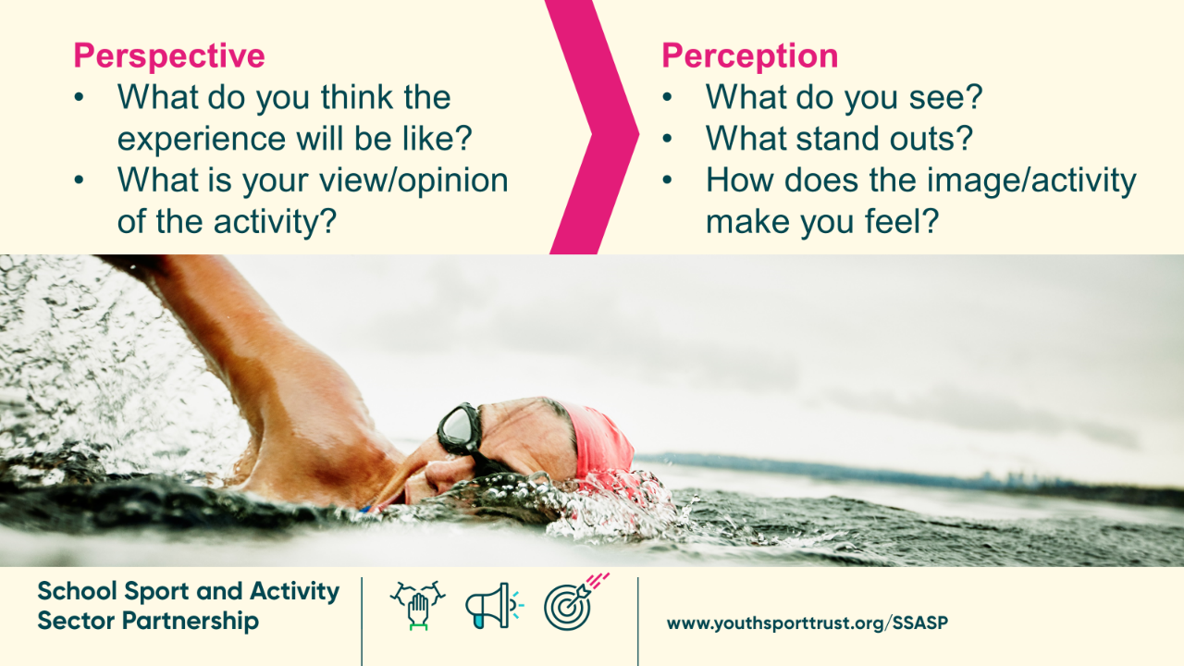
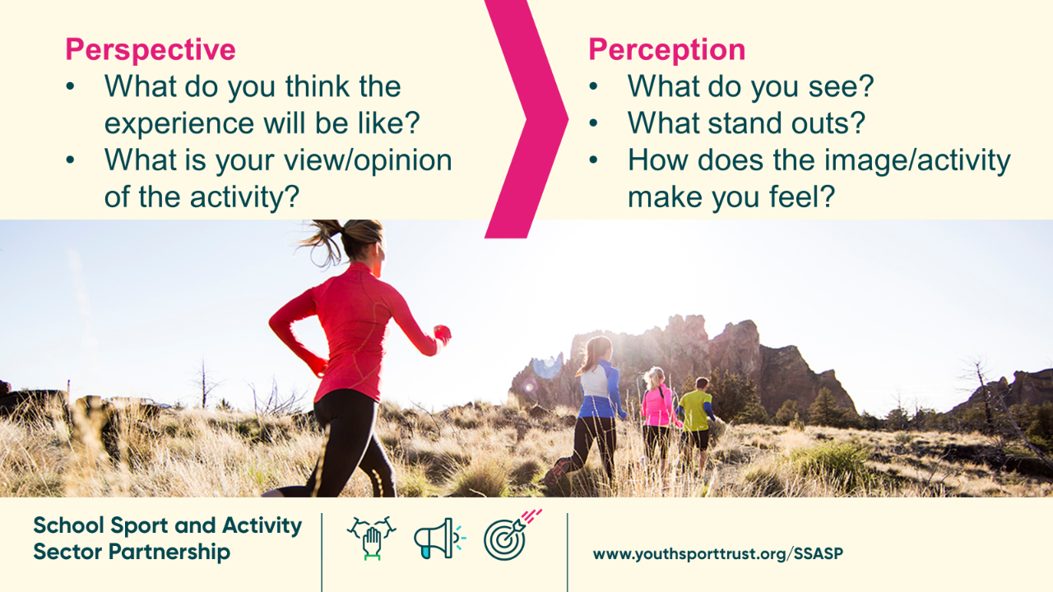
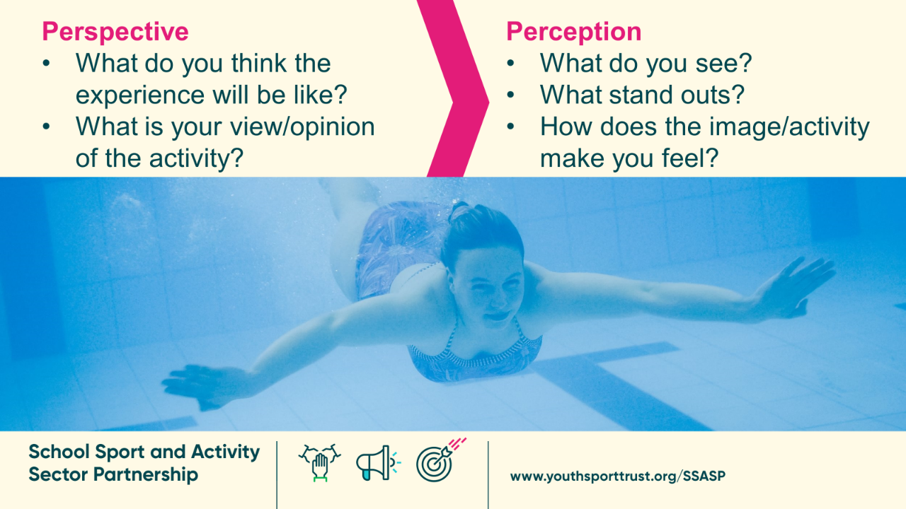
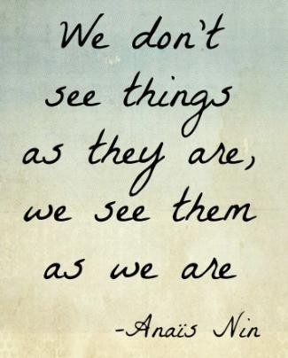
Perceptions-
the way we sense the world and interpret it
Perspective-
your point of view of said world
Notes:
Task Input: Clarify what we mean by perceptions and perspective.
When it comes to our relationship with movement, sport and physical activity- perceptions and perspective play a large part.
Perceptions, the way you sense the world and interpret it, impact on your perspective, your point of view of said world, which again influences your perceptions.
We’re going to unpick this further, by looking at a range of different movement experiences, and share our perceptions of what we see and how that feeds into our persptive.

Slide 21
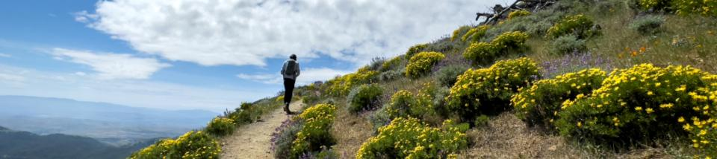
Perception
What do you see?
What stand outs?
How does the image/activity make you feel?
Perspective
What do you think the experience will be like?
What is your view/opinion of the activity?

Slide 22
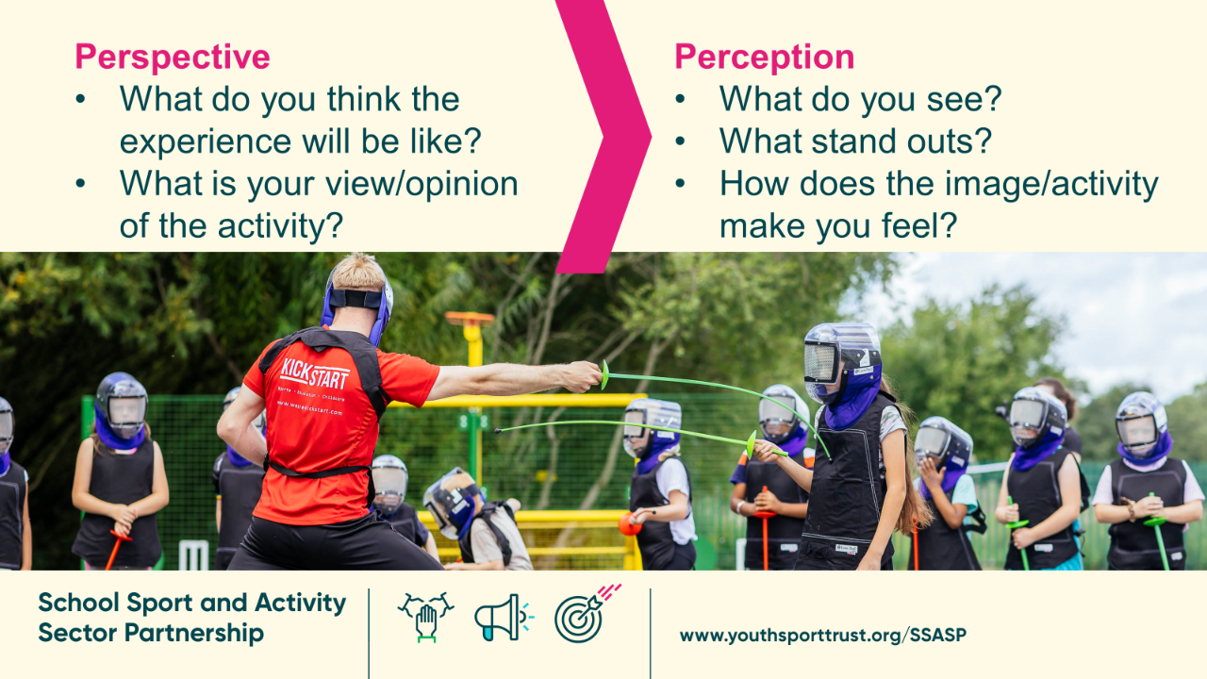
Perception
What do you see?
What stand outs?
How does the image/activity make you feel?
Perspective
What do you think the experience will be like?
What is your view/opinion of the activity?

Slide 23
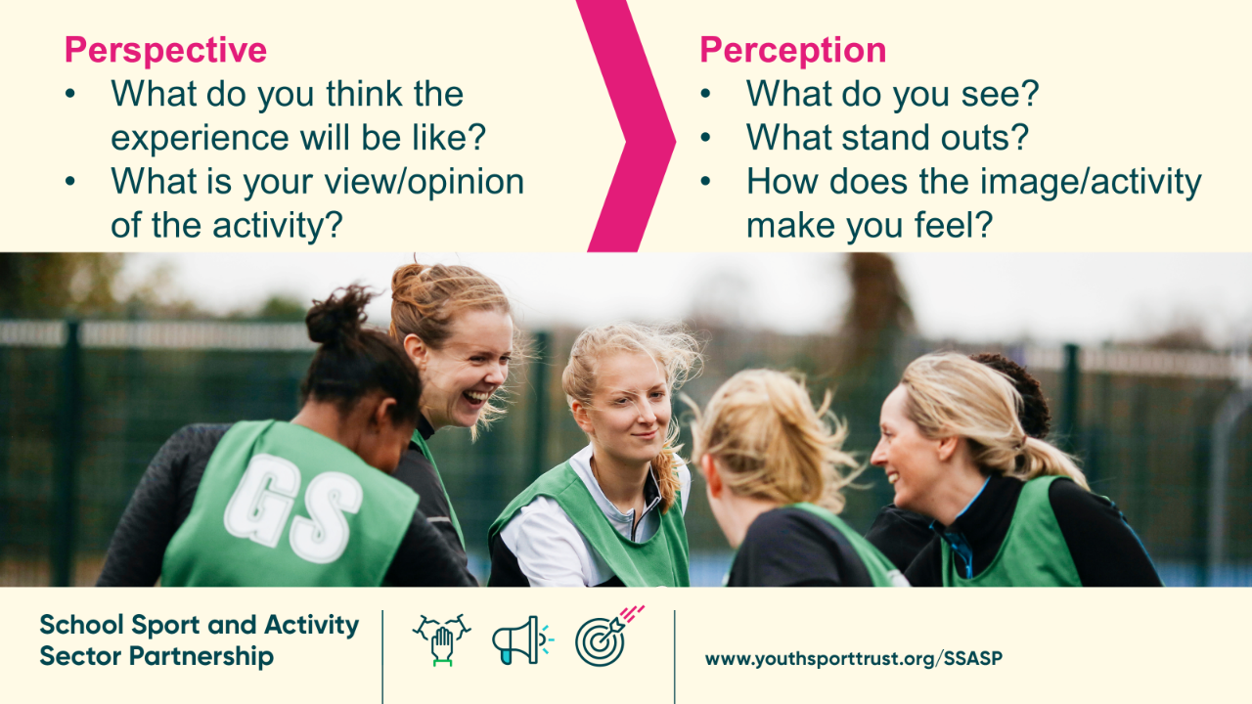
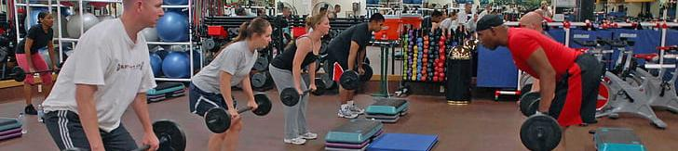
Perception
What do you see?
What stand outs?
How does the image/activity make you feel?
Perspective
What do you think the experience will be like?
What is your view/opinion of the activity?

Slide 24
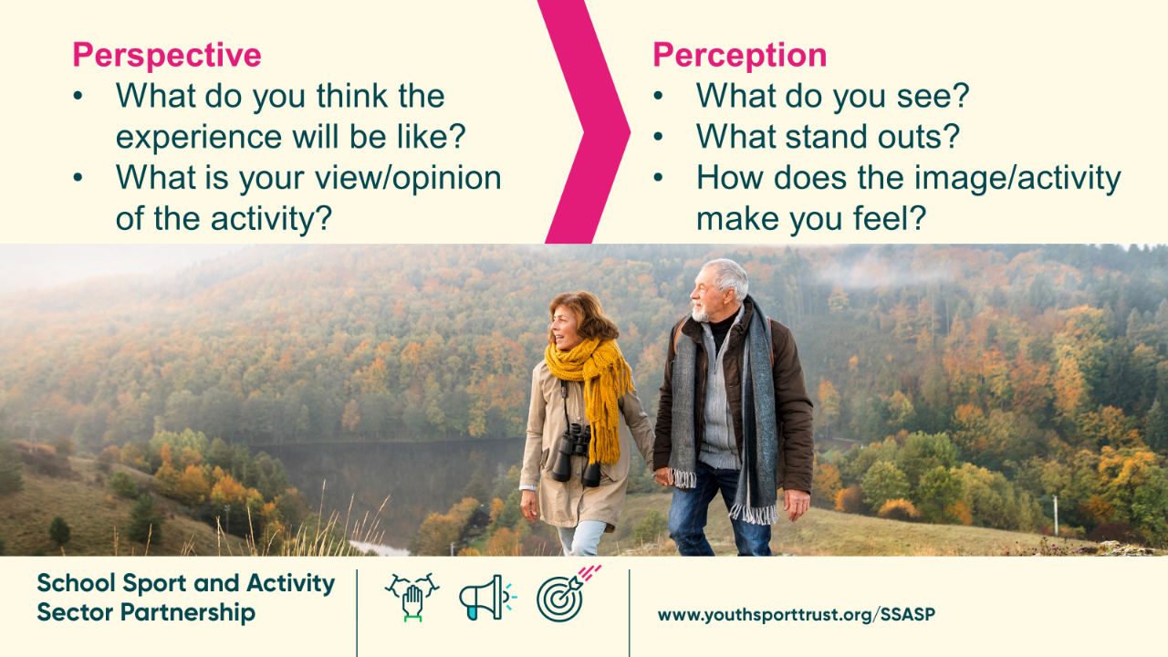
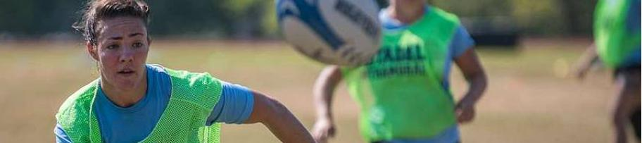
Perception
What do you see?
What stand outs?
How does the image/activity make you feel?
Perspective
What do you think the experience will be like?
What is your view/opinion of the activity?

Slide 25
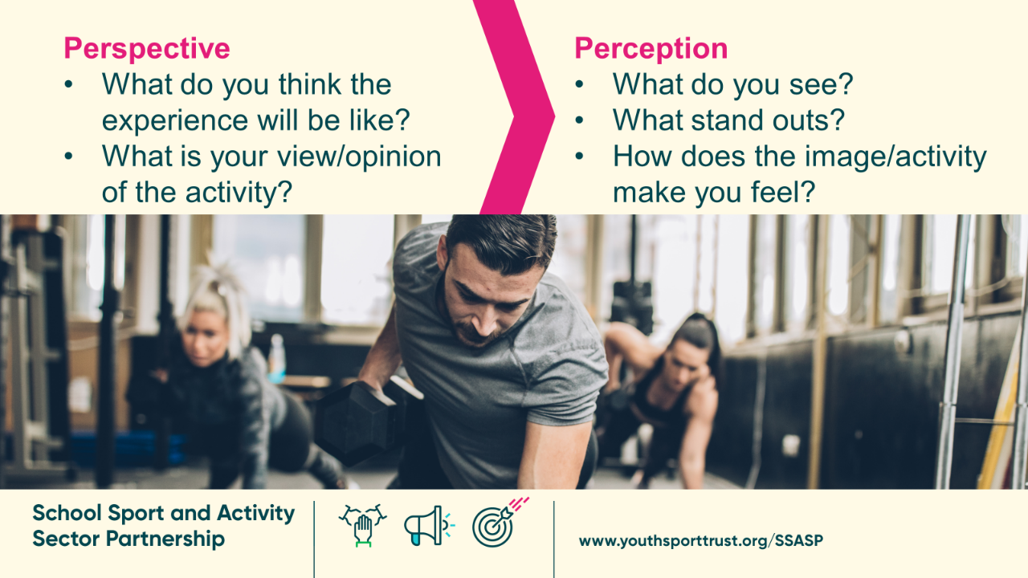

Slide 26
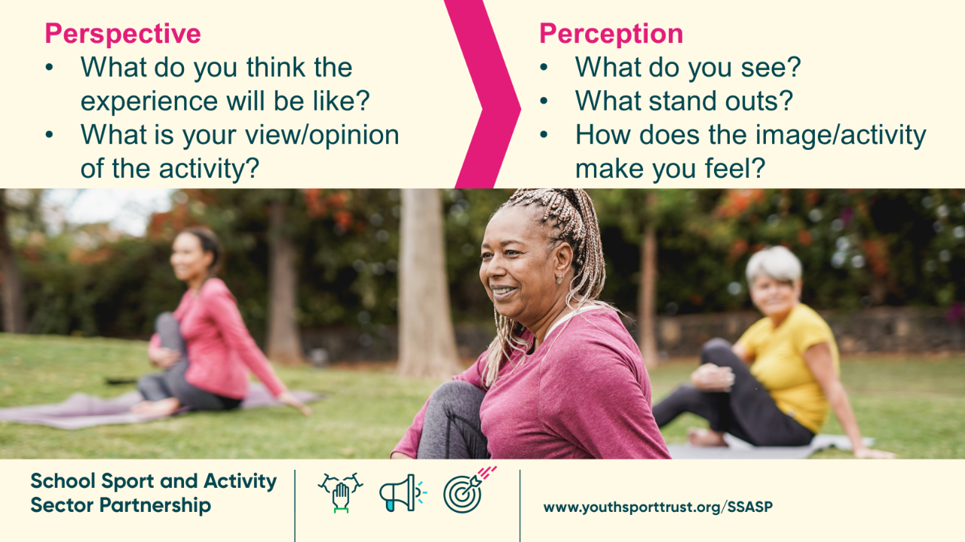

Slide 27
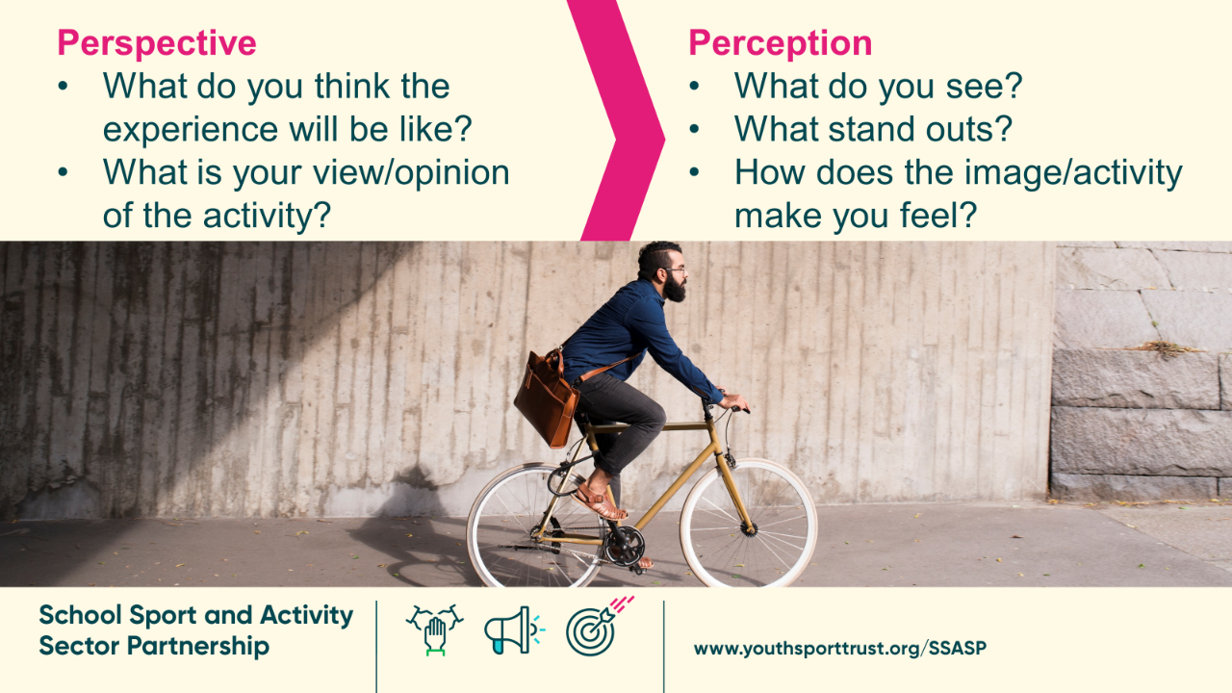

Slide 28
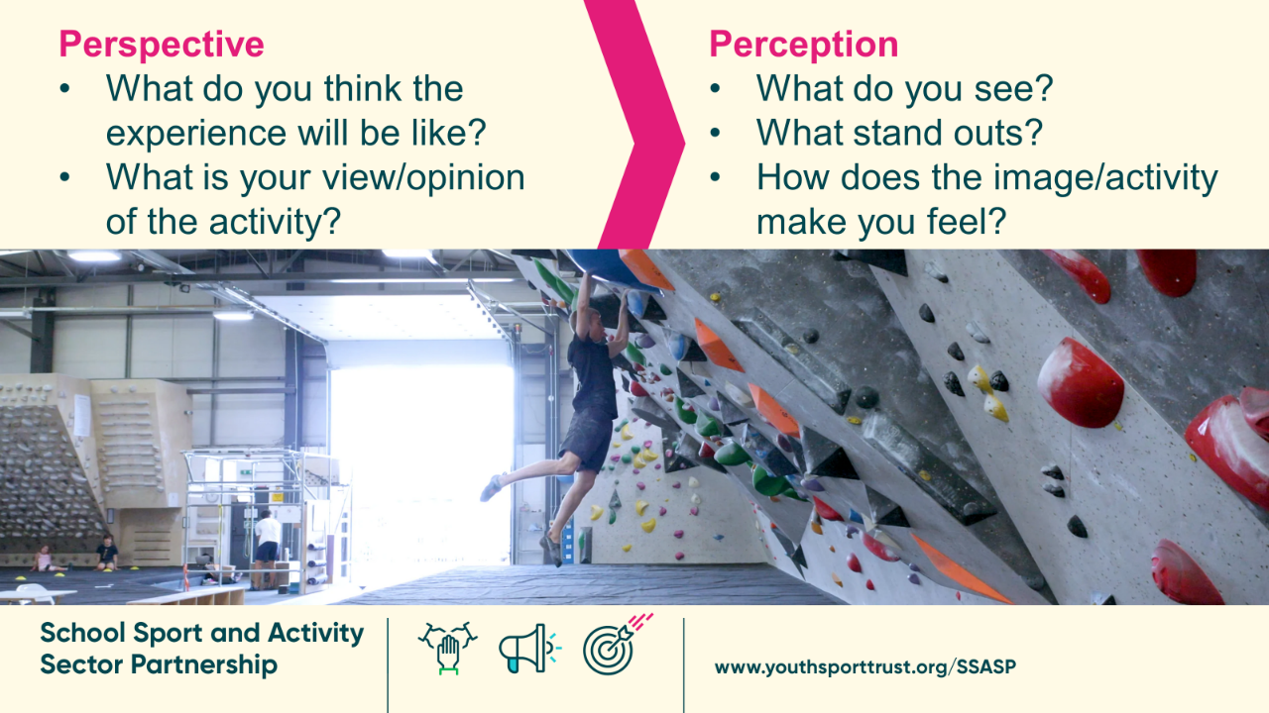

Slide 29
Task 5: A letter to movement
Notes:
This task is creative and aims to get very personal with physical literacy. You could ask participants to come prepared with a letter they have already written to use as part of the reflection and discussion tasks, or do the letter writing as part of the session.

Slide 30
A letter to movement
Dear Sport…
You were present early in my life, kicking a football against a wall while my dad played his Saturday league games, cheering on the grey horses on TV racing, putting on funny voices and reading aloud the football scorelines, doing fitness classes with mum, leotard over cycling shorts to look the part. You provided me with connection, consistency and routine which was especially needed as I spent weekends alternating between my mum and dad’s houses.
In school, you came into your own in year 5 - the year I made it into the school netball team. You built my confidence, gave me self-belief, motivated me to work as a team to achieve a shared goal. But your impact didn’t stay on the netball court, you rippled into my lessons, helped me raise my hand more, have a go at the tough questions and look for the progress not solely the result. It wasn’t just me who felt it, teachers knew the impact you were having too. You even got a mention in my school report as a positive influence on my learning.
Notes:
Task Input: Read an example of a letter. This one is titled to sport, but the example could be PE, a coach, teacher, family member. Further examples are given.

Slide 31
A letter to movement
Dear PE…
Thank you… thank you for shaping me into the person that I am today. Thank you for being my absolute passion. Thank you for being my joy, my pain, my simultaneous stress-giver and reliever and my pride all at once for all of these years. In moments of success there was and still is no better feeling, in moments of fear or feelings of ‘I can’t do this’ there are dark times, but you never let me give up. When there are moments now of ‘am I doing this right or why am I doing this?’ you still don’t fail to come through and show me better times. You have always been there waiting to push me further. You are so much more than just ‘PE, a subject at school’. You’ve taught me drive, determination, passion, grit, resilience and dedication and I can never show you how eternally grateful I am for that.
Because of you, I am the person that I am today.

Slide 32

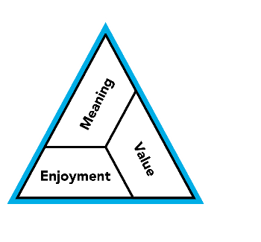
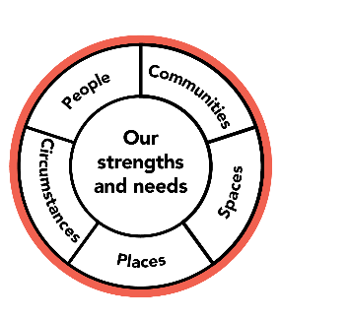
Activity:
A personal letter to movement
WHO will you write your letter to? This could be a person, a sport, an activity, a place, an environment or a community.
HOW has the letter recipient impacted your relationship with movement and physical activity?
WHAT are you grateful/ungrateful to the letter recipient for?
Notes:
Task Input: Write your own letter to movement. This could be a sport, context, person. This can reflect the good and the bad impact of the recipient on your relationship.
Really focus on the enjoyment, meaning and value that the letter recipient has (hasn’t) offered

Slide 33
Reflection
How does your story impact on:
Your relationship with movement today?
The leader or practitioner that you are?
How you influence others?
Notes:
Task input: Ask participants to reflect on ‘their story’ and how thy feel it impacts them in the role now.

Slide 34
Task 6: Movement Why
Notes:
This task is short and snappy. It can be done as a warm up, and can use print out images, screen images or could ask participants to even draw their top three images. You could place the images around the room and ask for everyone to write a word or phrase to derive what they see. To draw out similarities and differences.
It is a quick way to see exactly what people value, enjoy and finding meaning in with movement and physical activity, and opens the floor to more discussions on why this is.
You can edit and change the photos to a selection right for your focus and audience. You could choose to use only sport specific, or lifestyle images to home in on particular types of movement. But ideally this task is aimed at represented the diversity of movement experiences.

Slide 35

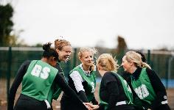
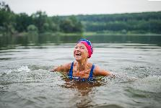
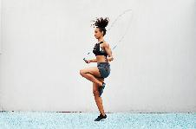
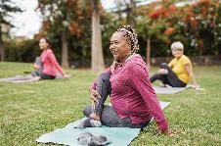
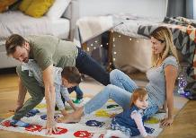
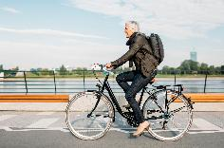
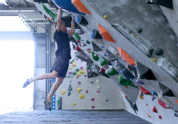
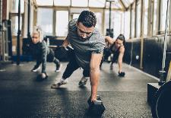
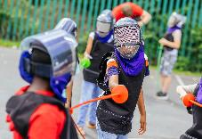
What’s your why?
Choose three images that stand out to you most for what movement and physical activity means to you. Give each image a word or phrase for what it symbolises to you. Discuss.
Notes:
Task input: Select three images that stand out most to you and give each a word or phrase to describe personally what it means to you. Share and discuss.

Slide 36
Task 7: A newbie?
Notes:
This task encourages participants to reflect on when as an adult they may have tried a new activity for the first time. This highlights:
The different domain experiences and how these can differ by person, activity, session leaders, spaces etc.
How it felt for us as adults
How it can feel for children or those who’s first experiences we impact on
the factors we need to consider for new participants
How we can create a positive first experience

Slide 37
When was the last time you tried a new activity?
How did it make you…
Move
Connect
Think
Feel
How did it make you move?
How did it make you feel?
How did it make you connect?
How did it make you think?
Notes:
Task Input: Discuss in small groups an example of a time when you last tried a new activity?
Consider how the activity provided an experience that made you move, connect, think and feel?

Slide 38
When was the last time you tried a new activity?
How did the experience feel to you?
What factors do we need to consider for new participants?
How can we create a positive first experience?
How did it make you move?
How did it make you feel?
How did it make you connect?
How did it make you think?
Notes:
Task Input: Reflect on the new experience and then consider learnings and relevance within your role.

