Slide 1




Slide 2

Getting started as an active play
Young Leader
Module 3 – Do

Slide 3

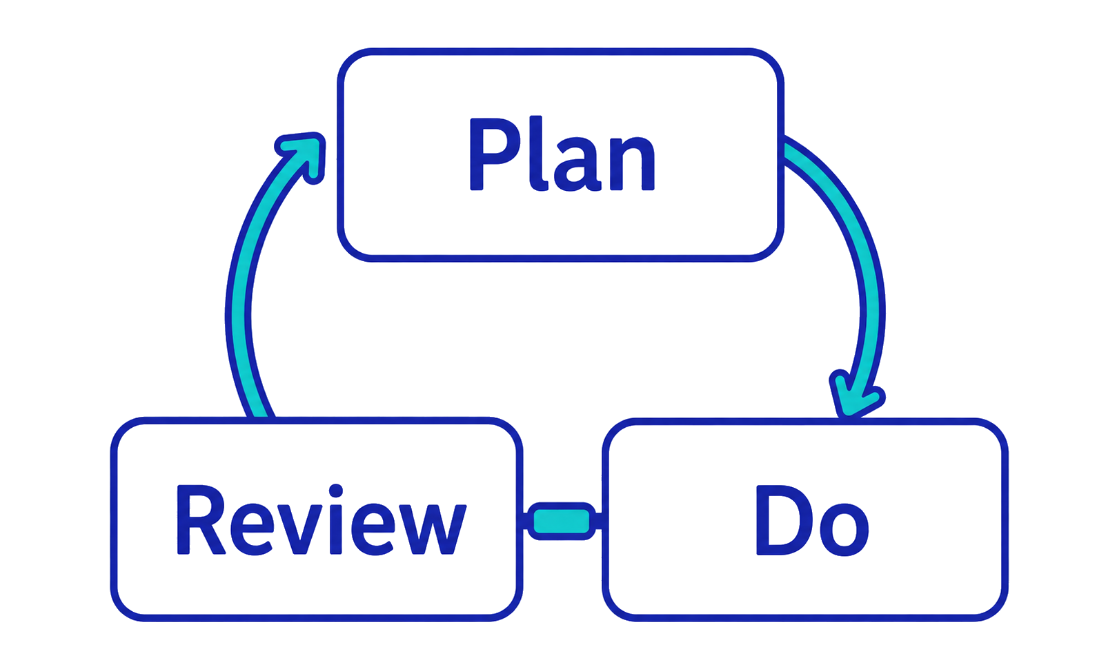
As young leaders, we will…
What do we need to know in advance?
How do we check they are working?
How will we run the activities?

Slide 4
Stepping stones
Goal: get the whole team to the other side of the river as safely and quickly as you can.
Rules:
You may only use the equipment you have been given.
You must not step in the river.
If a team member steps or falls in the river, they must start again.
All team members must make it to the far side.
Can you make it in time?

Slide 5
How well did you work as a team?
In your team, consider:
What did you do that helped you to achieve the task?
What did you do that hindered you from achieving the task?
Focus on your teamwork, not on individuals.

Slide 6
Teamwork skills
As a good team worker, I…
Respond positively to teammates’ (reasonable) requests.
Share ideas, resources and the workload.
Support others and accept support when I need it.
Try to find agreement (instead of focusing on disagreements).
Work towards the team’s goal, not just my own

Slide 7
Everyone should have SMILES during activities
S | Safe | Children are safe and feel safe.
M | Maximum participation | Children are involved as much as they want to be.
I | Included | All children can take part.
L | Learning | Children learn different skills (not just physical).
E | Enjoyment | Activities match children’s interests.
S | Success | Children feel pleased with themselves.

Slide 8
Examples of SMILES in a tag game
S | Safe | Only tag players between shoulder and knee.
M | Maximum participation | No one is ‘out’ – they become an extra tagger.
I | Included | Make a no-tag rest zone for some players.
L | Learning | Play in tag teams so players learn teamwork.
E | Enjoyment | Ask children for their tag game ideas.
S | Success | Celebrate joining in – not number of tags.
Notes:
TEACHER NOTES
Use the slide to show how SMILES can be achieved within a simple tag (chasing) game.
Optional: ask the young leaders for additional tag-related suggestions as you work through SMILES.

Slide 9
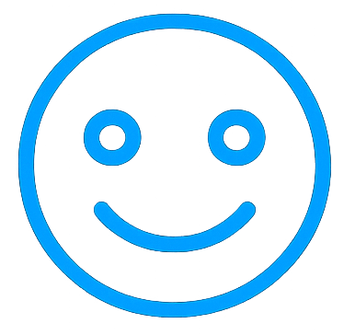
How will you make SMILES?
In your group, lead a quick activity for another group.
How will you run it so that it makes SMILES for everyone?
Afterwards, ask the players for constructive feedback, based on each letter of SMILES.
Safe
Maximum participation
Included
Learning
Enjoyment
Success
Notes:
ALTERNATIVES
Ask each group to design its own target game from the outset (incorporating their SMILES letters).
If a practical version is not possible, ask the young leaders to think about a target game (e.g., bowls, skittles, boccia, ten-pin bowling, throw golf, quoits, petanque, etc.) then share written or verbal ideas.
Vary how many and which letters of SMILES the groups focus on.
Each group demonstrates its target game and the other young leaders review it using SMILES to guide their feedback.
Work through one game as a whole group.
Provide an audio prompt for SMILES instead of the handout.

Slide 10
STEP in to change an activity
You can change…
Space | Where it is happening.
Task | How it is happening.
Equipment | What is being used.
People | Who is doing what.
Notes:
TEACHER NOTES
Share the STEP acronym.
Thinking about each letter of STEP will help the young leaders to adapt their activities to suit the child/children.
Share the STEP download (page 1) to give examples.

Slide 11
Examples of STEP in a target game
Space | Move targets closer or farther away.
Task | Score 2 points for hitting a target, not just 1.
Equipment | Use bean bags instead of balls.
People | Play in pairs (joint score) instead of singles.
Notes:
TEACHER NOTES
Share the example of STEP within a target game.
Optional: ask the young leaders for additional suggestions.
Explain that changes can be for one child, multiple children or the whole group.

Slide 12
Space
Task
Equipment
People
How will you STEP in?
In your group:
Use the activity you played earlier.
What changes can you make?
Identify at least two ideas for each letter of STEP.
You can make changes for everyone or for individuals.
Notes:
ALTERNATIVES
Use STEP as your own prompt to adapt the activity as needed. For example:
Space – sit on chairs across a table, stand or sit in a circle (on chairs or the floor), pass up and down a line in a corridor.
Task – use different body parts (hand, elbow, knee, foot, head), have more than one tap before passing, make it a timed challenge.
Equipment – balloon/balloon ball, small paper balls, beach ball, volleyball, scarf, bat instead of hand.
People – pairs instead of groups, solo, large group.

Slide 13
Well done! You have completed module 3.
Get ready for module 4 on:
Teacher to add details
Notes:
Reorder slides 11 and 12 if you use the optional task.

