Slide 2
Girls Leadership & Marketing Roles
Workshop 3

Slide 3
WORKSHOP OUTCOMES
By the end of this session you should be able to:
Identify the different roles you might undertake as a Girls Active Leader
Explain how girls can motivate their peers by taking on advocacy, marketing, and delivery roles
Understand the importance of developing an engaging brand
Develop an impactful slogan that engages and influences an audience

Slide 4
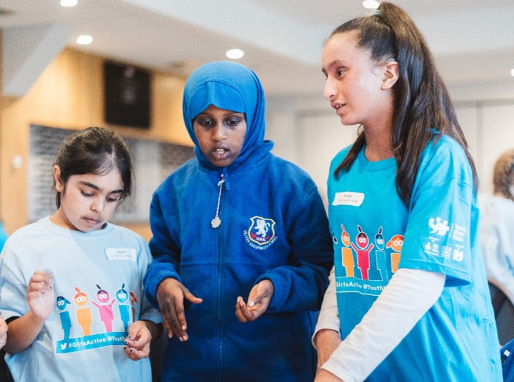
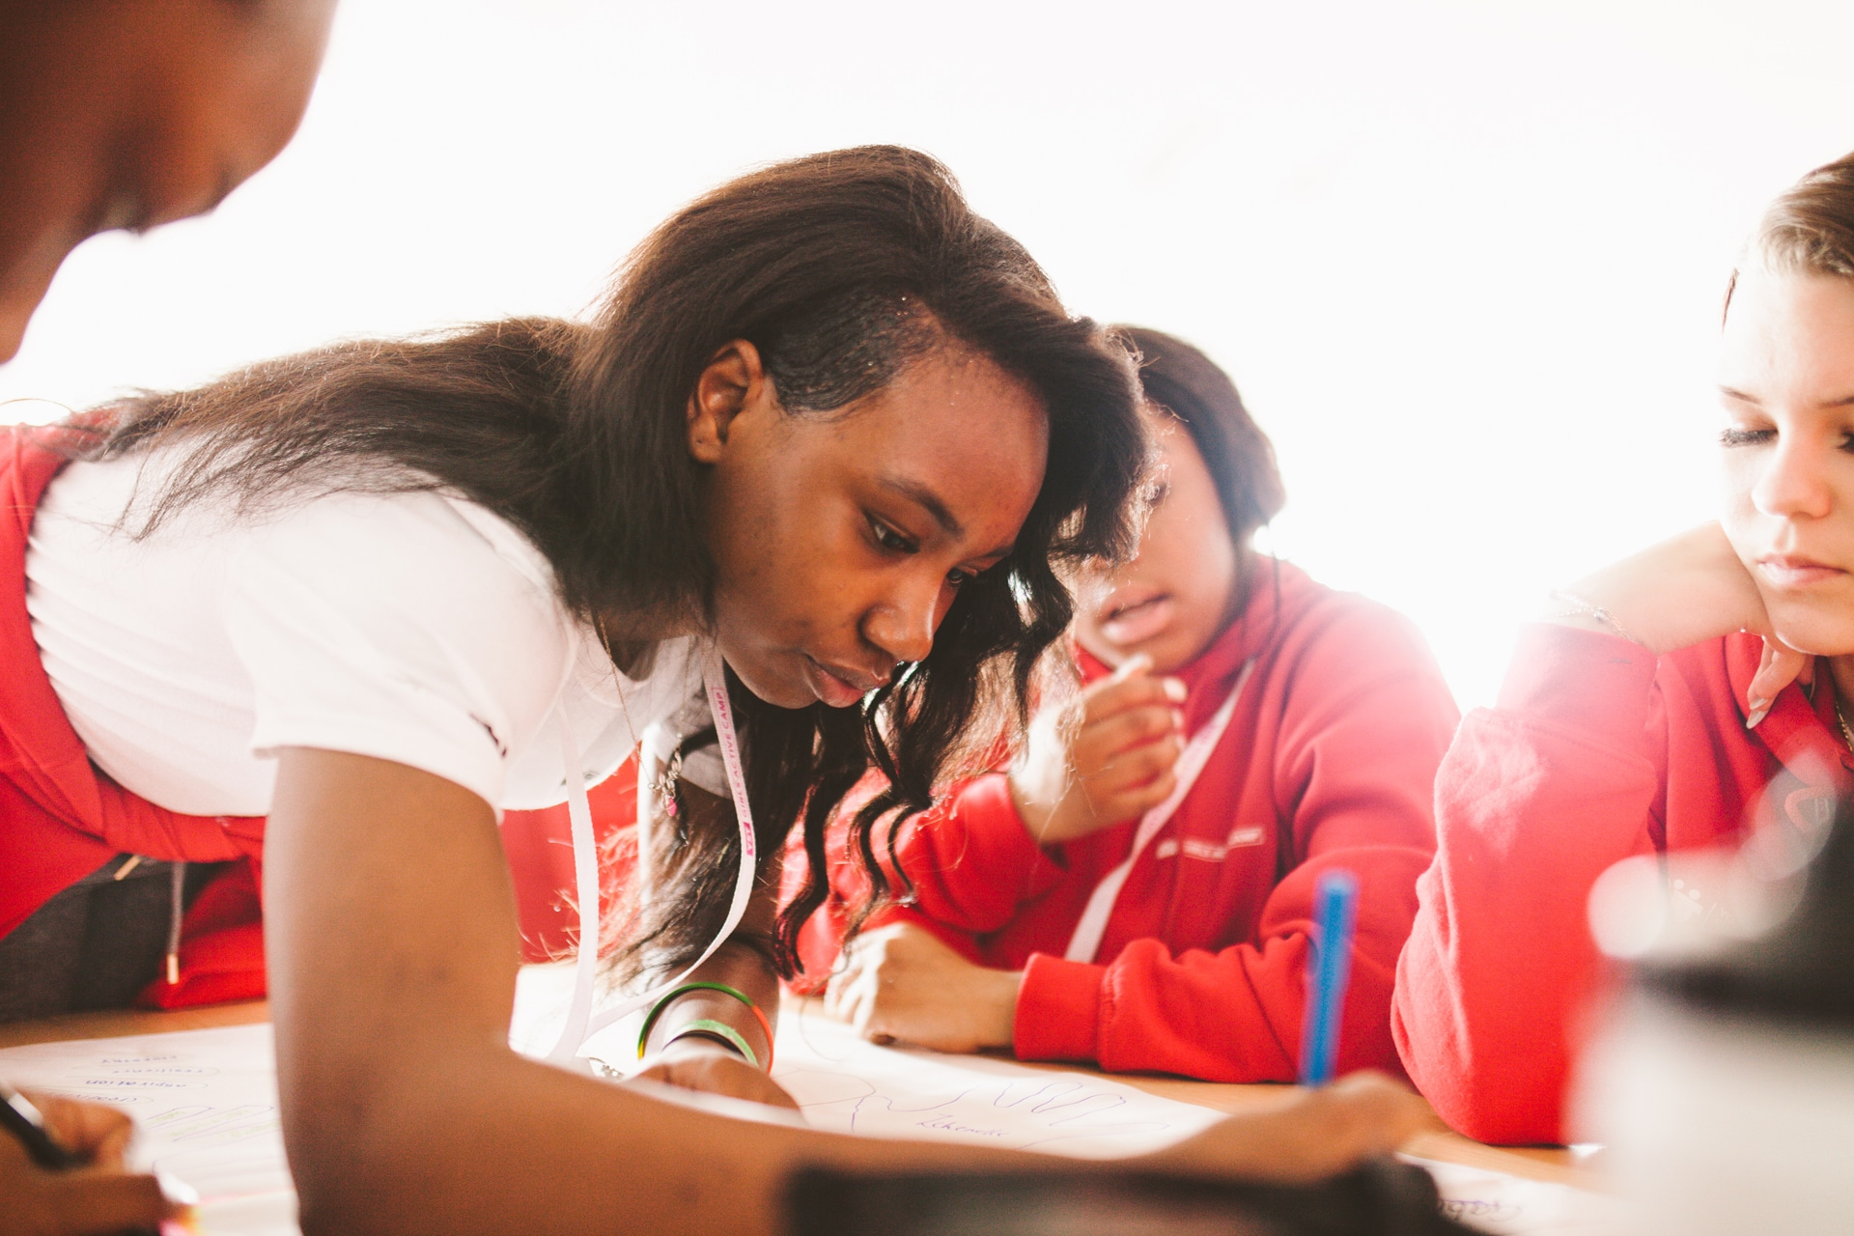
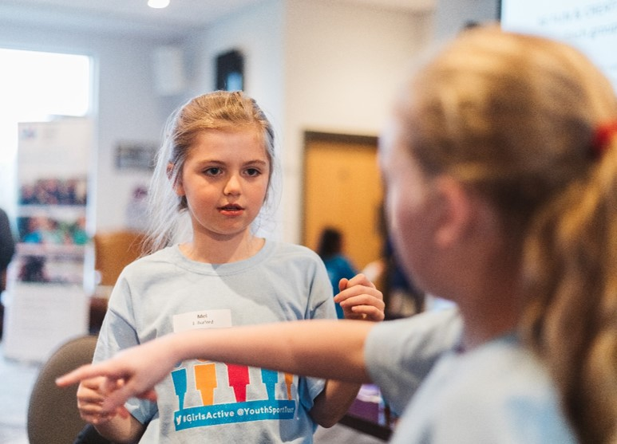
Girls Active Leader Roles
Image
Image
Image
Advocacy
Marketing
Delivery

Slide 5
Power of 3
Do you know the slogans for these well-known brands?

Slide 6
What is YOUR slogan?
Each girl in the group to draw around one of their hands.
In each hand write down one word that could feature in your slogan. Think about what is important to you as a Girls Active Leader and how you would like girls to feel when taking part in sport & physical activity.
Can you use these words to create an inspiring, impactful slogan?

Slide 7
Power of 3 in practice…

Slide 8
What 3 things can you commit to in order to promote your slogan & get your message heard around school?
1.
2.
3.

