Slide 1
Community Interest Companies
Claire Tennyson

Slide 2
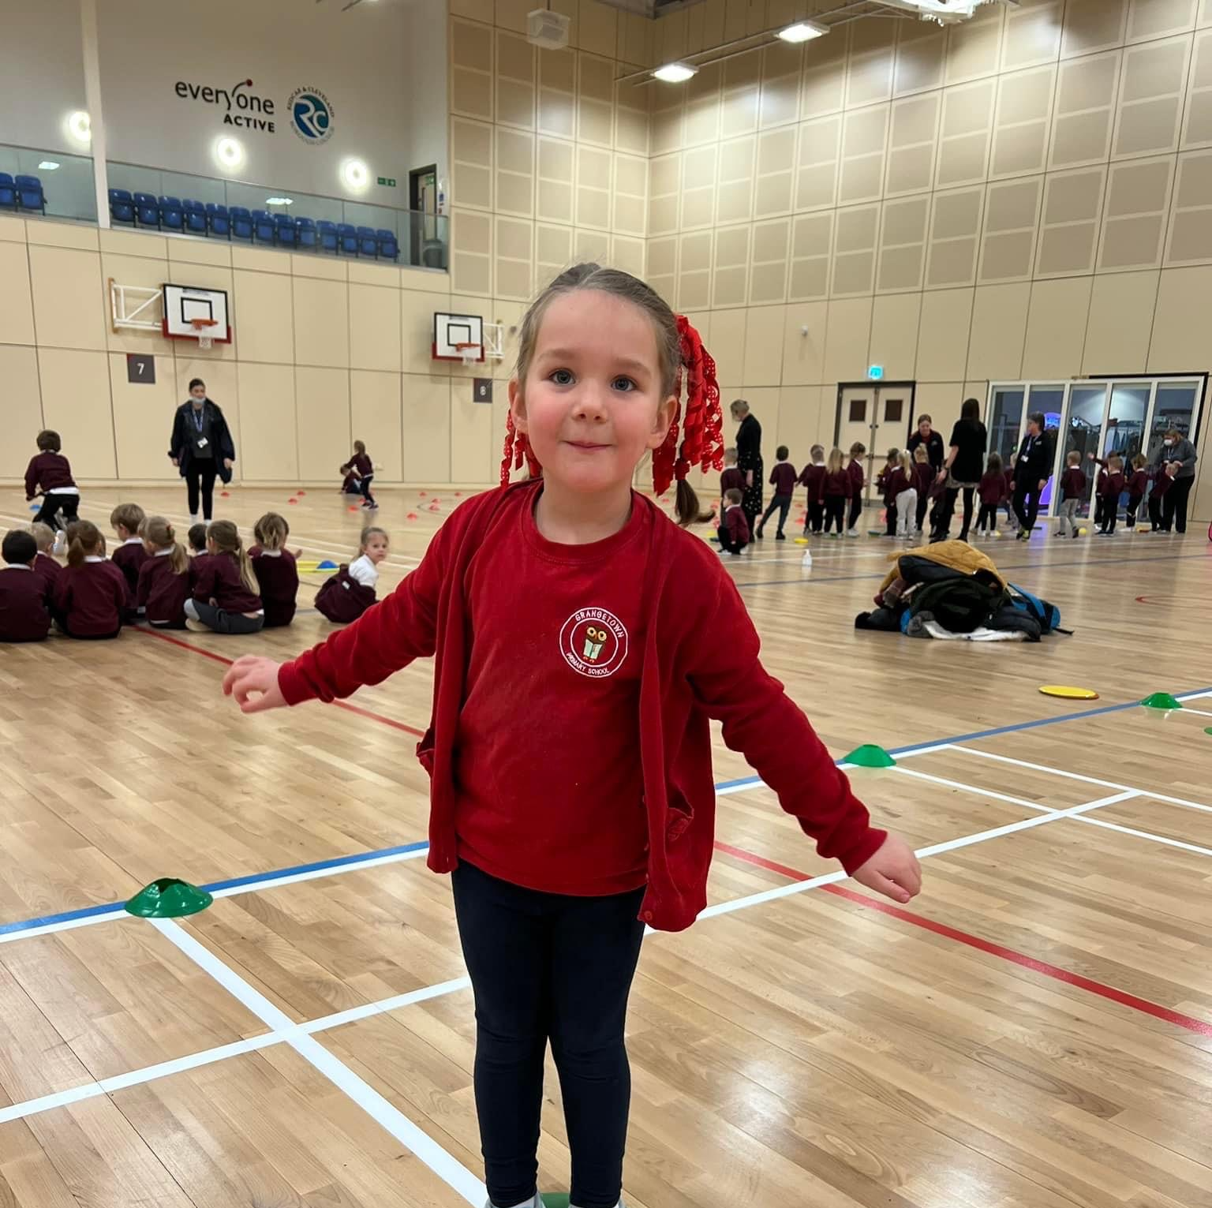
Why did we go down this route?
Ownership
Independence
Funding opportunities

Slide 3
What is a CIC?
Community Interest Company is a special form of non-charitable limited company, which exists primarily to benefit a community or with a view to pursuing a social purpose, rather than to make a profit for shareholders.
A limited company that is not for profit. (Limited by shares or guarantee)
Asset lock – CIC’s money will be used for the benefits of its social objectives rather than for individual shareholders
This provides assurances to funders/investors
Subject to ongoing regulation by CIC regulator to create confidence and integrity of a CIC.

Slide 4
Pros
Funding – some donors/grants will only give to charities or CIC, because of the protections these vehicles provide.
Limited liability – a limited company, is limited liability. This provides an important element of security for those who manage the business.
Protection of assets – related to social enterprise rather than a school or individual.
Familiarity – Similar to running a business for leaders. Funders understand a CIC is not for profit.
Governance – much easier than a charity. A charity board should not have paid officers having significant control.
Quick to set up.
Dissolution – If company is dissolved then assets go to the community.

Slide 5
Cons
No tax breaks (unlike a Charity)
Assets are locked – If dissolved they must go to the community
CIC34 must be completed each year
SGO Funding – schools only
Business management
HR
Payroll
Accounts
Policies & procedures

Slide 6
Overview of the process
Set up a Government Gateway account to start the process – choose a business name.
Appoint minimum of 2 Directors.
Application form to Companies House (CIC36), signed by all prospective directors alongside a £35 fee, describing the social purpose of the company.
Articles of association – Set of rules (clear case that it has a community interest)
Memorandum of Association – A legal statement signed by directors (online system creates it for you).
Accounts filed each year, companies house and HMRC.
Annual confirmation statement each year (CIC34) at a cost of £13
If you want to pay staff set up a PAYE.
Payroll, HR, pensions etc.

Slide 7
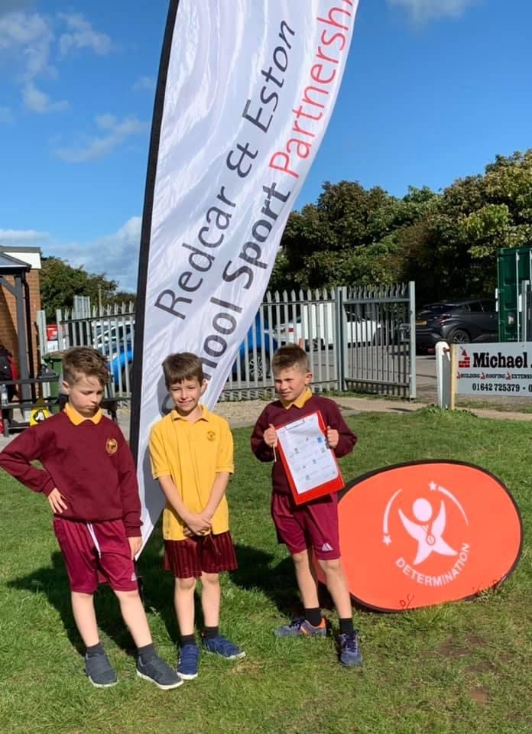
Other terminology
Person of significant control (PSC) – Not always directors but small CICs it usually is.
Guarantors – promise an agreed amount of money to the company if it cannot pay its debts – CIC’s is normally the directors and it’s normally £1
SIC Codes – standard industrial classification codes provide Companies House with a description of the company’s nature of business. There are codes for health, sport, education (you can select multiple)

Slide 8
Discussion & Questions

