Slide 1
Week 3: To be able to describe different ways to purchase and pay for items that don’t involve cash
Recognise that cash is only one way to pay for goods and services
Know that a debit card is used to spend money from a current account
Know that a credit card is used to borrow money that has to be paid back
Describe how purchases can be made face to face and remotely using technology, understanding PIN and contactless ways to pay

Slide 2
Ways to Pay
Debit Card | Credit Card | Money | Gift card
Notes:
Record observations from pupils on the similarities and differences between the different ways to pay

Slide 3
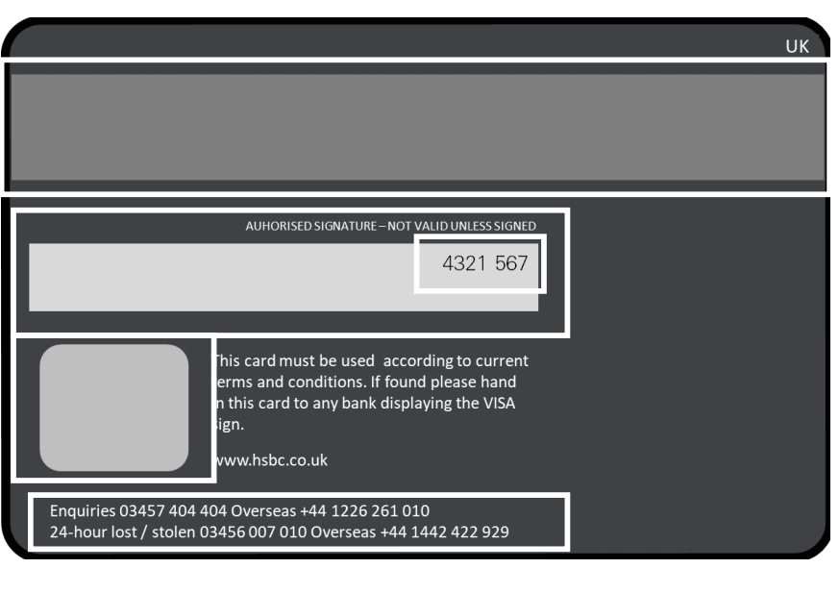
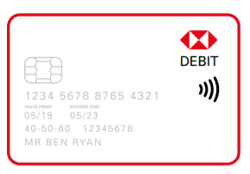
The features of a debit card
Back
Front
Notes:
Chip – stores your account information and is what is used in chip & pin payments
Bank account number – eight numbers that link the card to your bank account
Sort code – is what identifies which bank or building society you belong to and often which branch your account was opened with
Valid from – the date the card was issued to you
Expiry date – when you can use your card until
Long number across the centre
This is the permanent account number (PAN) and is needed for making a purchase over the phone or online
The first six numbers of this make up the bank identification number (BIN)
The remaining numbers are the individual account identification number
Contactless – This symbol means that you can use the card for payments up to £45 – you just hold your card over the card reader (or tap)
Back of card - Signature strip – this is for your signature and may be needed when you need to sign to make a payment so the shop can check that you are the owner of the card/bank account
Magnetic strip – contains details of you and details of your account which can be read by the card reader.
Hologram – has 3D image on it and helps show that your card is real and not fake
Security code or CVV – is another way of showing your card is legitimate. You usually have to give this if you are paying for something online or by phone
Information of who to call if your card is lost or stolen – put this number into your phone or make a note of it somewhere as you will need to call it if you lose your card to block anyone else from using your account and to order a new one. You can also block your account using mobile banking if you have misplaced your card.

Slide 4
Team Talk
Throughout a month there are many different goods or services that we need to pay for.
What could these be?
Are all purchases made face to face?
What things may you pay for there and then?
What can you pay for in advance?
Where can you pay for these?

