Slide 1




Slide 2

Getting started as a Youth Sport Trust
Young Leader
Step 2 – Plan

Slide 3

Overview for teacher
Aim: Enable primary-age pupils to run fun and informal physical activities for other children in school.
Audience: Pupils aged 8-11 years who are new to leading physical activities.
Organisation:
This introductory resource includes four bitesize modules, which use pupil-facing slides and interactive tasks to help young leaders to get started. The four steps are:
Purpose
Plan
Do
Review
Time:
Each module includes approx. 30 mins of core tasks plus 15-30 mins of optional tasks.
Preparation:
Read the individual slide notes to support your delivery of the module to your pupils.
Play the slides in slideshow mode to see how the animations work.
Refer to slide 4 for a summary of the module, including required equipment and resources.
Download the associated handouts to support pupils’ learning (optional).
Inclusion: The slide notes suggest alternatives to help you to include pupils with different needs and abilities.
Notes:
Teacher slide – will be hidden during presentation.

Slide 4
Module 2 summary: plan
Aim: Help young leaders to recognise what they need to know and decide when planning activities.
Plan-do-review | Use the slide to remind the young leaders about plan-do-review; this session will focus on plan. Highlight the elements they need to plan for (shared in module 1).
Who will take part? | Use a giant silhouette to help young leaders to think about the children they will be running activities for. Optional: use a storytelling activity to encourage young leaders to consider different needs. | Large sheets of paper Sticky tape Flipchart pens Paper, pens
When and where will activities be? | Use the slides to highlight the logistics that will affect the young leaders’ activities. Use an active quiz to identify potential hazards. | Safety checklist (downloads)
What will the activities be? | Ask young leaders to play a mime game to suggest a wide variety of activities. Share the session planner to support their planning. | Session planner (downloads)
Notes:
Teacher slide – will be hidden during presentation.

Slide 5
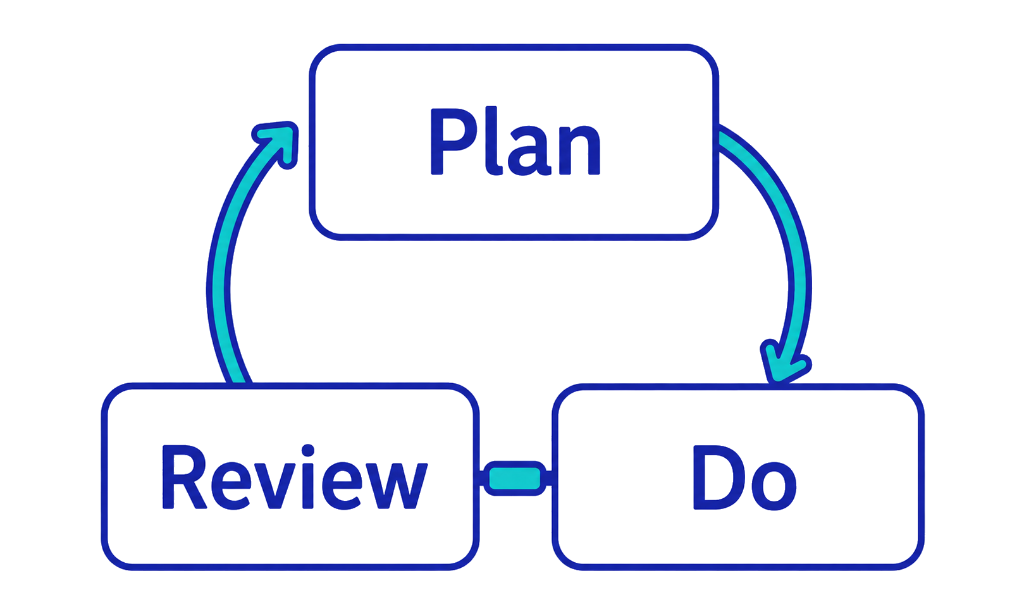
As a young leader, you need to…
Notes:
TEACHER NOTES
Remind the young leaders that there are three stages to running fun physical activities: plan-do-review.
This is an ongoing cycle – not a one-off action.
This session will focus on plan.

Slide 6
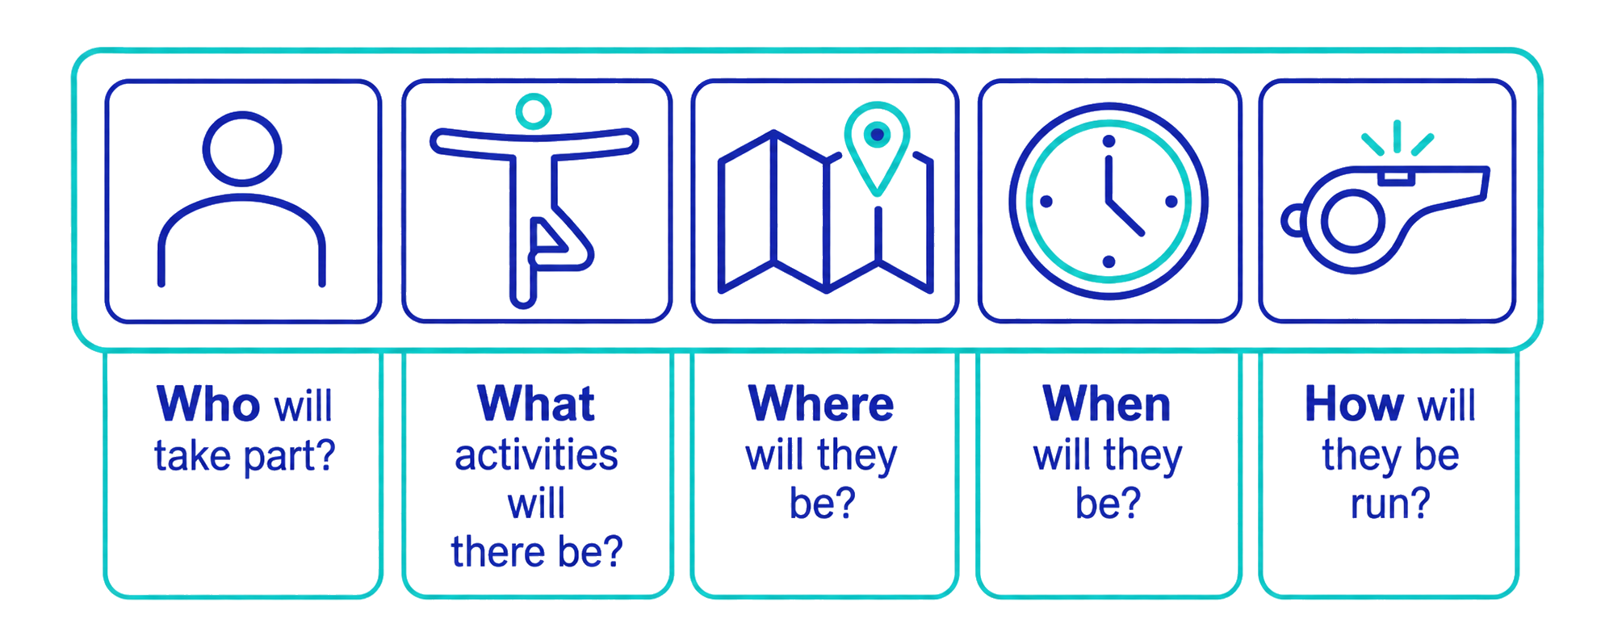
When you plan, you will need to find out and decide…
Notes:
TEACHER NOTES
Highlight the key elements the young leaders will need to know when planning their activity sessions.
Sometimes they will need to find this out (because they can’t change it).
Sometimes they will need to decide (because they can make a choice or change).
Remind them that these were shared in session 1, when they added their ideas to the graffiti wall.
NB. The final element (How will they be run?) will be covered in step 3 (the ‘Do’ part of the process).
ALTERNATIVES
Ask the young leaders if they remember these key elements before revealing the slide, e.g., “What will you need to find out or decide before running your activity sessions?

Slide 7
Who will take part?
Notes:
TEACHER NOTES
This section focuses on the children for whom the young leaders will be running activities.

Slide 8
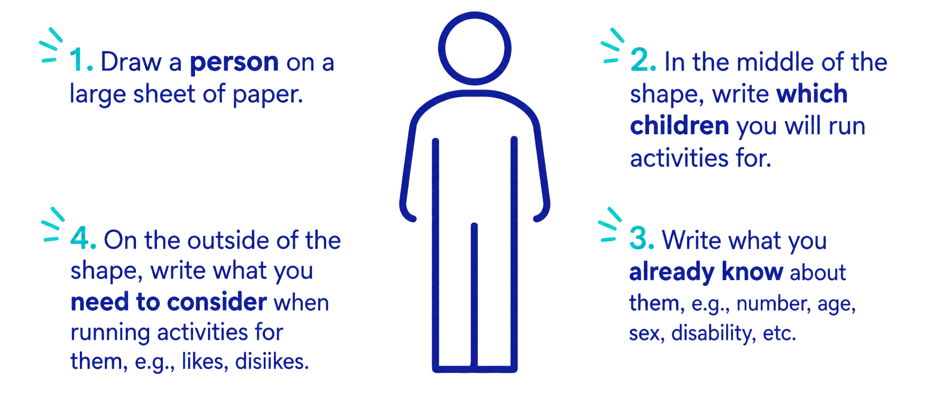
Which children will you run activities for?
Notes:
TEACHER NOTES
PREP – Create a large sheet of paper by sticking sheets together or using wallpaper lining paper.
Use the slide animations step-by-step to guide the young leaders through the task.
If the paper is large enough, draw around one of the young leaders to create the silhouette.
Provide any school-led information at step 2 if known, e.g., you may have already selected a target group of participants.
ALTERNATIVES
Young leaders work individually or in pairs and write their suggestions on separate sticky notes before sticking them to the figure. (Use different colours for the different steps.)
Small groups create their own figure (for a target group of participants). Gallery the groups’ silhouettes so they see others’ ideas.
Provide a pre-prepared anonymised example of a child/ group of children in your school.
Young leaders draw their suggestions instead of writing.
Young leaders create an audio-description instead of writing suggestions.

Slide 9
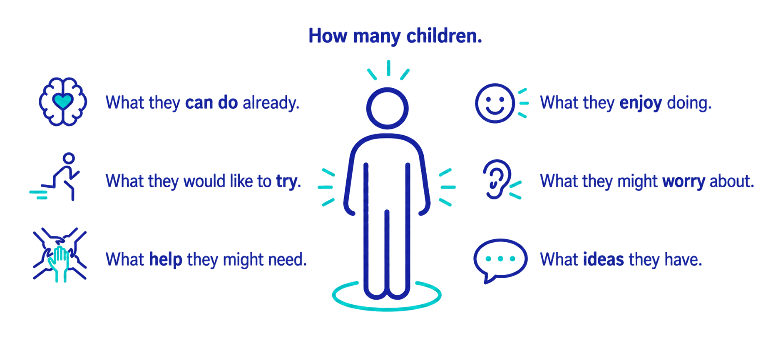
Did you think about…?
Did you think about?
Notes:
TEACHER NOTES
Use the slide to summarise, reinforce and/or add to the young leaders’ suggestions.
Emphasise that they should always start by thinking WHO their activities are for.
If we don’t know, it’s really important that we go and ask! We want to create activities for young people which will appeal to them, the best way to do this is to ask them what they might like to see or so. How can we do this between now and the next session?

Slide 10

Make it fair…
We don’t treat everyone the same because…
…children have different needs and interests.
Try to meet each child’s needs.
Try to balance different children’s needs.
Notes:
TEACHER NOTES
Summarise by accentuating ‘fairness’ (one of the leadership skills – see module 1 and personal goals download). This does not mean treating everyone the same but trying to meet children’s different needs and interests.

Slide 11
What is your story?
Notes:
OPTIONAL TASK
TEACHER NOTES
This session promotes empathy, which supports fairness, by encouraging the young leaders to share their own physical activity stories.
It also develops the young leaders’ communication skills (listening and speaking).

Slide 12

What is your story?
Write, draw or record your physical activity story.
  For example:
  Why do you take part in physical activity?
  What do you like or dislike about physical activity?
  Where and when do you take part?
  Who encourages you to take part?
  What do you do now and what would you like to do in future?
Share your story with a partner.
  How is their story different from or similar to your story?
Notes:
OPTIONAL TASK
TEACHER NOTES
Ask the young leaders to think about their own experience of physical activity – their ‘story’.
Use the slide to offer prompts.
Allow individuals to log their story in ways that suit them best, e.g., write, draw, record in video, record in audio.
Ask the young leaders to share their stories in pairs. They will need to choose a partner with whom they feel comfortable but encourage them to work with someone who might have a different story.
Give storytellers a time limit, e.g., 2 minutes. Encourage active listening (without interrupting) from the listener. Swap roles.
Summarise by recognising that every individual has a different experience of physical activity so has different needs and interests. The young leaders need to remember this when they plan activities for other children.

Slide 13
Communication skills
How well did you connect with someone else?
Speak
Listen
How well did you…?
Focus on the main points.
Speak clearly.
Express your feelings.
Use the right pace, volume and tone.
Use facial and body language.
How well did you…?
Pay attention.
Not interrupt.
Note the main points.
Recognise their feelings.
Show you understood.
Notes:
OPTIONAL TASK
TEACHER NOTES
Use the slide to encourage the young leaders to reflect on their communication skills during the activity, both as speakers (transmitting) and listeners (receiving).
Ask for and/or share positive examples that highlight what young leaders were saying/doing to show good communication skills.
If the young leaders are working towards the YST Young Leader Levels 1 and 2, remind them that communication skills are one of the 4 core skills they need to show to achieve the award. Encourage them to use their Young Leader Log to note examples of when they communicate effectively, in their team or with the children who are participants.

Slide 14
When and where will activities be?
Notes:
TEACHER NOTES
This session focuses on the logistical elements of when and where.

Slide 15
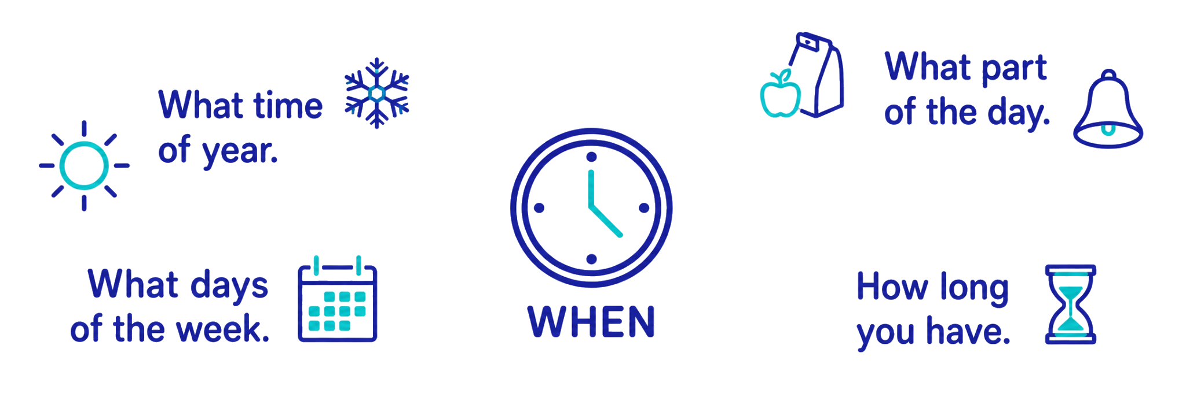
Find out or decide…
Notes:
TEACHER NOTES
Use the slide to highlight what is covered by WHEN.
Provide or ask for school-based examples of existing provision to illustrate each point.
Share any pre-determined information, i.e., you may have already decided when to deploy the young leaders to complement other activities.

Slide 16
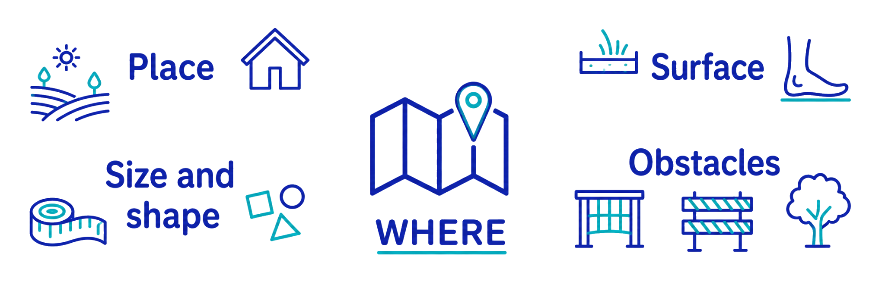
Find out or decide…
How will you make the space safe?
Notes:
TEACHER NOTES
Use the slide to highlight what is covered by WHERE.
Provide or ask for school-based examples of existing provision to illustrate each point.
Share any pre-determined information, i.e., you may have already decided where to deploy the young leaders to complement other activities.
Introduce the fact that the young leaders will need to make sure that the space they use is safe.

Slide 17
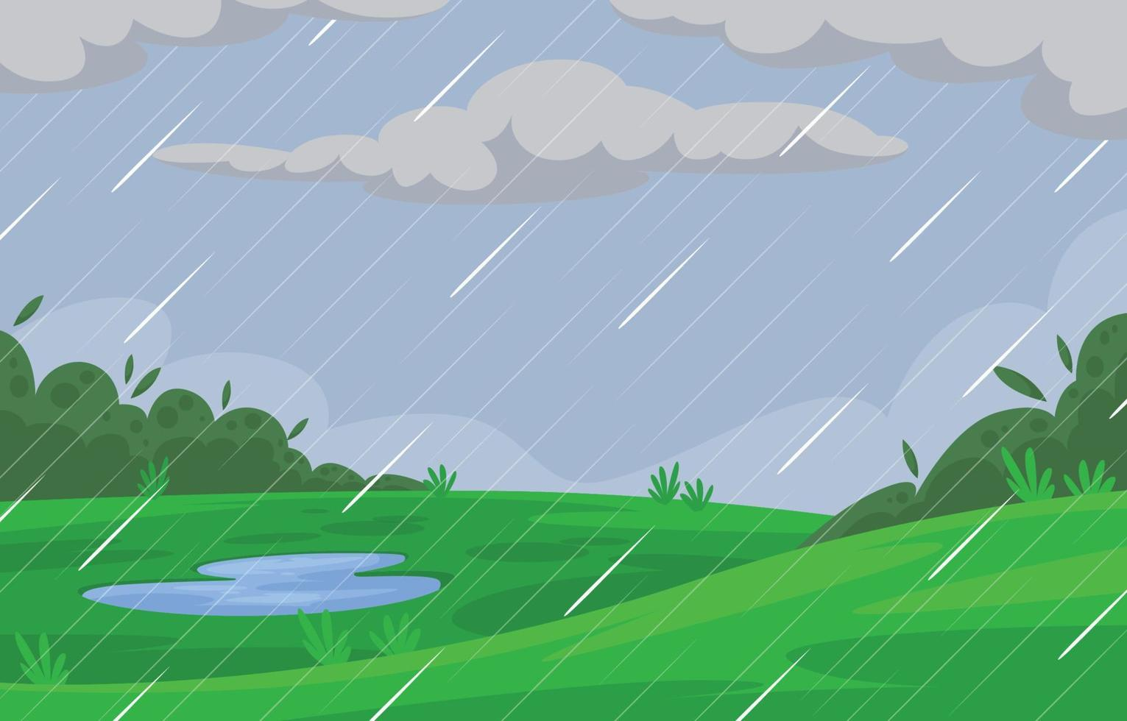
Spot the hazard – 1
Why might this be a problem?
A. Children might get muddy.
Wet surface
B. Children might slip.
Be responsible: how could you make it safer?
Notes:
TEACHER NOTES
Use these three slides to help the young leaders to think about safe spaces.
Reinforce that responsibility is one of the leadership skills.
For each of the following hazards:
Ask the young leaders to stand up.
As you reveal each hazard, ask them to decide what the main problem is.
Ask them to vote:
Stretch up
Crouch down
Click again to reveal the answer. (The correct answer will bounce.)
Encourage the young leaders to suggest ways to make it safer. (NB. They might not be able to change the space itself but they can change how they run the activity.)
POTENTIAL CHANGES FOR THIS HAZARD
Move indoors
Use activities where children don’t need to run and dodge
Reduce speed, e.g., walk instead of run
ALTERNATIVES
Change which action the young leaders use to share their views, e.g., move to sides of room, raise right/left hand, show thumbs up/down.
Give young leaders A and B signs or objects to hold up, e.g. red side of table tennis bat = A, black side of bat = B.
Agree answers in pairs before voting.
Provide one safer suggestion as an example.

Slide 18
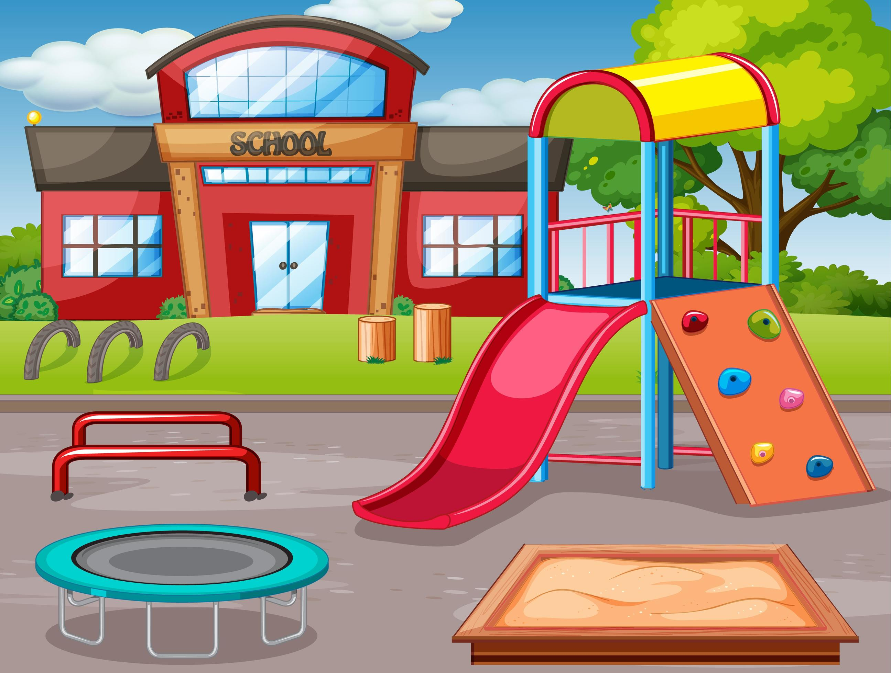
Spot the hazard – 2
Why might this be a problem?
A. Children might bump into it.
B. Children might play on it.
Fixed equipment
Be responsible: How could you make it safer?
Notes:
TEACHER NOTES
Use these three slides to help the young leaders to think about safe spaces.
Reinforce that responsibility is one of the leadership skills.
For each of the following hazards:
Ask the young leaders to stand up.
As you reveal each hazard, ask them to decide what the main problem is.
Ask them to vote:
Stretch up
Crouch down
Click again to reveal the answer. (The correct answer will bounce.)
Encourage the young leaders to suggest ways to make it safer. (NB. They might not be able to change the space itself but they can change how they run the activity.)
POTENTIAL CHANGES FOR THIS HAZARD
Make some areas out of bounds.
Make a clear ‘run off’ space between the playing area and obstacles/walls.
Make children aware before and during activities (e.g., ‘heads up’ warm up)
ALTERNATIVES
Change which action the young leaders use to share their views, e.g., move to sides of room, raise right/left hand, show thumbs up/down.
Give young leaders A and B signs or objects to hold up, e.g. red side of table tennis bat = A, black side of bat = B.
Agree answers in pairs before voting.
Provide one safer suggestion as an example.

Slide 19
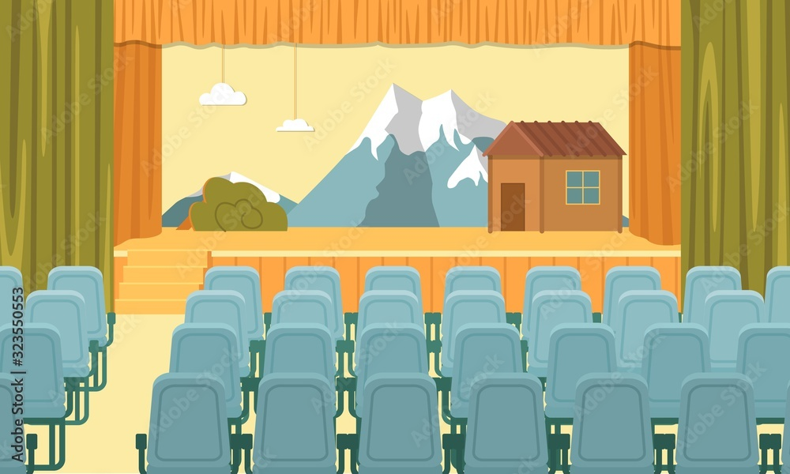
Spot the hazard – 3
Why might this be a problem?
A. Needs more time to set up.
B. Something might get broken.
Also used for other activities
Be responsible: How could you make it safer?
Notes:
TEACHER NOTES
Use these three slides to help the young leaders to think about safe spaces.
Reinforce that responsibility is one of the leadership skills.
For each of the following hazards:
Ask the young leaders to stand up.
As you reveal each hazard, ask them to decide what the main problem is.
Ask them to vote:
Stretch up
Crouch down
Click again to reveal the answer. (The correct answer will bounce.)
Encourage the young leaders to suggest ways to make it safer. (NB. They might not be able to change the space itself but they can change how they run the activity.)
POTENTIAL CHANGES FOR THIS HAZARD
Allow extra time to set up and move some items.
Adapt activities, e.g., roll balls instead of throwing.
Children run or throw in one direction, e.g. away from fixed hazards, rather than in all directions.
ALTERNATIVES
Change which action the young leaders use to share their views, e.g., move to sides of room, raise right/left hand, show thumbs up/down.
Give young leaders A and B signs or objects to hold up, e.g. red side of table tennis bat = A, black side of bat = B.
Agree answers in pairs before voting.
Provide one safer suggestion as an example.

Slide 20
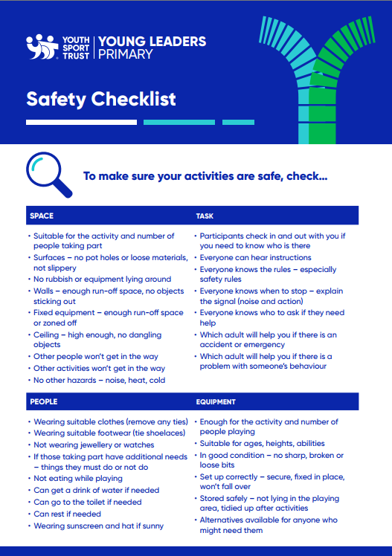

Use the safety checklist
Check for hazards.
Decide what changes to make.
Notes:
TEACHER NOTES
Share the safety checklist (see downloads).
Encourage the young leaders to use this when they plan and run their activities.
Work through a practical school-based example with them beyond the modules.
NB. Necessarily, this is a GENERIC checklist. You will need to alert the young leaders to any school-based hazards or guidance.
OPTIONAL TASK
If you have access to a practical space during this module, set up some hazards within the space. For example:
Rubbish (or water) on the floor.
Spare equipment lying in the playing area.
Apparatus (or playing zones) too close to each other.
An object dangling from/ sticking out from the wall.
‘Plant’ some young leaders with jewellery or inappropriate clothing or footwear.
Using the safety checklist, ask the young leaders – working in groups – to spot the real hazards.
Give them a time limit: how many can each group spot in the given time?
Ask each group to suggest a change for a specific hazard: What would they do to make it safe(r)?

Slide 21
What will the activities be?
Notes:
TEACHER NOTES
This section focuses on the variety of activities that the young leaders might run for other children.
Remind them that the WHO, WHEN, WHERE will help them to decide which activities might be right for each group/session.

Slide 22






Moving mimes
Stand or sit in a circle.
First person mimes a sport or physical activity.
Second person copies the previous person then adds their own mime.
Keep going around the circle.
How many different sports or physical activities can you mime?
Notes:
TEACHER NOTES
Use the slide to explain the task.
Encourage the young leaders to include as many different activities as possible, i.e., avoid duplication if possible.
ALTERNATIVES
Young leaders don’t need to copy the previous mimes; they just perform their own.
Work in pairs or smaller groups.
Young leaders stand in a line and pass a mime along the line. The last person runs to the front and sets off another mime.
Young leaders play charades: they take turns to perform their mime for the rest of their group to guess.
Pass a bean bag/ tap a balloon/ roll a ball between young leaders. Each time they receive it, they suggest a different activity.
Use a flipchart relay race to generate ideas instead of using mimes.
Young leaders create a gallery of drawings to show different activities.
Each group is given a category (see slide 22) to stimulate their suggestions.

Slide 23
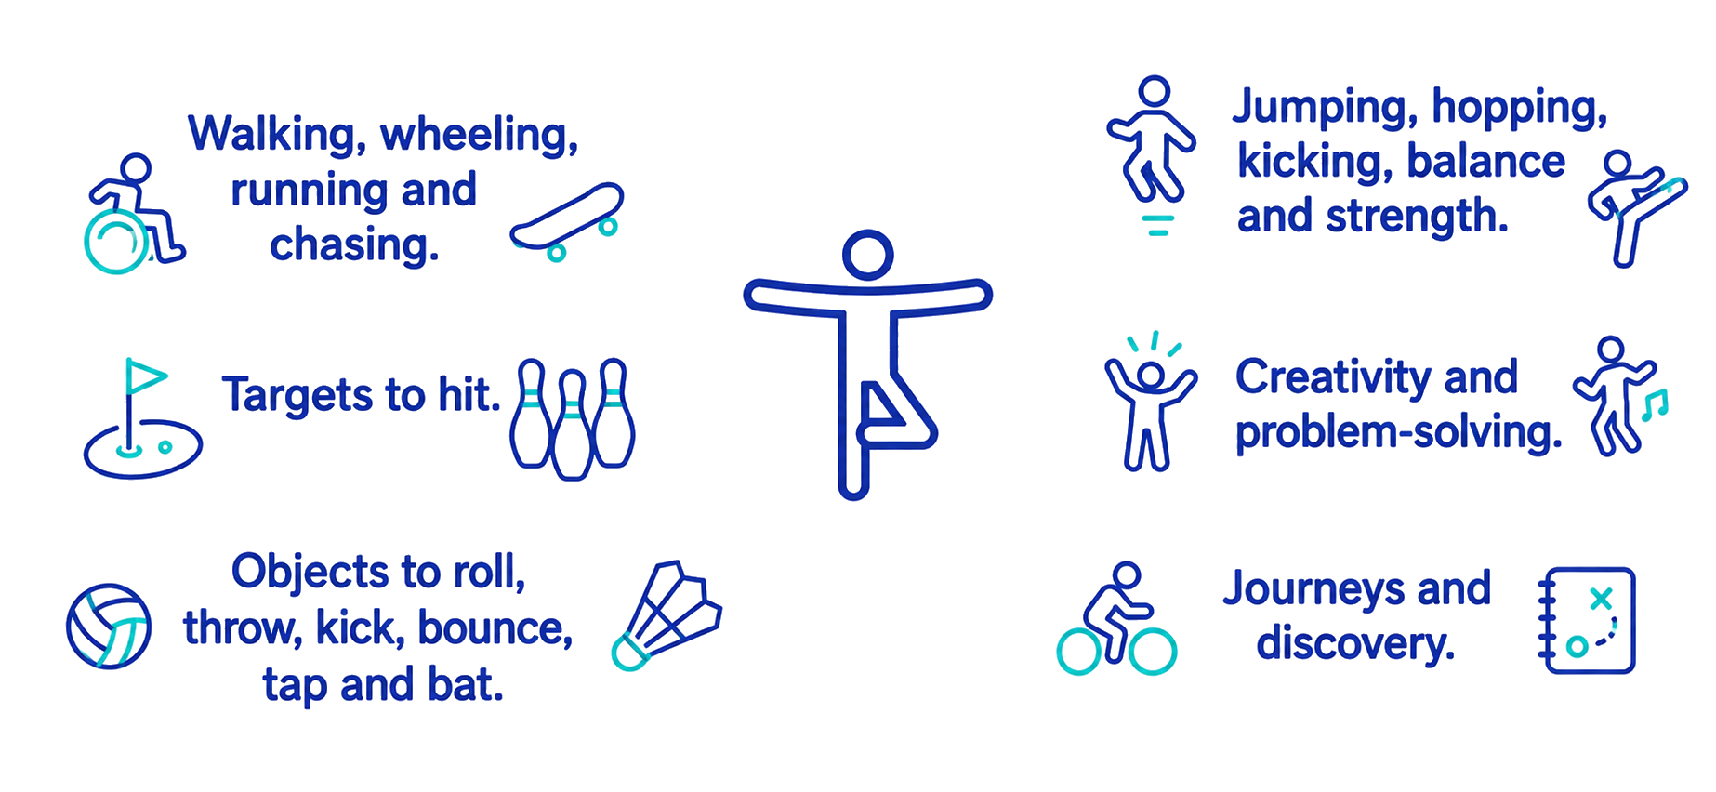
Think about activities that involve…
Think about activities that involve…
Notes:
TEACHER NOTES
Use the slide to summarise the variety of activities that the young leaders could run.
Emphasise that they can be creative and do not have to stick to traditional ‘sports’ or the activities they do in PE.
Provide or ask for specific examples for each of the categories shown on the slide, e.g.
Walking, wheeling etc. – playground tag games, team relay races, rollerskating.
Targets – boccia, bowls, skittles, throw golf.
Objects – keepy-uppy, dribbling around a slalom, two-baller against a wall.
Jumping, hopping etc. – skipping, hopscotch, fitness exercises.
Creativity – dance, circus skills, outdoor activity problem-solving tasks.
Journeys – cycling, orienteering, trails.
Provide the young leaders with a copy of the activity ideas handout (see downloads) to reinforce or extend their ideas.
If appropriate, share the activity cards (see downloads) as potential starter activities or to spark the young leaders’ own ideas.

Slide 24
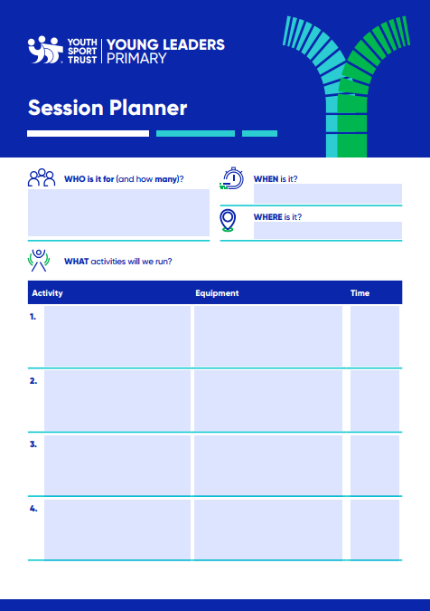
What will you plan for your first session?
Discuss your ideas as a group.
Use the session planner to help you to plan and prepare the details.
Notes:
TEACHER NOTES
EITHER during the session OR afterwards, ask the young leaders to use the session planner handout (see downloads) to plan their first session.
Work through the first one together before encouraging the young leaders to become more independent.
Emphasise that this is a prompt to help them to get started. When they have more experience as young leaders, they may be able to plan ‘in their head’ instead of writing a plan.

Slide 25
Well done! You have completed step 2.
Get ready for step 3…
Notes:
TEACHER NOTES
Let the young leaders know when step 3 is to be delivered.

