Slide 1
Rugby Counts Assembly

Slide 2
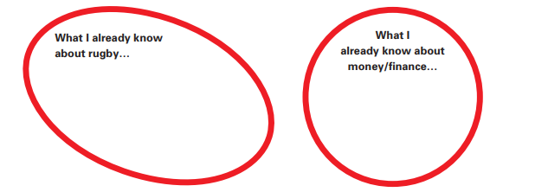
Rugby and Finance

Slide 3
Notes:
Video link https://vimeo.com/540723314/255de369e1

Slide 4
Meet the Teams
Women’s
Men’s

Slide 5
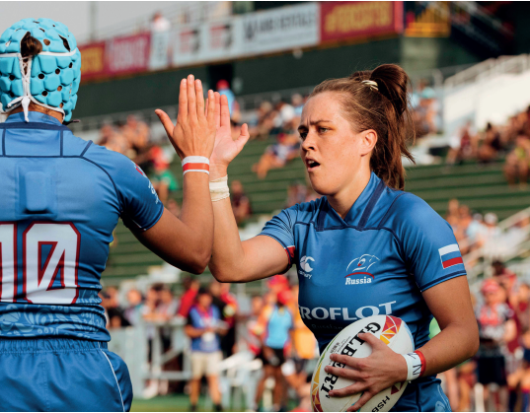
Rugby Values- TREDS
- What are the rugby values? - What does each mean? - How are they similar to our school values? - How may these values be useful with
money/finance?

Slide 6
Team Talk - What are you most excited about? - What would you like to learn?

