Slide 1
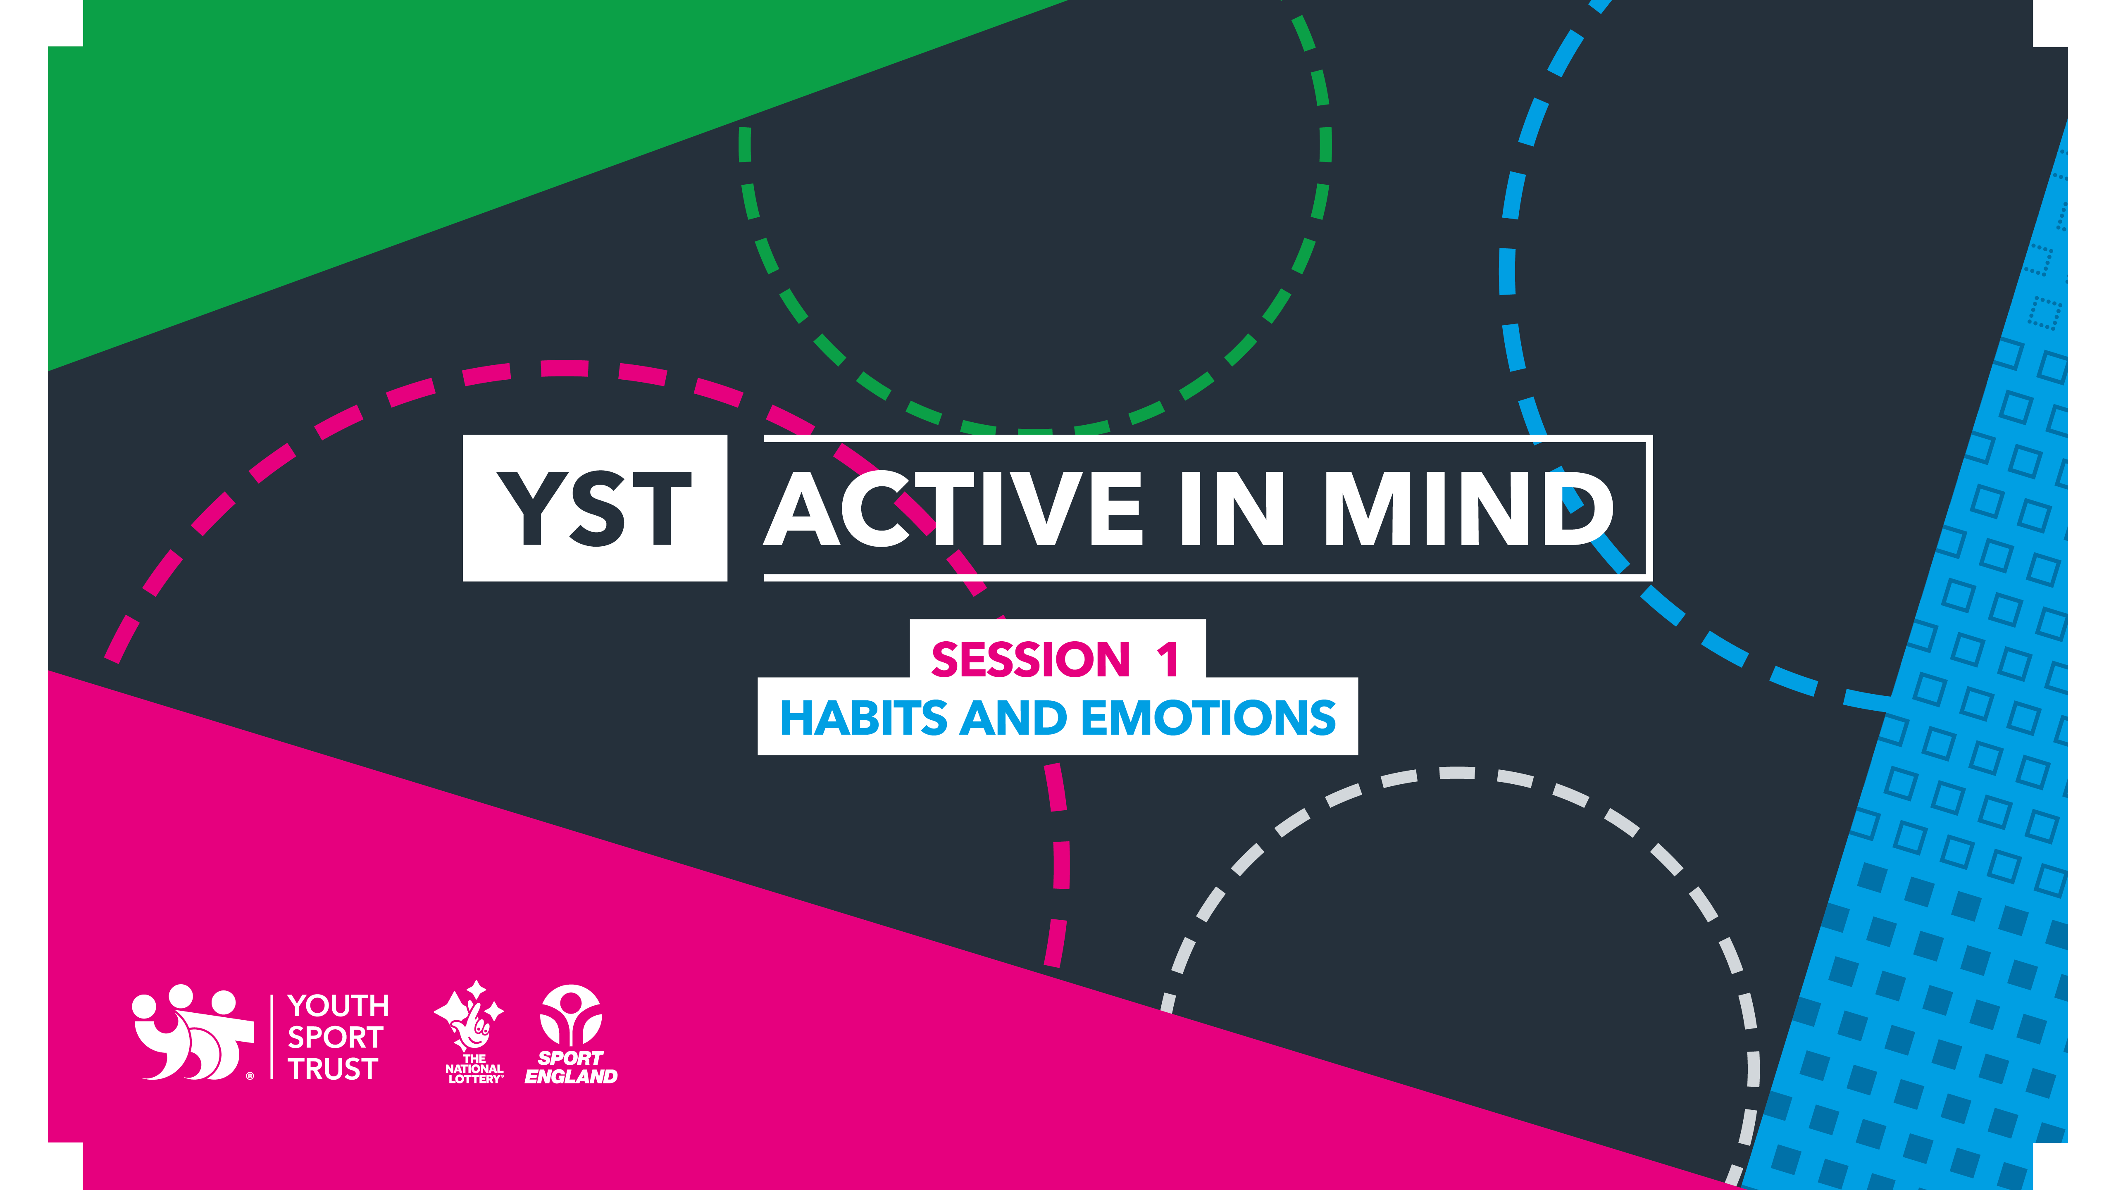
TEACHER CPD
Notes:
Further Reading:
The Teenage Brain: The Stress Response and the Adolescent Brain. (2013). Current Directions in Psychological Science, 22(2), 140–145.
Ratey, J. J., & Hagerman, E. (2008). Spark: The revolutionary new science of exercise and the brain.
van der Kolk, B. A. (2014). The body keeps the score: Brain, mind, and body in the healing of trauma. Viking.
Walker, Matthew. 2018. Why We Sleep. Harlow, England: Penguin Books.
Frances E. Jensen, A. E. N. (2015). The Teenage Brain. HarperCollins.
De France, K., Hancock, G. R., Stack, D. M., Serbin, L. A., & Hollenstein, T. (2021). The mental health implications of COVID-19 for adolescents: Follow-up of a four-wave longitudinal study during the pandemic. American Psychologist. https://doi.org/10.1037/amp0000838.supp (Supplemental)
Cumming, M. M., Smith, S. W., & O’Brien, K. (2019). Perceived stress, executive function, perceived stress regulation, and behavioural outcomes of adolescents with and without significant behaviour problems. Psychology in the Schools, 56(9), 1359–1380. https://doi.org/10.1002/pits.22293
A Comprehensive Overview on Stress Neurobiology: Basic Concepts and Clinical Implications:
https://www.frontiersin.org/articles/10.3389/fnbeh.2018.00127/full#h4
Rodriguez Tori. (2015). Without Enough Sleep, Teenagers’ Mental Health Suffers. Scientific American Mind, 26(4), 18.
Dong, L., Gumport, N. B., Martinez, A. J., & Harvey, A. G. (2019). Is improving sleep and circadian problems in adolescence a pathway to improved health? A mediation analysis. Journal of Consulting and Clinical Psychology, 87(9), 757–771. https://doi.org/10.1037/ccp0000423.supp (Supplemental)
Çifçi, F., & Demir, A. (2020). The Effect of Home-Based Exercise on Anxiety and Mental Well-Being Levels of Teachers and Pre-Service Teachers in COVID-19 Pandemic. African Educational Research Journal, 8, 20–28.
Lachance, L., & Ramsey, D. (2015). Food, mood, and brain health: implications for the modern clinician. Missouri medicine, 112(2), 111–115. https://www.ncbi.nlm.nih.gov/pmc/articles/PMC6170050/
https://doi.org/10.1016/j.jped.2020.08.008
Araújo, L. A. D., Veloso, C. F., Souza, M. D. C., Azevedo, J. M. C. D., & Tarro, G. (2021). The potential impact of the COVID-19 pandemic on child growth and development: a systematic review. Jornal de Pediatria, 97, 369-377.

Slide 2

Improving mental health and learning outcomes using the lessons from sport and physical activity
Outcomes:
Understand the role of physical activity (and the tools of sport performance) in improving the mental health and attainment of young people.
Understand the content of Active in Mind and its role in supporting young people to develop positive mental health strategies.
Identify opportunities across the whole school curriculum to reinforce the Active in Mind content.
Support staff well-being with education around the relevance of the active in mind strategies for their own mental health.

Slide 3

Without adequate mental health support students are not able to fulfil their academic potential; schools must therefore prioritise the well-being of students within every subject area.
Notes:
HOT TOPIC icebreaker for discussion:
Split into smaller groups/zoom breakout rooms.
Allow time to discuss the statement above – prompt with “What would prioritizing the well-being of students look like”.
Take some feedback from the group. Ask the group to share how wellbeing is prioritized in their school/lessons.

Slide 4

1 in 6 young people has a probable mental health disorder
13% of 11- to 16-year-olds and 58% of 17–19-year-olds have an eating disorder.
40% of young people report feeling lonely compared to 27% of those aged over 75*.
School climate explains 30-50% of the between school variance in children’s mental health outcomes**
Notes:
Share the statistics. The data is from 2021. .
Discussion points:
How do these statistics make you feel?
Are there any that are surprising?
Do they reflect what is visible within your school environment?
What do we mean by school climate?
Context from NHS England https://digital.nhs.uk/news/2021/rate-of-mental-disorders-among-children-remained-stable-in-2021-after-previous-rise-report-shows
A survey published today by NHS Digital found one in six children in England had a probable mental disorder in 2021
Eating problems⁹: The proportion of 11 to 16 year olds with possible eating problems increased from 7% in 2017 to 13% in 2021. Rates were higher for older age groups. Among young people aged 17 to 19, the proportion with a possible eating problem rose from 45% in 2017 to 58% in 2021.
Sleep problems: In 2021, over a quarter (29%) of six to 10 year olds, over a third (38%) of 11 to 16 year olds, and over half (57%) of young people aged 17 to 23 were affected by problems with sleep on three or more nights of the previous seven. Across all age groups, levels of sleep problems were much higher in those with a probable mental disorder.
Loneliness: In 2021, 5% of 11 to 16 year olds and 13% of 17 to 22 year olds reported feeling lonely often or always. Rates were higher in girls and young women than in boys and young men, and in those with a probable mental disorder, compared with those unlikely to have one.
Data just assessing loneliness demonstrates a higher prevalence of loneliness in young people.
https://yougov.co.uk/topics/relationships/articles-reports/2019/10/03/young-britons-are-most-lonely
https://www.bbc.co.uk/mediacentre/latestnews/2018/loneliest-age-group-radio-4
Substance use: In 2021, most 11 to 16 year olds reported that they had not used alcohol (94%), cigarettes (98%), or cannabis or other drugs (99%) in the previous seven days. While rates of cigarette and drug use remained similar in 2020 and 2021, the proportion of 17 to 22 year olds who had had an alcoholic drink in the previous seven days fell from 56% in 2020 to 43% in 2021.
Social media: In 2021,17% of 11 to 16 year olds using social media agreed that the number of likes, comments and shares they received had an impact on their mood, and half (51%) agreed that they spent more time on social media than they meant to. Girls were more likely to agree with both statements than boys. Responses were similar in 2017 and 2021.
Family connectedness and functioning: Children and young people aged between 11 and 23 with a probable mental disorder had lower levels of family connectedness than those unlikely to have a mental disorder. Looking at family functioning, in 2021 16% of six to 16 year olds were living in a family with reported problems with functioning. The prevalence of family functioning problems were similar in 2020 and 2021.
Household circumstances since August 2020: For 8% of children aged six to 16 in 2021, parents reported having recently fallen behind with bills and for 4%, parents could not afford to buy enough food or had needed to use a food bank more. Children with a probable mental disorder were more likely to live in households that had fallen behind with bills, rent or mortgage during the pandemic - 13% of parents of six to 16 year olds with a probable mental disorder reported this, and 9% had become more likely to be unable to afford to buy food, or had used a food bank. This compares with 7% and 3% respectively of those unlikely to have a mental disorder. These findings were similar to levels in 2020. Black and Black British six to 16 year olds were about three times more likely to live in a household that had recently fallen behind with bills, rent or mortgage (19%) than children in the White British group (6%).
Perceived impact of coronavirus restrictions: In 2021, 13% of 11 to 16 year olds and 24% of 17 to 23 year olds felt their lives had been made ‘much worse’ by coronavirus restrictions. In contrast, 4% of 11 to 16 year olds and 2% of 17 to 23 year olds felt these had made their lives ‘much better’. Children and young people with a probable mental disorder were about twice as likely to report that restrictions made their lives much worse, compared with those unlikely to have a mental disorder.
School absence: Overall, 11% of six to 16 year olds missed more than 15 days of school for any reason during the 2020 Autumn term. Children with a probable mental disorder were twice as likely to have missed this much school (18%) as those unlikely to have a mental disorder (9%).
Learning resources: There was an increase in the proportion of 6 to 16 year olds with a laptop or tablet they could work on at home – this rose from 89% in 2020 to 94% in 2021. The proportion receiving regular support from school or college also increased, from 74% in 2020 to 80% in 2021.
Special Educational Needs and Disabilities (SEND) support: In 2021, the parents of 46% of six to 16 year olds with SEND reported a reduction in the support their child received due to the coronavirus pandemic.
**https://www.sciencedirect.com/science/article/abs/pii/S0091743520303169?via%3Dihub
School climate: Data for 24000 students. More positive school climate was associated with lower mean emotional and behavioural symptoms and lower odds of mental health difficulties. Choice of school is not the primary determinant of mental health onset, but it is for some young people who develop a mental health disorder (5%). Of those children for whom school is a factor the climate of the school is the overwhelming factor in determining effect on a young person’s mental health. A focus on improving school climate might provide an accessible and actionable target that is also low cost to help promote students mental health.
School climate: Relates to the physical environment, the interpersonal relationships and values expressed by students and staff.
Is the physical space cluttered/busy/over stimulated/uncomfortable?
Physical discomfort creates stress that has three major biological and neurological effects on us—our cortisol levels, our creativity and ability to focus, and our experience of pain. I
In a study by the Princeton University Neuroscience Institute, researchers monitored task performance when an individual was surrounded by organized versus disorganized environments. Researchers concluded that physical clutter in our environment can overload the visual cortex, competing for attention in our brain and interfering with our ability to focus and process information.
The organisation of the environment also refers to the structure of the school day, how students are grouped into classes, availability of resources and the availability of recreational areas.
Do students feel safe?
Physical Safety: the degree to which violence, aggression, and physical bullying are present. It also refers to the strategies used to eliminate violence.
Identity Safety: is identity an asset rather than a barrier? Do all feel welcomed and valued?
Emotional Safety: are there school-based mental-health services? Is there an absence of verbal bullying, and positive attitudes about individual differences. It is also affected by the students' and staff's attitudes about bullying and their response to it.
Order and discipline: how often does disruptive behaviour affect the experience of others. Is there a fair and consistent discipline procedure?
Is there a sense of Community?
The quality of relationships between members of a school (teachers, students, and administrators) and its local community has an influence on students 'wellbeing and achievement.
Relationships: the quality and consistency of relationships among students, staff members, and between teachers and students.
Connectedness: refers to students' feelings of attachment and belonging towards the school. Feeling accepted and included by the other members of the school.
Respect for diversity: ethnicity, gender, sexual orientation, or religious affiliation equally. It also means cultivating awareness and appreciation for others.
Community partnership: refers to the involvement of parents and other community members in school life.

Slide 5

NEURO-PLASTICITY
Notes:
Play clip to explain brain: https://www.youtube.com/watch?app=desktop&v=1EQ3kAPzVVI
The “too scared to learn” phenomena comes a s consequence of prolonged or significant stress which has an adverse effect on a child, altering architecture and function of a child’s brain, (this can occur even if experienced in-utero). The consequences of experiencing threat (whether real or perceived) can be long lasting if the changes to the brain’s architecture and not reversed once the stress is removed.
Prior to adulthood the brain is more sensitive to the effects of experience. In particular the regions of the brain that are maturing most rapidly during adolescence (the hippocampus, the pre-frontal cortex and amygdala) are more sensitive to environmental demands. These are the areas of the brain that enable us to memorise and learn (hippocampus) and to make decisions and regulate our emotions. (pre-frontal cortex).
Puberty is marked by profound changes in an individual’s nervous system, physiology, and behaviour. Although this may render an individual especially vulnerable to harm during this period, it may also allow for interventions to mitigate earlier or concurrent emotional and/or physical trauma – these interventions should look to support the development of voluntary control and should be reinforced repeatedly in order to create changes to the architecture of the brain. The active in mind programme provides the tools to support young people in developing voluntary control but will be most effective if it is delivered and reinforced across the curriculum and not just as an intervention but as a part of the school culture.
Stress burden during adolescence strongly correlates with subsequent onset of depressive and/or anxiety disorders in adulthood. Individuals exposed to stress during puberty show increases in the neuro-biological response to stress when entering adulthood with increases in stress-induced anxiety and involuntary response to stressful situations.

Slide 6
FIGHT OR FLIGHT
Notes:
It’s worth re-capping on how the central nervous system copes with stress (or perceived threat).
The response to short-term stress is critical for survival. It powers the “fight-or-flight, freeze or flop” response that allows animals to respond quickly to danger signs in order to escape and survive.
When we’re acutely stressed “fear center” of the brain, the amygdala activates our central stress response system. The parts of our brain responsible for rational thought, memory and learning (pre-frontal cortex and hippocampus) are shut down so we are able to react quickly.
The amygdala signals for activity in the hypothalamic-pituitary-adrenalcortical (HPA) (comprising of the hypothalamus, pituitary gland, and the adrenal cortex), this stress response system regulates hormones, particularly the stress hormones cortisol and adrenaline.
These hormones result in changes in the automatic functions in the body – respiratory rate, heart rate, blood pressure, digestion, excretion, etc,, changes to our motor system – our muscles tense, our posture alters and the sensory information we receive is interpreted hyper-vigilantly or by-passed. In addition the shift from activity in the thinking regions of the brain to the response system changes our emotional state, reduces clear thought and impairs memory.
After the danger has passed, the system works to return hormone levels to normal.
When stress becomes chronic, this system is turned up all the time with consequences for the brain architecture, our immune and cardiovascular systems and our mental health.
As many young people will have experienced the pandemic as a traumatic event to a greater or lesser extent structural reorganisation of the stress response centres of their brain – a typical reaction is hyperarousal of the fight, flight, freeze or flop response. The biological hypervigilinace of the stress response system renders children “too scared to learn” often expressed as disruptive behaviours, withdrawal,
Stress is an essential part of the human experience. Stress within tolerable levels improves outcomes in both cognitive and physical tasks, results in positive change to the architecture of the brain and increases engagement.
Stress which is intolerable has an adverse effect on a child (and adult), altering architecture and function of a child’s brain, (this can occur even if experienced in-utero). The consequences of experiencing threat (whether real or perceived) can be long lasting if the changes to the brain’s architecture and not reversed once the stress is removed.
Children and adolescents without robust stress-regulation strategies perform less well in school and present with internalizing and externalizing behaviours which negatively effect school performance and well-being.
School-based stress is a positive predictor of behaviour problems.
Peer-stress is a predictor of prolonged maladaptive behaviour (adolescents are biologically driven to connection with their peers – lack of connection results in emotional un-safety).
Stress regulation, intrinsic to successful mental health outcomes, can vary from less effective involuntary responses to more effective voluntary coping responses.
Voluntary coping involves the effortful self-regulation of thought, behaviour, physiological response and environment – aspects supported by the content of active in mind. These coping strategies enable individuals to effectively manage situations in which they perceive a threat and reduce both internalising and externalising problems. Students who are supported to develop engagement based coping strategies display significantly fewer behavioural problems.
Involuntary responses – physiological, emotional and behavioural which attempt to move young people away from stress (disengagement coping) are linked to behaviour problems. These responses might look like avoidance, denial, disengagement, wishful thinking, acting out, etc.
Interventions that directly support the consequences of stress are effective in improving behavioural, attainment and health outcomes.
ADDITIONAL CONTEXT:
The pandemic will have been experienced as an ACE for many young people. Whether the result of parental stress, neglect (physical or emotional – parents also trying to work from home or stressed themselves. The high level of stress may generate tolerable or toxic stress for children and adolescents, depending on if and how support is ensured. With constant feelings of security and affection, the child’s body reorganizes itself biochemically and quickly returns to levels of physiological functioning without further damage. How-ever, when this support is non-existent or inadequate, a failure of the body’s functions to return to basal level primarily impacts the cardiovascular and neurological systems, with consequent irreversible loss of connections in the brain, due to toxic stress. Many of the effects of the pandemic are recognized ACE’s (social and economic reconfiguration, isolation, loss of support networks, financial challenges, the difficulty of families working at home). Sleep, exercise and nutrition (increases in obesity likely, with overweight malnourishment) were all altered during the pandemic. Reduction in outside time, loss of sensory stimulation, incidental movement opportunities were all removed which directly impact on the development of the emotional centres of the brain. Evidence from previous pandemic situations shows an increase in anxiety disorders, mood disorders, PTSD and OCD for young people.
We are able to observe in individuals exposed to variable physical and social stressors during adolescence volumetric deficits in the hippocampus which are long-lasting (and perhaps permanent without proactive intervention). The hippocampus is the region of the brain responsible for memory and learning and is most influenced by the neurotransmitter BDNF – described as miracle gro for the brain. BDNF production is stimulated by exercise and in particular moderate to vigorous physical activity. Unmanaged stress down regulates the production of BDNF and does the SAD (standard American diet). BDNF is utilised in the hippocampus for neurogenesis most effectively whilst we sleep and as a result those who don’t meet the recommended guidelines for sleep are shown to have lower levels of BDNF.
The PFC is a key brain region involved in the regulation of emotional behaviours, executive function, and fear extinction. Organisation within the pre-frontal cortex is delated in comparison to other regions of the brain and occurs most profoundly during adolescence. This is a developmental quirk which encourages risk taking in adolescents so they move from the family group in order to establish mating relationships and create their own tribe. What it means for our teenagers is that they quite often don’t consider the consequences of their actions, have difficulty placing priority on future rather than immediate reward and have more difficulty regulating self. Stress induced remodelling of the pre-frontal cortex is particularly associated with impairment of attention, self-regulation and cognitive performance and results in persistence of the adolescent traits mentioned. For example individuals exposed to unmanaged stress during their teenage years are more likely to present with addictive behaviour patterns – immediate reward without consideration for the long term consequences. The PFC under stress shows atrophy of the dendrites in the same way that we observe in the hippocampus.
The Amygdala plays a central role in emotional memory and fear conditioning, unlike the hippocampus and pre-frontal cortex – expose to stress results in neuronal hypertrophy of the amygdala. On imaging young people exposed to stress (including behavioural stressors like poor diet, lack of exercise and sleep) have a larger more responsive amygdala than their peers. Increased levels of anxiety like behaviours are observed and continue to be observed even if the stressor is removed (relevant particularly in the light of the pandemic).
“Genetic developmental programming is strongly influenced by the environment. In an environment with social restrictions - where play and leisure activities are only possible within the home environment; where people wear masks and the learning of facial expressions, communication, and language is restricted; and where demonstrating affection is discouraged by many - there is a tendency towards limitations in the formation of certain areas of the brain, including the social brain, with consequent impairment in the acquisition of cognitive, behavioural, social, and communication skills.” (Araujo et al, 2021).

Slide 7
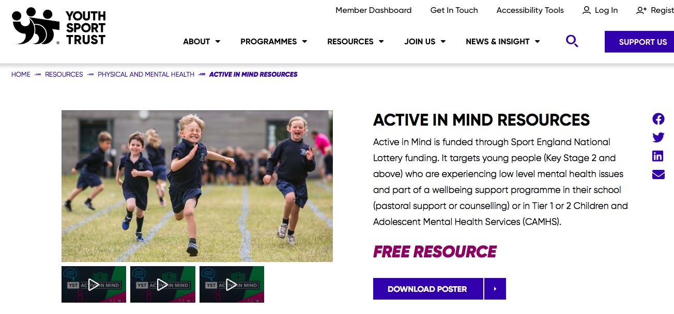
Notes:
Share the web page link for the active in mind resources and explain what is available to download for schools to use.
https://www.youthsporttrust.org/resources/physical-and-mental-health/active-in-mind-resources
A teacher PowerPoint and matrix covering the conditions required to support the development of voluntary emotional regulation. The PowerPoint and matrix provide activities, links to videos and discussion points which support completion of the student poster. The session can be delivered as whole session of broke up into bitesize points.
Video’s from the YST athlete mentor team sharing their stories and top tips. - Story telling influences our thinking and attitudes, particularly around behavior change in relation to health. Story telling is powerful because people relate and empathise. Recognising themselves in the story and being able to link this to actions they might take. This is more powerful than simply giving advice. For example saying – ”Drink more water” produces less effect than a story about how an individual carries out this behavior by putting times on their water bottle.
Downloadable posters for young people to record their behavior change goals on. When written down we are 42% more likely to take action.

Slide 8
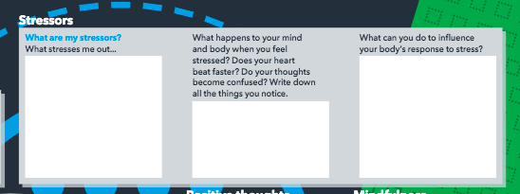
HELPFUL STRATEGIES
Notes:
What does the content cover?
Reflection on identifying stressors and the consequences from a physiological, emotional and cognitive perspective. Effective voluntary management of stressors requires reflection and appreciation of stimulates a stress response.
You could extend this activity to include keeping a stress diary – ensure that this has both stressors and activities which negate or reduce stress.
It’s also important that teachers are given the culture of the school enables all school staff to reflect on their level of stress and to share this openly, supported to put in place solutions. Prolonged stress in adults creates the same hyperarousal as we discussed as occurring for young people. In order to create a culture that supports positive mental health for young people its critical that this extends to teaching staff. Adults who are hypervigilant express themselves in ways that do not support the well-being of young people – posture, respiratory pattern, mood management, choice of language etc. All which could have a detrimental effect on the sense of safety of young people.

Slide 9
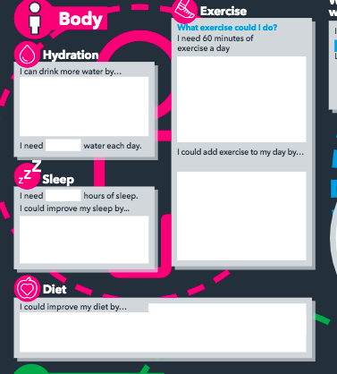
Notes:
Lifestyle habits and behaviours:
American researchers surveyed an ethnically diverse sample of 27,939 suburban high school students in Virginia. Although teenagers need about nine hours of sleep a night on average, according to the National Institutes of Health, only 3 percent of students reported getting that amount, and 20 percent of participants indicated that they got five hours or less. The average amount reported was 6.5 hours every weekday night. After controlling for background variables such as family status and income, the researchers determined that each hour of lost sleep was associated with a 38 percent increase in the odds of feeling sad and hopeless, a 42 percent increase in considering suicide, a 58 percent increase in suicide attempts and a 23 percent increase in substance abuse.
These correlational findings do not prove that lack of sleep is causing these problems. The reverse can be true: depression and anxiety can cause insomnia. "But the majority of the research evidence supports the causal direction being lack of sleep leading to problems rather than the other way around,"
Improving sleep by improving sleep hygiene and shifting adolescent behavior away from eveningness (i.e. reducing activity in the evening) improves Emotional, Behavioural, Social, Cognitive and Physical outcomes.
Increasing physical activity across the school day is one of the simplest things teachers could do improve the learning, behaviour, mental and physical health and performance of students.
“Exercise optimizes your mind-set to improve alertness, attention, and motivation; second, it prepares and encourages nerve cells to bind to one another, which is the cellular basis for logging in new information; and third, it spurs the development of new nerve cells from stem cells in the hippocampus." In short, not only does exercise help the brain get ready to learn but it actually makes retaining information easier. John Ratey, Spark
Exercise has a direct effect on the acute and chronic consequences of stress – through production of endorphins, serotonin, nor-epinephrine and dopamine – important in regulating mood. It also mitigates the physical consequences of stress – with contraction and subsequent relaxation of the muscles, altering the respiratory rate and pattern – resulting in diaprhragmatic breath pattern, a trigger for the autonomic nervous system to shift from fight or flight to rest and digest.
Teacher physical activity and in particular group activity reduces teacher stress, anxiety and improves interpersonal relationships – having a positive effect on the school culture.
The western SAD diet is associated with an increase in depressive symptoms – likely connected to the inflammatory effect of this kind of diet. Those following a SAD have an altered gut microbiome, lower levels of BDNF production, increases in the inflammatory cytokines, low levels of omega-3 fatty acids (critical for the neuronal cell membrane) and low levels of essential micronutrients. Higher levels of fruit and vegetable consumption are associated with lower levels of mood disorders in adolescents.
Even mild dehydration can affect a child’s mood, focus and ability to learn – encouraging regular consumption of water across the day is the most effective means of mitigating dehydration.
BREAKOUT ROOMS/DISCUSSION: With the information so far what could Active in Mind look like in your school.

Slide 10
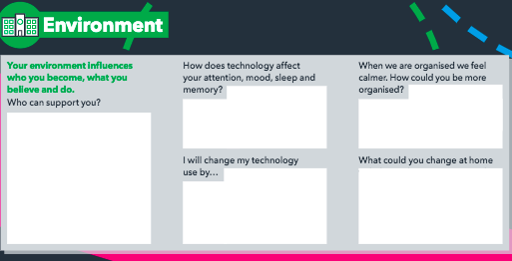
Notes:
Connectedness is an important protective factor for young people that can reduce the likelihood of a variety of health risk behaviors. ...
Young people who feel connected at school and home are less likely to experience negative health outcomes related to sexual risk, substance use, violence, and mental health.
The use of technology for young people is not all negative. However recent work suggests important implications of specific online experiences for the development of psychopathology. For instance, adolescents’ uses of social media not generally, but rather specifically for social comparison and feedback seeking, may be associated with depressive symptoms, perhaps even more strongly than adolescents’ engagement in offline excessive reassurance-seeking behavior (Nesi & Prinstein, 2015). Furthermore, a growing body of literature has established that the experience of cybervictimization, or victimization that occurs through digital media, is associated with heightened risk for internalizing and externalizing symptoms, as well as suicide and self-injury (e.g., John et al., 2018).
Organisation and goal setting are key factors in developing a sense of purpose. Consider for a moment. Do all the young people in your classroom understand how to make progress, do they have specific targets that are measurable to them. Are their behaviour targets clear – do they understand what they would look like? Is we ask a child to behave in a certain way me must explain to them what that would look like in order for them to develop a schema around putting in to action. For example is we ask a child to be more resilient or to develop a growth mindset we need to explain what that looks like in practical terms, then reinforce it when we see the behaviours in action and allow for reflection in order to strengthen the neurological pathway associated

Slide 11

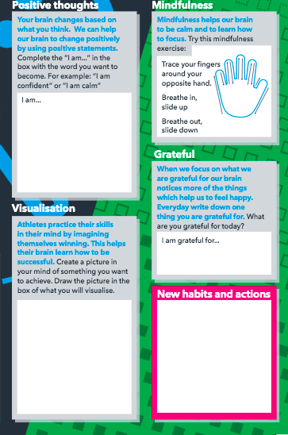
Change your thoughts and
you change
your world
Notes:
Psychological tools tor voluntary regulation of emotion and response to stress can be reinforced regularly throughout the school day.
Guide participants through the strategies highlighted on the poster.
POSITIVE THOUGHTS (LANGUAGE)
Language affects our behavior depending on the meaning we apply to the words. When we are stressed the language areas of the brain become less active and we become more aggressive in our choice of language Positive and optimistic words stimulate frontal lobe activity whilst negative words stimulate the amygdala. Angry words create a fear response that reduces activity in the pre-frontal cortex reducing our ability to respond with positive behaviours.
The words we repeat to ourselves reinforce pathways that we seek – our brains like certainty so look to reinforce our beliefs.
For our young people, that might be pathways that relate to their own self-worth – negative self talk that inhibits the action of the pre frontal cortex in certain learning environments – reinforcing the expected outcome. As teachers the narrative we have about students will create extra vigilance for behaviours we are expecting to see (good or bad). Consider the conversation you have with yourself about coming in to school – which emotion is it likely to elicit? How could we use our language to influence our young people?
Visualisation – turning activity.
Our perception of self and the construct we create for ourselves in our subconscious has a direct impact on our ability to perform and behave. Linked to prior experience we will set up neurological pathways that pre-frame our response to situations. Increasing or decreasing our stress response, creating body language related to our expected outcome.
Posture – stand up and move. Challenge the group to consider the postures of young people to adopt them. What do those postures tell us about the emotions of the young people? Mirror neurons pick up our social cues from the postural expression of those around us – particularly those with “perceived power”. What can we do to present ourselves in a way that will elicit positive response. How can we set up the classroom to shift young people’s posture to ensure we stimulate positive emotions?
Mindfulness – Take 5 activity.
The physiological response to stress increases the heart rate and respiratory rate. Deep slow breathing stimulates the phrenic nerve – the light switch for the parasympathetic nervous system – the rest and digest part of the CNS. We can change physiology and therefore our stress response state by altering our breathing.
Gratitude – reflecting on the positive regularly creates an expectation of happiness.
In your groups share something you are grateful for in your current role and explore how the techniques discussed could be share across the whole school .

Slide 12
What could
Active in Mind look
like in your school?
Notes:
Feedback – how could the principles be implemented for students and staff.

Slide 13
“We are what we repeatedly do” Happiness, therefore is an action and not an outcome
*Aristotle

