Slide 1
Week 1: Understanding the value of money and setting effective savings goals
Recognising the value of notes and coins; and recording monetary values accurately
Understanding what goal setting is and be able to set personal and team goals
Explaining why we save and how to set a savings goal
Explaining where, how and why to keep money safe

Slide 2
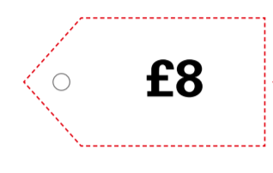
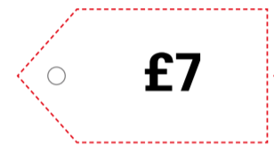
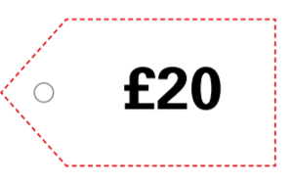
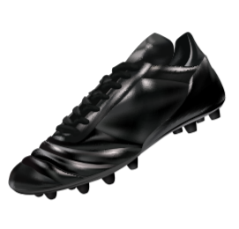
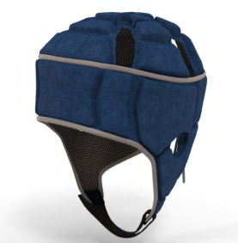
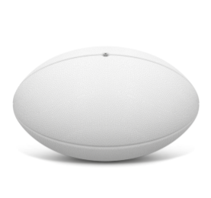
Activity 1
- Discuss what the items are - Discuss what value you think they are (cheap/expensive). - Match the price tags to the item

Slide 3
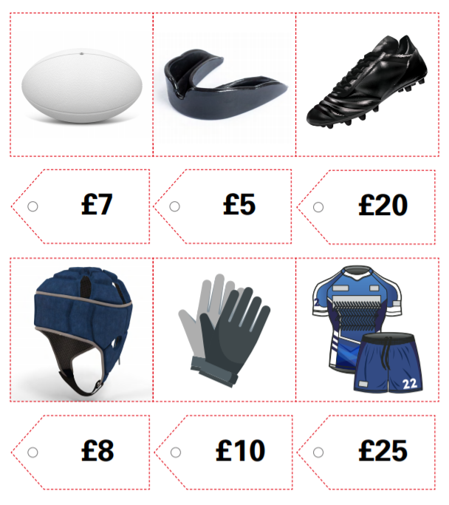
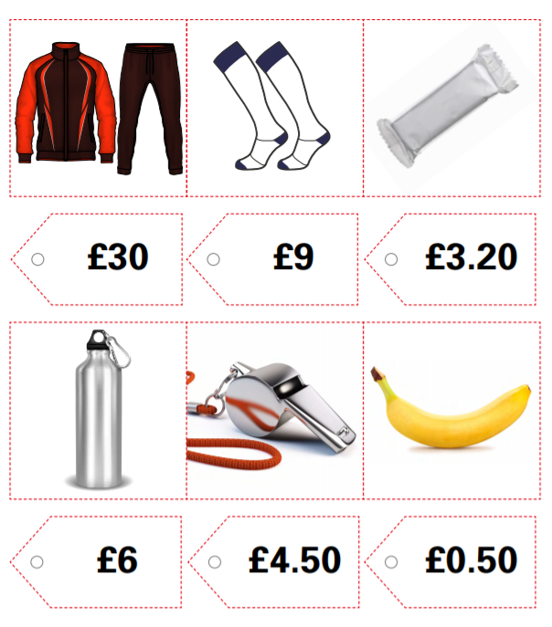
Activity 1- Answers

Slide 4
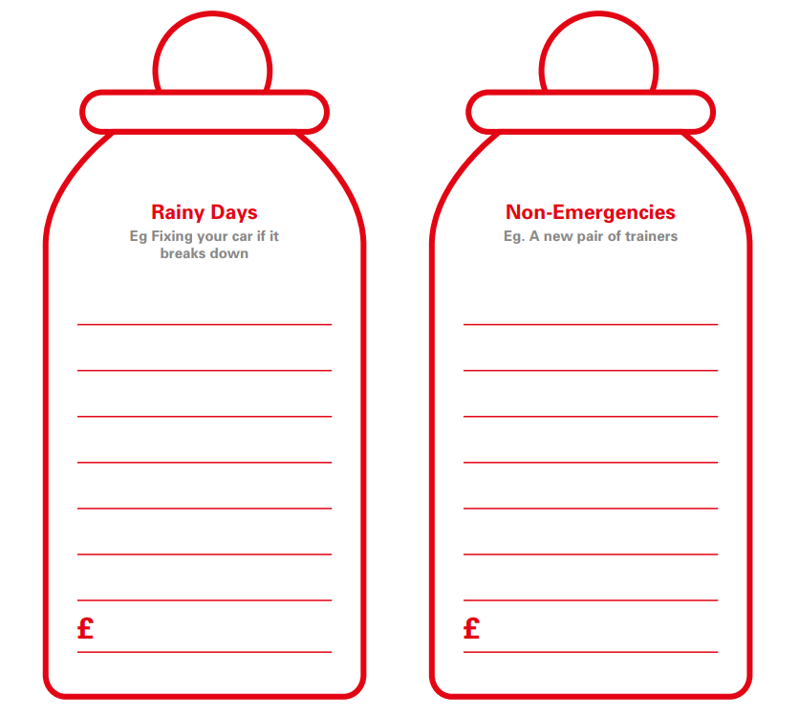
Why do we need to save?

Slide 5
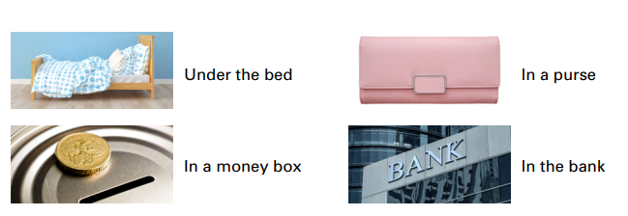
Where might we keep our savings?

Slide 6
Play video - Goal-setting for physical and financial fitness
What is physical fitness?
What is financial fitness?
What were Nolli’s goals when she was younger?
What does Ben save for?
What skills do you need when working towards a goal?
Notes:
Click on the title to play video https://vimeo.com/539558429/ce46caec40

Slide 7
Personal Goals
50 points- You and a friend can go to playtime early
100 points- First in the dinner queue
150 points- HSBC money box

Slide 8
Class Goals
1500 points- First class in for dinner
3000 points- Extra PE lesson
7500 Points- Golden Time

Slide 9
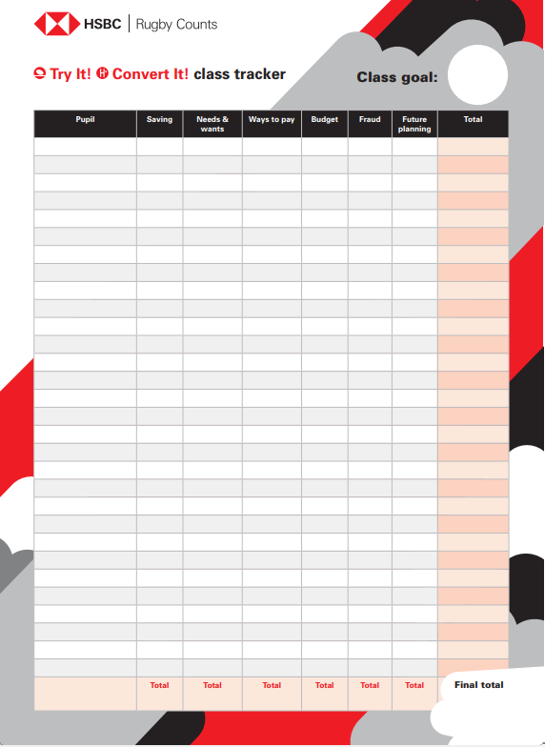
Recap
Why do we save?
Where do we save?
How do goals help us?
How can we track our savings?

