Slide 1




Slide 2

Getting started as a Youth Sport Trust
Young Leader
Step 1 – Purpose

Slide 3

Overview for teacher
Aim: Enable primary-age pupils to run fun and informal physical activities for other children in school.
Audience: Pupils aged 8-11 years who are new to leading physical activities. You can determine if you would like to work with younger leaders and feel content is appropriate for them based on individuals.
Organisation:
This introductory resource includes four bitesize modules, which use pupil-facing slides and interactive tasks to help young leaders to get started. The four steps are:
Purpose
Plan
Do
Review
Time:
Each module includes approx. 30 mins of core tasks plus 15-30 mins of optional tasks.
Preparation:
Read the individual slide notes to support your delivery of the module to your pupils.
Play the slides in slideshow mode to see how the animations work.
Refer to slide 4 for a summary of the module, including required equipment and resources.
Download the associated handouts to support pupils’ learning (optional).
Inclusion: The slide notes suggest alternatives to help you to include pupils with different needs and abilities.
Notes:
Teacher slide – will be hidden during presentation.

Slide 4
Module 1 summary: purpose
Aim: Help pupils to recognise their role as young leaders.
Congratulations | Congratulate the newly selected young leaders. Optional: issue them with young leader ID cards. Define what we mean by ‘leader’. | ID cards (downloads)
What will we do? | Share the overall goal. Use a graffiti wall to generate ideas for your school. | Large sheets of paper Sticky tape Flipchart pens
What matters most? | Explain the importance of belonging. Use slides for an active ‘agree’ or ‘disagree’ debate. | Signs (optional) Sticky tac (optional)
What will we gain? | Highlight the benefits of being a young leader. Use the download to support young leaders to set personal goals and recognise leadership skills. Optional: Create a team brand. | Young leader goals and skills (downloads) A4 paper, pens Stars (optional)
Notes:
Teacher slide – will be hidden during presentation.

Slide 5


Congratulations!
You are now a
Young Leader
Notes:
TEACHER NOTES
Congratulate the selected pupils on becoming young leaders (primary).
Optional: download the ID cards (print on stiff card and/or laminate) and issue one to each of the young leaders. This reinforces their role and status as a young leader for your school.

Slide 6
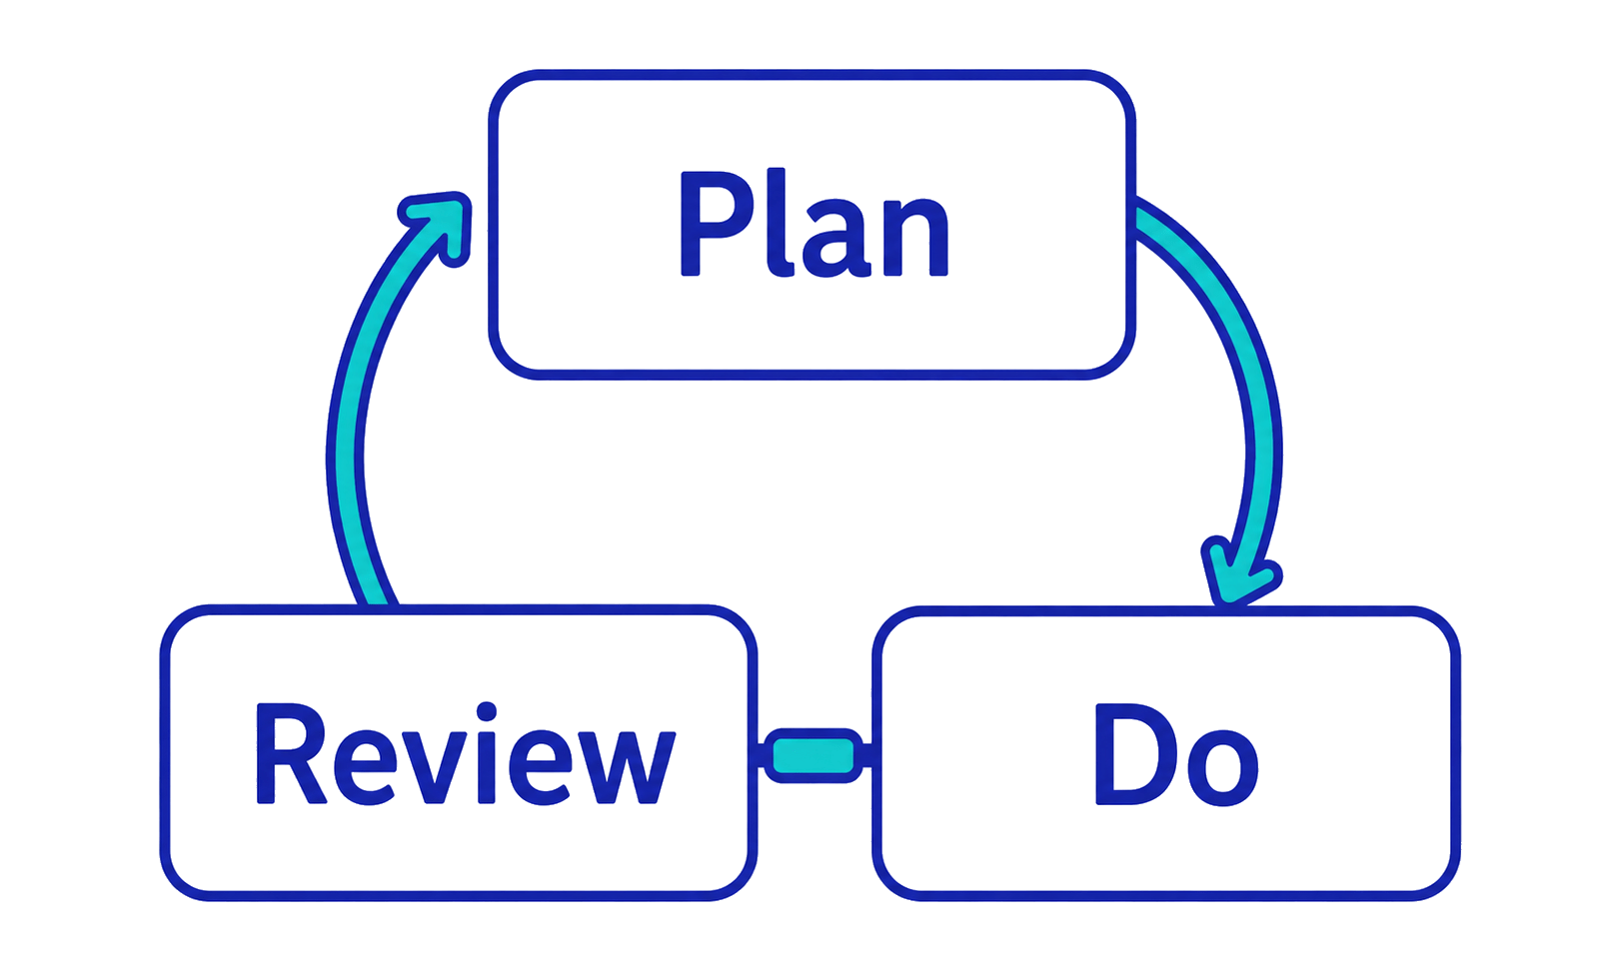
Four steps to getting started as a young leader
Purpose: What will we do?
Plan: What do we need to know?
Do: How will we run the activities?
Review: How do we check they are working?
Notes:
TEACHER NOTES
Explain that, to get started as young leaders, they will take part in 4 short sessions (approx. 30 minutes each OR extended/combined into longer session(s) to suit your school).
Clarify that ‘Purpose’ (this module) explains the job of a young leader.
The other 3 steps focus on how they can use an ongoing plan-do-review process to run activities in school.

Slide 7
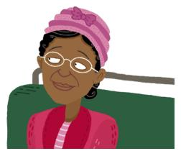
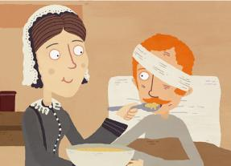
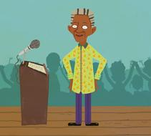
What is a leader?
These are examples of leaders from the past. What made them a leader?
Rosa Parks
Florence Nightingale
Nelson Mandela
Images from BBC Bitesize
Notes:
TEACHER NOTES
Share the examples of leaders from the past. See additional examples on the next slide if you wish to add to or change the examples. (You may wish to replace them with examples from your own curriculum.)
Ask young leaders to consider what made these examples leaders: What did the leaders do? How did they behave? What were their values?
Give young leaders time to reflect and share ideas in pairs before feeding back to the whole group.
Find out or share more information about these examples by linking to the BBC Bitesize website:
Rosa Parks: https://www.bbc.co.uk/bitesize/articles/zkhknrd
Florence Nightingale: https://www.bbc.co.uk/bitesize/articles/znsct39
Nelson Mandela: https://www.bbc.co.uk/bitesize/topics/zjkj382/articles/zj3p8xs
ALTERNATIVES
Ask the young leaders to suggest their own examples of leaders before and/or after sharing these examples. Encourage them to consider current leaders – in different areas of life – as well as historical leaders, e.g., to reflect a topical issue or event.
Sort young leaders into small groups. Give each group one of the example leaders. Enable groups to research the examples via the BBC Bitesize website on school devices before feeding back their ideas.
Share the examples then go direct to slide 9 (show and tell instead of asking for young leaders’ input).

Slide 8
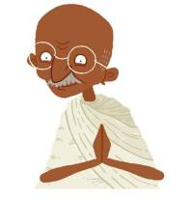

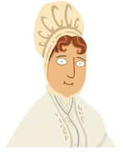
What is a leader?
These are examples of leaders from the past. What made them a leader?
Mohandas Gandhi
Stephen Hawking
Elizabeth Fry
Images from BBC Bitesize
Notes:
TEACHER NOTES
Share the examples of leaders from the past. See additional examples on the previous slide if you wish to add to or change the examples. (You may wish to replace them with examples from your own curriculum.)
Ask young leaders to consider what made these examples leaders: What did the leaders do? How did they behave? What were their values?
Give young leaders time to reflect and share ideas in pairs before feeding back to the whole group.
Find out or share more information about these examples by linking to the BBC Bitesize website:
Mohandas Gandhi: https://www.bbc.co.uk/bitesize/articles/z4fwy9q
Professor Stephen Hawking: https://www.bbc.co.uk/bitesize/articles/zjkp8xs
Elizabeth Fry: https://www.bbc.co.uk/bitesize/articles/z76jvk7
ALTERNATIVES
Ask the young leaders to suggest their own examples of leaders before and/or after sharing these examples. Encourage them to consider current leaders – in different areas of life – as well as historical leaders, e.g., to reflect a topical issue or event.
Sort young leaders into small groups. Give each group one of the example leaders. Enable groups to research the examples via the BBC Bitesize website on school devices before feeding back their ideas.
Share the examples then go direct to slide 9 (show and tell instead of asking for young leaders’ input).

Slide 9
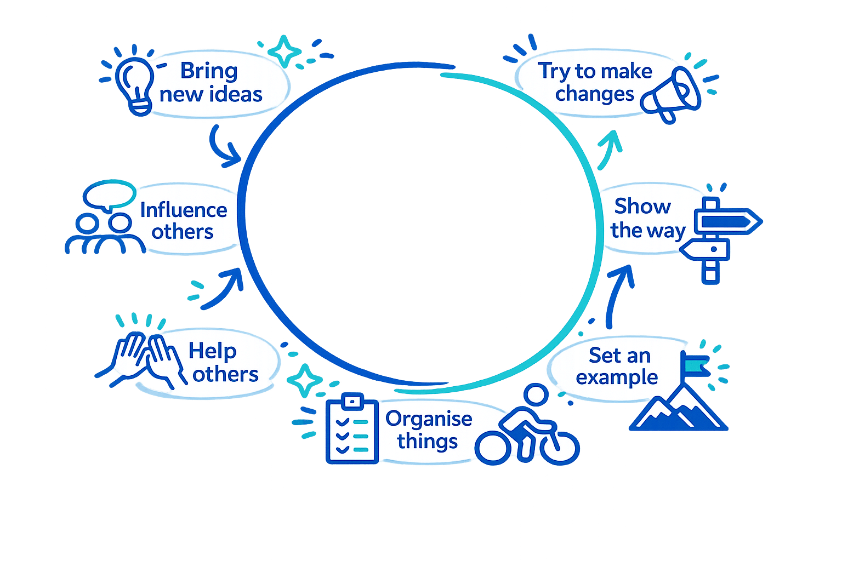
Leaders inspire others to act. They…
Notes:
TEACHER NOTES
Share some of the behaviours that make someone a leader.
Reinforce that people can be leaders in different ways and in different contexts.
Explain that they will be physical activity leaders.
Optional cross-curricular link: to reinforce the links between citizenship and being a young leader, use the BBC Bitesize Citizenship in the Community resources: https://www.bbc.co.uk/bitesize/topics/zfb7m39/articles/zvr2m39#z4wkkty

Slide 10
What will we do?
Notes:
TEACHER NOTES
This section focuses on the overall role of the young leaders in a physical activity context and what it might look like in action.

Slide 11

As a young leader, your goal is to get…
…by running fun physical activities in school.
more children
more active
Notes:
TEACHER NOTES
Explain that the young leaders’ overall role is to help your school to get more children more active. They will do this by running fun physical activities for other pupils within school.
Add your own parameters if there are any specific school priorities, e.g., the young leaders might be running activities for targeted groups of pupils.

Slide 12


What will fun physical activity look like in our school?
Who will take part?
What activities will there be?
Where will they be?
When will they be?
How will they be run?
Notes:
TEACHER NOTES
PREP – stick large sheets of paper together (or use wallpaper lining paper) to create a long ‘wall’ of paper; set out a variety of coloured markers/felt-tip pens.
Explain that you are going to ask the young leaders to share their ideas of what fun physical activity might look like in your school.
Before they share their ideas, highlight the different elements that they will need to consider, i.e., who, what, where, when and how.
Offer some existing examples from your school to aid the young leaders’ understanding, e.g.,
Who – younger pupils in Years 3 and 4.
What – circus skills challenges.
Where – gym.
When – lunchtimes.
How – pupils come along and choose their own challenges as they wish; they take part individually or in pairs/small groups of friends.
Set out the blank ‘wall’ of paper – on a wall or on the floor – and ask young leaders to write or draw their own ideas for what fun physical activity might look like.
Encourage them to use their imagination and think creatively – what they would like to happen – rather than being restricted by logistics or current provision.
Run for at least 5 minutes and encourage them to look at each others’ ideas, not just their own.
Summarise that we would like them to be creative and bring new activity ideas as a young leader as they know better than teachers what other children might like.
ALTERNATIVES
Use separate sticky notes then stick them to a wall so young leaders can work in their own space.
Work in small groups and run as a relay race: group members take turns to run to a flipchart and add their ideas.
Each young leader creates one idea covering all of the elements – who, what, where, when, how – then shares their idea (verbal or written) with the whole group.
Pass a bean bag/ tap a balloon/ roll a ball between young leaders; as each one receives it, they share one idea.
Young leaders write ideas on separate pieces of paper, scrunch them into a ball (or post them into a box) so ideas can be shared anonymously afterwards.

Slide 13


Notes:
TEACHER NOTES
Use the slide to summarise that, as young leaders, they will need to vary the what, where, when and how to suit different children. That way they create better chances for all pupils to enjoy physical activity and, in turn, become or stay active so it’s really important that we listen to what others want.

Slide 14
What matters most?
Notes:
TEACHER NOTES
This session focuses on the values and principles that underpin enjoyable physical activity for all children.

Slide 15

As a young leader, you should help everyone to feel…
Notes:
TEACHER NOTES
Use the slide to share that the most important part of being a young leader is to help everyone to feel a sense of belonging.
Explain that a sense of belonging comes from feeling good about ourselves, being with others, enjoying activities and feeling at ‘home’ in other spaces.
Having a sense of belonging is essential to our overall happiness and wellbeing.
Explain that the young leaders will consider how they can help to create a sense of belonging through the following active voting/debating activity.

Slide 16
Active debate: what builds belonging?
Think about the action.
Will it help to build children’s sense of belonging?
Move to the ‘agree’ or ‘disagree’ side to show your decision.
Share why you made that decision.
Notes:
TEACHER NOTES
Use this slide to explain the process for the next 8 slides (2 slides per topic).
For each of the following topics:
Ask the young leaders to start in the middle of the room.
Indicate (verbally and/or with signs) which sides of the room are ‘agree’ (left as the young leaders face the slides) and ‘disagree’ (right).
As you reveal each slide, ask the young leaders to decide if this action will help to build other children’s sense of belonging.
Give them 30 seconds thinking time before they move to agree or disagree.
Encourage them to have confidence and courage and make up their own mind instead of just copying others.
Once they have moved, give them 30 seconds to share their rationale with each other and/or with you.
Try to avoid sharing your own judgements. Encourage the young leaders to consider different children’s experiences, preferences and needs each time.
Use the ‘positives’ and ‘negatives’ slide after each short debate to summarise. (This may be deleted or skipped if they have covered the issues.)
ALTERNATIVES
Change which action the young leaders use to share their views, e.g., stand/sit, raise right/left hand, show thumbs up/down.
Give young leaders double-sided signs to hold up for agree/disagree.
Work in pairs/small groups rather than as individuals.
Work in 4 groups and give each group one of the slides. They discuss briefly and present their views to the whole group.
Skip the positive and negative summaries.

Slide 17

Why do you think that? Share your views.
We will build belonging by…
1. Running lots of competitions.
Notes:
TEACHER NOTES

Slide 18

1. Running lots of competitions.
You may like competition.
You may feel that you belong in a team.
You may dislike competition.
You may feel left out if you aren’t as good as others.
Think about personal and group challenges, not just competitions.
Notes:
TEACHER NOTES

Slide 19
Why do you think that? Share your views.
We will build belonging by…
2. Letting people choose activities.
Notes:
TEACHER NOTES

Slide 20
2. Letting people choose activities.
You enjoy the activity more.
You discover what motivates you to stay active.
Too many choices are difficult to organise.
You may not try new activities.
Offer easy choices and encourage everyone to have a go.
Notes:
TEACHER NOTES
Reinforce the importance of listening to pupils to be able to create activities that they enjoy most and encourage those who aren’t as keen.

Slide 21
Why do you think that? Share your views.
We will build belonging by…
3. Asking people to pick teams.
Notes:
TEACHER NOTES

Slide 22
3. Asking people to pick teams.
You feel safe with your friends.
You choose others with the same interests or abilities.
You feel sad when you are not picked or are picked last.
Nobody makes new friends.
Mix it up: sometimes people choose, sometimes you sort them.
Notes:
TEACHER NOTES

Slide 23
Why do you think that? Share your views.
We will build belonging by…
4. Keeping to the rules.
Notes:
TEACHER NOTES

Slide 24
4. Keeping to the rules.
Everyone plays safely.
You know what you should be doing.
You aren’t having fun.
The rules don’t allow for people’s different needs and abilities.
Adapt activities to suit the people – as long as they are safe.
Notes:
TEACHER NOTES

Slide 25
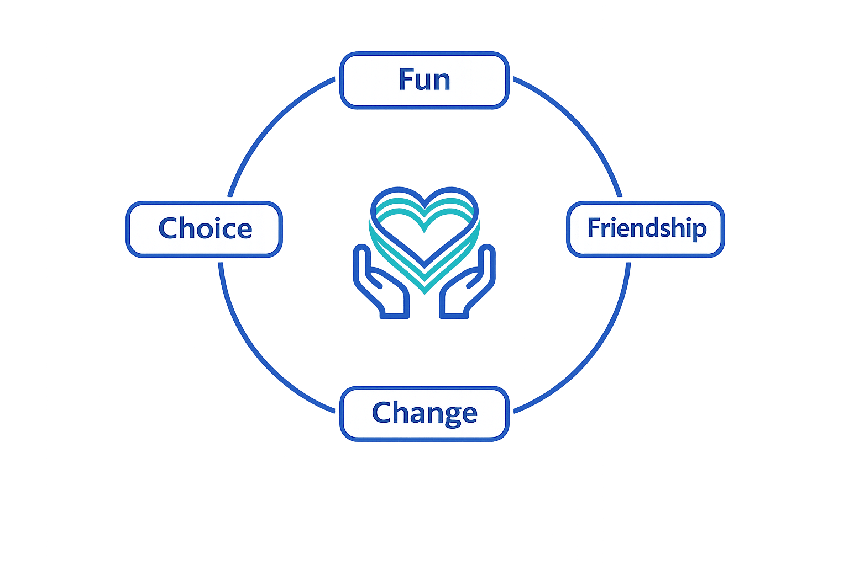
We will build belonging by focusing on…
Notes:
TEACHER NOTES
Use the slide to summarise how physical activity can help to build belonging:
Fun – when it stops being fun, children will stop playing.
Friendship – encourage everyone to respect, cooperate and get to know each other.
Change – adapt the activities to suit the children.
Choice – encourage children to take part as they wish so they don’t feel forced to do something.
These reflect ‘how’ activities can be delivered, i.e., same activity but different ways for different children.

Slide 26
What will we gain?
Notes:
TEACHER NOTES
Explain that we want all children to benefit from their work as young leaders and they will benefit as individuals too.

Slide 27


Being a young leader will help you to…
Meet new people and make friends.
Try new experiences.
Learn skills – for leadership and life.
Grow in confidence.
Have good wellbeing.
Notes:
TEACHER NOTES
Use the slide to summarise the different ways in which the pupils might benefit from being young leaders.
In terms of wellbeing, you may wish to reinforce that volunteering (GIVE) is one of the five ways to wellbeing.
ALTERNATIVES
Ask the young leaders to suggest how they will benefit before showing this slide.
For each benefit, ask if any of the young leaders have practical examples from previous volunteering/ leadership (not necessarily within physical activity).

Slide 28
The leadership skills you will use include…
Skill | Definition | Examples
Communication | I connect with others. | I give instructions clearly. I listen carefully to other people’s ideas.
Responsibility | I act responsibly and reliably. | I arrive early to set up the equipment. I do all of the jobs – not just the fun ones.
Teamwork | I trust and cooperate with others. | I ask for help when I need it. I share my ideas with the other leaders.
Resilience | I deal with setbacks. | I try again if something didn’t work at first. I look for positives as well as negatives.
Notes:
TEACHER NOTES
Use the slide to highlight some of the skills that the young leaders will develop and use. (See the Goals and Skills download.)

Slide 29
The leadership skills you will use include…
Skill | Definition | Examples
Fairness | I acknowledge people’s needs. | I adapt activities to suit each child. I balance the children’s different requests.
Problem-solving | I find different solutions. | I ask why we are doing something a set way. I try many ways to play to see what works.
Evaluating | I make judgements. | I find out what the children liked best. I think about what could be even better.
Notes:
TEACHER NOTES
Use the slide to highlight some of the skills that the young leaders will develop and use. (See the Goals and Skills download.)

Slide 30
What do you want to gain from being a young leader?
Use the handout to write or draw your personal goals.
Choose the leadership skills that you want to practise most.
Insert image of handout when designed.
Notes:
TEACHER NOTES
EITHER during the session OR afterwards, ask the young leaders to use the goals and skills handout (see downloads) to set their own goals.
Encourage pupils to think about their leadership skills. They will practise these as young leaders. Which ones are they good at already? Which ones do they want to improve?

Slide 31
Who are we?
Notes:
OPTIONAL TASK
TEACHER NOTES
Explain that the young leaders are now going to consider their brand, i.e., how they want to be known and how they will promote themselves in school.

Slide 32
How will you promote yourselves?
What is your brand?
Name
Logo
Slogan
Notes:
OPTIONAL TASK (use within a session or ask young leaders to bring their ideas/decision to the next module).
TEACHER NOTES
Reinforce that they are young leaders and that is the term that will be used within the modules.
However, now that they know their role, ask them how they want to be known and promote themselves in school.
Explain that they could create their own brand, i.e., name, logo and slogan.
Ask the young leaders if they know any brands, e.g., sport, shops, charities.
Share the brand examples on the next slide if required.
ALTERNATIVES
Just focus on ‘name’ rather than asking the young leaders to create a brand, e.g., Physical Activity Leaders (PALs).
Use the name that is already established in your school and ask the young leaders to create their own logo for it.

Slide 33






Brand examples
Notes:
OPTIONAL TASK (use within a session or ask young leaders to bring their ideas/decision to the next module)
TEACHER NOTES
Share the examples of brands with names, logos and slogans.

Slide 34
Draw and decide
Draw or write your brand ideas on paper – one sheet for each different idea.
Spread the papers across the table or floor.
Take 3 stars each. Stick your stars next to the brand ideas you like best for the team.
Which ideas does the team like most?
Do you need to mix and match ideas?
What will the children you lead think?
Notes:
OPTIONAL TASK (use within a session or ask young leaders to bring their ideas/decision to the next module).
TEACHER NOTES
Ask the young leaders to draw and/or write their brand ideas on pieces of A4 paper. They may create as many as they wish (but encourage quality) and may focus on a single element of the brand (e.g., just name, just logo, all 3) as they wish.
Spread the completed sheets of paper across a large table or the floor. Make sure they are anonymous!
Give each young leader 3 stars and ask them to stick their stars next to the ideas they think will work best for the team. They may star a name from one brand and a logo from another. They may give 3 stars to one idea or spread their stars across 3 ideas.
Identify the most popular and ask the young leaders to discuss and agree which will work best for their team in your school.
Emphasise that this is not about favouring individuals but about agreeing what is best for the team and their leadership role. What will the children they lead respond to best?
Hold a second round of voting (e.g. stick stars to shortlisted options) if needs be.
ALTERNATIVES
Put shortlisted options into a hat and select the winner randomly.
Divide the young leaders into 3 groups and give each group a focus: name, logo and slogan. Check they complement each other when finalised.
Ask for a smaller team of volunteers to create a selection of brands between modules and vote for the whole team’s preferred brand at the start of module 2.

Slide 35
Well done! You have completed step 1.
Get ready for step 2…
Notes:
TEACHER NOTES
Let the young leaders know when step 2 is to be delivered.

