Slide 1
Welcome
This session will be recorded
Please turn your camera on and mute on (until breakout rooms)
Type questions into the chat function
Notes:
Welcome on behalf of the Schools Active Movement Board. We know its becoming increasingly more difficult to attend as the lockdown rules start easing and more activity can be delivered in schools by you and your teams.
Start with a quick update and set the context for todays webinar.

Slide 2
Agenda
Evolution of SAM
School Sport & Activity Sector
Networking opportunity

Slide 3
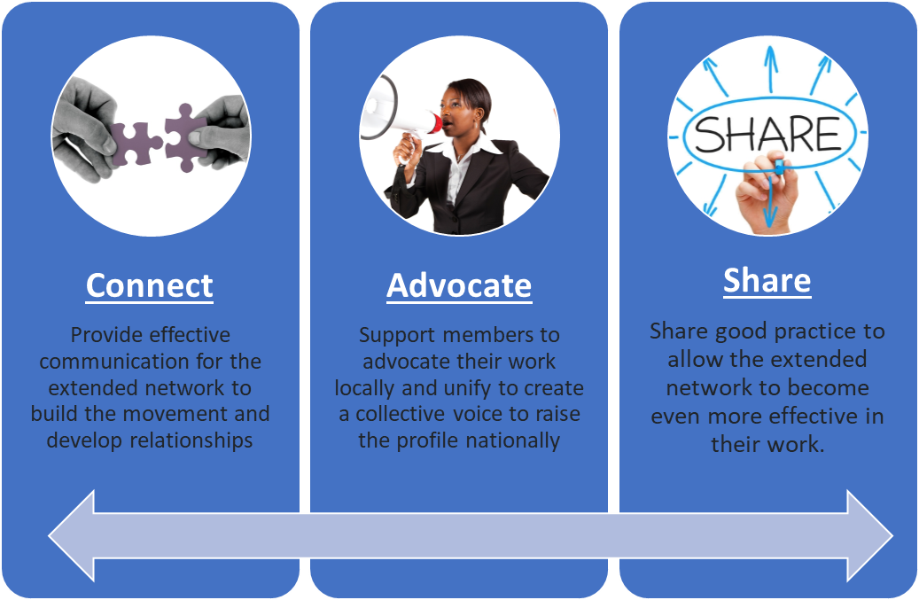
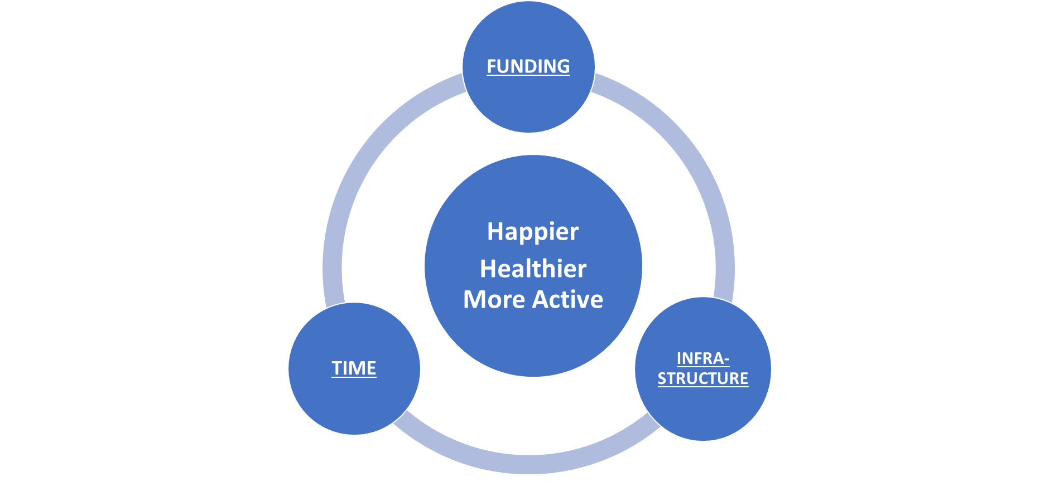
SCHOOLS ACTIVE MOVEMENT
SAM Created
(Connect/Advocate /Share)
FIT 4 HHA
(Funding / Infrastructure / Time)
Happier-Healthier-More Active
EVOLUTION

Slide 4
WHY EVOLVE
HOW
PROACTIVE
CONSISTENT FOCUS
PURPOSE & DRIVE
GO BEYOND £
ENGAGE MEMBERS
RESULTS
5 WORKING GROUPS
CLEAR REMIT / AIMS
BOARD AGENDA
RESULT FOCUS

Slide 5
HEALTH & WELL-BEING
* National Agenda
* Data Gathering / Sharing
* Projects/Organisations /Initiatives
ADVOCACY
* National Advocacy / Press / Awareness
*Growth of Networks
* Partnerships & Alignment with key organisations outside SAM
STRUCTURES/ ORGANISATION
* Represent variety of structures represented (SGO/PDM/SSP/CIC/Consultant etc)
* Support network for developing new structures
* Ensure representation of all involved with a voice
GOOD PRACTICE
* Sharing of Good network practice
* Workshops/Webinars
* Case studies
SUSTAINABILITY & FUNDING
* National Funding
(SGO / PESP)
* Additional Funding Streams
(ie. ITT / Football / Project monies)
(PROPOSESD) SAM WORKING GROUPS

Slide 6
QUESTIONS
From the list of sub-groups, do you feel they cover all the areas you have as your priorities? (Is there anything missing?)
From each group what would you want to ensure each groups is focused on achieving ?
Is there anyone you would nominate to be involved in any of the groups from your local area? (you can nominate yourself)

Slide 7
School Sport and Activity Sector
An update

Slide 8
School Sport and Activity Sector
Developing a consistent language to build understanding

Slide 13
Future Dates
Date | Format | Zoom Registration Link
Monday 23rd May 11-12.30pm | Webinar | https://youthsporttrust.zoom.us/meeting/register/tJEoc-msqj4oGdbST5E-DiNs88ToDIajtOD9
Wednesday 6th July 12.30-2pm | Networking | https://youthsporttrust.zoom.us/meeting/register/tJ0of--tqzMoGt2uVJVcR613OSkcFi-LcRjC
Notes:
SAM survey results and how SAM members are addressing / Heads perspective / YP-case studies of how SP has help develop their lives (laura leadership now PE teacher) /

Slide 14
‘Off the topic’ Networking

