Slide 2
Understanding & Influencing Your Audience
Workshop 2

Slide 3
WORKSHOP OUTCOMES
By the end of this session you should be able to:
Develop an understanding of how other girls might feel
Identify the barriers girls face in being active and understand what motivates them
Develop the skills needed to influence and motivate others
Reflect on your own skills/qualities as leaders and identify a goal to work on

Slide 4
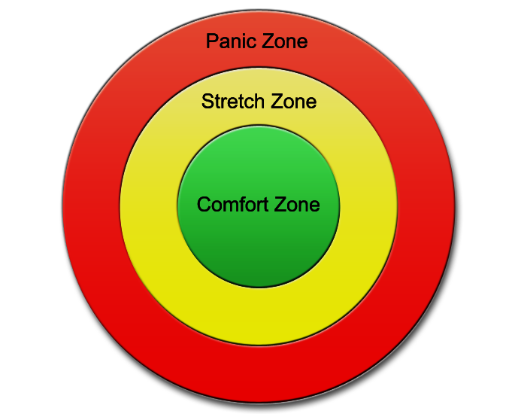
Comfort, Stretch, Panic
Spiders?
School?
Sport?
Being a Girls Active Leader?
Leading activities to other girls in your school?

Slide 5
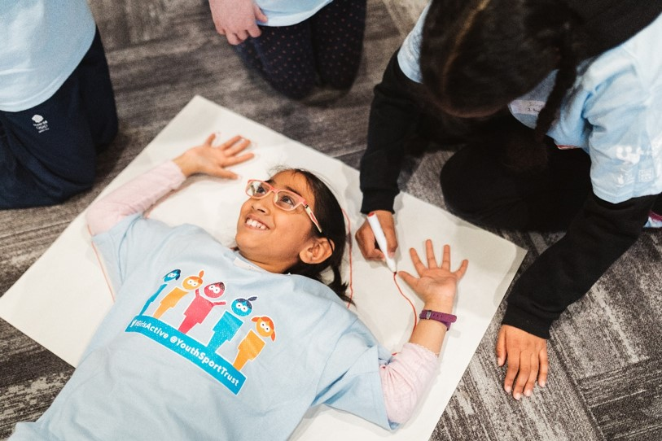
Activity: Your Target Audience
1. Draw around somebody in your group and bring to life the average girl that you will be targeting in your school.
2. What are the barriers or issues that prevent this girl from taking part in sport and physical activity? Write on inside of girl.
3. What might motivate this girl to take part in physical activity? Write on outside of girl.

Slide 6
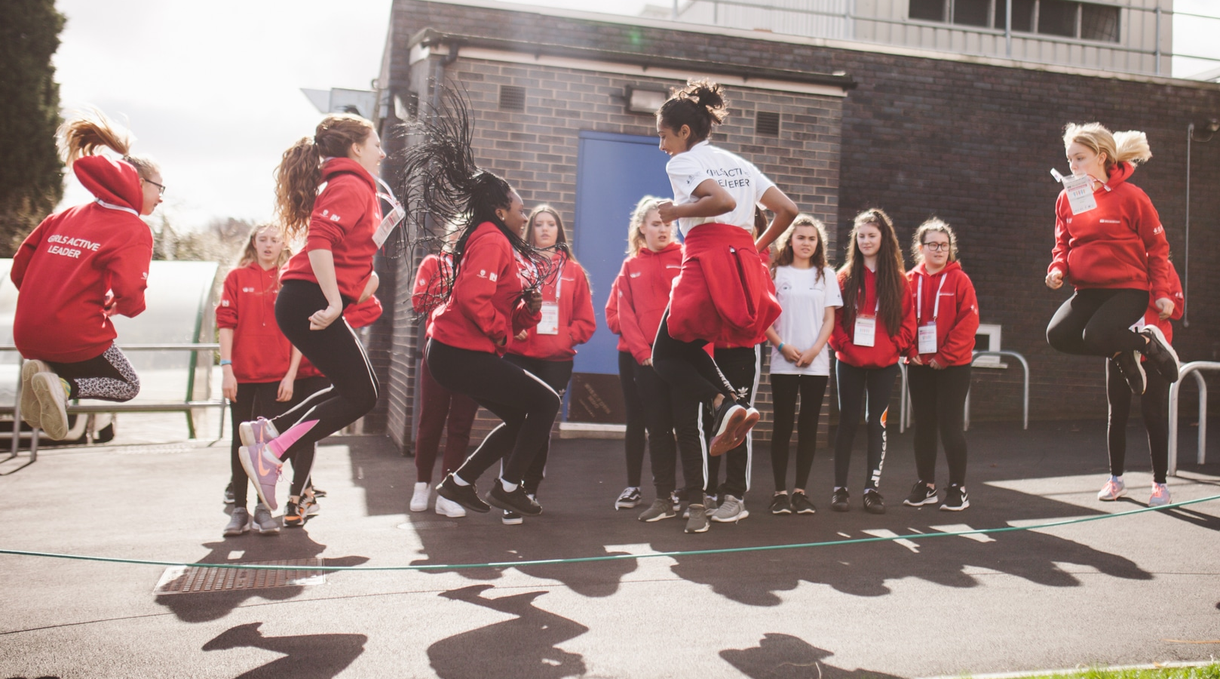
Why do girls take part in physical activity?
Key themes based on YST research:
Being in the right environment
Learning something new
Looking and feeling good
Spending time with friends
Having fun

Slide 7
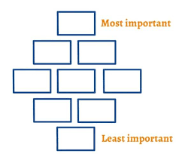
Influencing Skills
What skills do we need to influence others?
Refer to your influencer skills cards and create a Diamond 9 by listing the skills in order of importance from most important to least important.
Select your top 3 skills and create a fun game to highlight these skills in action!

Slide 8
