Slide 1
Week 5: To know what fraud is and how to be in control of my own money
Explain what fraud is and how fraudsters work
Know ways to protect and keep money safe
Be able to express how loss can feel and the emotions people may experience

Slide 2
Team talk You have been given £100.
How do you feel?
Who would you trust to tell about your money?
What risks might there be to having money?
What could you do to keep it safe?
Where would you keep it?

Slide 3
Team talk
What is fraud?
What is a scam?
Who is a fraudster?
Can you think of some words to describe a fraudster?

Slide 4
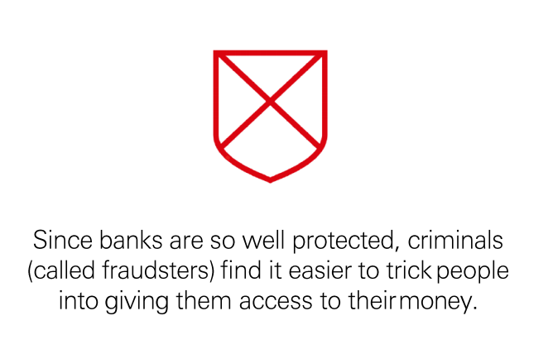
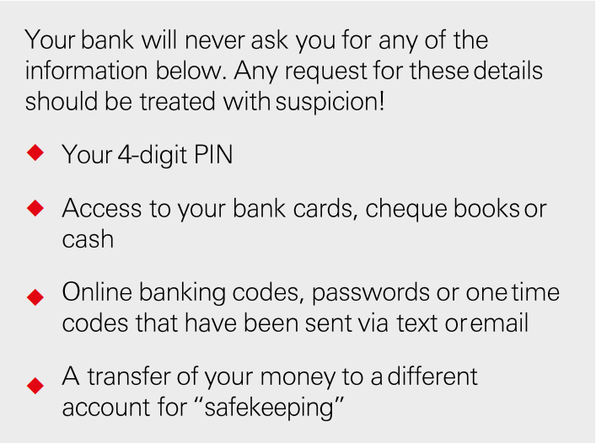
Keeping Your Money Safe

Slide 5
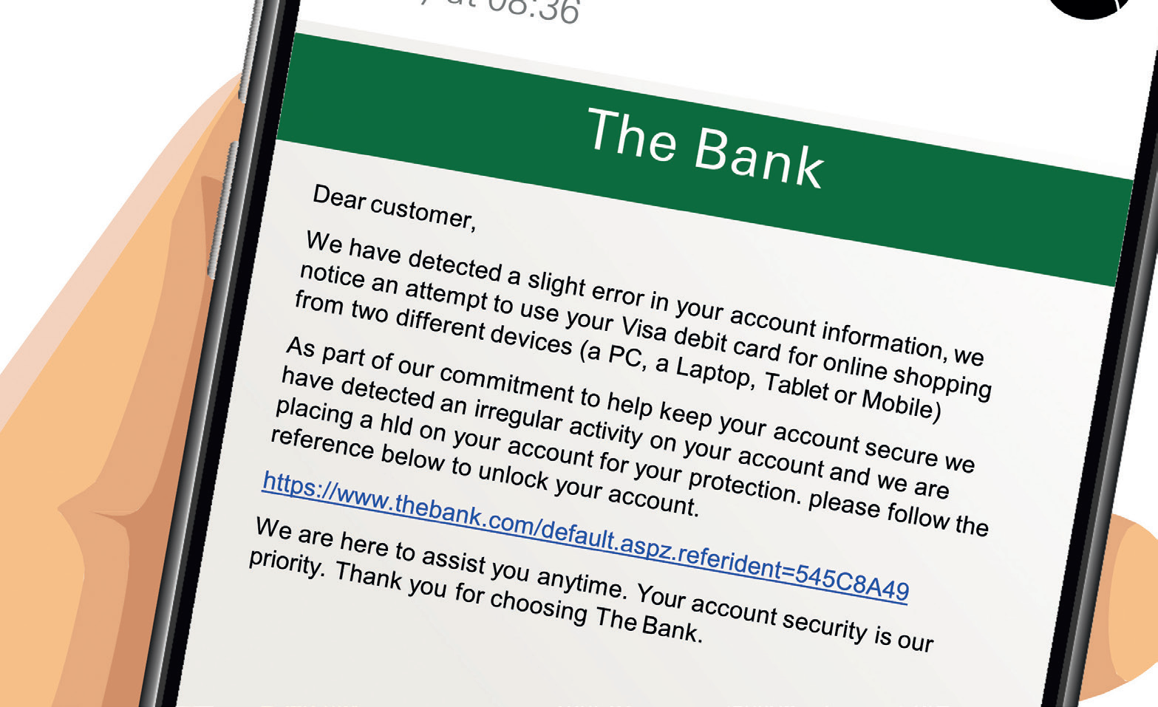
Spot the signs of fraud
Notes:
‘Dear customer’ – if you are known to the bank then they would always address you by name
‘Slight error’ – it either is or it isn’t, no such thing as a ‘slight error’
Grammatical errors throughout, banks have lots of systems in place to avoid these – ‘notice an attempt’ not ‘noticed’, no full stop at the end of the first paragraph, ‘placing a hld’ not ‘hold’
Link – it is better to log in through your usual methods rather than clicking on links in text messages or emails

Slide 6
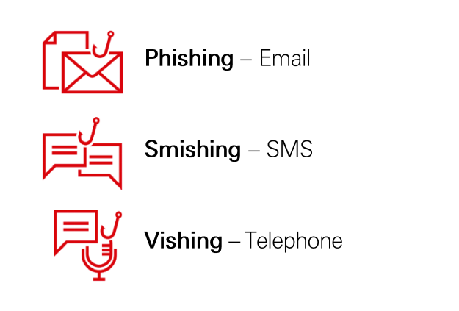
Types of Fraud

Slide 7
Play video – Sportsmanship
What is sportsmanship?
How does this link to fraud?
What were some of the emotions that Ben and Nolli felt?
Notes:
Click on title to play video
https://vimeo.com/540721328/5bf6b2cbd7

Slide 8
How would you feel?
At the end of a match, a player from the opposition refuses to shake your hand.
During a match, you are awarded a penalty. Rather than handing you the ball, the opposition kick it off the pitch.
You are about to cross the finish line in a running race in first place, but with a few strides to go you trip. The runner finishing behind you stops, helps you up and allows you to finish first.

Slide 9
Recap
To know what fraud is and how to be in control of my own money
Explain what fraud is and how fraudsters work
Know ways to protect and keep money safe
Be able to express how loss can feel and the emotions people may experience

