Slide 1




Slide 2

Getting started as a Youth Sport Trust
Young Leader
Step 4 – Review

Slide 3

Overview for teacher
Aim: Enable primary-age pupils to run fun and informal physical activities for other children in school.
Audience: Pupils aged 8-11 years who are new to leading physical activities.
Organisation:
This introductory resource includes four bitesize modules, which use pupil-facing slides and interactive tasks to help young leaders to get started. The four steps are:
Purpose
Plan
Do
Review
Time:
Each module includes approx. 30 mins of core tasks plus 15-30 mins of optional tasks.
Preparation:
Read the individual slide notes to support your delivery of the module to your pupils.
Play the slides in slideshow mode to see how the animations work.
Refer to slide 4 for a summary of the module, including required equipment and resources.
Download the associated handouts to support pupils’ learning (optional).
Inclusion: The slide notes suggest alternatives to help you to include pupils with different needs and abilities.
Notes:
Teacher slide – will be hidden during presentation.

Slide 4
Module 4 summary: review
Aim: Help young leaders to recognise how to evaluate if they are being effective.
Plan-do-review | Use the slide to remind the young leaders about plan-do-review; this session will focus on review.
How do the children feel? | Use a ball-passing game to identify what children’s enjoyment (SMILES) might look and sound like. Explore practical feedback tools to suggest how young leaders might use them with the children. | Soft ball Paper, pens, cones, bean bags Feedback tools handout (downloads)
How do we think we are doing? | Optional: Explore scenarios to develop resilience. Ask the young leaders to create top tips for responsibility and good teamwork. Encourage the young leaders to use the team- and self-review handout to identify what is going well and what could be improved. | Scenario slides as handouts (optional) Paper and pens Self-review handout (downloads)
Notes:
Teacher slide – will be hidden during presentation.

Slide 5
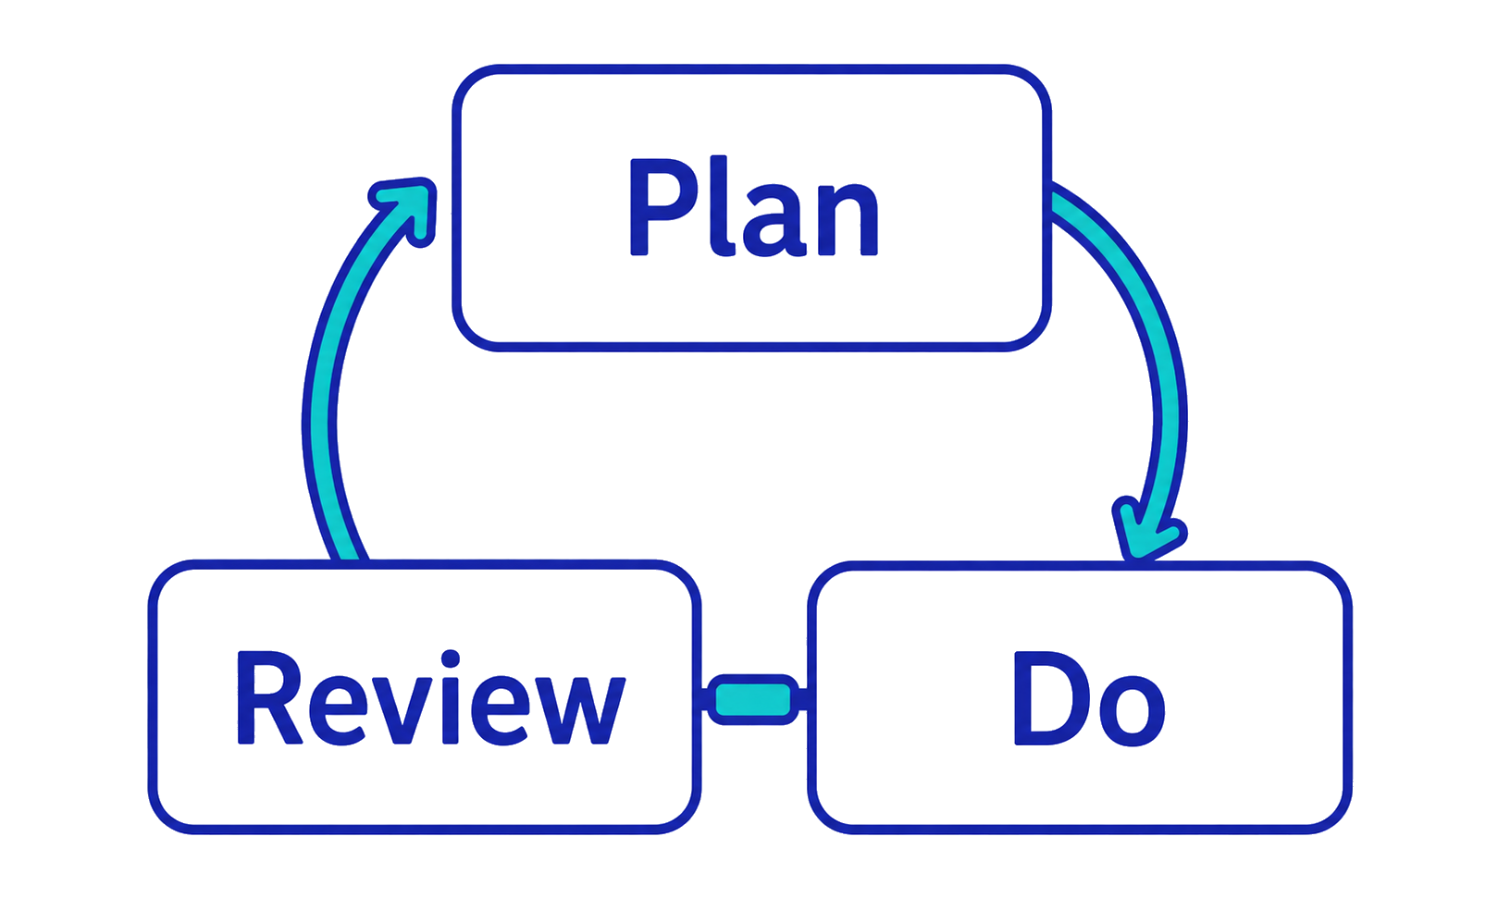
As a young leader, you need to…
Notes:
TEACHER NOTES
Remind the young leaders that there are three stages to running fun physical activities: plan-do-review.
This session will focus on review – this means evaluating whether they are effective as physical activity leaders.
NB. Evaluating is one of the leadership skills.

Slide 6
How do the children feel?
Notes:
TEACHER NOTES
This section focuses on how finding out how participants feel about the young leaders’ activities.

Slide 7
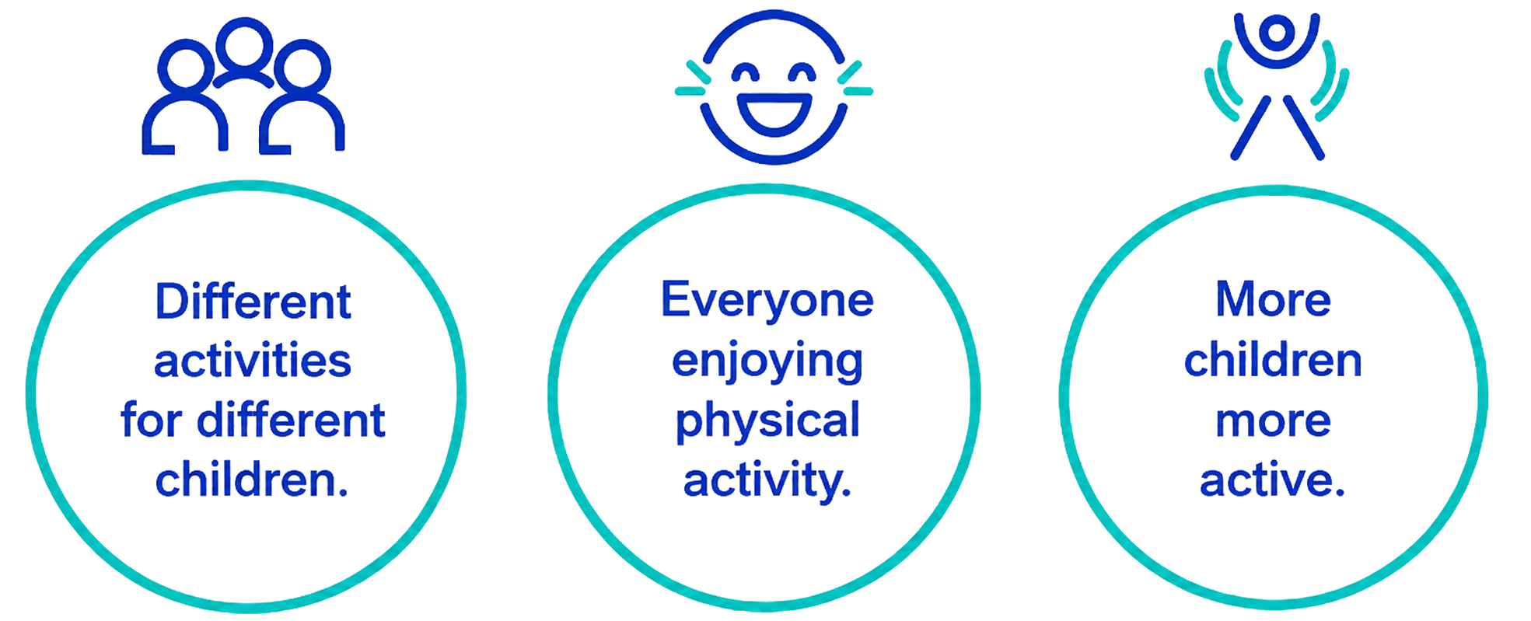
Your goal as young leaders
Notes:
TEACHER NOTES
Use the slide to remind the young leaders of their goal.
They will be running different activities, but children will only be more active if they are enjoying them.
As part of their review, they need to find out if/how much the children are enjoying the activities.
(The animation will accentuate the enjoyment aspect.)

Slide 8
Get instant feedback: Can you see SMILES?
Imagine you are making a film of children playing your activities.
What will you see or hear if the children are enjoying themselves.
Pass the ball. When you receive it – share an example.
Safe
Maximum participation
Included
Learning
Enjoyment
Success
Notes:
TEACHER NOTES
Explain that the young leaders can get instant feedback by watching and listening to the children as they take part.
Use the slide to guide them through the task.
Give the young leaders a moment to form a mental picture.
Pass the ball randomly around the whole group so young leaders can add their examples.
They may pass if they can’t think of one.
Join in too to stimulate ideas (drawing from the examples on slide 9).
ALTERNATIVES
Share examples in pairs before passing the ball.
Work in small groups.
Tap a balloon if they will struggle to coordinate catching.
Use verbal volleyball – instead of ball-passing, they ‘bat’ their example around a circle.
Use a flipchart relay race instead of ball-passing – young leaders run to a central (or team) board to add an example (write or draw).
Ask small groups to make a poster (drawing) of what they might see and hear.
If you have more time, ask small groups to act out their examples and/or make a 1-minute film using a tablet.

Slide 9
You might see or hear children…
Laughing
Helping
Not giving up
Smiling
Encouraging
Celebrating
Joining in
Focusing
Mixing
Sharing ideas
Trying new things
Notes:
TEACHER NOTES
Use the slide to summarise and/or add to the young leaders’ examples.
Remind the young leaders that different children might behave in different ways so looking and listening will only give them a general idea if their activities are working.
They will also need to ask the children.

Slide 10

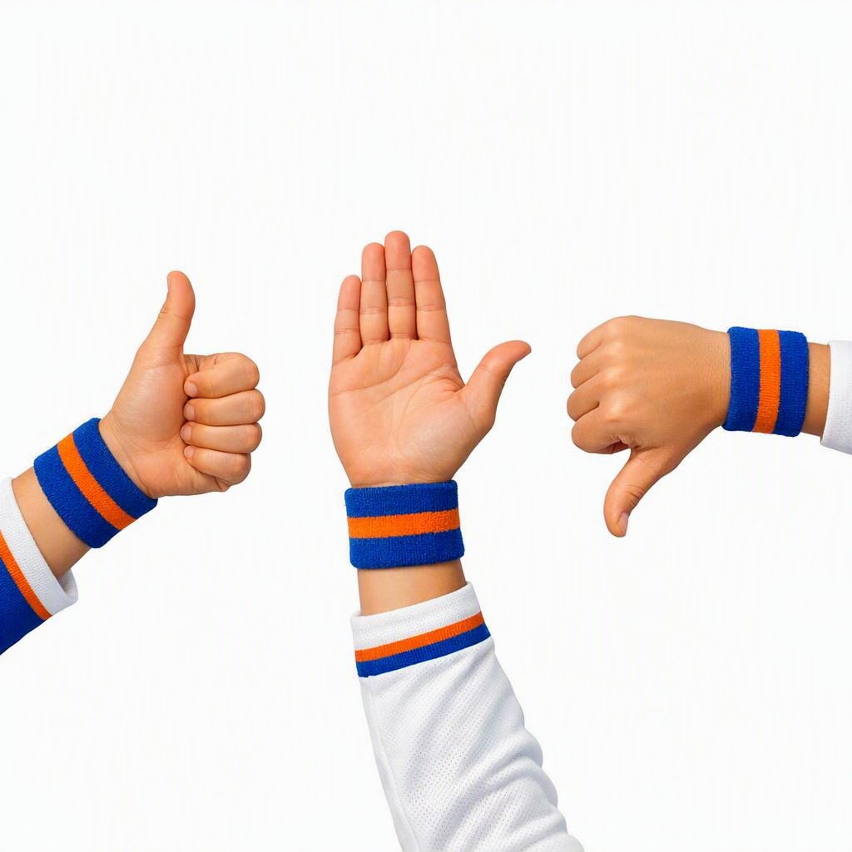
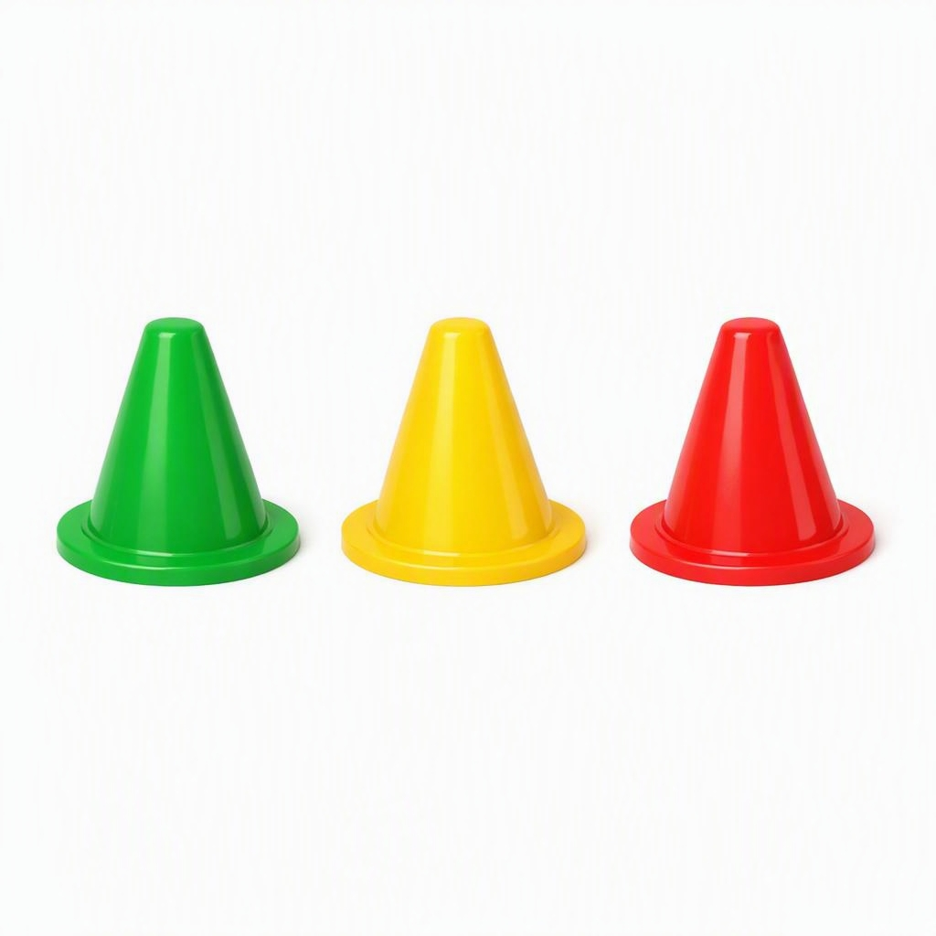

Find out from the children
Use simple tools to get feedback
Emojis
Thumbs
Bean bag votes
Traffic Light Cones
Notes:
TEACHER NOTES
Explain that the young leaders can get feedback from the children.
Use the slide to share some simple tools for getting feedback during and after activities.
Share an example of how you use these to gather pupils’ feedback in school and/or ask young leaders for one or two examples.

Slide 11
How could you use these tools?
In your group, think about the tool you have been given.
How could you use this to get feedback from the children during or after an activity session?
Demonstrate one quick idea.
Notes:
TEACHER NOTES
Use the slide to guide the young leaders through the task.
Work in small groups.
Give each group one of the four tools and ask them to share ideas for how they could use their tool to get feedback from children during or after an activity session.
Encourage them to consider practical and easy methods.
Ask each group to demonstrate one idea. Keep it quick!
Use the feedback tools handout (see downloads) to reinforce or add to their ideas.
ALTERNATIVES
Groups discuss how to use their feedback tool then share one idea verbally.
Ask for verbal suggestions from the whole group.
Spread flipcharts around the room – one for each tool. Young leaders visit the flipcharts in their own time and add ideas.
Model your own ideas, with young leaders as ‘participants’, for example:
Emojis – draw 3 emoji signs; children tap the relevant sign when they leave the session; three young leaders observe and keep count.
Thumbs – young leaders shout ‘stop’ midway through an activity; with eyes closed (so they don’t copy peers) children show thumbs to reflect feelings.
Traffic lights – young leaders spread coloured cones around the space at the end of the session; children move around the cones then stop next to the relevant colour when the music stops (Green = good, Yellow = okay, Red = bad).
Bean bag votes – young leaders place targets/containers around the space – one for each activity; children throw a bean bag into the relevant target to show which activity they liked best.

Slide 12
How well do you bounce back?
Notes:
OPTIONAL TASK
TEACHER NOTES
Use this to focus on the young leaders’ resilience – their ability to ‘bounce back’ and recover from setbacks.

Slide 13

Bouncing back
When you make a mistake…
When activities go wrong…
When children don’t like it…
…you need to be resilient.
Resilience means ‘bouncing back’ after setbacks.
To have resilience you need to persevere and learn from experience.
Notes:
OPTIONAL TASK
TEACHER NOTES
Use the slide to introduce or reinforce the skill of resilience.
Either share the definition upfront or ask the young leaders for their definitions before showing the slide.

Slide 14
What would you do if…
In your group…
Look at the scenario – this might be something that will happen when you are leading activities for children.
Discuss how you would deal with it.
How would you show resilience?
  What would help you to persevere?
  What could you learn from it that will help you next time?
Share your thoughts with another group.
Notes:
OPTIONAL TASK
PREP – Print slides 15 and 16 for use as handouts.
TEACHER NOTES
Sort the young leaders into an even number of small groups, e.g., 2 groups, 4 groups, 6 groups (maximum of 4 in a group).
Give each group one of the scenarios (on the following slides) to consider. (Print the slides as handouts.)
Give groups time to discuss their scenario.
Pair groups so they present their scenarios and responses to each other (each will have a different scenario).
ALTERNATIVES
Work through one or both scenarios as a whole group.
Ask the young leaders to create their own scenario, based on their practical experience of leadership. (For example, group A creates a scenario for group B to discuss; group B creates a different scenario for group A to discuss.)
Post the scenarios on separate tables. Give the young leaders sticky notes and ask them to write their individual responses then stick them next to the scenario.
Ask the young leaders to create a short ‘play’ and act out their scenario and responses.

Slide 15
Scenario 1
You organised a lunchtime activity club for other children.
You spent a lot of time planning and preparing for it.
You are giving up your lunchtime to run it.
Only 8 children turned up in week 1.
Even fewer children turned up in week 2.
How do you stay resilient?
Notes:
OPTIONAL TASK
TEACHER NOTES
Scenario 1 for task on slide 14.

Slide 16
Scenario 2
You organised an after-school basketball tournament.
You spent time sorting the teams so that they are fair.
You spent time planning the order of games.
On the day, children want to pick their own teams.
During games, those who aren’t playing are messing around.
How do you stay resilient?
Notes:
OPTIONAL TASK
TEACHER NOTES
Scenario 2 for task on slide 14.

Slide 17
Resilience is a leadership skill
You can practise by…
Staying calm
Keeping going
Recognising what is and what is not working
Trying different ways to do the task
Asking for help if you have tried everything else
Being willing to try again in future
Notes:
OPTIONAL TASK
TEACHER NOTES
Use the slide to summarise, reinforce or extend the young leaders’ responses.
Recognise that having good problem-solving skills (another leadership skill) helps young leaders to be resilient as they can find different ways to do something if the original plan isn’t working.

Slide 18
How do we think we are doing?
Notes:
TEACHER NOTES
This section focuses on how the young leaders think they are doing as leaders.

Slide 19
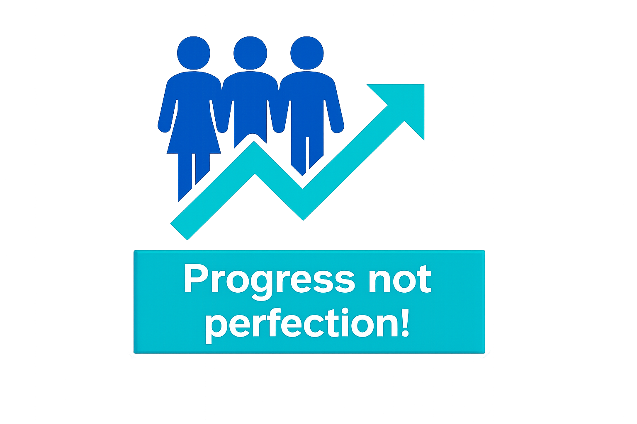
Evaluating: are you becoming good leaders?
Do the children enjoy your activities?
Are you responsible?
Do you work well as a team?
Notes:
TEACHER NOTES
Use the slide to explain that to be good leaders, they need:
Children to enjoy the activities (using instant feedback and the feedback tools to find out) – as per earlier section.
To be responsible – so they are using their (and staff) time well.
To work together as a team so everyone pulls their weight.
Emphasise that they are learning to be good activity leaders. Practising will help them to progress.
Reviewing helps them to evaluate (one of the leadership skills – see module 1 and goals and skills download), i.e., judge how well they are doing.

Slide 20
Practise to make progress
Group 2
Group 1
What will we be doing if we are responsible?
Write 3 top tips.
Example: Be punctual (arrive on time to set up).
What will we be doing if we work well as a team?
Write 3 top tips.
Example: Communicate (listen to each other’s ideas).
Notes:
TEACHER NOTES
Use the slide to guide the young leaders through the task.
Work in 2 groups: group 1 focuses on responsibility; group 2 focuses on teamwork.
They may discuss more than 3 tips but will focus on 3 each to feedback to the other group.
Encourage them to focus on practical things they can do as young leaders in school.
ALTERNATIVES
Increase or decrease the number of tips.
Set up 2 stations – one for responsibility, one for teamwork – both groups visit both stations (with the second group adding new ideas to the first group’s list).
Discuss in pairs then share in the whole group.
Have 2 groups for each topic who combine their tips into one list before sharing.
Print and cut up the examples (slide 21). In small groups, ask the young leaders to sort the separate tips into the two respective groups (responsibility and teamwork). To make it more active, the group members take turns to collect the separate tips from piles around the room.

Slide 21
Did your top tips include…?
Teamwork
Responsible
Keep to time
Make notes or reminders
Have correct equipment
Check/ follow instructions
Complete tasks
Tidy up
Be resilient
Communicate:
  Speak clearly
  Listen carefully
Respect each other
Agree plans and decisions
Help each other
Share ideas and resources
Share the workload
Notes:
TEACHER NOTES
Use the slide to reinforce or add to the young leaders’ top tips.
Remind the young leaders about the other leadership skills they are learning (see module 1 and personal goals download). These tips focus on responsibility (which also requires resilience) and teamwork (which also requires communication).

Slide 22
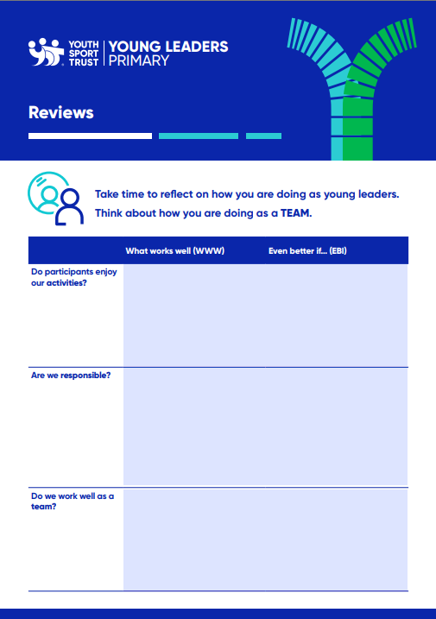
Take time to reflect
Use the team- and self-review handout.
What are you doing well? (team + self)
What will you try to do even better? (team + self)
Are you getting closer to your personal goal?
What leadership skills have you used – and how?
Notes:
TEACHER NOTES
Share the reviews (team and self) handout (see downloads).
After they have run a few activities, encourage the young leaders to reflect on their progress as activity leaders.
They can review as a team and individually.
Remind the young leaders of the personal goals they set themselves at the start. Are they getting closer? Have they achieved them? Do they need to set themselves new goals? (See module 1 and downloads.)
Encourage them to reflect on their leadership skills. Which skills have they used – and how?

Slide 23
Congratulations!
You have completed the course for young leaders.
It is time to put your ideas into action.
Notes:
TEACHER NOTES
Confirm how the young leaders will get started in your school.

