Slide 1




Welcome
This session will be recorded
Please turn your camera on and mute on (until breakout rooms)
Type questions into the chat function
We understand that people are working from home and the distractions that go with it!
Notes:
Welcome on behalf of the Schools Active Movement Board. We know its becoming increasingly more difficult to attend as the lockdown rules start easing and more activity can be delivered in schools by you and your teams.
Start with a quick update and set the context for todays webinar.

Slide 2



SAM membership
196 members
12,000 schools
3.25 million children
Notes:
-195 members who represent their organisation. In some cases that organisation is run solely in others are multiple staff
-Work with 12,000 schools and 3.25 million children.
-Membership continues to grow.

Slide 3

Thankyou
Notes:
On behalf of the SAM board I would like to thank those that were able to contribute to the SAM national school survey. We understand that not everyone was able to participate due to local surveys being circulation at the time but around half were.
It was a momentous effort with phenomenal response from schools which proves how connected members are with their schools. Andy will be going through the results shortly.

Slide 4
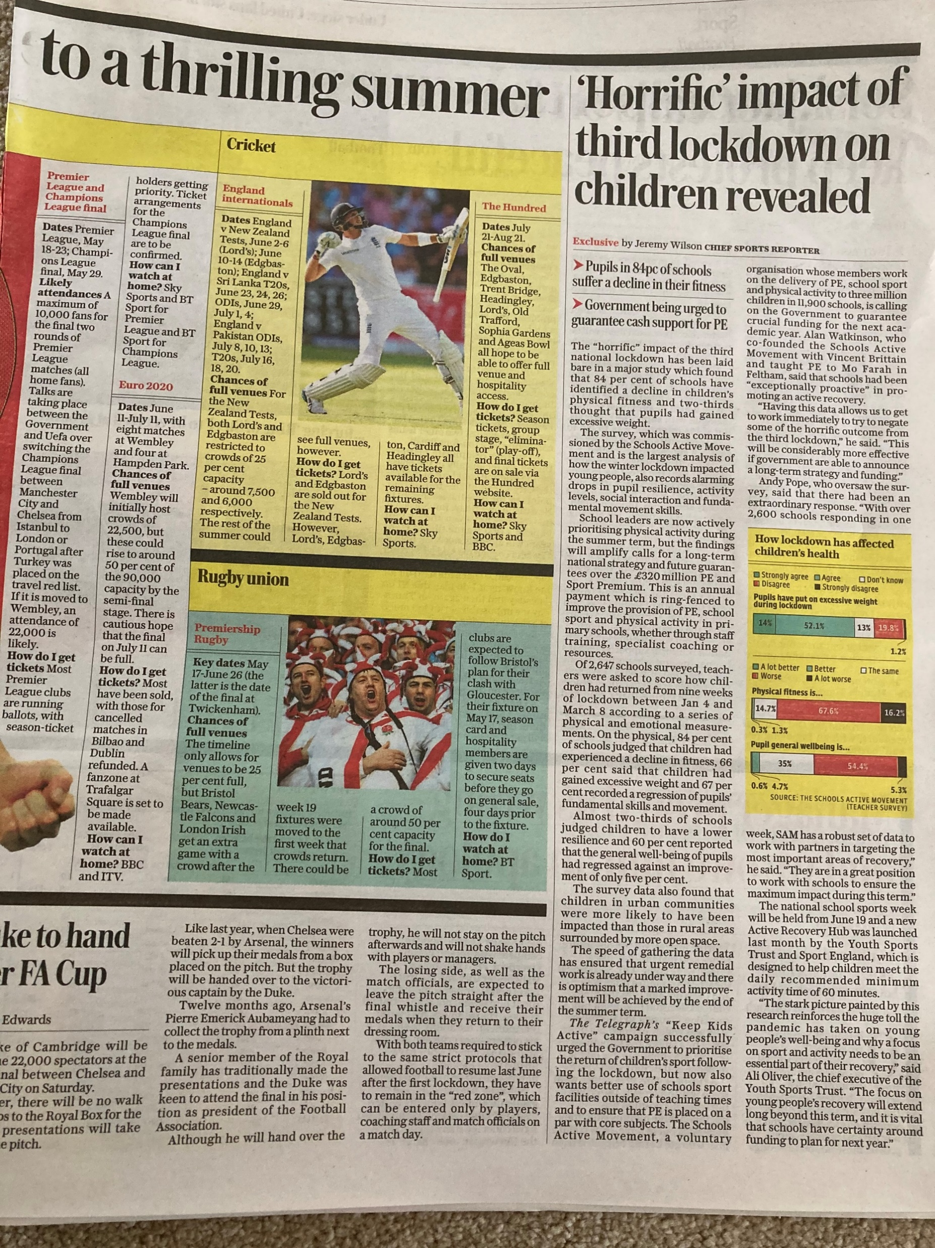
Thankyou
Notes:
With this data we were able to secure coverage in the Telegraph and will be expecting more once we publish the impact report.

Slide 5

Context of todays webinar
No PE and School Sport Premium announcement
School Games Contract ends October 21
‘Call to action’ required
We will do this both locally and nationally focussing on the impact that this uncertainty is having on us/schools playing our important contribution of an ‘active recovery’ for the benefit of children & young people
Notes:
We don’t currently have an announcement of Premium and we completely understand that may of you that perform an SGO role have contracts that end in October.
Its time for the movement to come together and raise the awareness of issues .
We will do this both locally and nationally focussing on the impact that this uncertainty is having on us playing our important contribution of an ‘active recovery’ for the benefit of children & young people. The data we have collected through the SAM national school survey will allow us to demonstrate further the importance of SAM members work being delivered locally for local communities across England.

Slide 6
Agenda
SAM National survey data
BREAKOUT 1 – Practical Context
Call to action
BREAKOUT 2 – Political Context
Ali Oliver
Timeline
Notes:
SAM National survey responses data will be analysed by Andy
BREAKOUT-will be facilitated by Board members and will look at identifying and sharing the good practice to tackle identified issues to be able to demonstrate what we are doing collectively nationally and locally (system for collecting good practice needs to be explained either before or after-what is the system?)
call to action-Alan will detail what we can all do as members to raise the awareness locally to the people that need to be aware
BREAKOUT-Board members will lead the breakout session to explore how politically how can we use the data effectively.
Ali Oliver-Ali will give use insight as to what YST are doing behind the scenes
Timeline-We will look through a timeline to ensure engage with the call to action in a timely manner

Slide 7
National Survey Data
Notes:
Andy Pope

Slide 8
National Data Headlines
2647 Schools Responded to the Survey
94 SAM Member areas were represented in the Survey
30 Active Partnership areas were represented in the Survey
Responses came from Primary, Secondary and Special Schools
The data is reported by SAM Member, Active Partnership, Nationally
The data is available in both Hard Figures and Percentages
The data represents the professional judgement of PE leads and head teachers across these 2647 schools; it does not represent individual pupil data

Slide 9
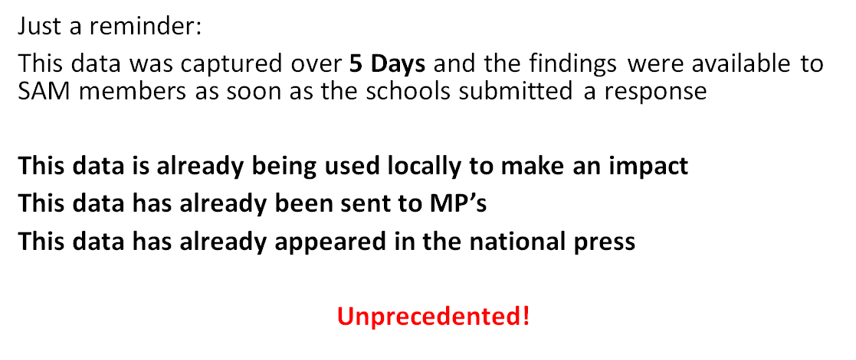
Congratulations

Slide 10
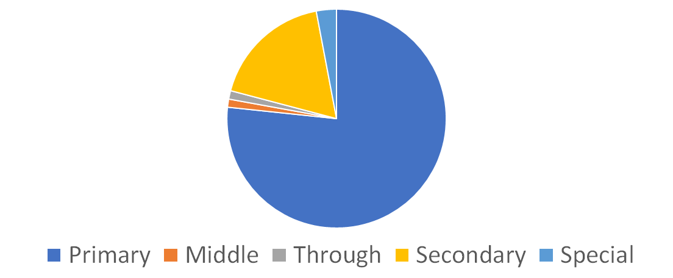
Type of School
76.80% | 1.02% | 1.25% | 17.94% | 2.98%
Primary | Middle | Through | Secondary | Special

Slide 11
Since returning to school on the 8th March, following the Third National Lockdown……………..

Slide 12
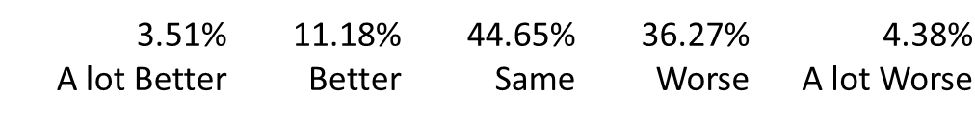
Pupil Social Interaction is…

Slide 13
Pupil resilience is…
1.62% | 6.04% | 27.96% | 56.63% | 7.74%
A lot Better | Better | Same | Worse | A lot Worse

Slide 14

Pupil resilience is…
Powered by

Slide 15
Pupils have put on excessive weight during Lockdown
14.02% | 52.06% | 12.96% | 19.76% | 1.21%
Strongly Agree | Agree | Don't know | Disagree | Strongly Disagree

Slide 16
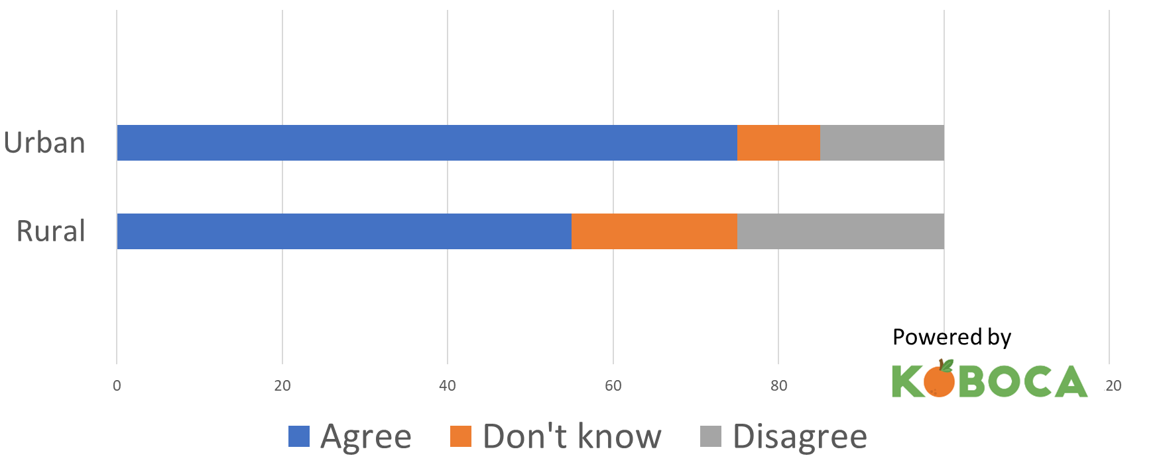
Pupils have put on excessive weight during Lockdown

Slide 17
FMS of pupils are…
0.38% | 1.17% | 31.05% | 59.20% | 8.20%
A lot Better | Better | Same | Worse | A lot Worse
Powered by

Slide 18
Physical Fitness is…
0.30% | 1.28% | 14.70% | 67.55% | 16.17%
A lot Better | Better | Same | Worse | A lot Worse
Powered by

Slide 19
Physical Fitness is…
Powered by

Slide 20
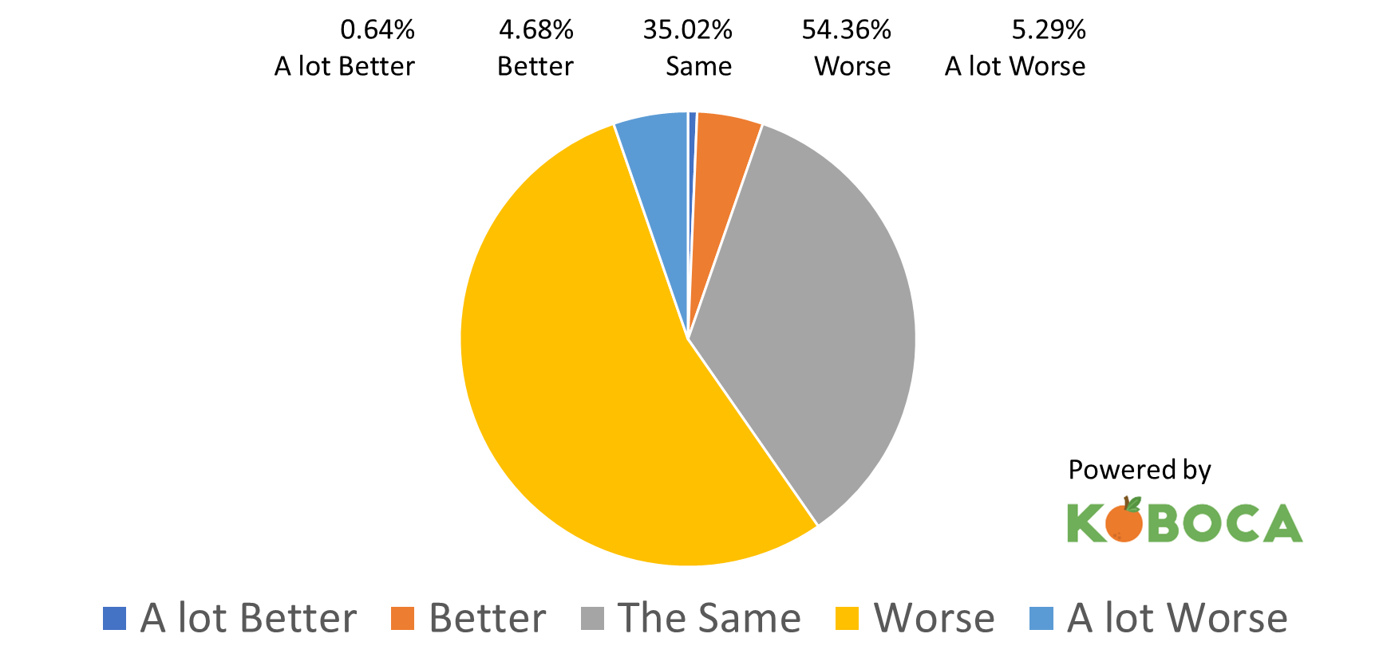
Physical Activity Levels are…

Slide 21
Physical Activity Levels are…
Powered by

Slide 22
Pupil General Wellbeing is …
0.64% | 4.68% | 35.02% | 54.36% | 5.29%
A lot Better | Better | Same | Worse | A lot Worse
Powered by

Slide 23
National Picture & Local Picture

Slide 24
System
For further info and a full presentation of the System
Contact: andypope14@outlook.com

Slide 25
Breakout 1 – Practical context
What are you doing or planning to do locally to tackle the issues identified in the survey?
Notes:
BREAKOUT-good practice tackling identified issues to be able to demonstrate what we are doing collectively nationally and locally (system for collecting good practice needs to be explained either before or after-what is the system?)
Ali is going to give an example

Slide 26
Call to action –
Local awareness of SAM survey (who?)
Using local and national data - what YOU are doing to tackle the issues. The value of the network to achieve HHA.
FIT4HHA – The framework for your discussions
Accentuate the positives
Consider the priorities
MPs (connect/re-connect)
Letter
Notes:
Alan Watkinson
What WE need to do (call to action)
BREAKOUT-politically how can we use the data effectively. Dean Gilmore to give his example

Slide 27
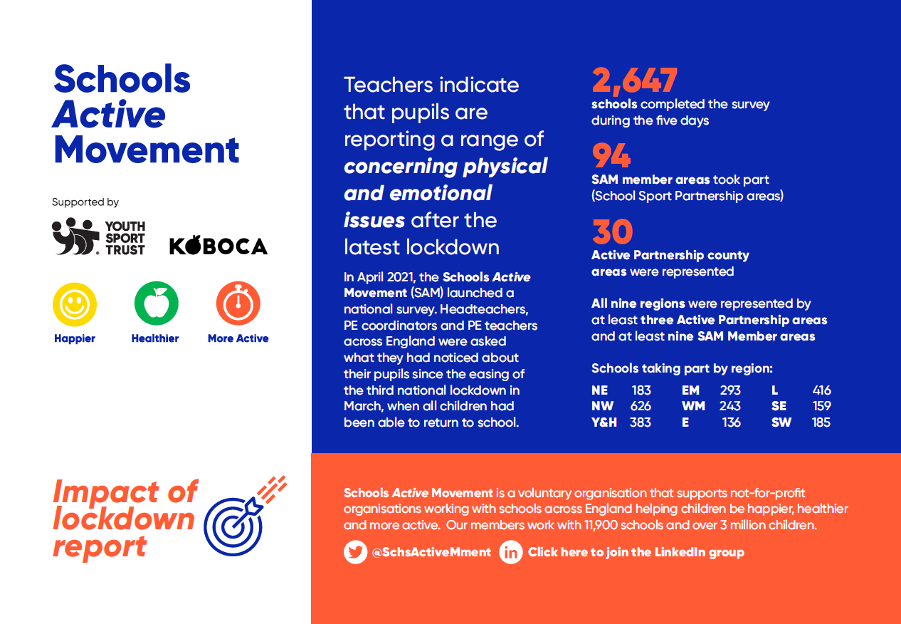
Notes:
Alan Watkinson
What WE need to do (call to action)
Raise locally the awareness of SAM survey (using local or national data) and crucially what YOU are doing to tackle the issues. FIT4HHA
Heads, Active Partnerships, Council, Public Health, local press
MPs
SAM survey results & how YOU are addressing the issues
PE Premium/School Games Contract impact this is having on schools being able to plan effectively
Question to raise in parliament/house of commons (ACTION-need question)
FIT4HHA
BREAKOUT-politically how can we use the data effectively. Dean Gilmore to give his example along with Vincent

Slide 28
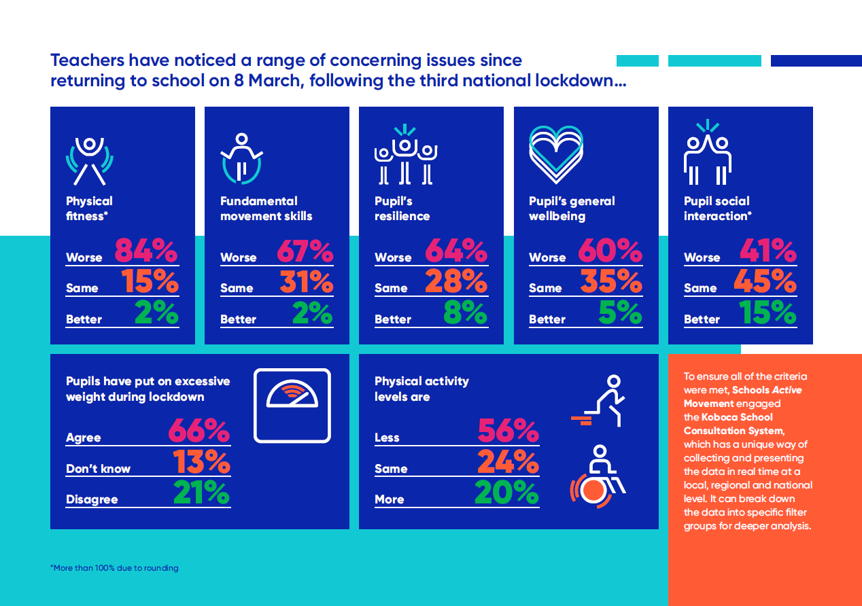
Notes:
Alan Watkinson
What WE need to do (call to action)
Raise locally the awareness of SAM survey (using local or national data) and crucially what YOU are doing to tackle the issues. FIT4HHA
Heads, Active Partnerships, Council, Public Health, local press
MPs
SAM survey results & how YOU are addressing the issues
PE Premium/School Games Contract impact this is having on schools being able to plan effectively
Question to raise in parliament/house of commons (ACTION-need question)
FIT4HHA
BREAKOUT-politically how can we use the data effectively. Dean Gilmore to give his example along with Vincent

Slide 29

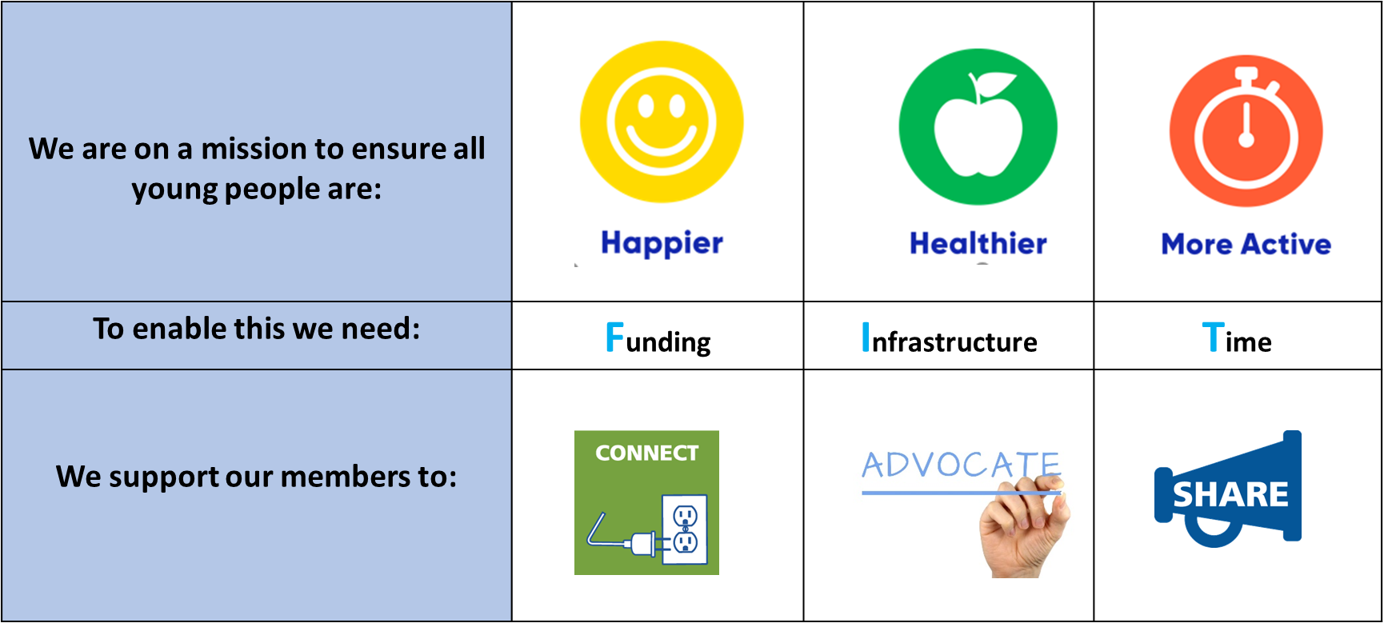

Slide 30
MP letter/email
Please refer to MP template letters sent to members on 24th May
Notes:
Alan Watkinson
What WE need to do (call to action)
Raise locally the awareness of SAM survey (using local or national data) and crucially what YOU are doing to tackle the issues. FIT4HHA
Heads, Active Partnerships, Council, Public Health, local press
MPs
SAM survey results & how YOU are addressing the issues
PE Premium/School Games Contract impact this is having on schools being able to plan effectively
Question to raise in parliament/house of commons (ACTION-need question)
FIT4HHA
BREAKOUT-politically how can we use the data effectively. Dean Gilmore to give his example along with Vincent

Slide 31
Breakout 2 – Political context
Lets share how we are engaging now and share what we can do
Notes:
Alan Watkinson
What WE need to do (call to action)
Raise locally the awareness of SAM survey (using local or national data) and crucially what YOU are doing to tackle the issues. FIT4HHA
Heads, Active Partnerships, Council, Public Health, local press
MPs
SAM survey results & how YOU are addressing the issues
PE Premium/School Games Contract impact this is having on schools being able to plan effectively
Question to raise in parliament/house of commons (ACTION-need question)
FIT4HHA
BREAKOUT-politically how can we use the data effectively. Dean Gilmore to give his example along with Vincent

Slide 32
Ali Oliver MBE

Slide 33
Call to action timeline
18th May-11th June
  SAM members advocate locally
    Share SAM data
    MPs
    Local press
    Connect with sporting figures
7th June onwards
  SAM Board will commence a national campaign
  School Sport & Activity Sector Support

Slide 34
Call to action
Notes:
Reflect on last year, importance of doing something not putting it off or thinking someone else is doing it. Schools Active Movement is only as strong as what its members support us. The SAM board will advocate nationally and represent you BUT you must represent yourselves locally too.

Slide 35
Thank you for joining the webinar.
We look forward to seeing you at the next informal networking session on
Thursday 17th June 1.30pm
Please complete the evaluation survey and tell us the good practice you are doing to combat the issues SAM survey has identified

