Slide 1
Welcome
This session will be recorded
Please turn your camera on and mute on (until breakout rooms)
Type questions into the chat function
Notes:
Welcome on behalf of the Schools Active Movement Board. We know its becoming increasingly more difficult to attend as the lockdown rules start easing and more activity can be delivered in schools by you and your teams.
Start with a quick update and set the context for todays webinar.

Slide 2
Agenda
Welcome and SAM Update
Observations from School Sport & Activity Sector meeting 16th September
Observations from DfE Ministerial Round Table and future of PE and Sport Premium
Breakout – Informal networking
Pupil Activity and Well Being Survey
Interview with Jonathan Broom-Edwards Paralympian Gold Medallist
Future Dates

Slide 3
SAM update
Notes:
Conscious that we have a number of new members so I apologise if I'm go over old ground
Urge you to read our FIT4HHA which details our asks on the SAM hub.

Slide 4
Notes:
What we (SAM) have achieved in the first year
Created a supportive network for those with an extended remit working with schools (networking events-planned 3 networking and 3 webinars this year). Over 200 not for profit organisations working across the breadth of England working in 12,500 schools, 3.35 million children

Slide 5
Notes:
Established a Board with representation of every region of England
Looking for member to support working groups during the year

Slide 6
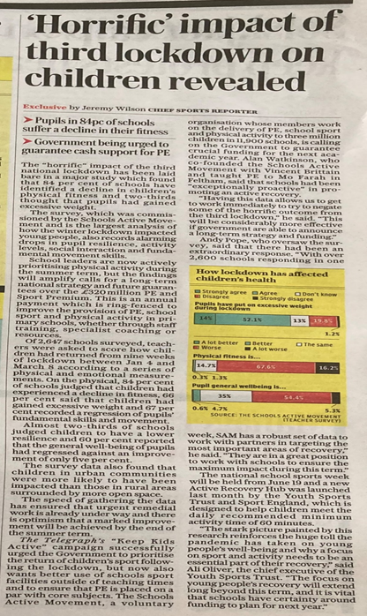
SAM survey post lockdown 2
Notes:
National School Survey which over 10% of schools in England contributed that highlighted the issues facing young people returning from the last lockdown-this was used to demonstrated to Government the importance of the work we do and used by national media! Data was also able to be broken down to support local planning and advocacy work.

Slide 7
MPs
Notes:
MP engagement advocating the work we do locally. Vitally important to ensure government 'get it'.
As well as many SAM members connecting with their local MPs we had Gareth Davies MP attend one of our webinars

Slide 8
Notes:
Established the SAM Hub
Have representation on the School Sport & Activity Sector forum

Slide 9
School Sport and Physical Activity Sector Summit Observations
Notes:
SAM survey results and how SAM members are addressing / Heads perspective / YP-case studies of how SP has help develop their lives (laura leadership now PE teacher) /

Slide 10
School Sport and Physical Activity Sector Summit Observations
What funding should cover
1.Targeted activity to address consequences of the pandemic
2.Extending the reach and depth of the successful School Games programme
3.Investment in teacher training
4.Further opening up of school sports facilities, ensuring that every child has access to an inclusive active extended school day.

Slide 11
School Sport and Physical Activity Sector Summit Observations
1. Targeted activity to address consequences of the pandemic
This includes:
•Tackling a growth in inequality of participation, particularly among young people from lower socio-economic groups
Vital support for teaching swimming and water safety, which have been particularly badly hit over the past 18 months

Slide 12
School Sport and Physical Activity Sector Summit Observations
2. Extending the reach and depth of the School Games
This should include continued investment in a local infrastructure of nationally deployed professional school sport and activity organisers and young volunteers.
It should build on the three-days-a-week of the national School Games Organiser network to connect, contextualise and deliver a national plan in local communities

Slide 13
School Sport and Physical Activity Sector Summit Observations
3. Investment in teacher training
In line with the commitment made in the Conservative party’s 2010 General Election manifesto, this should:
•Refocus Physical Education on movement, confidence, competence, physical fitness, mental health and character
•
•Support all teachers to engage young people in activity across the school day.

Slide 14
School Sport and Physical Activity Sector Summit Observations
Further the opening up of school sports facilities
Every child should have access to an inclusive and active extended school day. This should support coaching capacity and links between clubs and schools.

Slide 15
DfE Ministerial Round Table Observations
Notes:
SAM survey results and how SAM members are addressing / Heads perspective / YP-case studies of how SP has help develop their lives (laura leadership now PE teacher) /

Slide 17
Networking
Thoughts on Sport and Activity Sector and Round Table observations
Notes:
Board members to support. 5-10 minutes depending on time. Ask board members to feed back any pertinent feedback

Slide 18
Pupil Activity and Well Being Survey
Notes:
SAM survey results and how SAM members are addressing / Heads perspective / YP-case studies of how SP has help develop their lives (laura leadership now PE teacher) /

Slide 19
Pupil Activity and Well Being Survey

Slide 20
Pupil Activity and Well Being Survey
66% of Pupils in Y6 are worried about going into Y7 next year with 15% worried 'a lot'
20% of Y6 said they cannot fulfil any of the curriculum swimming requirements
44% of pupils who disagree with the statement "there is an adult I can talk to if something is worrying me" said "if something upsets me, I struggle to recover"
34% of Secondary pupils said they haven't played in their school teams, but would like to or go to a festival

Slide 21
Jonathan Broom-Edwards
Notes:
Spot light on JBE whilst doing Q&A
Thank you for agreeing to become a patron for SAM alongside sir Mo Farah. Going to show a short clip of you in action in Tokyo and then ask a few questions
-How did you become a Paralympian and how did your school years support that journey?
-How did you prepare for Tokyo with a rupture of left Achilles in 2018, 2019 a chronic knee issue, then covid struck and games being delayed for a year! (understand that your that as part of your preparation you had daily hot baths to get used to the humidity but as we saw in the video clip it looked quite wet and cold!)
-What was going through your mind when you had failed 2.07m height twice and failing again would have resulted in a bronze medal. How did you cope with the pressure?
-What was your Tokyo highlight (JBE answer-volunteers/officials -synergy to SAM members and the important role you are all playing with supporting children’s recovery)
-Finally what's your view on the importance of PE & School Sport especially now as we are coming through this pandemic
Thank you on behalf of the SAM board and members for becoming a patron for SAM!

Slide 22
Notes:
Spot light on JBE whilst doing Q&A
Thank you for agreeing to become a patron for SAM alongside sir Mo Farah. Going to show a short clip of you in action in Tokyo and then ask a few questions
-How did you become a Paralympian and how did your school years support that journey?
-How did you prepare for Tokyo with a rupture of left Achilles in 2018, 2019 a chronic knee issue, then covid struck and games being delayed for a year! (understand that your that as part of your preparation you had daily hot baths to get used to the humidity but as we saw in the video clip it looked quite wet and cold!)
-What was going through your mind when you had failed 2.07m height twice and failing again would have resulted in a bronze medal. How did you cope with the pressure?
-What was your Tokyo highlight (JBE answer-volunteers/officials -synergy to SAM members and the important role you are all playing with supporting children’s recovery)
-Finally what's your view on the importance of PE & School Sport especially now as we are coming through this pandemic
Thank you on behalf of the SAM board and members for becoming a patron for SAM!

Slide 23
Future Dates
Date | Format | Zoom Registration Link
Wednesday 8th December 9-10.30am | Networking | https://youthsporttrust.zoom.us/meeting/register/tJEqduCupzwjHdLX_gXP8QOyjH0QAvnYkP8w
Thursday 10th February 11-12.30pm | Webinar | https://youthsporttrust.zoom.us/meeting/register/tJUrdeuprjgrG9fL1nlqoRVirYm4AAPKoGjS
Friday 25th March 9-10.30am | Networking | https://youthsporttrust.zoom.us/meeting/register/tJcof-CurDgjE9zV_97pJT9pk5AqCbTNX9vL
Monday 23rd May 11-12.30pm | Webinar | https://youthsporttrust.zoom.us/meeting/register/tJEoc-msqj4oGdbST5E-DiNs88ToDIajtOD9
Wednesday 6th July 12.30-2pm | Networking | https://youthsporttrust.zoom.us/meeting/register/tJ0of--tqzMoGt2uVJVcR613OSkcFi-LcRjC
Notes:
SAM survey results and how SAM members are addressing / Heads perspective / YP-case studies of how SP has help develop their lives (laura leadership now PE teacher) /

