Slide 2
BUILDING ON ACTIVE 30:30
FOR PHYSICAL HEALTH
Chris Wright
Head of Health & Wellbeing, Youth Sport Trust
Neil McAvoy
Deputy Headteacher and PESSPA Programme Director, Clavering Primary School

Slide 3
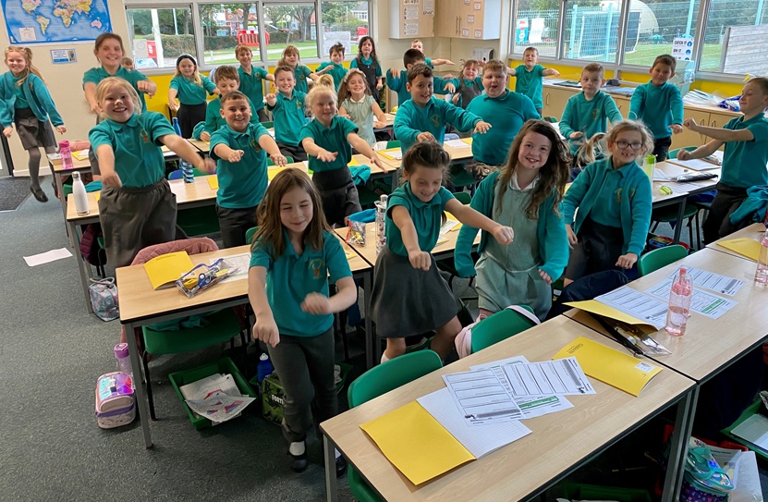
FIVE TOP TIPS

Slide 4
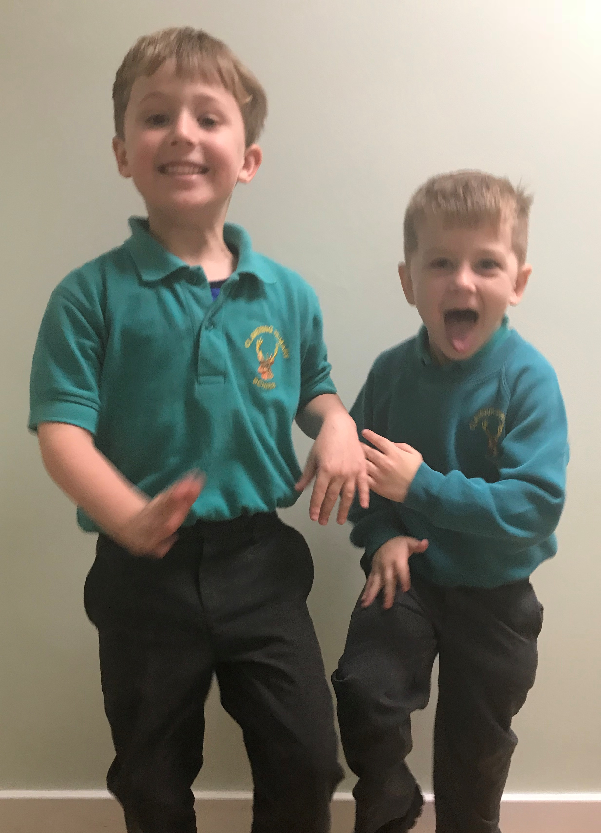
1. The programme isn’t being led by one person: our programme has been designed and implemented by the Senior Leadership Team in consultation with others; it hasn’t been left to just one key member of staff to lead on.
Every member of staff is involved, every member of staff has been part of the design of the programme and every member of staff is accountable for the programme. When our strategy was first launched, it was part of each school leader’s, each teacher’s and each teaching assistant’s performance management targets.
Add large image here
logo + Y should sit on top
If they disappear,
right click on the image and
select send to back

Slide 5
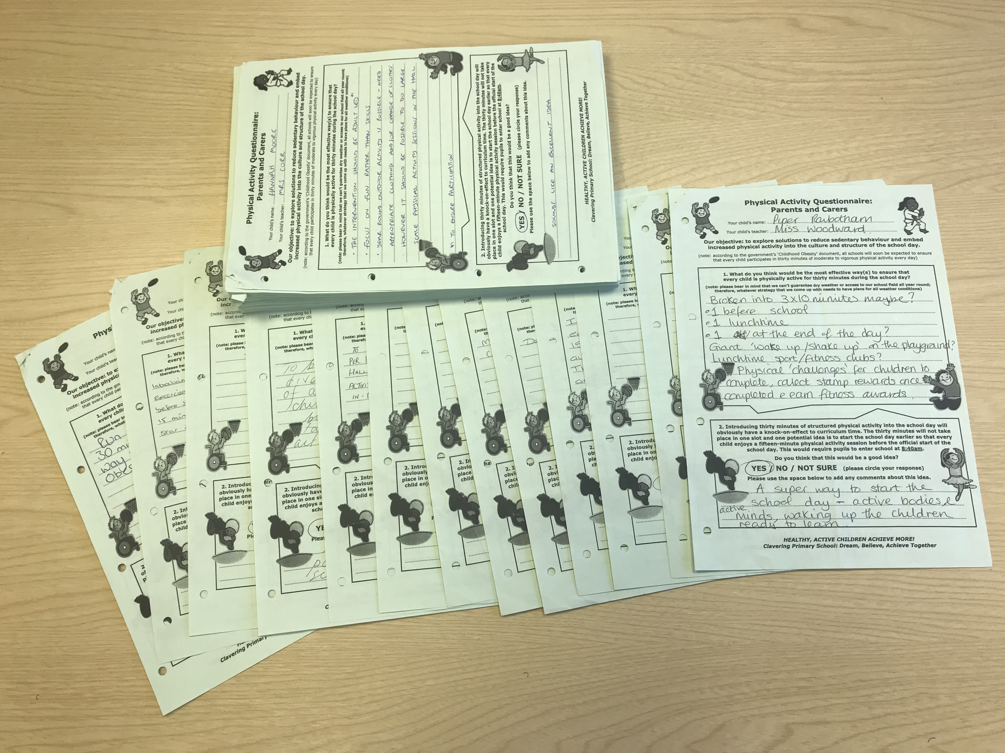
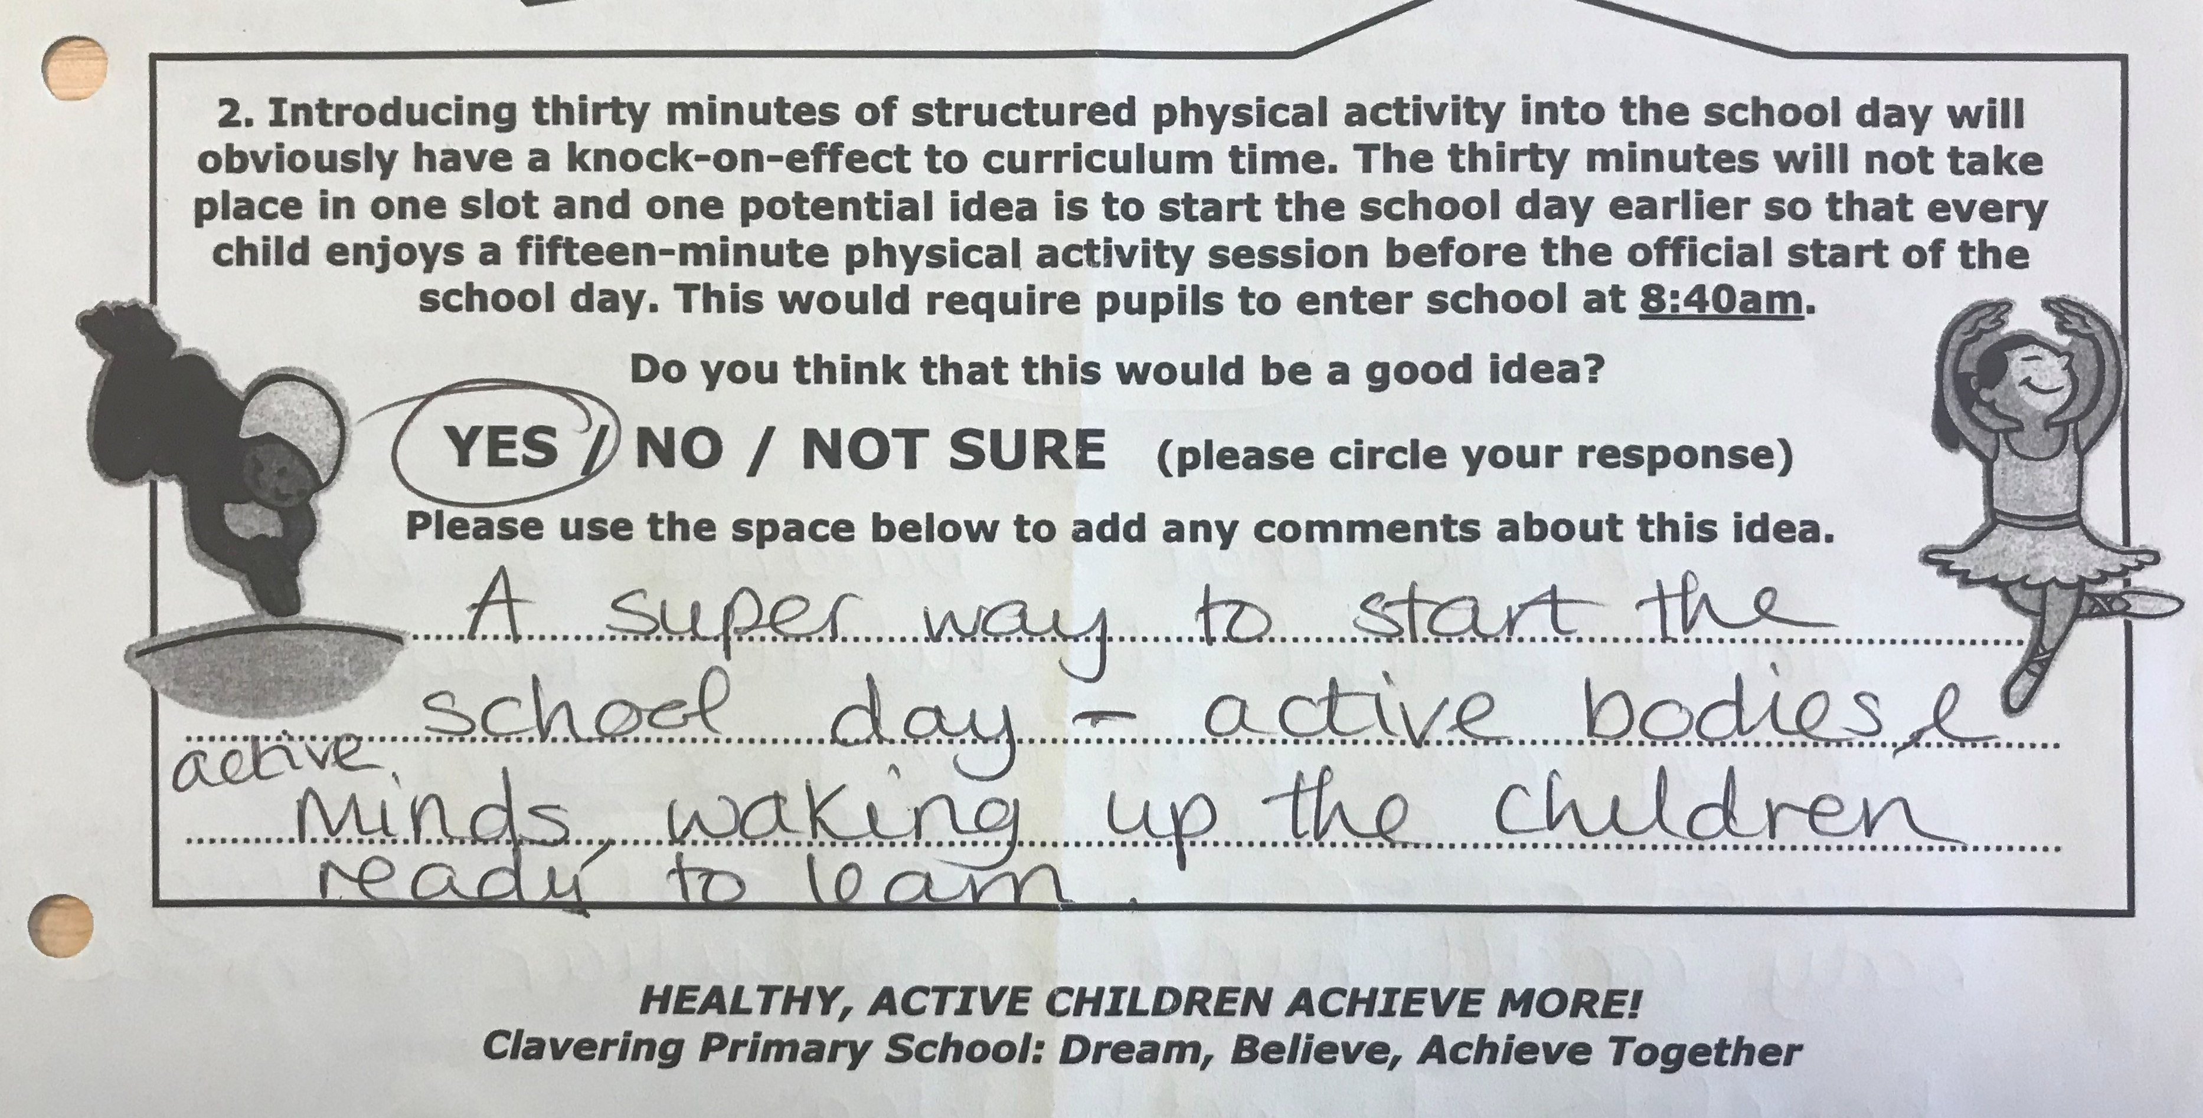
2. All other stakeholders are involved: governors fully back the programme (particularly our PESSPA link governor); families have been consulted and support the programme; and pupils love being physically active!
Note:
We knew that it was crucial to get our parents and carers on board and so we sent out a questionnaire to all our families. The large majority of families completed the questionnaire, expressing a great deal of support for the school’s efforts to increase physical activity. The very large majority of respondents were in favour of achieving 15 of the expected 30 minutes of physical activity during a before-school slot.
A similar questionnaire was distributed to all staff members and, again, there was overwhelming support of our intention to increase physical activity and decrease sedentary behaviour.
Add large image here
logo + Y should sit on top
If they disappear,
right click on the image and
select send to back

Slide 6
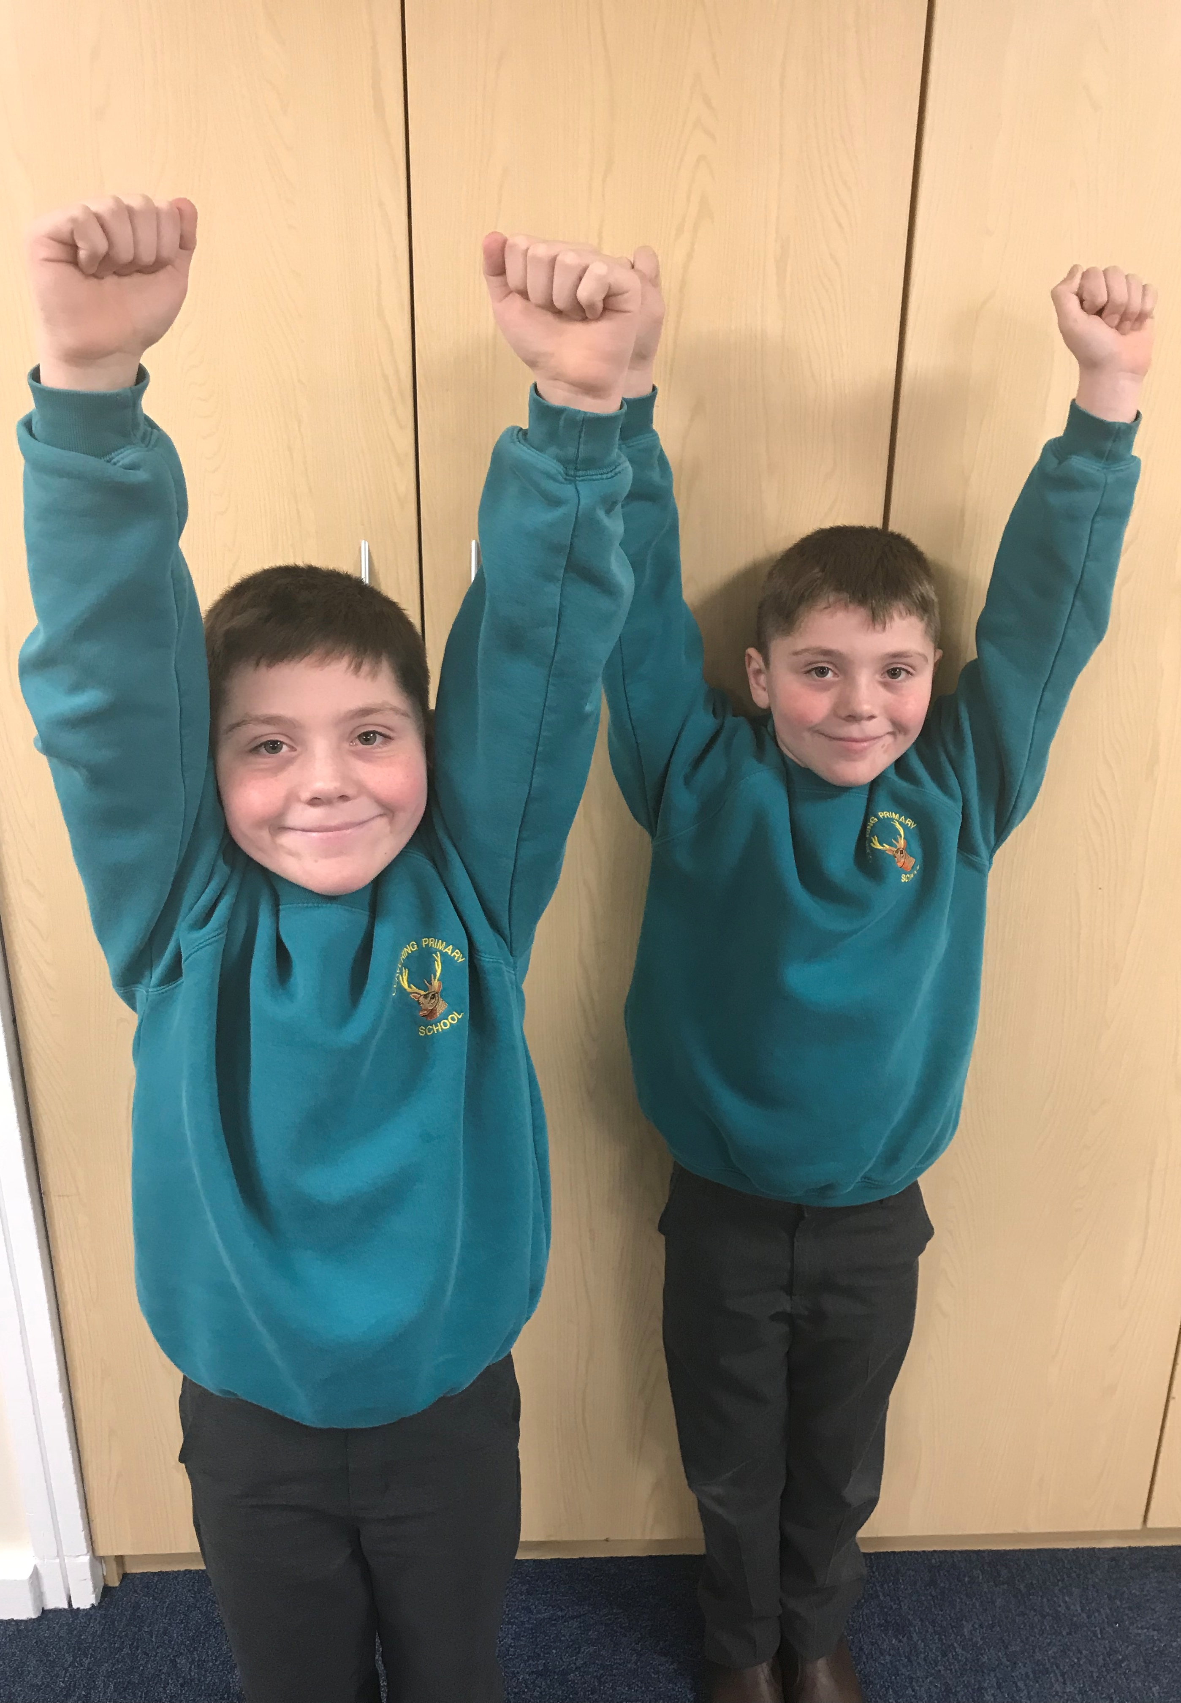
3. The programme has been very, very, very carefully planned with a no-excuses culture:
→ the programme has been planned so that lack of space cannot be an excuse;
→ the programme has been planned so that being outside is not required;
→ like all schools, we are stretched for time, staff and funding; however, our strategy has no additional costs, it doesn’t eat into teaching time, and children don’t get changed for the activities; in fact, teachers have reported that the ‘Clavering 30:30 Strategy for Physical Activity’ enhances learning rather than detracts from it.
Add large image here
logo + Y should sit on top
If they disappear,
right click on the image and
select send to back

Slide 7
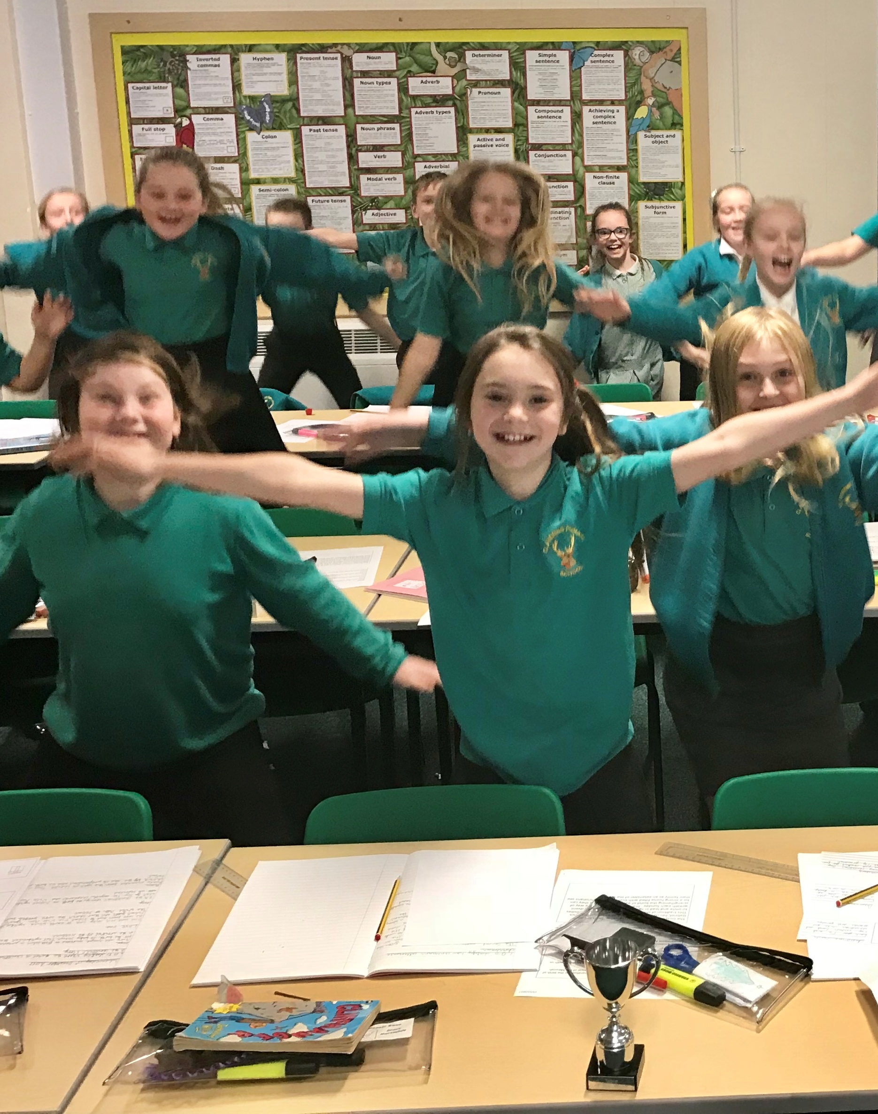
4. Although a huge amount of time, thought and energy went into creating our strategy, it is very, very, very simple to follow on a daily basis:
→ we can guarantee that every child is active for thirty minutes because the ‘Get Up, Get Active’ sessions and ‘Active Breaks’ total thirty minutes every day;
→ teachers can focus on providing additional, quality opportunities for active learning rather than thinking that they need to find thirty minutes of physical activity opportunities every day;
→ other opportunities (active learning, active transport, active playtimes, active lunchtimes, PE lessons, school sport, extra-curricular activities, etc) are all in addition to the thirty minutes;
→ staff members only need to press ‘play’!
000000000000000000000
Add large image here
logo + Y should sit on top
If they disappear,
right click on the image and
select send to back

Slide 8
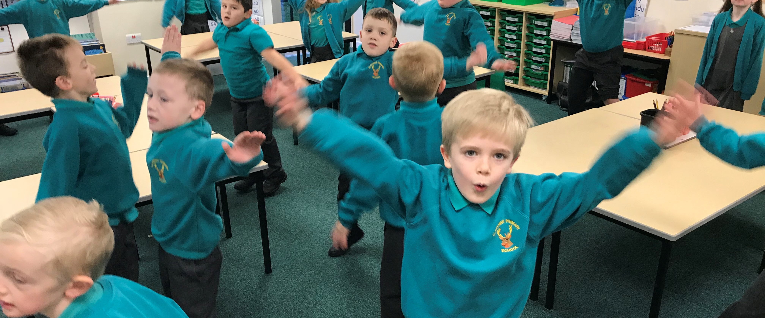
5. It’s fun!
We cannot emphasise enough how important this fifth reason is! We want every Clavering child to be committed to maintaining a healthy, active lifestyle; they are far more likely to do this, if they enjoy what they are doing!
Add large image here
logo + Y should sit on top
If they disappear,
right click on the image and
select send to back

Slide 9
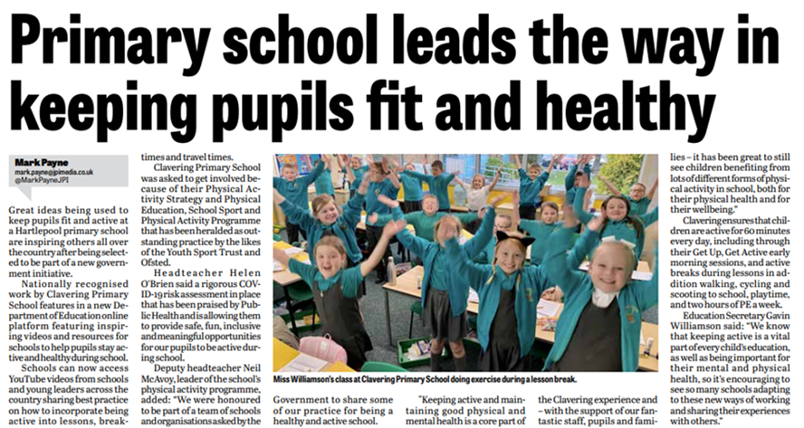
THANK YOU!
Neil McAvoy
N.McAvoy@claveringschool.org.uk
@Neil_McAvoy
PESSPA@claveringschool.org.uk
@ClaveringPESSPA

