Slide 1

School Sport and Activity Sector Partnership Summit

Slide 2

Agenda
Time | Session | Speakers & Contributors
10:00 | Opening Addresses Sector Pledges State of the Nation Policy Updates Strategic Insight | Gavin James, Youth Sport Trust & Sara Yasin, Youth Sport Trust Youth Board Ali Oliver - Youth Sport Trust Matthew Hopkinson - Department for Education Kate Thornton-Bousfield - Association for Physical Education Alan Watkinson - Schools Active Movement Heather Douglas - UK Coaching
11:15 | A Unified Response
12:15 | Networking Lunch
13:00 | It All Starts With Play | Eugene Minogue - Play England & Chris Wright – Youth Sport Trust
14:00 | Share & Learn Carousel - System Partner Insight | Wendy Taylor – FA x Muslim Sports Foundation Will Brown - Modern Pentathlon Steph Matthews, Youth Sport Trust Ashley Jones – Swim England
15:00 | Panel Q&A
15:30 | Close | Gavin James - Youth Sport Trust

Slide 3


Use the strength of our united voice
Notes:
To use the strength of our united voice to provide consistency of understanding to advocate for the place of positive outcomes from P.E., school sport and physical activity in schools and its importance to every young person’s personal development, health and wellbeing.

Slide 4
Advocacy & Influence
As a sector we will use the strength of our united voice to:
Provide a strong, aligned response to government consultations and new policies across key government departments, helping to advance progress against the Government’s missions.
Reinforce the importance of 60 positive and meaningful active minutes a day in supporting children and young people’s wellbeing and development.
Showcase the value and importance of multi-skill and multi-sport approaches to all education settings (primary, secondary, special schools and alternative provisions) in developing positive relationships with movement.
Evidence and advocate for the role of unstructured and informal play, aligned to a wider ambition to embed physical activity across and beyond the school day.

Slide 5


Take collective, direct action
Notes:
To take collective, direct action to better understand and tackle systemic challenges in our sector so that every young person can benefit from the positive outcomes that participation in P.E., school sport and physical activity offers.

Slide 6
Direct & Collective Action
As a sector we will go beyond single sport/organisation solutions to:
Develop multi-sport content that supports after-school clubs, allowing every child to build confidence, develop skills, and maintain a passion for movement.
Collaborate with young people to co-design and co-produce Key Stage 4 PE, physical activity, and sport content.
Provide resources, tools, and insight to support the development of our workforce, including young people.

Slide 7


Improve the sector from within
Notes:
To improve the sector from within by networking, sharing best practice and providing a supportive environment for all sector parties to thrive to better provide for young people and educators.

Slide 8
Improve the Sector from Within
As a sector we will collaborate to tackle inequalities by:
Sharing effective practice and case studies within our organisations and across our networks.
Engaging with seldom heard young people, particularly those with SEND (and their advocates), from low-income households and ethnically diverse communities to understand and address systemic barriers to participation.
Understanding the impact of inequalities on education outcomes and experiences, using insights to inform our language and interventions.

Slide 9

Ali Oliver
CEO, Youth Sport Trust

Slide 10
Partnerships
NGBs
Active Partnerships
National Organisations
Academics

Slide 11


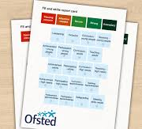
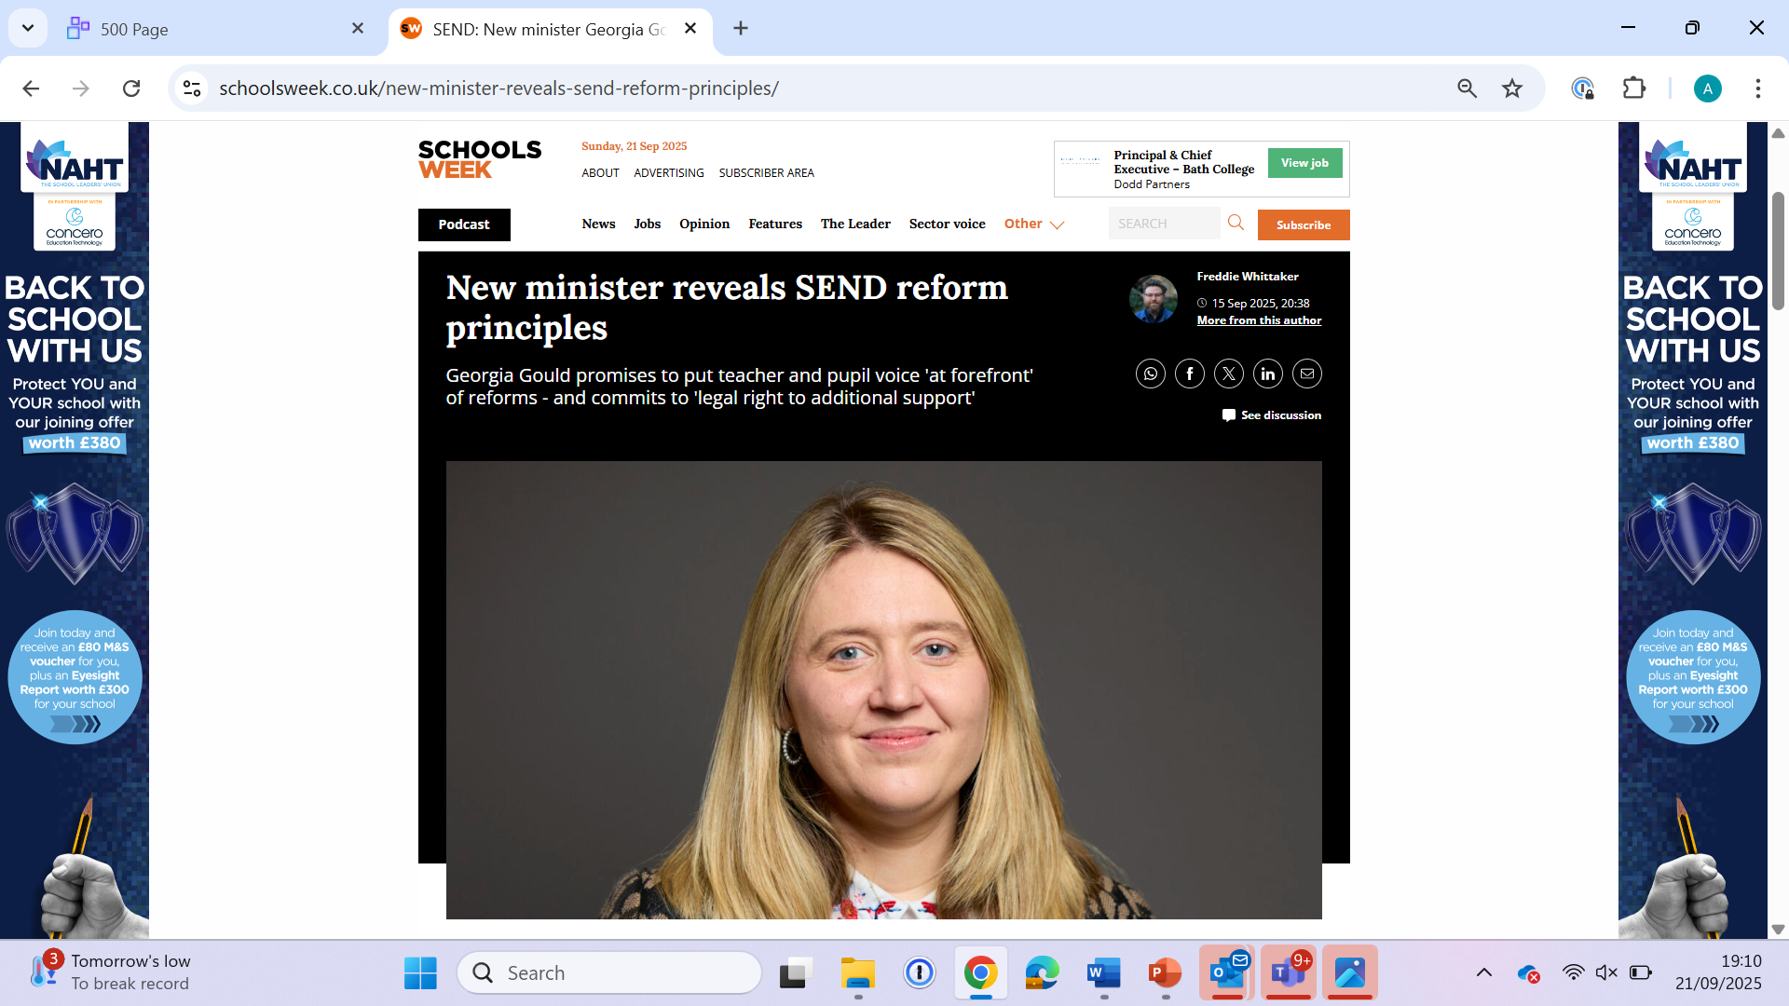




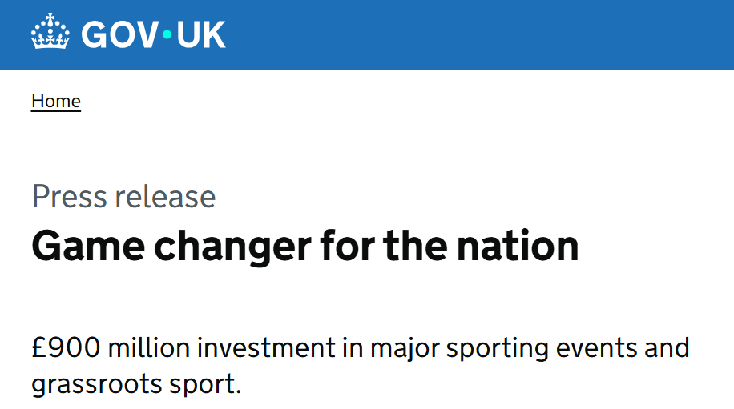

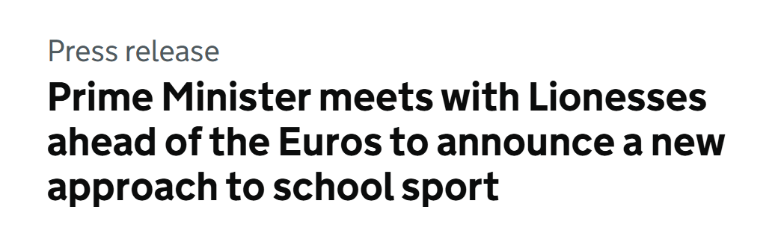

Slide 12
Kate Thornton-Bousfield
CEO, Association for Physical Education

Slide 13
afPE’s support to the sector
Advocacy and Influence
Direct and Collective action
Improve the sector from within
Two hours of HQ PE every child, every week
Notes:
A and I: CAR, NC, Primary PE and sport premium, influence policy. Hold government to account over the two hours of HQ PE EC, EW, EY.
D and C Action: Co design of curriculums, sharing best practice
Improve: active listener, understanding the challenges some YP face – inclusion/ inequalities - ensuring the curriculum meets their needs and they can be successful.

Slide 14
Renew
Growth
Transform
‘We are renewing our purpose, growing our reach and transforming PE’
Curriculum and Assessment Review: National Curriculum PE
Drive purpose, aims and content and assessment and examination of the subject
Ensuring we have a workforce suitably qualified to deliver

Slide 15

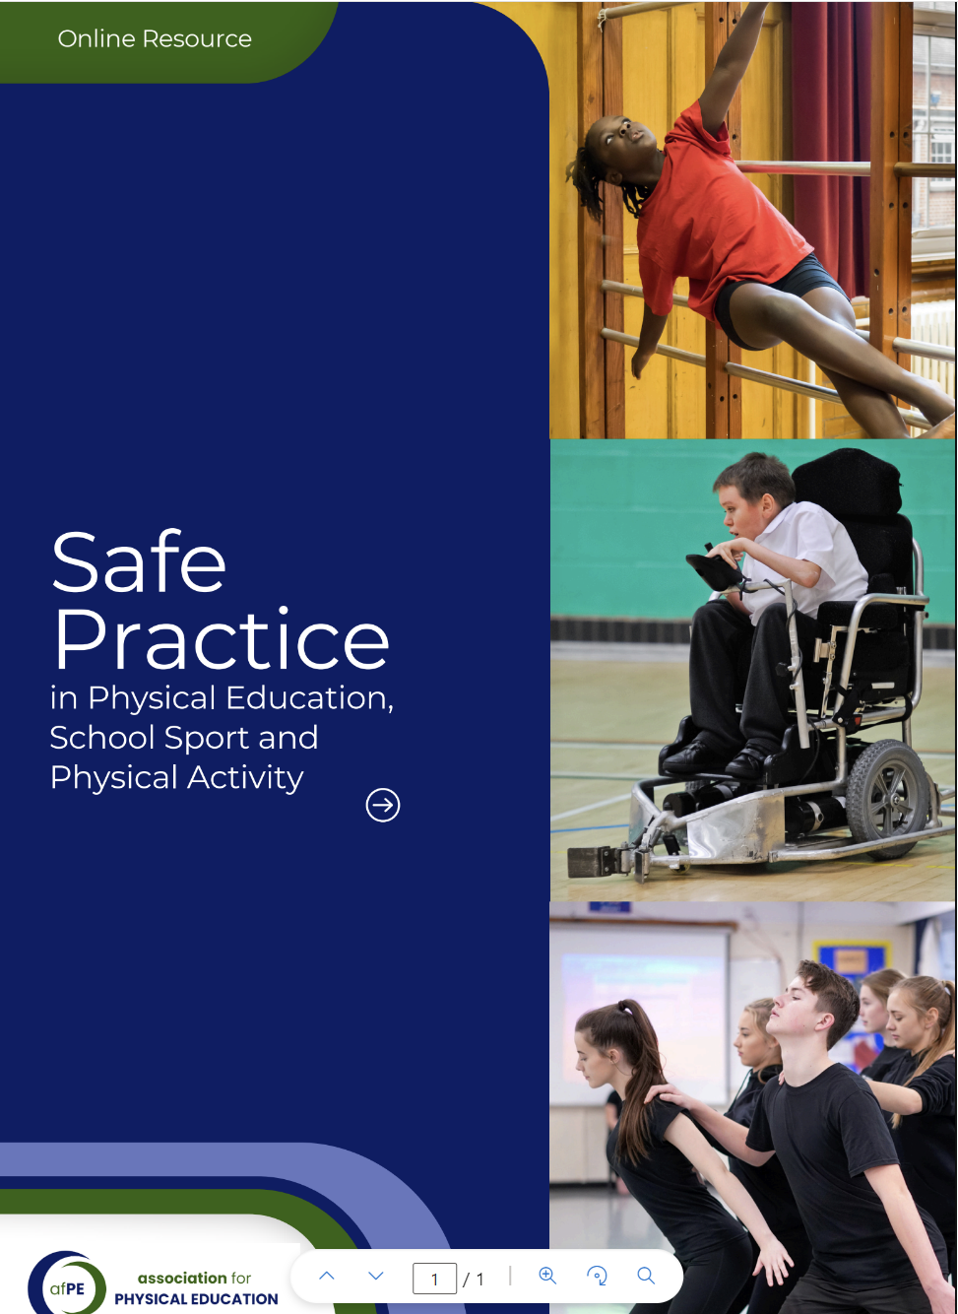

Reassurance and quality assurance
Operational excellence
Strategic insight
Regulatory confidence
Stakeholder trust
Customer confidence
Transparent communication
Qualifications
afPE Certificate Primary PE specialism (level 5)
afPE Certificate Leading effective teaching and learning as a subject leader – Primary/Secondary

Slide 16
Alan Watkinson
Co-Founder, Schools Active Movement

Slide 17

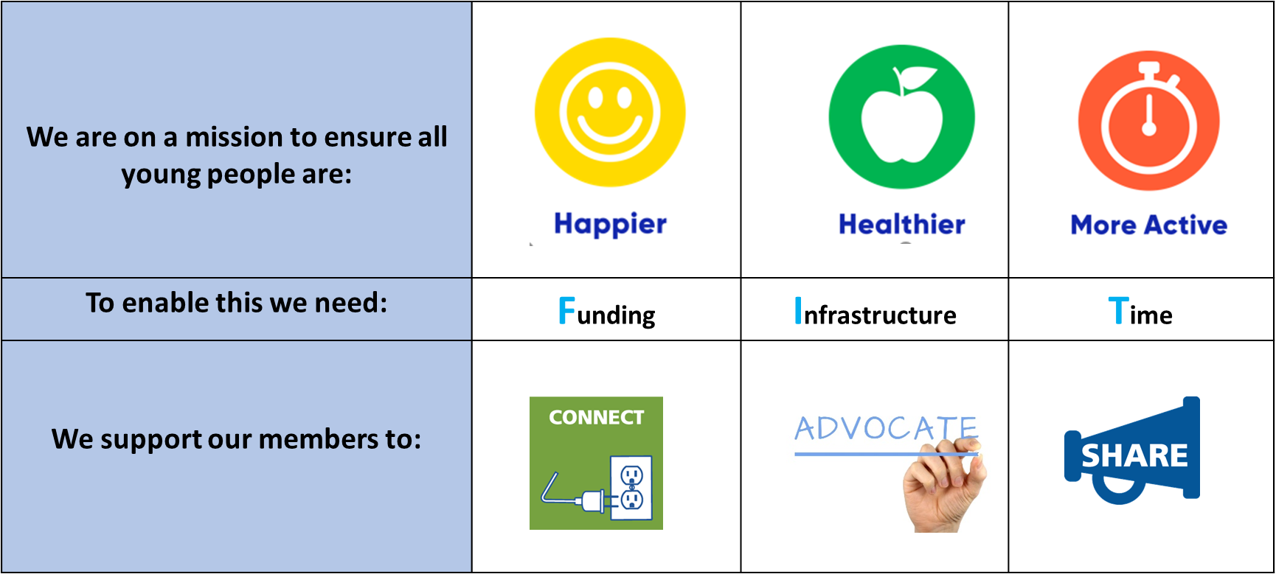

Slide 18
Heather Douglas
Head of Coaching & Policy – UK Coaching

Slide 19




Heather Douglas
Head of Coaching & Policy
UK Coaching Sponsor for Play their Way
www.playtheirway.org

Slide 20


The intersection and alignment of The Children’s Coaching Collaborative and Play Their Way
The Right to be Heard - Voice
The Right to Play - Choice
The Right to Develop - Journey
=

Slide 21
Pre covid CCC assemble, 12 founding orgs
Sept 21 UK Coaching dedicated marketing team
March 22 Primary research fuels creative strategy
Jan 23 Creative identity and resource hub built
May 23 PTW launched a digital campaign - Coaches
May 23 – to date KPIs monitored growth of movement
Phase 2 Teachers & Parents engagement
Sep 23 CCC overarching strategy development
June 25 Youth Voice mechanism established
Autumn 25 Membership model Launch
Winter 25 CCC Strategy launch
All underpinned by ongoing, research, coach tracking, youth voice and coach / org feedback

Slide 22
Share & Learn Carousel
- Insights from the Sector

Slide 23
Swim England
Inclusion 2024
Modern Pentathlon
Obstacle Course Experience
FA x Muslim Sports Foundation
Improving PE & Sport for Muslim Girls
Youth Sport Trust
Rewarding & Recognising Young Leaders

Slide 24

Improving PE & Sport for Muslim Girls
The FA and Nike, alongside Youth Sport Trust and Muslim Sports Foundation have created a practical guide to help you break down the barriers Muslim girls face, in football and across wider sport. It’s full of real insights and practical tips to help you create spaces where every girl feels seen, respected, and empowered to take part.
Schools
Every Girl is Made for This Game
Clubs
Every Girl is Made for this Game | England Football
The FA and Nike, alongside Youth Sport Trust and Muslim Sports Foundation have created a practical guide to help you break down the barriers Muslim girls face, in football and across wider sport. It’s full of real insights and practical tips to help you create spaces where every girl feels seen, respected, and empowered to take part.
Schools
Every Girl is Made for This Game
Clubs
Every Girl is Made for this Game | England Football

