Slide 1
Being a Leader & Role Model
Workshop 1

Slide 2
WORKSHOP OUTCOMES
By the end of this session you should be able to:
Understand why physical activity and sport is important for all girls
Understand that you are role models and have the ability to influence others
Identify the skills and qualities of a good leader and role model
Reflect on your own skills/qualities as leaders and identify a goal to work on

Slide 3
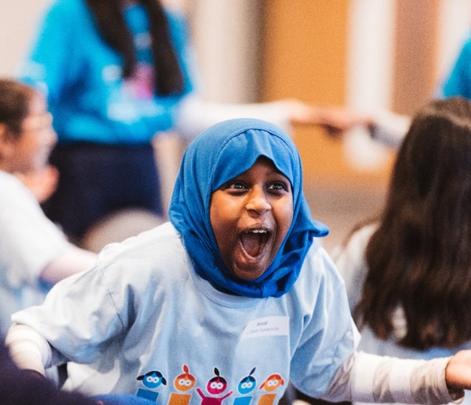
SNOWBALL FIGHT!
Write down:
What you think a leader or a role model is?
Why you think you have been selected to be a Girls Active Leader?
Who inspires you and why? Does anybody encourage you to be more active?
What skills make a good leader/role model?

Slide 4
Recommended activity - 60 mins a day
Builds confidence & social skills
Develops co-ordination
Improves concentration & learning
Strengthens muscles & bones
Improves health & fitness
Maintains healthy weight
Improves sleep
Makes you feel good

Slide 5
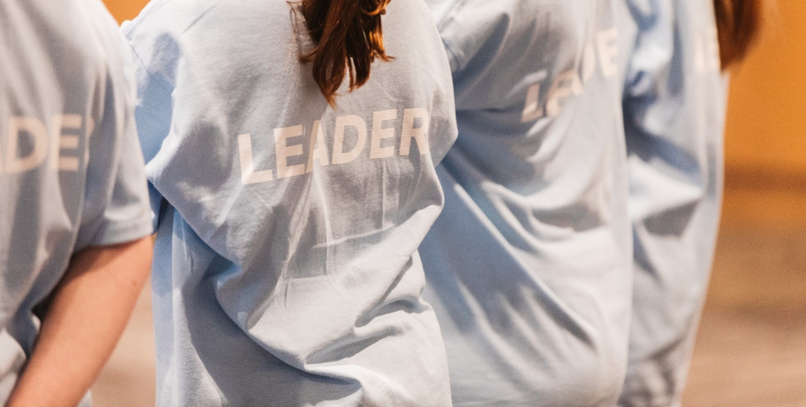
What is a Leader/Role Model?
A leader is someone who inspires others and a role model is someone people aspire to be like. A good leader can also be a role model.

Slide 6
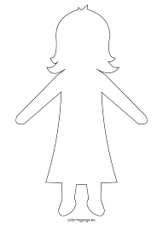
What skills make a good leader/role model?

Slide 7
Activity: Keepy Uppy Challenge!
Type: Individual
Time: 30 seconds
Task:
Pick up your scrunched up piece of paper
How many touches in 30 seconds can you make to keep the object in the air?
Sitting or standing - your choice
Check for hazards

Slide 8
Activity: Keepy Uppy Challenge!
Type: Group work
Time: 5 minutes
Task:
Set yourself a combined team target score
How many touches can you make as a team in 30 seconds?
Nominate a leader and repeat activity
What effect did having a leader have on the team?

Slide 9
To be the best leader I can be…
I am going to…
I want to improve…

Slide 10
“Great leaders don’t set out to be a leader…they set out to make a difference. It’s never about the role - always about the goal.”

