Slide 1
Week 2: To be able to make spending decisions through effective decision making
Be able to explain the difference between something I need and something I might want
Understand I can’t always have what I want
Recognise that people may make different choices about how to save and spend money
Learn to make choices about spending based on personal and team priorities

Slide 2
Play video – Needs and wants
Watch the video and then, working as a team, answer activity 1 questions in tracker.
Describe what a need is
Describe what a want is
What can you do if you really want something but can’t have it straight away?
Notes:
Click on the video title to play video https://vimeo.com/540720947/24b5552e6f

Slide 3
Need or Want?

Slide 4
Need or Want?
Images of rugby items
Need or Want?

Slide 5
Need or Want?
Images of rugby items
Need or Want?

Slide 6
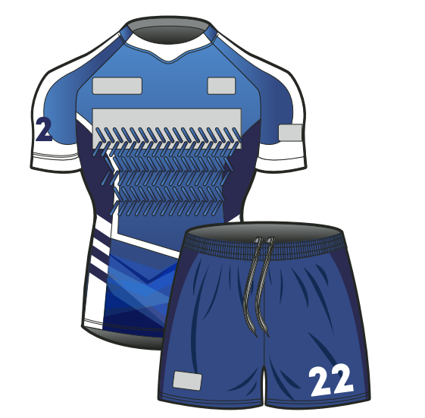
Need or Want?
Images of rugby items
Need or Want?

Slide 7
What will you pack?

Slide 8
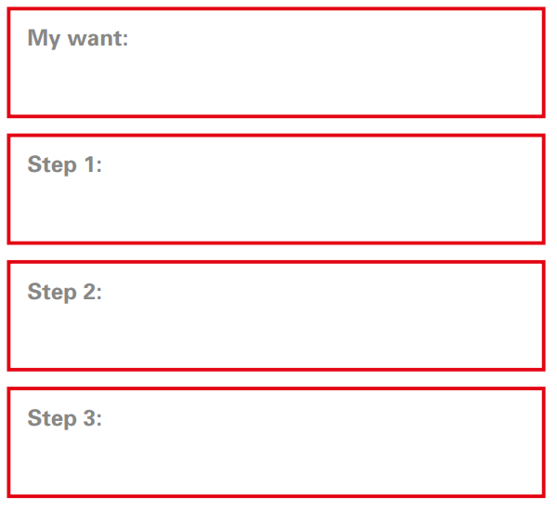
Working towards a want

Slide 9
Recap:
To be able to make simple spending decisions through effective decision making
Explain the difference between something I need and something I might want
Understand I can’t always have what I want
Recognise that people may make different choices about how to save and spend money
Begin to make choices about spending based on personal and team priorities

