Slide 1




Slide 2

Getting started as an active play
Young Leader
Module 2 – Plan

Slide 3

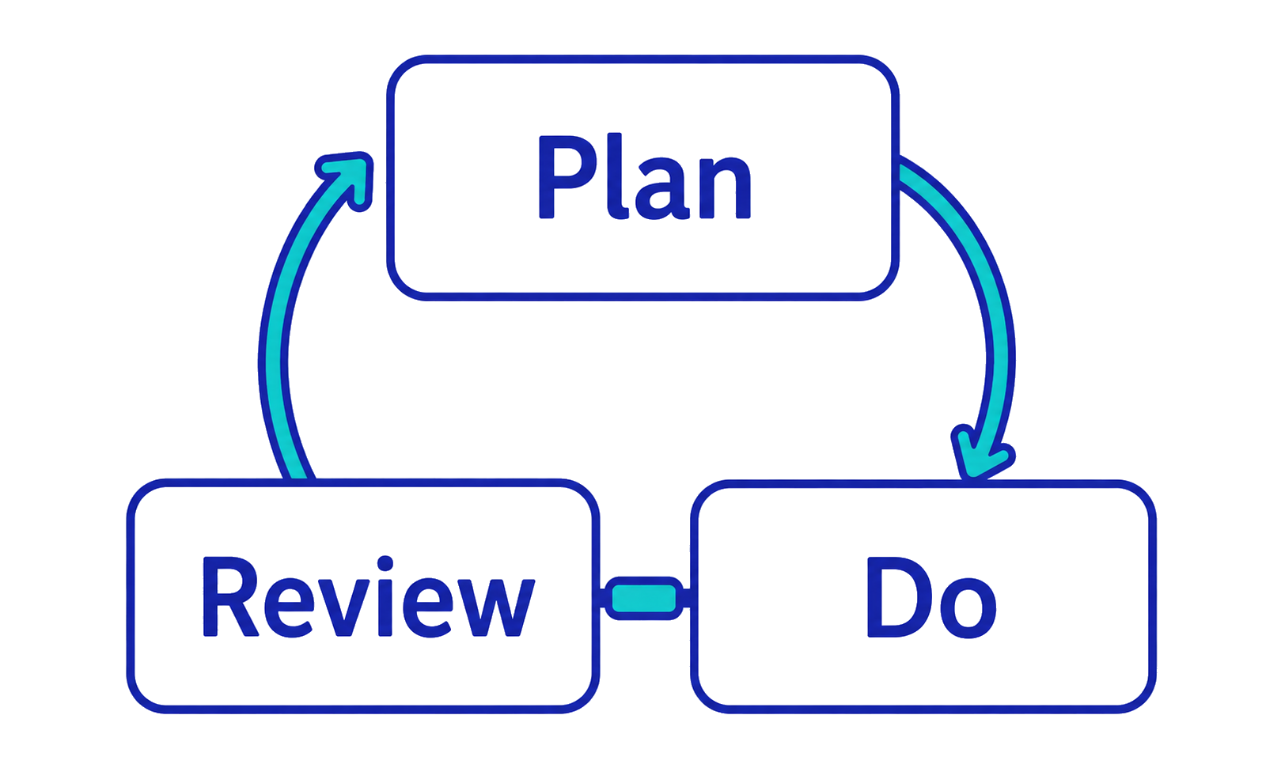
As young leaders, we will…
What do we need to know in advance?
How do we check they are working?
How will we run the activities?

Slide 4
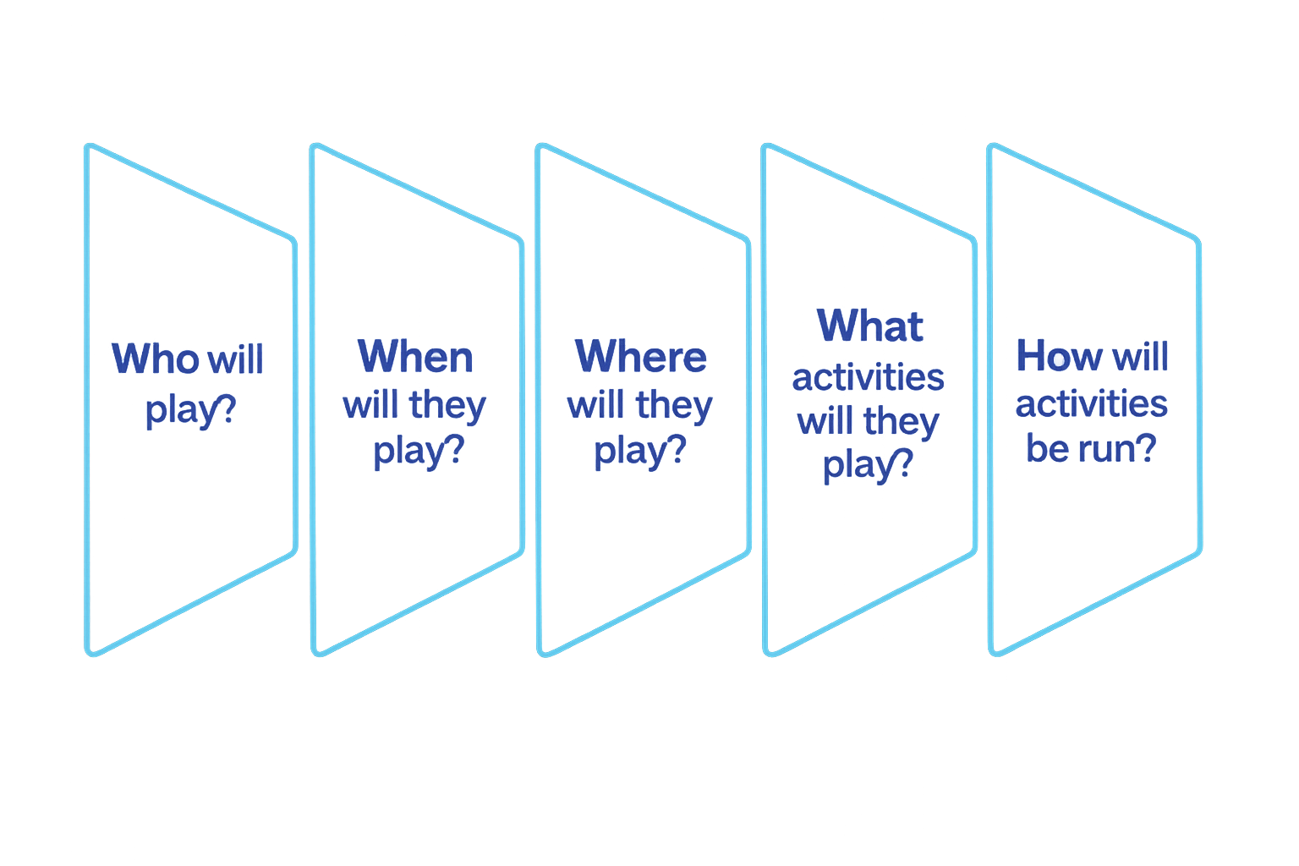
When you plan, you will need to identify and decide…

Slide 5
In pairs, share…
Two things that make the activity positive for you…
What made it enjoyable?
How did it help you to feel a sense of belonging?
Share one thing that was negative for you…
What would have made it more enjoyable?
How could it have given you a better sense of belonging?

Slide 6
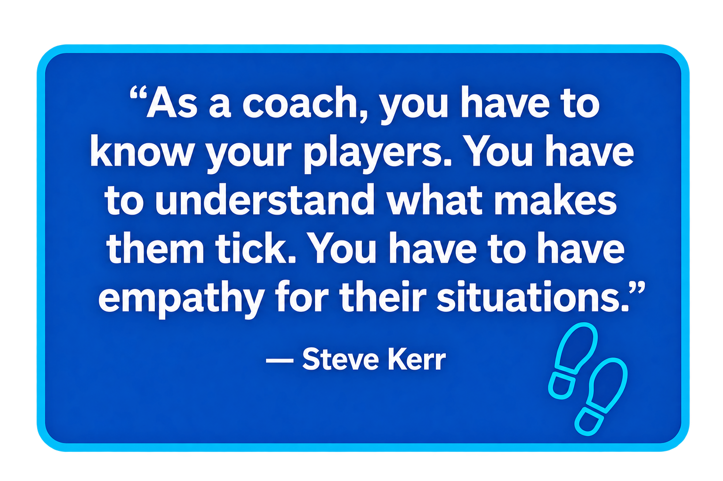
Empathy
I see other people’s perspectives.
For example:
I listen to find out why someone doesn’t want to play.
I recognise the barriers that make it hard for someone to join in.
I consider how someone feels when they are excluded.

Slide 7
Communication Skills
How well did you connect with someone else?
Listen
How well did you…?
Pay attention.
Not interrupt.
Note the main points.
Recognise their feelings.
Show you understood.
Speak
How well did you…?
Focus on the main points.
Speak clearly.
Express your feelings.
Use facial and body language.
Ask questions sensitively.

Slide 8
Make it fair… fit the person
Find out what other young people need and want.
Motivations:
What helps them to take part?
What do they like about physical activity?
Barriers
What stops them from taking part?
What do they dislike about physical activity?

Slide 9
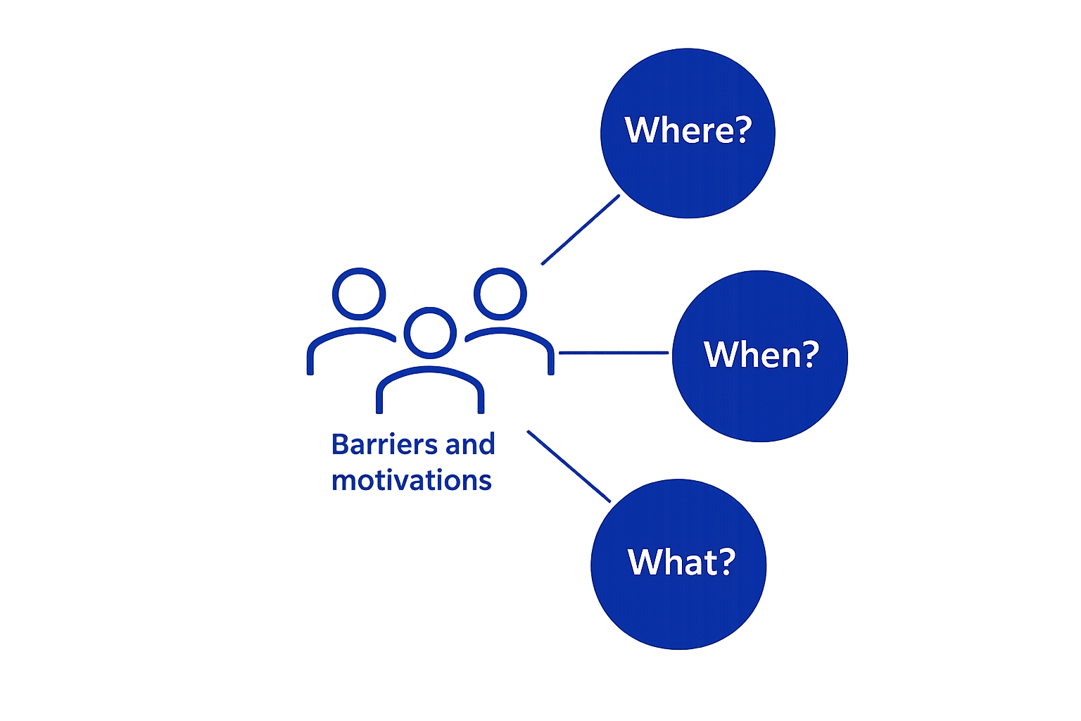
Activity plans will be shaped by…
e.g. hall, field, yard, studio, corridor, etc.
e.g. breakfast, lunchtime, after school, etc.
e.g. cooperative games, competitive games, personal challenges, creative movement, adventurous tasks, etc.
Notes:
Include who, what year group etc.

Slide 10
What activities might you deliver?
In your group:
Look at the example cards to get some ideas.
Discuss and note your own ideas.
Present your ideas in any way you choose.
  (Show your communication skills.)
Show what each activity is and how to play.
Show who it is for.
Show where and when it will take place.

Slide 11
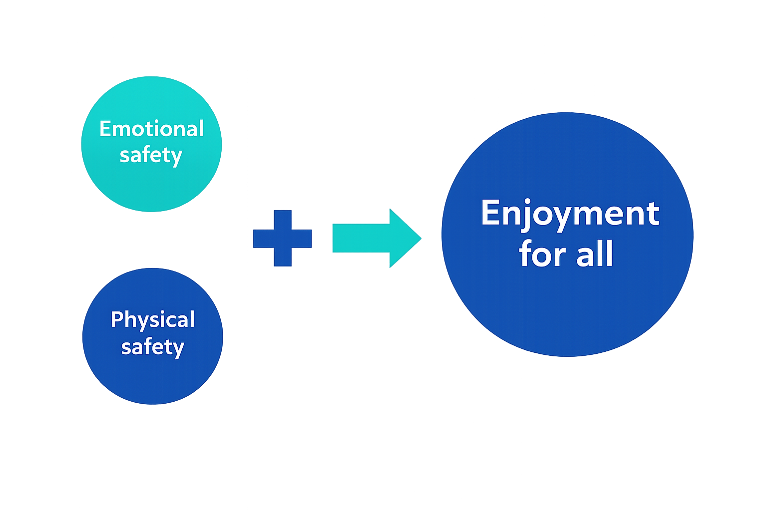
When you plan, you will need to identify and decide…
E.g. choose to play, feel part of group, feel respected by leader, can play without being judged.
E.g. wear appropriate footwear, use correct equipment, don’t bump into hazards, aren’t too hot.

Slide 12
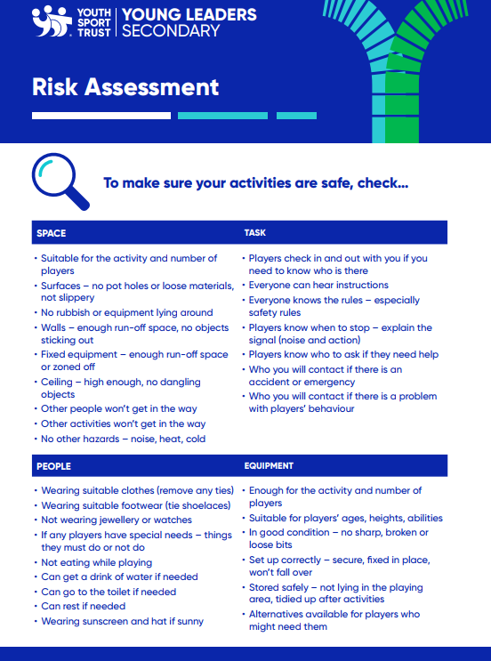
Manage the risks
In your group:
Look at the activity card.
Imagine who is playing, when and where.
What are the potential risks?
How will you make them safe or safer?

Slide 13
Well done! You have completed module 2.
Get ready for module 3 on:
Teacher to add details

