Slide 1




Slide 2

Getting started as a
Young Leader
Module 1 – purpose

Slide 3

Connect through active play: spider ball
Stand in a large circle.
Pass the bean bag across the circle so everyone receives it once. (Do not pass to your immediate neighbours.)
Keep the same order of passing for the following rounds.
  Round 1: Say your name when you throw the ball. (Repeat this round.)
  Round 2: Say the name of the person you are passing to. (Repeat.)
  Round 3: Add a second bean bag. (Stop saying names.)
  Round 4: Add more bean bags. (Maximum one per person.)
How many consecutive passes can you make without dropping any?
Notes:
ADAPTATIONS
Space:
Larger or smaller circle
Task:
Sit or kneel instead of standing
Roll or kick a ball
Focus on names only
Add categories, e.g., name a sport, food, film, etc.
Use different body parts (if tapping a balloon)
Change the order of passing each time
Equipment:
Use balloons/balloon balls
Use a bell ball
Use a light volleyball/beach ball
Do not add multiple objects
People:
Play in smaller or larger groups
Start in small groups and build up to the full group

Slide 4
Through active play, you will help to…
Get more young people more active and
Create a sense of belonging for young people
…in our school

Slide 5
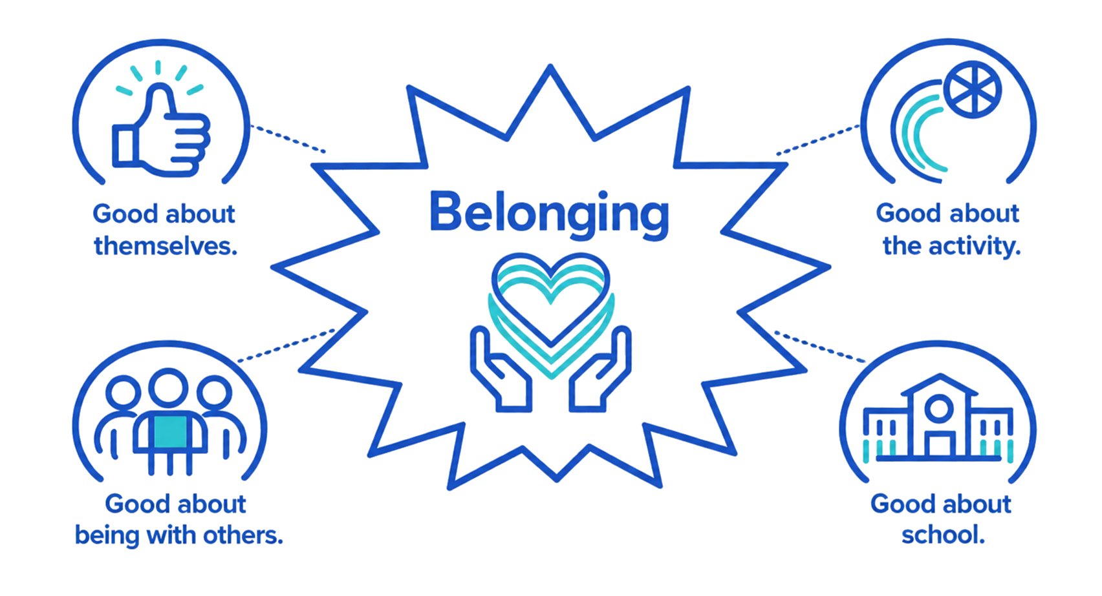
We want all young people to feel…
Notes:
Positive about activity and play.

Slide 6
What is a leader?
In your group…
Think about people who have leadership roles.
They might be local, national or global leaders.
They might work in different areas, e.g., politics, arts, sport, science, tech, environment, community.
They might be from the past or present.
What makes them a leader?
What do they do? How do they act?
Notes:
It would be beneficial to discuss what active play is at this stage as many of the young people might not have heard this concept before.

Slide 7
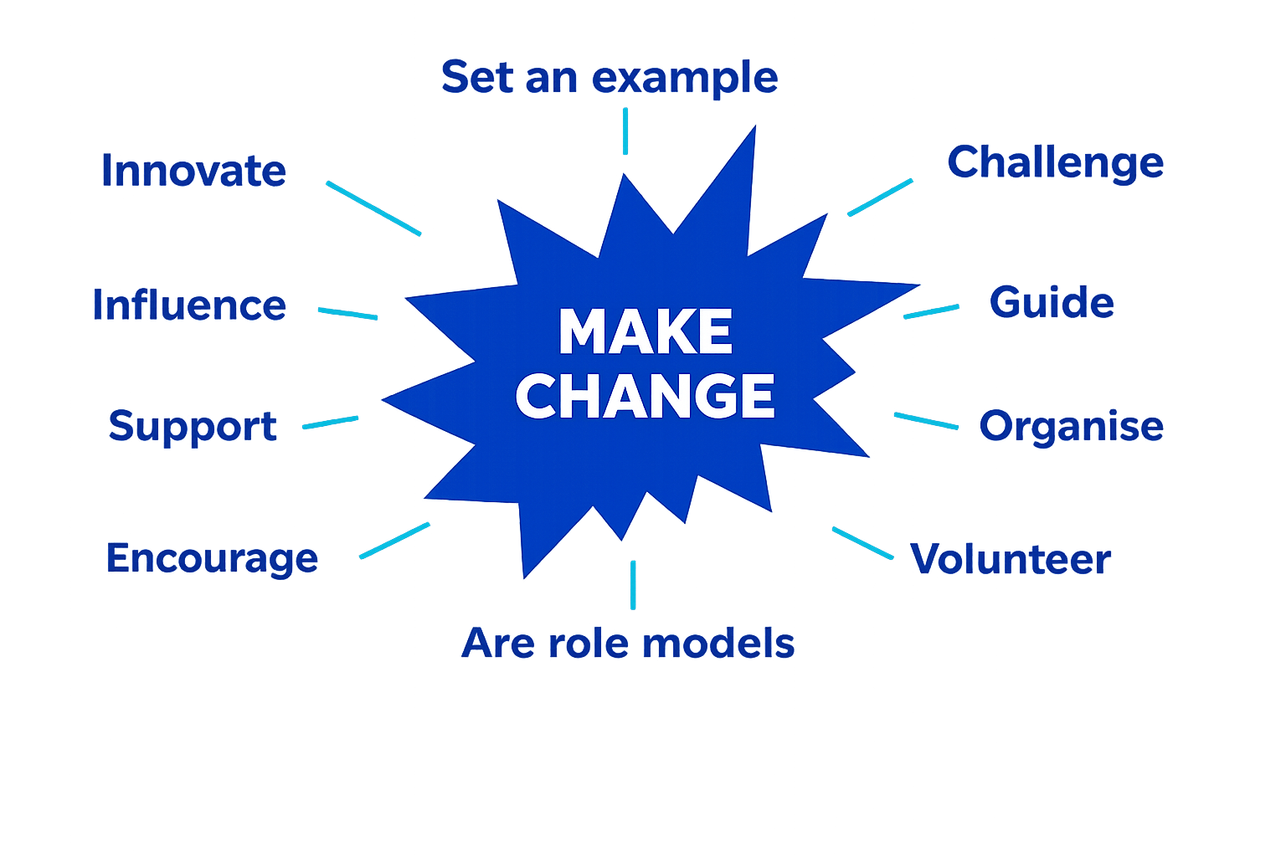
Leaders inspire others to act. They…

Slide 8
Give it a go!
In your group…
Choose and run a quick play activity for yourselves.
  Keep it simple. Try to create enjoyment and belonging for everyone.
As you are playing…
Reflect on these questions:
  What do you need to do to lead active play sessions that create enjoyment and belonging for others?
  How will you know you are succeeding?

Slide 9
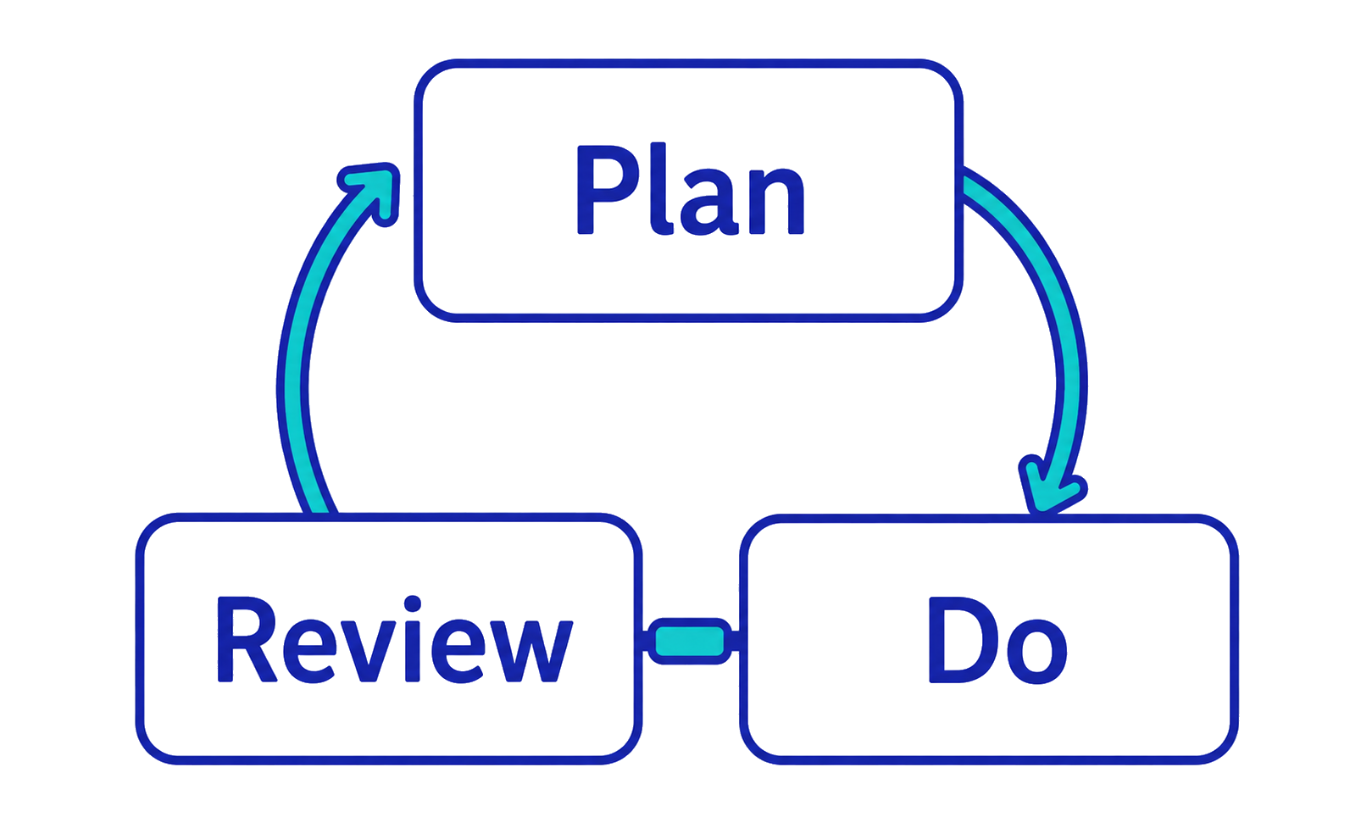
As young leaders, we will…
What do we need to know in advance?
How do we check they are working?
How will we run the activities?

Slide 10
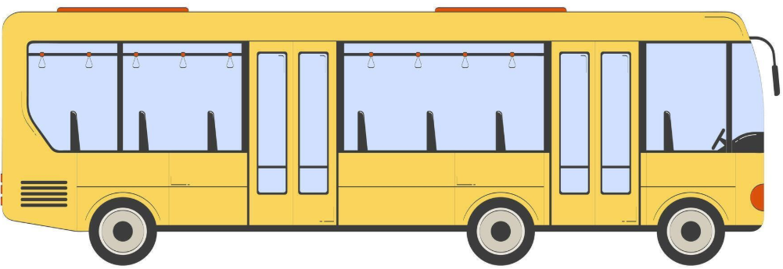
Supporter bus – athlete example
Fans
Friends
Physio
Athlete
Family
Sponsor
Coach

Slide 11
Who is on your bus?
?
?
?
Young Leader
?
?
?

Slide 12
Well done! You have completed module 1.
Get ready for module 2 on:
Teacher to add details
Notes:
Reorder slides 11 and 12 if you use the optional task.

Slide 13
Leaders inspire others to act. They…
Specific | What exactly will you do? | I will improve my speaking skills.
Measurable | What will success look like? | I explain activities clearly and players know what to do.
Accepted | Does everyone involved agree? | My teacher and I agree this will help my confidence.
Realistic | What practical steps can you take? | Practise at home then with friends before sessions.
Time-bound | When will you reach it? | Introduce at least 4 activities by half-term.
Notes:
OPTIONAL TASK
Introduce the concept of SMART goals.
When goals are SMART, they are more likely to be achieved.
The young leaders may agree SMART goals as a group and individually.
This is an example of a SMART personal goal.
Using the handout, ask the young leaders to set themselves a personal goal.
NB. This version of SMART replicates that used in the current AQA GCSE Physical Education (sport psychology) guidance: https://www.bbc.co.uk/bitesize/guides/zwr34j6/revision/3
You may wish to adapt the slide if you use a slightly different version in your school.

